Slide 1
Evidence that Demands a Verdict!

Slide 2
Investigating the Case for Christ
As the legal editor at the Chicago Tribune, Lee Strobel was skilled at investigating and exposing corruption.
The Salvation of his wife Leslie in 1980 turned his “comfortable” world upside down.
Lee’s “Case for Christ” actually began
as a “Case” against Christ!

Slide 3
Investigating the Case for Christ
He put his skills to work in order to “Save” Leslie from “Christianity” by exposing it as religious imagination or manipulation.
What began as a serious and sincere “case against Christ” led Lee down the pathway of objective “facts” that confronted him
with some very “Inconvenient Truths”.

Slide 4
Investigating the Case for Christ
Though we may start from different points in our “case” for/against Christ’s Claims,
Lee’s journey reflects facets of our own.
We all must wrestle with the “inconvenient” truths about ourselves and God,
as well as our own perspectives and prejudices about the Claims of Jesus Christ.

Slide 5
Investigating the Case for Christ
It didn’t take long for Lee to learn that his “case against Christ”
was more challenging that he anticipated.

Slide 6
When Lee was confronted about his own “prejudice” and challenged to “follow the facts”
wherever they led him,
It began to change his perspective.
Are you willing
to do the same?

Slide 7
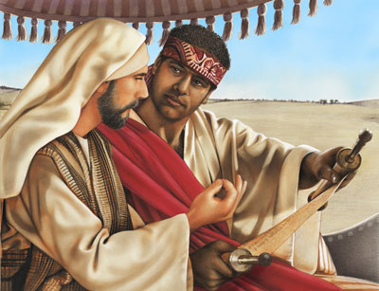
Investigating the Case for Christ
Most people will face some spiritual “sticking points” on their journey of Faith.
Acts 8:26-40
“Understandest thou what thou readest?
How can I, except some man should guide me?”

Slide 8
“Barriers to Belief”
I Can’t Believe! “How can I?”
(Understand)
A. Usually an “intellectual” obstacle.
1) Conflicts with our education, logic,
reason, or experience” become
“barriers to our belief”.

Slide 9
2) These can be corrupted! Col 2:8-10
“Beware lest any man spoil you through philosophy and vain deceit, after the tradition of men, after the rudiments of the world,
and not after Christ.
in him dwelleth all the fulness of the Godhead
And ye are complete in him ”
(plēroō: completed, fulfilled)

Slide 10
“Barriers to Belief”
3) These can be Programed!
1 Tim 6:20-21 “avoiding profane and vain babblings, and oppositions of science
(gnosis) falsely so called:
Which some professing (embracing)
have erred concerning the faith.”

Slide 11
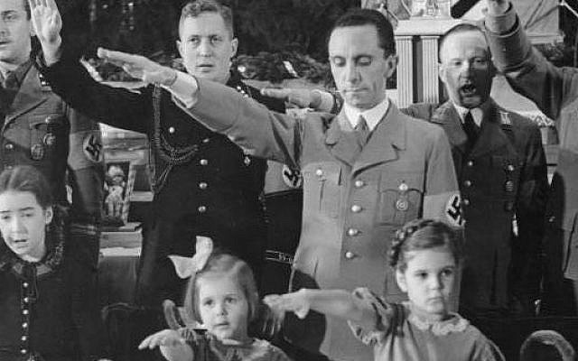
Remember Nazi Germany?
“Propaganda works best when those being manipulated are confident that they are acting on their own free will.”
Joseph Goebells

Slide 12
Barriers to Belief: “I can’t…”
B. Solution for skepticism. Is 55:6,7
“Seek the LORD while he may be found, call ye upon him while he is near:
Let the wicked forsake his way,
and the unrighteous man his thoughts:
and let him return unto the LORD,
and he will have mercy upon him…”

Slide 13
Barriers to Belief: “I can’t…”
B. Solution for skepticism.
“Seek (objectively, honestly)
and see for yourself!”
Jn 8:32 “ye shall know the truth, and the truth shall make you free.”

Slide 14
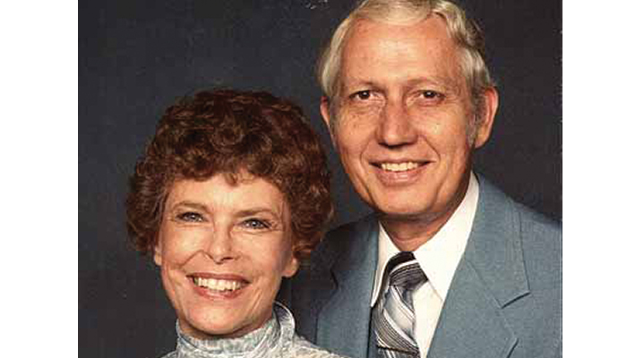
“Seek for yourself”
Lee discovered many “seeking sceptics”
1) Dr. Viggo and Joan Olsen wrote
about their journey in
“The agnostic who dared search”
After discovering the truth, they became Missionaries to Bangladesh,
Starting hospitals and
120 churches!

Slide 15
The Olsen’s told Lee:
“We wouldn’t have missed it for the world!
Finding the purpose for which God made you and then fully pursuing it
is simply the very best way to live!”

Slide 16
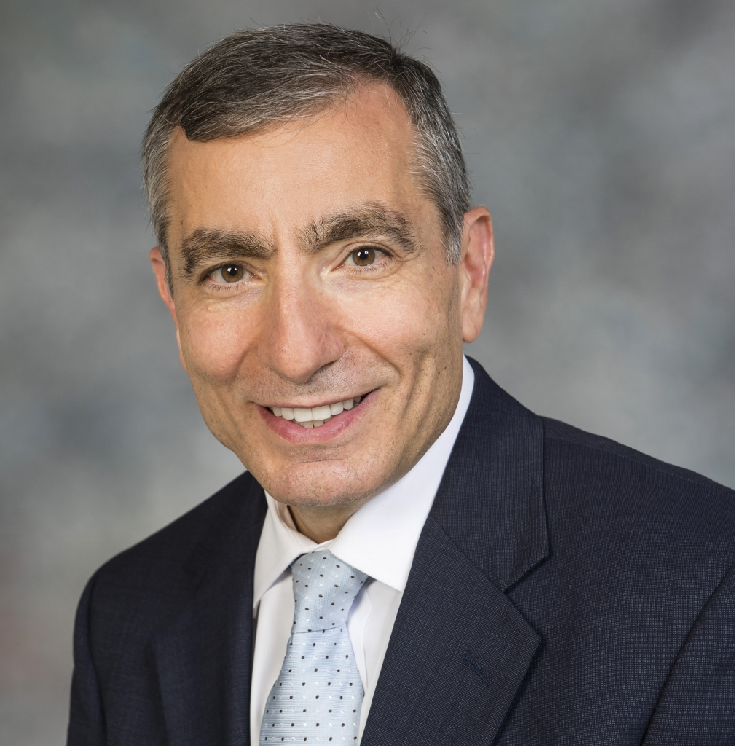
Seeking Sceptics
2) Dr. James Tour (Head of Nanoscience Center, Rice University) told Lee:
“I build molecules for a living,
I can’t begin to tell you how difficult that job is!
I stand in awe of God because of what he has done through his creation.”

Slide 17
Dr. James Tour (Head of Nanoscience Center, Rice University wrote:
“Only a rookie who knows nothing about science would say science takes away from faith.
If you really (objectively) study science,
it will bring you closer to God!”

Slide 18
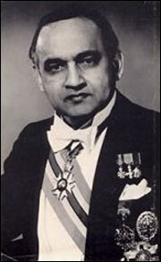
Seeking Sceptics
3) Lionel Luckhoo: World’s Greatest Attorney.
Guinnes book of World Records for Winning (defending) the most murder cases in history!
“the evidence for the Resurrection of Jesus Christ is so overwhelming that it compels acceptance by proof which leaves
absolutely no room for doubt.”

Slide 19
Conclusion:
Lee realized that he was one of many “sceptics” who, when they honestly began seeking for the truth,
discovered that “the Truth” (John 14:6)
was actually seeking them!

Slide 20
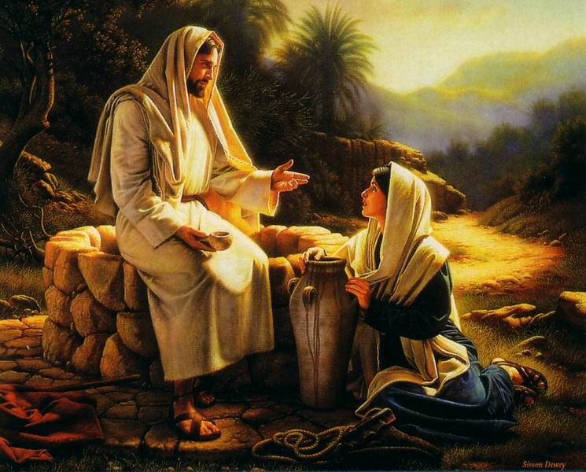
Barriers to Belief 1. “I Can’t”
God is seeking you!!!!!! John 4:23
“true worshippers shall worship the Father in spirit and in truth:
“the Father seeketh such.”

Slide 21
Barriers to Belief: “I can’t…”
“Seek for yourself”
1) The Ethiopian had been seeking truth!
a) He Traveled 2000 miles from Ethiopia
to Jerusalem “to worship” Acts 8:27
b) Bought and Read scripture. Acts 8:28
He discovered that the “Truth” (Jesus) was also actively at work “Seeking” him!

Slide 22
“Seek for yourself”
While the Eunuch was seeking God:
God was “seeking” the Ethiopian!
He Redirected Philip. (Acts 8:26)
He “coincidently” led the Ethiopian to
be reading Isaiah 53!
He gave him an inquiring mind? Vs. 34

Slide 23
“Seek for Yourself”
Acts 8:35
“Then Philip opened his mouth, and began at the same scripture,
and preached unto him Jesus.”

Slide 24
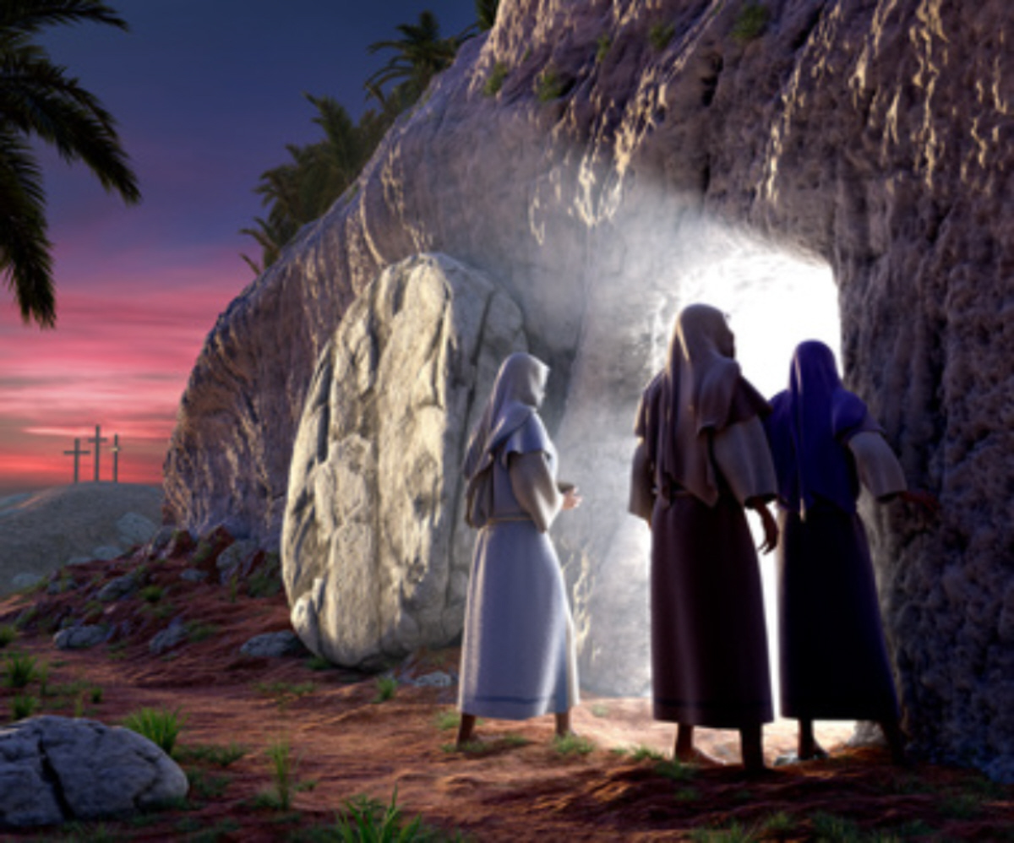
2) The women at the grave. Mt 28:6
The Angel’s were waiting for them!
“He is not here: for he is risen, as he said.
Come, see
the place where the Lord lay.”
Examine the evidence!

Slide 25
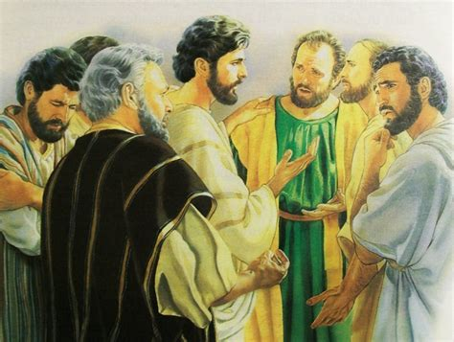
“Seek for yourself”
3) “Doubting” Thomas Jn 20:25
“Except I shall see in his hands the print of the nails, and put my finger into the print of the nails, and thrust my hand into his side,
I will not believe!”

Slide 26
Jesus went to him. Jn 20:27 “Thomas,
Reach hither thy finger, and behold my hands; and …thy hand, thrust it into my side:
and be not
faithless,
but believing.”
From Peitho: Convinced!

Slide 27
Thomas responded: John 20:28-29
“My Lord and my God!
Jesus saith unto him, Thomas, because thou hast seen me, thou hast believed:
blessed are they that have not seen, and yet have believed.”

Slide 28
Application:
Perhaps you, like the Ethiopian, are honestly “seeking” truth about a relationship with God, but have been stuck at the barrier of belief.
“How can I, except some man should guide me?” Acts 8:31

Slide 29
If so, please know that:
God desires a relationship with you!
Mt. 11:28 “Come unto me…”
2) He has wonderful plans to bless you!
Jer. 29:11 “to give you and expected end”
3) God is seeking You! Gen. 16:13
“Thou God, seest me!”

Slide 30
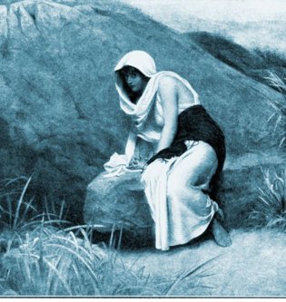
Will you honestly seek God? Gen. 16:13
“Thou God seest me!
Have I also here looked after him that seeth (and seeketh) me?”

Slide 31
Will you honestly seek God?
Jer. 29:13
“ye shall seek me, and find me, when ye shall search for me with all your heart.
And I will be found of you!”
God invites “Seekers” Mal. 3:10 “Prove me now saith the Lord”

Slide 32
God’s seeking you:
“The son of man is come to seek and to save, that which was lost.” Lk 19:10
And Satan is seeking to sidetrack you!
“Seek the Lord while He may be found, call ye upon Him while He is near!”
Isaiah 55:6

Slide 33
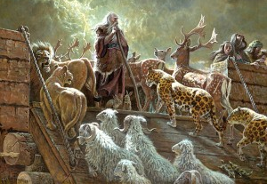
Gen. 6:3“My Spirit will not always strive with man.”
Will you join me on this journey
of Faith?

Slide 34
Evidence that Demands a Verdict!

