Slide 1
Evidence that Demands a Verdict!

Slide 2
Everyone is on a Journey of Faith!

Slide 3
Though we may start from different points in our personal “faith journeys”,
we all must wrestle with the choices and challenges we find along the way.
Each of us must decide repeatedly who and what to believe and trust.
Each choice requires “faith” and moves us further down the path we’re on.

Slide 4
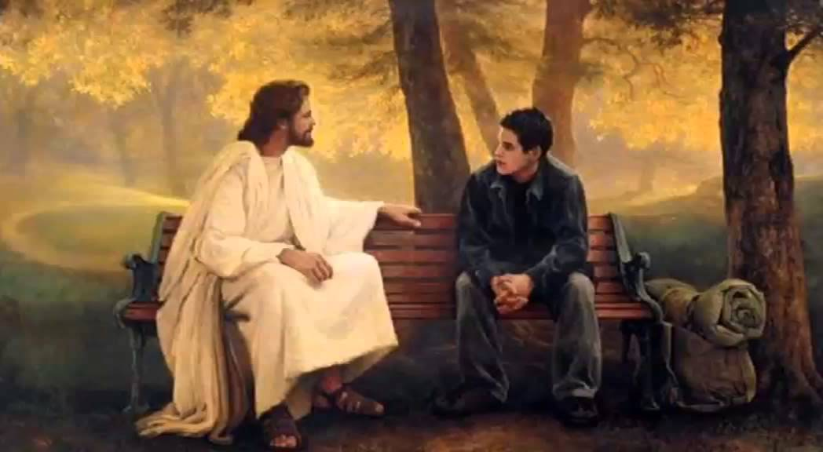
Where’s that path leading you?

Slide 5
Pr. 14:12 “There’s a way that seems right to a man,
but the end thereof
are the ways of death.”
Dt 30:15 “I have set before thee this day life and good,
and death and evil;”

Slide 6
“Therefore choose life” Vs 19

Slide 7
The Devil will resist our attempts to find “the path of life” (Ps. 16:11) and erect:

Slide 9
Last week we examined the barrier of “understanding” (I can’t believe!)
This is a barrier of the mind as we confront Satan’s lies with God’s Truth.
This can be broken down by the sincere and honest evaluation and application
of God’s Truth. 2 Cor. 4:4,6

Slide 10
2 Cor 10:4-5 “the weapons of our warfare are not carnal, but mighty through God
to the pulling down of strong holds;
Casting down imaginations, and every high thing that exalts itself against the knowledge of God,
and bringing into captivity every thought
to the obedience of Christ;”

Slide 11
Breaking through this barrier, often leads to the next!
“I don’t want to believe!”
This is usually more about “lifestyle” than “learning” from the evidence.
Some prefer a blissful ignorance that allows them to play god rather than confronting the “inconvenient truths” about the true God!

Slide 12
Romans 1:21-22
“Because that when they knew God,
they glorified him not as God,
neither were thankful;
but became vain in their imaginations, and their foolish heart was darkened.
Professing themselves to be wise,
they became fools,

Slide 13
Romans 1:25,28
Who changed the truth of God into a lie,
and worshiped and served the creature,
more than the Creator…
And even as they did not like
to retain God in their knowledge,
God gave them over to a reprobate mind”
(Adokimos nous) Worthless understanding!

Slide 14
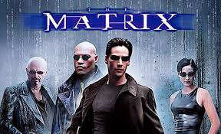
“I don’t want to believe!”
These would rather live in lies
than to allow the truth to
Challenge and
Change Them!
(John 8:32)

Slide 15
“I don’t want to believe!”
1. This is a matter of the Will!
Obedience brings understanding.
Jn 7:17 “If any man will do his will,
he shall know of the doctrine,
whether it be of God,
or whether I speak of myself.”

Slide 16
“I don’t want to believe!”
B. Disobedience brings Darkness!
Jn 5:39-40 “Search the scriptures;
for in them ye think ye have eternal life:
and they are they which testify of me.
And ye will not come to me,
that ye might have life.”
Ro. 1:38 “gave them over to a reprobate mind”

Slide 17
1. This is a matter of the Will!
C. Stubbornness is Satan’s Tool! 1 Sam. 15:23
“Stubbornness is as iniquity and idolatry”

Slide 18
“I don’t want to believe!”
Why so “stubborn?”
2. Our Morality often dictates
our “theology”. (Values)
Jn 3:19 “light is come into the world and
men loved darkness rather than light,
because their deeds were evil!”

Slide 19
“I don’t want to believe!”
2. Morality often dictates “theology”.
A. People don’t want to bow to a God who might change their lives and values,
so they manufacture reasons not to believe!

Slide 20
2. Morality often dictates “theology”.
1) Jewish rulers (after Lazarus’ resurrection)
John 11:47-48 “Then gathered the chief priests and the Pharisees a council, and said,
What do we? This man doeth many miracles.
If we let him alone, all …will believe on him:
and the Romans shall come and
take away our place!”

Slide 21
2. Morality often dictates “theology”.
2) Modern “philosophers”. (Aldous Huxley)
In his book “Ends and Means” admits:
“I had motives for not wanting the world to have a meaning; consequently
I assumed that it had none,
and was able without any difficulty to find satisfying reasons for this assumption…

Slide 22
“the philosophy of meaninglessness was essentially an instrument of liberation…from a system of morality.
We objected to the morality
because it interfered with
our sexual freedom.”
Aldous Huxley

Slide 23
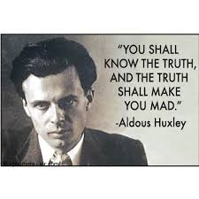

Slide 24
“I don’t want to believe!”
2. Morality often dictates “theology”.
3) This was Satan’s original “bait”.
“Ye shall be as gods, knowing
(‏יָדַע‎ {yādaʿ} determining your own)
good and evil.”
Gen. 3:5

Slide 25
“I don’t want to believe!”
3. Fear of intimacy.
This fear keeps God (and others)
at a “safe” distance.
A. Intimacy with God is at the
heart of Christianity!

Slide 26
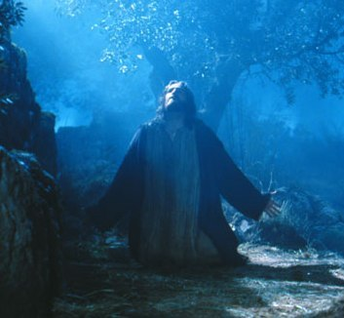
Intimacy is at the heart of Christianity!
John 17:3 “And this is life eternal,
that they might know thee
the only true God,
and Jesus Christ,
whom thou hast sent.”

Slide 27
Intimacy is at the heart of Christianity!
John 14:21 “He that hath my commandments, and keepeth them,
he it is that loveth me:
and he that loveth me shall be loved of my Father, and I will love him,
and will manifest myself to him.”

Slide 28
“I don’t want to believe!”
4. Rebellion. (Authority issues)
“It’s my life…I’ll run it my way!”
A. This plays into Satan’s hand!
“rebellion is as the sin of witchcraft.”
1 Sam 15:23
See Psalm 2

Slide 29
B. God goal isn’t to control us but to:
1) Guide us into our greatest purpose
and potential. (Jer. 29:11; Ro. 8:28)
Ps. 16:11 “Thou wilt shew me the path of life:
in thy presence is fulness of joy;
at thy right hand there are pleasures
for evermore.”
(contrast with Heb. 11:26)

Slide 30
B. God goal isn’t to control but to:
2) Protect us from Evil and our
own self-destructive choices.
Pr. 3:5,6 “in all thy ways acknowledge Him, and He shall direct thy paths”
“We’re free to choose our own paths,
but not free to choose the consequences!”

Slide 31
“Be sober, be vigilant, for your adversary the devil, as a roaring lion, walketh about, seeking whom he may devour.
Whom steadfastly resist in the faith…”
1 Pt 5:8

Slide 32
“Count the Cost” Luke 14:25-35
1) Consider where this path of “playing god”
will eventually (and permanently) take you.
Mt 16:24-25 “If any man will come after me, let him deny himself, and take up his cross,
and follow me.
For whosoever will save his life shall lose it:
and whosoever will lose his life for my sake
shall find it.

Slide 33
“Count the Cost” Luke 14:25-35
Mt 16:26 “For what is a man profited, if he shall gain the whole world,
and lose his own soul?
or what shall a man give
in exchange for his soul?”

Slide 34
“Count the Cost” Luke 14:25-35
33 “whosoever he be of you that forsaketh not all that he hath, he cannot be my disciple.
34 Salt is good: but if the salt have lost his savour, wherewith shall it be seasoned?
35 It is neither fit for the land, nor yet for the dunghill; but men cast it out.
He that hath ears to hear, let him hear.”

Slide 35
“Count the Cost” Luke 14:25-35
1) Consider where this path of “playing god”
will eventually (and permanently) take you.
2) Consider where the path of faith and
obedience will lead you. (John 10:10)
Ps. 16:11 “thou shalt show me the path of life, in thy presence is fulness of Joy.
At thy right hand are pleasures forevermore”

Slide 36
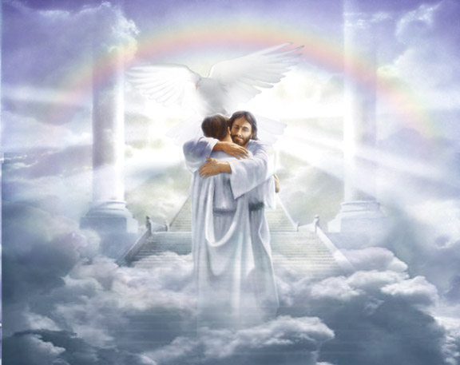
“Enter into the Joy of thy Lord!” Mt. 25:21
“Well done good and faithful servant”

Slide 37
“Come now and let us reason together saith the Lord” Is. 1:18

