Slide 1
What Child is This?

Slide 2
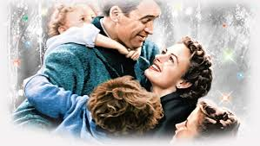
One “Christmas Tradition” in our house is to watch the classic movie:
“It’s a Wonderful Life!”

Slide 3
Jesus: A truly “Wonderful” Life!
“What's in a name?” Juliet
Pr 22:1 “A good name is rather to be chosen than great riches”
Phil. 2:9 “God also hath highly exalted him,
and given him a name which is above every name:”
Name (shēm) “Mark or memorial
of individuality.”
honor, authority, character.

Slide 4
“Unto us a child is born, unto us a son is given…
And his name shall be called
Wonderful,
Counselor,
the mighty God,
the everlasting Father,
the Prince of Peace.”
Isaiah 9:6

Slide 5
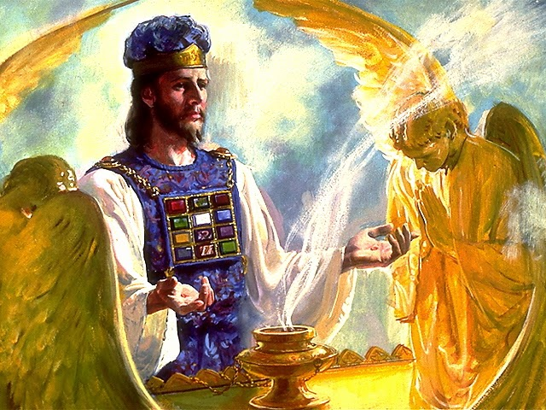
“His name shall be called wonderful”
‎‏פֶּלֶא‎ (peh'-leh) a miracle: marvelous, a “wonder”
‏פָּלָא‎(paw-law’) to separate, distinguish, accomplish!
Jesus Wonderfully “accomplished” God’s plan of Redemption!
“For such an high priest became us,
who is holy, harmless, undefiled,
separate from sinners,
and made higher than the heavens;”
Hebrews 7:26

Slide 6
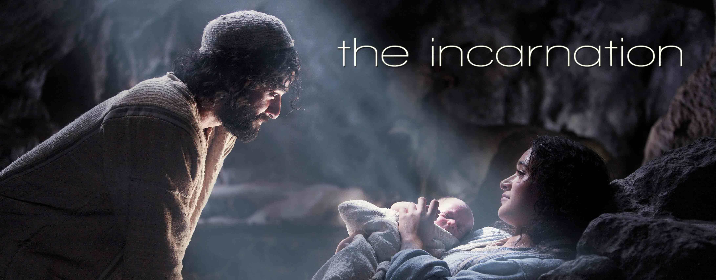
1. Wonderful in his Birth!
“Unto us a child is born.” Speaks of His Humanity
“Unto us a son is given.” Speaks of his Divinity!

Slide 7
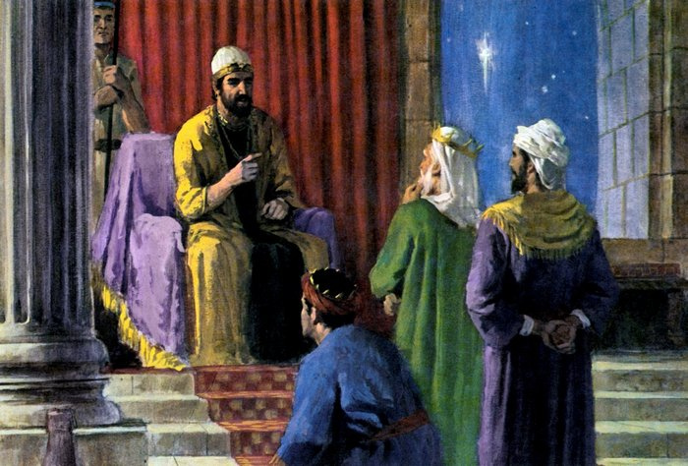
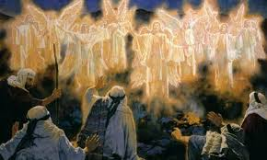
1. Wonderful in his Birth!
It was
Heralded by Angels
(Luke 2:10)
Hated by Herod. (Mt. 2:16)

Slide 8
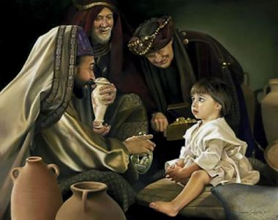
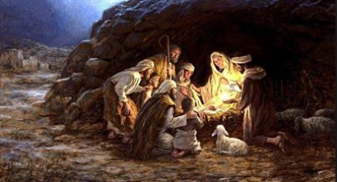
1. Wonderful in his Birth!
Witnessed by
Shepherds,
(Luke 2:15-18)
Worshipped by
Wise men. (Mt. 2:11)

Slide 9
1. Wonderful in his Birth!
Luke 2:18-20 “all they that heard it wondered at
those things which were told them by the shepherds.
Thauma’zō: Marveled
But Mary kept all these things,
and pondered them in her heart.
And the shepherds returned, glorifying and praising God for all the things that they had heard and seen”

Slide 10
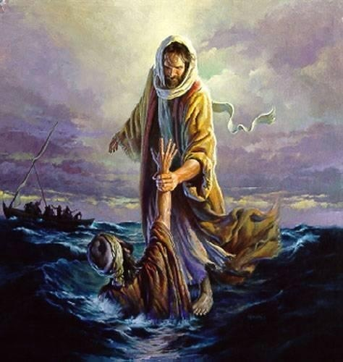
2. Wonderful in His Life!
Jn 1:14 “the Word was made flesh, and dwelt among
us, (and we beheld his glory, the glory as of the
only begotten of the Father,) full of grace and truth.”
Mark 6:51 “And he went up unto them into the ship; and the wind ceased: and they were sore amazed
in themselves beyond measure,
and wondered.”

Slide 11
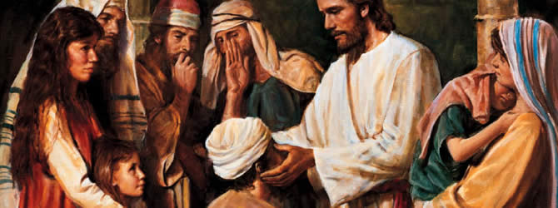
2. Wonderful in His Life!
Mat 15:31 “the multitude wondered, when they saw the
dumb to speak, the maimed to be whole, the lame to
walk, the blind to see: and they glorified God.”

Slide 12
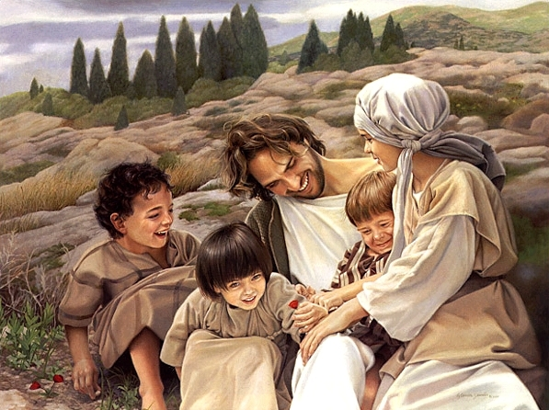
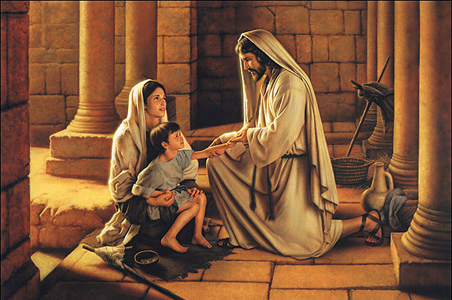
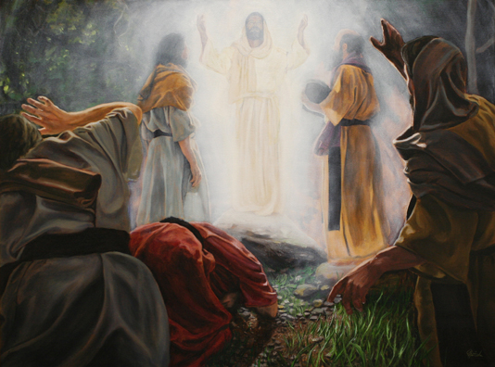
2. Wonderful in His Life!
Lk 4:22 “And all… wondered at the gracious words
which proceeded out of his mouth.”
Lk 8:25 “And they being afraid wondered, saying…
What manner of man is this!”
Lk 9:43 “they were all amazed at the mighty power of
God; while they wondered every one at all things
which Jesus did.”

Slide 13
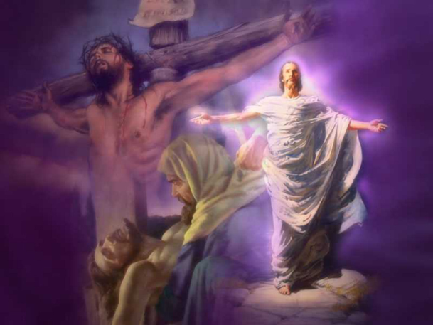
Wonderful in His Death

Slide 14
Wonderful in His Death
His enemies could find no fault in him. (Mt. 27:24)
The sun hid its face. (Mat. 27:45)
The earth quaked. (Mt. 27:51)
The dead rose to life. (Mt. 27:52)
The veil of the temple parted. (Mt. 27:51)
His mother was provided for. (John 19:26,27)
A condemned thief was pardoned. (Luke 23:43)
Even The soldiers who put him to death declared:
"Truly this was the son of God" Mt. 27:54

Slide 15
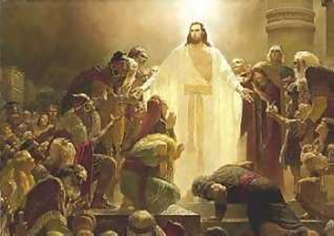
4. Wonderful in His Resurrection
Luke 24:41 “Behold my hands and my feet, that it is I myself: handle me, and see…
they yet believed not for joy, and wondered”

Slide 16
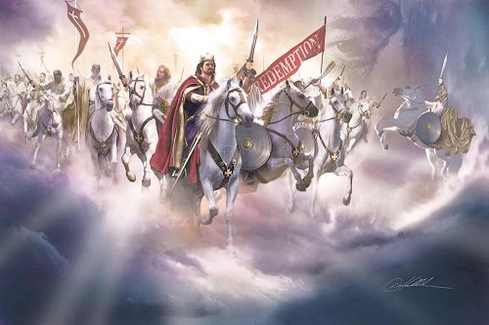
5. Wonderful in His Return
.

Slide 17
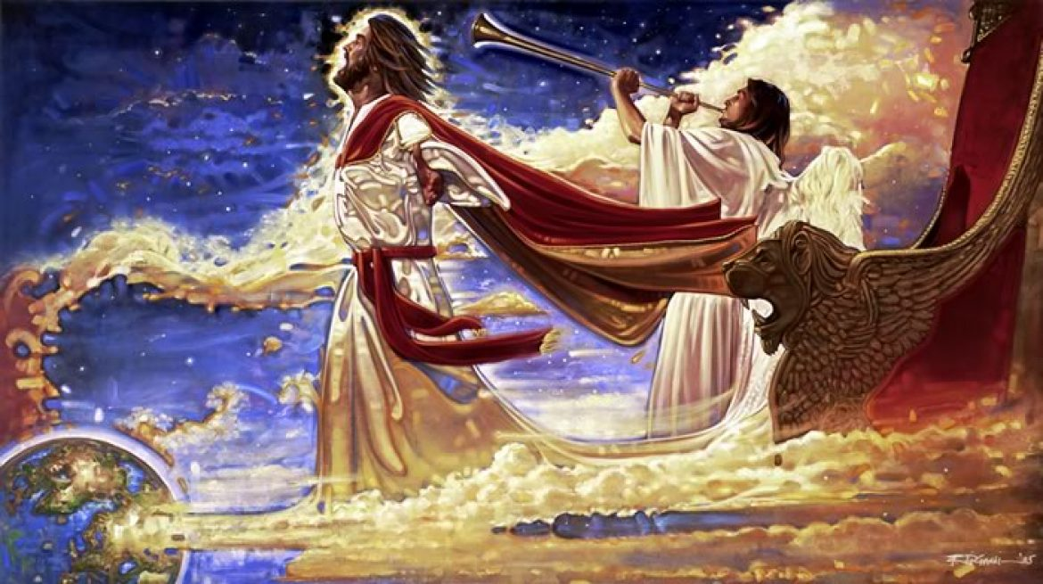
5. Wonderful in His Return 1 Thes 4:16-18
“For the Lord himself shall descend from heaven with a shout, with the voice of the archangel, and with the trump of God:
and the dead in Christ shall rise first:
¹⁷ Then we which are alive and remain shall be caught up together with them in the clouds,
to meet the Lord in the air:
and so shall we ever be with the Lord.” .

Slide 18
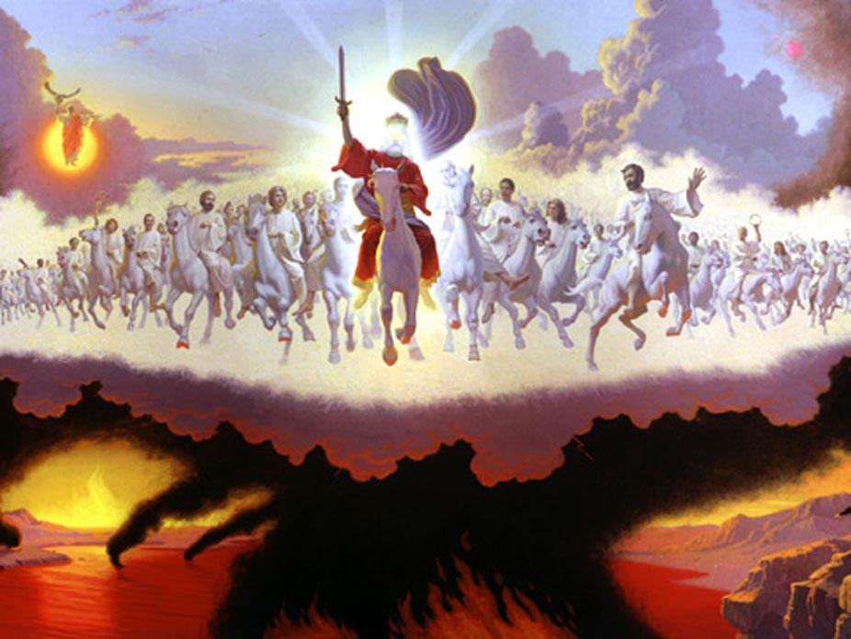
5. Wonderful in His Return Rev 19:11-16
¹¹ And I saw heaven opened, and behold a white horse; and he that sat upon him was called Faithful and True, and in righteousness he doth judge and make war.
¹² His eyes were as a flame of fire, and on his head were many crowns; and he had a name written, that no man knew, but he himself.
¹³ And he was clothed with a vesture dipped in blood:
and his name is called The Word of God.
.

Slide 19
5. Wonderful in His Return Rev 19:11-16
¹⁴ the armies which were in heaven followed him upon white horses, clothed in fine linen, white and clean.
¹⁵ And out of his mouth goeth a sharp sword, that with it he should smite the nations: and he shall rule them with a rod of iron: and he treadeth the winepress of the fierceness and wrath of Almighty God.
¹⁶ And he hath on his vesture and on his thigh a name written, KING OF KINGS, AND LORD OF LORDS.”
.

Slide 20
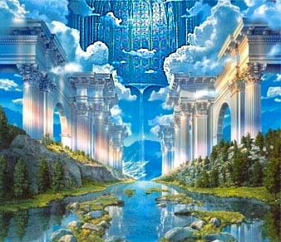
Wonderful in His Birth, Life, Death, and Return.
Rev 21:5-6 “And he that sat upon the throne said,
Behold, I make all things new. …
Write: for these words are true and faithful.
It is done. I am Alpha and Omega, the beginning and
the end. I will give unto him that is athirst of the
fountain of the water of life freely.”
Are you Thirsty?
.

Slide 21
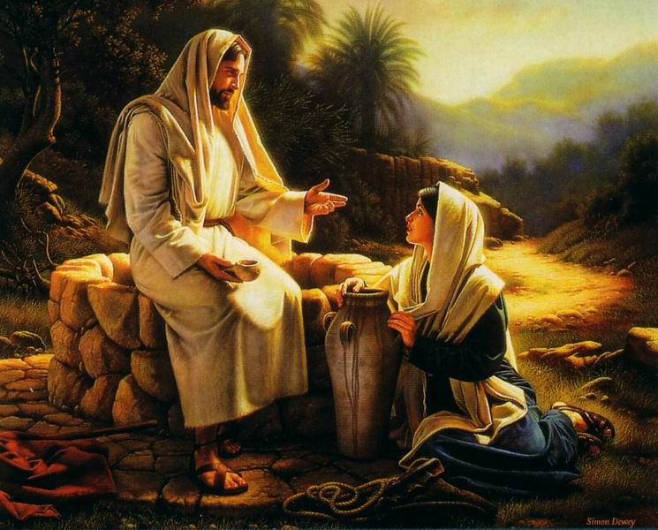
“Whosoever drinketh of this water shall thirst again:
But whosoever drinketh of the water that I shall give
him shall never thirst;
but the water that I shall give him shall be in him a well of water springing up into everlasting life.”
John 4:13-14

Slide 22
I wonder... Do you know Him?
Col 1:27 “To whom God would make known what
is the riches of the glory of this mystery;
which is Christ in you, the hope of glory:”
Hope: from elpo (to anticipate with pleasure)
If you Know “Christ in You”;
You Know “the hope of Glory”
.

Slide 23
Don’t waste this “wonderful” opportunity! (Heb. 3:7,8; 4:7)
No “Christ in you”…
No “Hope of Glory!”
(John 3:36; 1 Jn 5:12)

Slide 24
What Child is This?

