Slide 1
Navigating the New Year
“Thou wilt shew me the path of life:
in thy presence is fulness of joy;
at thy right hand there are pleasures
for evermore.”
Psalm 16:11

Slide 2
Finding the “path of life” requires:
A reliable “map”. Mt 22:29
“Ye do err,
(plana’o: get deceived, drift, go astray}
not knowing the scriptures,
nor the power of God.”

Slide 3
Finding the “path of life” requires:
A fixed point of reference. Mt 22:34-40
“The end (telos: goal) of the commandment is charity…
from which some having swerved
(astoche’ō: to miss the mark
by aiming at the wrong target!)

Slide 4
The three types of “love” God has blessed us with include:
Physical: (Eros: erotic) Pr 5:18,19
Emotional: (Philos: Affection) Ti 2:3,4)
Spiritual: (Agape: Charity) 1 Cor 13
“The greatest of these is charity”

Slide 5
Learning to Love
1 Corinthians 13

Slide 6
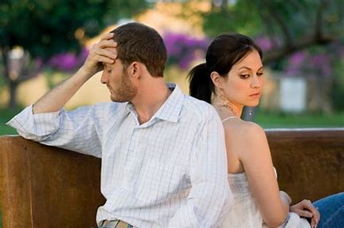
Physical and Emotional love are conditional on the “performance” of others and the “quality” of our relationship with them.

Slide 7
Spiritual love is conditional,
not on our relationship with others,
but on our relationship with God!
Eros and Philos are based on our strength or emotions.
Agape is based on God’s!
Gal. 5:22 “The fruit of the Spirit is Love…”

Slide 8
Hebrews 1:3 describes Jesus as:
“The brightness of His (God’s) glory,
and the express image of his person”
Charaktēr: an exact copy or representation!
Mt. 11:29 “learn of me”
Manthano: understand!

Slide 9
When we learn of love,
we learn of Him!
1 Jn 4:7-8 “for love is of God…
⁸ He that loveth not knoweth not God;
for God is love.”
Agape: Benevolent (giving) affection.

Slide 10
Dare To Care!
We’re Created to Care (Love)
but “caring” takes Courage!
A. Involves “relationships.”
(Relationships involve Risk)
1) God is relational! 1 Jn. 5:7
“these three are one”

Slide 11
Love Requires Courage.
Love is Relational
2) We’re designed in God’s image.
“let us make man in our image” Gen. 1:26
a) A Body to relate to (experience) Creation.
b) A Soul to relate to (experience) each other.
c) A Spirit to relate to (experience) God!

Slide 12
Love is Relational
1) God is relational! 1 Jn. 5:7
2) We’re designed in God’s image. Ge. 1:26
3) We’re incomplete without relationships!
Gen 2:18 “It is not good that the man
should be alone;
I will make an help meet for him.”

Slide 13
B. Love “Reaches” (It’s Vulnerable)
1) We must Reach out to Relate!
a) Physically: Open up our 5 senses.
b) Emotionally: Open up our “hearts, minds”
c) Spiritually: Open up our spiritual “senses”.
2) Whenever we reach out, (open up)
we risk “rejection”.

Slide 14
Dare to Care
Love Requires Relationships.
Relationships require “Reaching.”
Reaching involves Risk!

Slide 15
Dare to Care!
2. Risk requires Faith! Cor 13:13
“Now abideth Faith, Hope, Charity”
A. Faith is Foundational to love! Heb. 11:1
“Faith the substance of things hoped for,
the evidence of things not seen.”
Pistis: persuasion, conviction, trust!

Slide 16
Dare to Care!
A. Faith is Foundational to love!
“Faith is the substance” (hypos’tasis: footing)
1) Every foundation requires a footing.
a) The foundation is only as solid (secure)
as the footing it rests on!
KS footings must be >3’ deep and
Measure at least 8” x 16”.

Slide 17
Dare to Care!
A. Faith is Foundational to love!
2) Every relationship is built on
the “footing” of faith!
Faith in what or who?

Slide 18
Dare to Care!
A. Faith is Foundational to love!
3) Contrast wise and foolish “footings”.
a) The “Wise” man of Luke 6:48 “digged deep,
and laid the foundation on a rock”
His “footing” was solid bedrock!
b) The foolish “built an house upon the earth.”
His “footing” was shifting dirt or sand!

Slide 19
2. Risk requires Faith!
B. Most build their relationships on
foolish (shifting) “footings”:
1) Physical attraction. (eros) Pr 7:22-23
“He goeth after her straightway, as an ox goeth to the slaughter, or as a fool to the correction of the stocks;
…and knoweth not that it is for his life.”
Pr. 11:22 “as a jewel in a swines snout…”

Slide 20
B. Some foolish “footings” include:
2) Emotional attraction. (philos) Pr 31:30
“Favor is deceitful, and beauty is vain”
Favor: ḥēn: kindness, pleasantness
Deceitful: sheq’er: “faked” or temporary
Vain: heb’el: temporary
Putting your “faith” in only the physical or emotional is Vain!

Slide 21
C. The only “Wise” footing is:
God’s Agape love! Pr 31:30
“Favor is deceitful, and beauty is vain:
but a woman that feareth the LORD,
(Has A Foundation Of Genuine Faith In God)
she shall be praised.”
(hālal’: to shine or celebrate)

Slide 22
We’re Created to Care. (Love!)
We can’t “Care” without
Connecting. (Relationships)
We can’t “connect” without
Reaching. (Risking Rejection)
Risk requires Faith!

Slide 23
Dare to Care!
Eros and Philos have an element of “insecurity” because of the frailty and “fickleness” of human relationships.
“There is no fear in love; (agape)
but Perfect love casteth out fear”
Perfect: teleios: Complete
1 John 4:18

Slide 24
Dare to Care!
1 John 4:18 “There is no fear in love;
but Perfect love casteth out fear”
The Security of our love is proportional to our relationship with the God of Love!

Slide 25
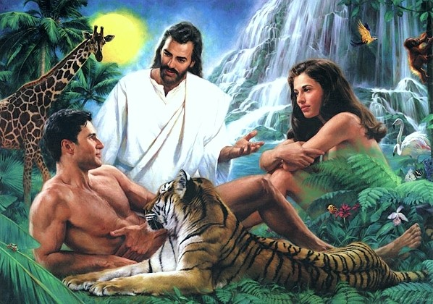
Consider the first “Relationship”
Adam’s faith in God’s love enabled him to recognize and respond to Eve with “agape”,
Producing security in both Philos and Eros.
Genesis 2:25 “they were both naked, the man and his wife,
and were not ashamed.”
Bôsh: Disappointed

Slide 26
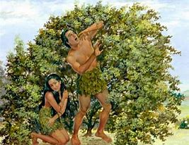
When willful sin entered the garden:
➔Adam rebelled against God’s Word. (Ro. 5:12)
➔They hid from God. (Gen. 3:8)
➔Their “nakedness” brought shame. (3:7)
➔They “turned” on each other. (3:12)
Their “strained” relationship with God,
“strained” their relationship with each other!

Slide 27
Application
Satan knows that agape (God’s Love) is the fountain and foundation
of human love! (eros and philos)
Ph. 4:13 “I can do all things through Christ,
Which strengtheneth me.”
That’ why we must be rightly related to God in order to rightly related to others!

Slide 28
Application
John 15:4,9 “Abide in me, and I in you.
As the branch cannot bear fruit of itself, except it abide in the vine;
no more can ye, except ye abide in me….
As the Father hath loved me,
so have I loved you:
continue ye in my love.”

Slide 29
^{1 John 4:18,21}
“There is no fear in love; but perfect love casteth out fear: because fear hath torment.
And this commandment have we from him,
(entole: authoritative prescription)
^{That he who loveth God}
love his brother (others) also.”

Slide 30
Ecclesiastes 4:9-12
“ Two are better than one…
For if they fall, the one will lift up his fellow:
but woe to him that is alone when he falleth;
Again, if two lie together, then they have heat:
but how can one be warm alone?
If one prevail against him, two shall withstand him;
and a threefold cord is not quickly broken.”

Slide 31
1 Corinthians 13:13
“now abideth Faith (conviction),
Hope (anticipation),
Charity (benevolent affection),
these three; but the greatest of these,
is charity”

Slide 32
Dare to Care!
Let’s stop repeating the rebellion of Eden,
(Ro. 5:12)
And reconnect with the Source of perfect love! (Rev. 2:5)
The Choice is yours!

Slide 33
Learning to Love
1 Corinthians 13

