Slide 1
“the goodmen of the house”
Mt. 24:43:

Slide 2
Over the past few weeks we’ve discussed God’s
plan for the Ages!
And how we’re part of it!

Slide 3
“Honor thy Father” Eph. 6:2
God’s Plan for the Man!
Timaō: to Prize or Value!

Slide 4
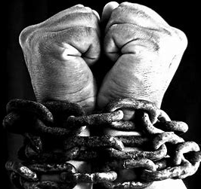
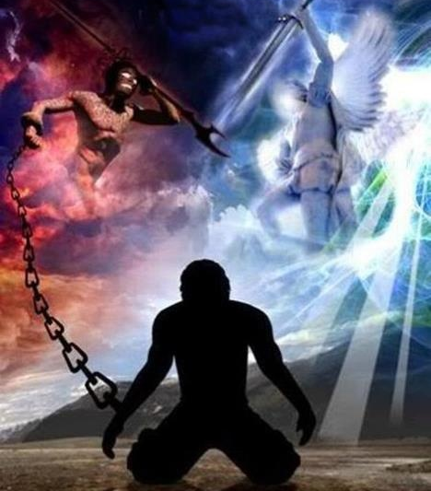
Satan’s Plan: “Bind (or Blind) the man””
Mark 3:27 “No man can enter into a strong man's house, and spoil his goods,
except he will first bind the strong man;
and then he will spoil his house.”

Slide 5
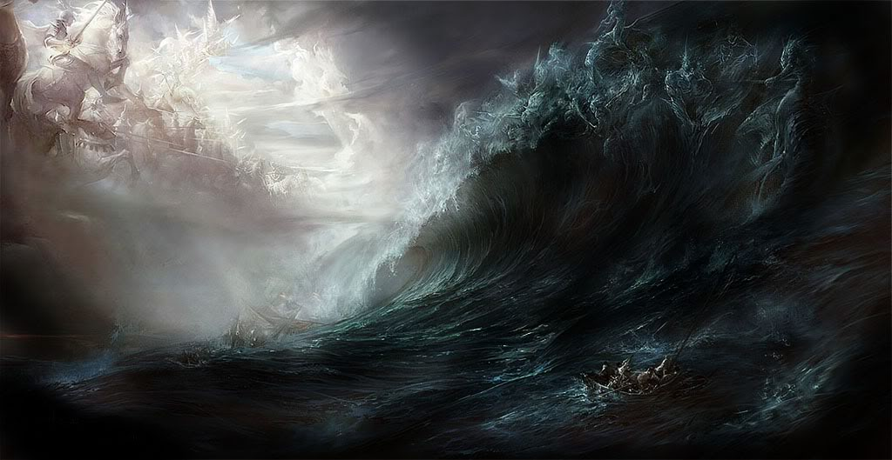
We’re caught in this struggle
Over Masculinity!

Slide 6
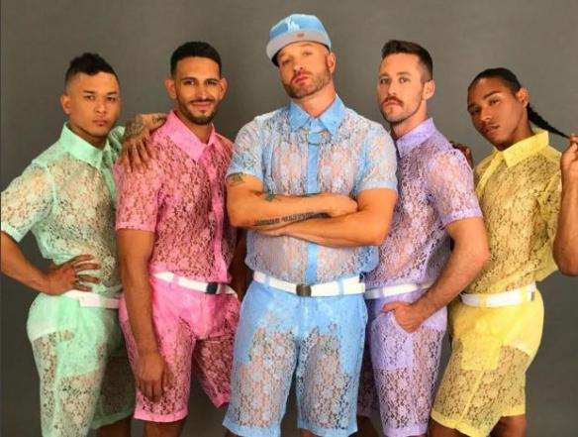
When we devalue God’s plan for masculinity, we
“Bind the strongman”
leaving our homes (and culture) vulnerable!
“spoil his house” (Mk 3:27)

Slide 7
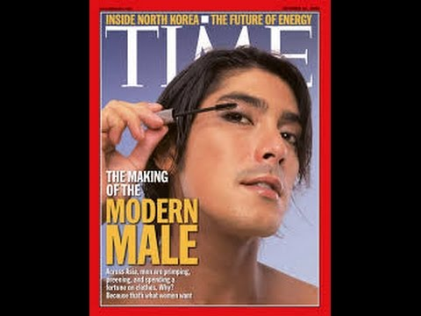
Masculinity is…
in Jeopardy!
Oct. 31, 2005

Slide 8
Masculinity is under attack!
Sometimes Subtly…:

Slide 9
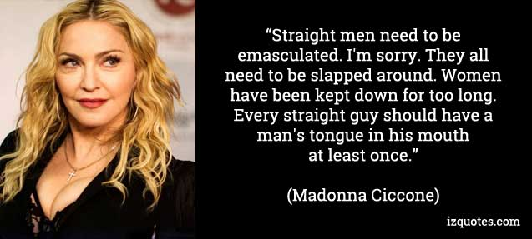
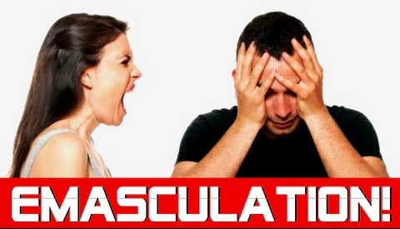
Masculinity is under attack.
Sometimes not so subtly

Slide 11
Where did the Men go?
Why does it matter?

Slide 12
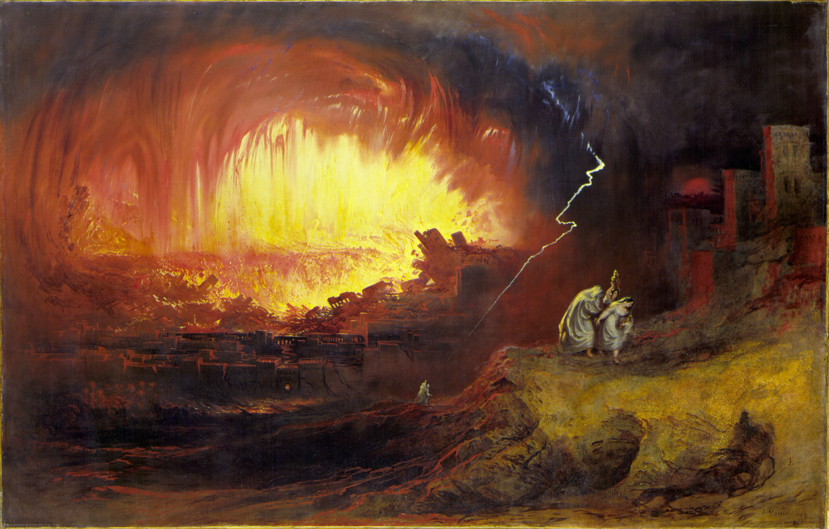
Jesus answered this question in relation to the last days.
Lk 17:28-30 “as it was in the days of Lot;
they ate…drank…bought…sold…planted…builded;
But the same day that Lot went out of Sodom it rained fire and brimstone from heaven, and destroyed them all.
Even thus shall it be in the day when the Son of man is revealed.”

Slide 13
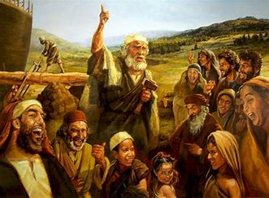
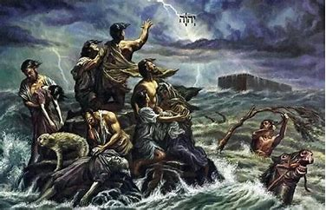
Mt. 24:37-39 “as the days of Noah were, so shall the coming of the Son of man be…They were eating and drinking...until the Noah entered the ark, And knew not until the flood came, and took them all away;
so shall also the coming of the Son of man be!”

Slide 14
Mt. 24:42,43 “Watch therefore: for ye know not what hour your Lord doth come.
But know this,
that if the goodman of the house had known in what watch the thief would come,
he would have watched, and would not have suffered his house to be broken up.”

Slide 15
“If the goodman of the house had known…”
1. What is a “Goodman”? Oikodespot’ēs:
A. “Oiko” means the home.
1) This is the final refuge from society & Satan!
2) That’s why our homes (families) are
under such aggressive attack!
(relational, emotional, financial, spiritual)
(John 10:10; Rev. 12:12)

Slide 16
“If the goodman of the house had known…”
1. What is a “Goodman”? Oikodespot’ēs:
B. “despo’tēs” (despot) literally means:
1) Lord
2) Ruler
3) Master of the house
4) Head of (Responsible for) the family.
Why does this sound so foreign?

Slide 17
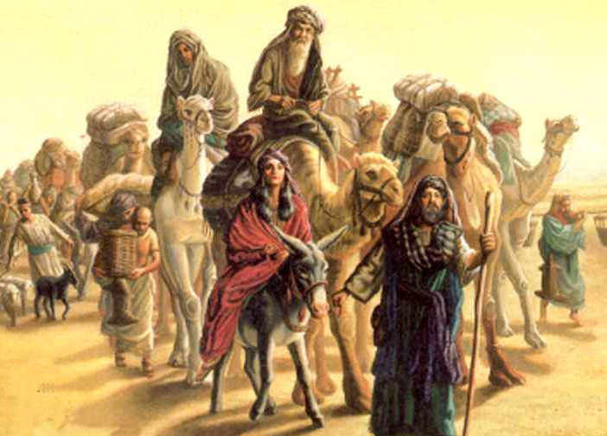
“If the goodman of the house had known…”
2. Who is the “Goodman”?
A. For millennium the “goodman” was
understood to be “the man”.
1) 4000 years ago: Gen 18:19 (also Joshua 24:15)
“I know him, that he will command his …household after him, and they shall keep the way of the LORD,
to do justice and judgment; that the LORD may bring upon Abraham that which he hath spoken of him.”

Slide 18
“If the goodman of the house had known…”
2. Who is the “Goodman”?
A. For millennium the “goodman” was
understood to be “the man”.
2) 2000 years ago: 1 Cor 11:3; Eph. 5:22-24
“the husband is the head of the wife,
even as Christ is the head of the church.”
3) Even 50 years ago it was understood.

Slide 19
Eph. 5:22-24 “the husband is the head of the wife,
Why does this sound so “crazy” today?
B. The pendulum effect!
1) God’s Design Is Balanced.
Leadership with Love.
1 Cor 11:1-12; Eph. 5:22-32
Amos 7:8 “Then said the Lord, Behold,
I will set a plumbline in the midst of my people”

Slide 20
Eph. 5:22-24 “the husband is the head of the wife,
B. The pendulum effect!
2) Our selfish desires lead us astray…
Producing relational “tug of war”.
God’s Way
Her Way!
His Way!

Slide 21
B. The pendulum effect!
3) Truly “Good” men (and women) are rare!
a) The value of something is proportional to it’s rarity.
Eccl 7:28 “Which yet my soul seeketh, but I find not:
one man among a thousand have I found;
but a woman among all those have I not found.
²⁹ Lo, this only have I found,
that God hath made man (kind) upright;
but they have sought out many inventions.”

Slide 22
B. The pendulum effect!
b) Even “good men” (and women) are flawed!
Pr 20:6-7 “Most men will proclaim every one his own goodness:
but a faithful (trustworthy) man who can find?
The just (righteous) man walketh in his integrity:
his children are blessed after him.”
Pro 11:3 “The integrity of the upright shall guide them:
but the perverseness (distorted, crooked) of transgressors shall destroy them.”

Slide 23
B. Cultural Pendulum effect:
4) The Feminist movement was a
reaction (in part) to “bad” men.
a) Some men refuse to be the “goodman”,
requiring the woman to assume this role.
b) Some strong willed women confiscate this role,
so the men relinquish their responsibilities.
Either way the family is vulnerable!
“suffered his house to be broken up.” Mt. 24:43

Slide 24
So what’s a “goodman” to do?

Slide 25
What’s a goodman to do?
1) Be Watchful Mt 24:42,43 “Watch therefore”
Grēgoreō: be vigilant/aware! (1 Peter 5:8)
“if the goodman of the house had known …he would have watched, and would not have suffered his house to be broken up.”
Remember God’s design is balanced.
Women are “keepers (guardians) at home” Titus 2:5
Men are the “goodman” or “strongman”. Mk. 3:27

Slide 26
What’s a goodman to do?
2) Be Ready! Mt 24:44 “be ye also ready…”
hetoi’mos: adjusted, so as to be prepared!
What “adjustments” do you need to make to be ready for Jesus’ return?
1 Jn. 2:28 “abide in him, that when he appears, we may have confidence, and not be ashamed.”
See also 1 Jn. 3:3! “Purifies himself.”

Slide 27
What’s a goodman to do?
3) Be Faithful. Mt. 24:25 “who is that faithful servant”
Pistos: Trustworthy, true.
Pr 20:6-7 “Most men will proclaim his own goodness:
but a faithful (trustworthy) man who can find?
The just (righteous) man walketh in his integrity:
his children are blessed after him.”
Luke 18:8 “when the Son of man cometh,
shall he find faith on the earth?”
(in you?)

Slide 28
Be Watchful, Ready, Faithful: Mt. 24:46-51
“Blessed is that servant, whom his lord when he cometh shall find so doing. Verily I say unto you, That he shall make him ruler (in Christ’s Kingdom) over all his goods.
Be Warned!
But and if that evil servant shall say in his heart,
My lord delayeth his coming; …
The lord of that servant shall come in a day when he looketh not for him, and in an hour that he is not aware.
There shall be weeping and gnashing of teeth.”

Slide 29
What can we do for our “goodmen”?
Pray for them. Eph. 6:10-19! “Praying always”
1 Thess. 5:25 “pray for us!”
Partner with them. Heb. 13:7 “For they watch
for your souls as they that must give account,
that they may do it with joy, and not with grief,
For that is unprofitable for you!”

Slide 30
What can we do for our “goodmen”?
“Price” (Honor/ value) them accurately.
Ro. 13:1 “render honor to whom honor is due”
1 Thessalonians 5:12-13
“know them which labor among you, and are over you in the Lord, and admonish you;
And to esteem them very highly in love
for their work's sake.”

Slide 31
“Goodman of the house”

Slide 32
“Honor thy father and mother; (the first commandment with promise;)
That it may be well with thee”
Eph 6:2-3
Timaō: to Prize or Value!

