Slide 1
ἀπολογία
Modern Day Reformer
By Joseph D. Peters

Slide 2
Apologetics
Apologetics is the attempt to defend ones beliefs$.^{1}$
1 Peter 3:15b (KJV) “…and be ready always to give an answer (apologia) to every man that asketh you a reason of the hope that is in you…"
Ravi Zacharias, C.S. Lewis, and Lee Strobel are good examples of people who practice apologetics
Pulpit & Pen
1. James K. Beilby, Thinking About Christian Apologetics: What It Is and Why We Do It. (Downers Grove: IVP Academic, 2011). 11.

Slide 3
Internal vs External Apologetics
External Apologetics:
- Defending your belief against the criticism of nonbelievers$.^{2}$
Internal Apologetics:
- Answering questions about our beliefs to other believers$.^{3}$
2. Beilby, Thinking About Christian Apologetics: 27.
3. Ibid., 28

Slide 4
Defending Essential Christian beliefs
Many Christians unintentionally argue against certain essential Christian beliefs because they do not properly understand it. For example:
The Virgin Birth
Relationship of the Trinity
The Hypostatic Union
The resurrection
Hardy Street Baptist Church
LDS Scripture Teachings

Slide 5
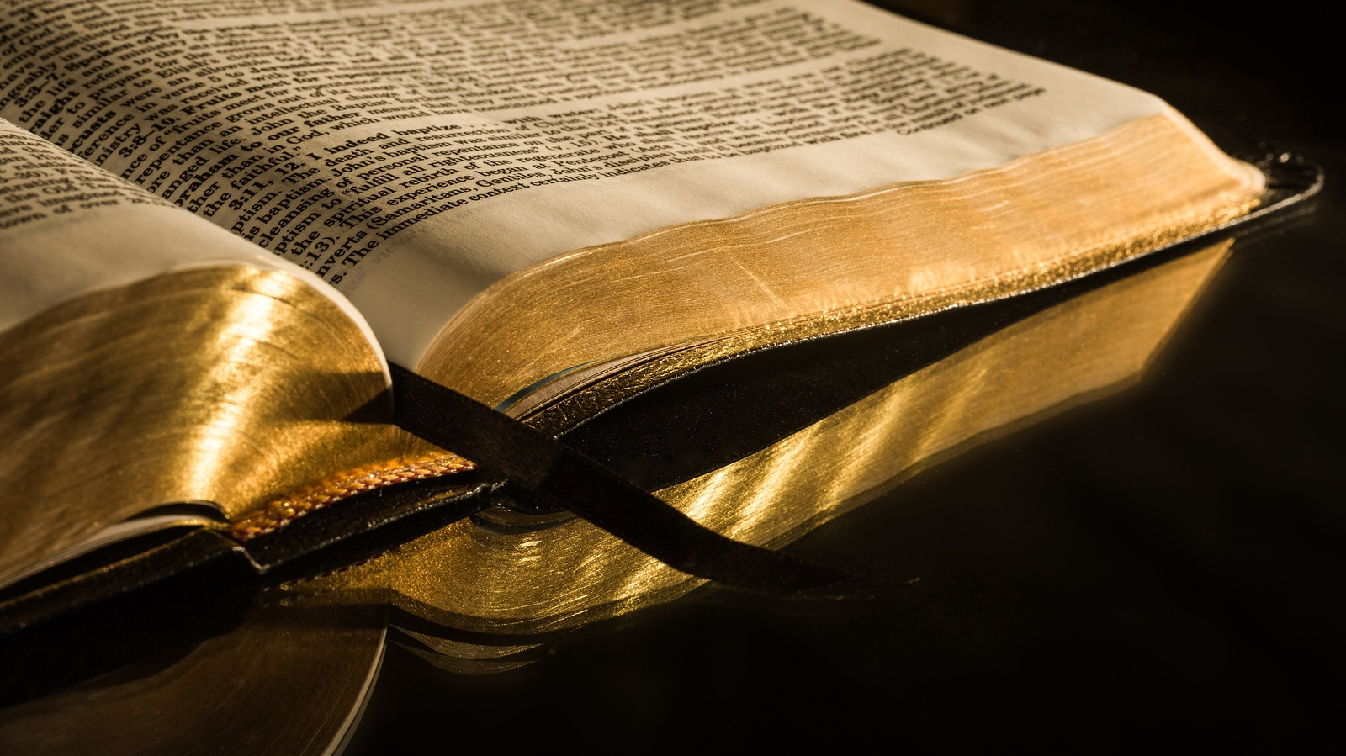
Which Doctrine is Foundational to These?

Slide 6
Objective
Objective:
- Every Christian should hold the doctrine of Biblical inerrancy to be true.
Response:
- For three reasons.

Slide 7
Reasons
Biblical Support
Necessary Doctrinal Structure
Slippery Slope/
Domino Theory

Slide 8
Biblical Inerrancy
Biblical Inerrancy:
All the teachings of Scripture are true$.^{4}$
Premises:
- All of Scripture is inspired by God (II Timothy 3:16),
- Who knows all things (Psalms 147:5, I John 3:20),
- Who cannot lie (Titus 1:2, Hebrews 6:18),
- Nor does He influence others to lie (James 1:13).
4. Millard J. Erickson, Christian Theology. 3rd ed. (Grand Rapids: Baker Academic, 2013). 189

Slide 9
Denying Biblical Doctrine
Salvation
Believe/Accept
Sinlessness
Sin
Depravity
Hypostatic Union
Adam
Hell
Heaven
Jesus
Inerrancy of Scripture

Slide 10
Denying Hell
Salvation
Believe/Accept
Sinlessness
Sin
Depravity
Hypostatic Union
Adam
Hell
Heaven
Jesus
Inerrancy of Scripture

Slide 11
Denying Hell
Salvation
Sinlessness
Believe/Accept
Hypostatic Union
Sin
Depravity
Adam
Heaven
Jesus
Inerrancy of Scripture

Slide 12
Denying Hypostatic Union
Salvation
Believe/Accept
Sinlessness
Sin
Depravity
Hypostatic Union
Adam
Hell
Heaven
Jesus
Inerrancy of Scripture

Slide 13
Denying Hypostatic Union
Salvation
Believe/Accept
Sinlessness
Sin
Depravity
Adam
Hell
Heaven
Jesus
Inerrancy of Scripture

Slide 14
Denying Depravity of man
Salvation
Believe/Accept
Sinlessness
Sin
Depravity
Hypostatic Union
Adam
Hell
Heaven
Jesus
Inerrancy of Scripture

Slide 15
Denying Depravity of man
Salvation
Believe/Accept
Sinlessness
Sin
Hypostatic Union
Adam
Hell
Heaven
Jesus
Inerrancy of Scripture

Slide 16
Denying Biblical Doctrine
Salvation
Believe/Accept
Sinlessness
Sin
Depravity
Hypostatic Union
Adam
Hell
Heaven
Jesus
Inerrancy of Scripture

Slide 17
Denying Biblical Doctrine
Salvation
Sinlessness
Sin
Depravity
Hypostatic Union
Adam
Hell
Heaven
Jesus
Inerrancy of Scripture

Slide 18
Denying Biblical Doctrine
Salvation
Believe/Accept
Sin
Depravity
Hypostatic Union
Adam
Hell
Heaven
Jesus
Inerrancy of Scripture

Slide 19
Denying Biblical Doctrine
Salvation
Believe/Accept
Sin
Depravity
Hypostatic Union
Adam
Hell
Heaven
Jesus
Inerrancy of Scripture

Slide 20
Denying Biblical Doctrine
Believe/Accept
Sin
Adam
Hell
Depravity
Salvation
Inerrancy of Scripture
Heaven
Hypostatic Union

Slide 21
Denying Biblical Doctrine
Sin
Inerrancy of Scripture
Adam

Slide 22
Denying Biblical Doctrine
Inerrancy of Scripture

Slide 23
Denying Biblical Doctrine

Slide 24
Scholarly Basis
Slippery slope:
Per the, Evangelical Dictionary of Theology, denial of this doctrine often leads to the denial of other doctrines
Even though this is true, some who deny this doctrine still remain dedicated to the other doctrines.
However, it is generally the first step to denying other doctrines$.^{5}$
Walter A. Elwell, Evangelical Dictionary of Theology. 2nd ed. (Grand Rapids: Baker Academic, 2001). 158.

Slide 25
Scholarly Basis
PlusPNG
Domino Theory:
Per, Christian Theology, By Millard Erickson, it is not “false in one, false in all”, as some have suggested, but, rather, it is “False in one, uncertain in all”$.^{6}$
So, just because you deny one part of Scripture does not mean you deny all Scripture. However, if one part can be wrong, then the rest is uncertain.
6. Millard J. Erickson, Christian Theology. 3rd ed. (Grand Rapids: Baker Academic, 2013). 189

Slide 26
Conclusion
Every Christian should hold the doctrine of Biblical inerrancy to be true,
Because its doctrines are structurally supported by it and denying it leads other doctrines to be doubted or at least questioned.

