Slide 1
Navigating the New Year.
(Part 3)

Slide 2
Perspective is Powerful because it affects our Perception.
But Perception is not the same as “Reality”!

Slide 3
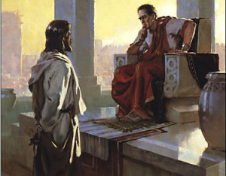
Jn 18:37 “To this end was I born, and for this cause came I into the world,
that I should bear witness unto the truth.
Every one that is of the truth heareth my voice.”
Pilate’s answer revealed his conflicted perceptions:
“What is truth?” vs 38

Slide 4
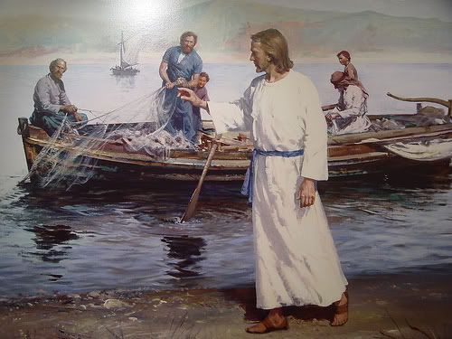
Jesus’ life was marked by “challenging” people’s perspectives and “calling” them to the Truth.
“I am the way, the truth, the life” Jn. 14:6
The first words of his ministry were: (Mt. 4:17)
“Repent, for the kingdom of heaven is at hand.”
His next recorded words: (19)
“Follow me, and I will make
you fishers of men.”
halitus’ (from hals): sailor!

Slide 5
“Repent”: Reconsider
(A New Perspective.)
“The Kingdom of Heaven”
“Follow Me”: Rearrange
(A New Direction.)
“Fishers of men”

Slide 6
He was calling them to “navigate” their lives according to God’s “Compass”. (Pr. 3:5,6; Ps. 119:105)
“Thou shalt guide me with thy counsel,
and afterward receive me to glory.”
Ps 73:24

Slide 7
Successful “navigation” requires that you consider:
Your Final (desired) Destination:
Your Current (actual) Location:
If you get either of these wrong,
you’ll end up adrift!

Slide 8
Your current “Location”
(Spiritual Condition)
2 Cor 13:5 “Examine (peirazō: Scrutinize) yourselves, whether ye be in the faith;
prove (dokimazō: Test) your own selves.
Know ye not your own selves, how that Jesus Christ is in you, except ye be reprobates?”
Adok’imos: unapproved, disqualified, rejected!

Slide 9
Possible “Spiritual” Locations
1. The “Natural” Person: 1 Cor 2:14
“the natural man (psychikos’: Body, Soul)
receiveth not the things of the Spirit of God: for they are foolishness unto him:
neither can he know (understand) them,
because they are spiritually discerned.”

Slide 10
1. The Natural Person: 1 Cor 2:14
A. Is Spiritually dead. Eph. 2:1
“you hath he quickened,
who were dead in trespasses and sins…”
1) They’re incapable of Spiritual life
(independent of God’s miraculous intervention.)
Eph 2:4-5 “But God, who is rich in mercy, … Even when we were dead in sins, hath quickened us together with Christ, (by grace ye are saved;)”

Slide 11
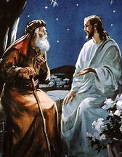
2) That’s why Jesus said in Jn. 3:3,6
“Except a man be born again (regenerated),
he cannot see the Kingdom of God…
That which is born of the flesh is flesh;
that which is born of the Spirit is spirit.”

Slide 12
1. The Natural Person:
B. Is spiritually deceived. Mt. 7:21-23
“Not every one that saith unto me, Lord, Lord, shall enter into the kingdom of heaven; …
Many shall say unto me, But Lord, have we not…
²³ And then will I profess unto them,
I never knew you: depart from me,
ye that work iniquity.” (also 2 Cor 4:4)

Slide 13
2. The “Spiritual” Person: 1 Cor 2:15,16
“But he that is spiritual
(Pneumatikos’: Regenerated, Spirit led.)
judgeth all things…
(Anakri’no: scrutinizes, examines)
For who hath known the mind of the Lord, that he may instruct him?
But we have the mind of Christ.”

Slide 14
2. The “Spiritual” Person: 1 Cor 2:15,16
A. Allows God’s Spirit to Guide them.
“But we have the mind of Christ.”
Nous: Understanding (See John 14:21)
1 Jn 2:20 “ye have an unction from the Holy One, and ye know all things.” (eidō pas)
Consider, understand, recognizes the whole!
(aka: gets the big picture)

Slide 15
Eph 5:15-18
“See then that ye walk (navigate) circumspectly, (carefully, on track) not as fools, but as wise,
Redeeming the time, because the days are evil.
Wherefore be not unwise, but understanding what the will of the Lord is.
And be not drunk with wine…
but be filled with the Spirit”

Slide 16
“be filled with the Spirit”
plēro’ō: filled up, under the influence of.
aka: Navigates by God’s directions!
How much “influence” does God’s Spirit have in your life?
Galatians 5:16 “Walk in the Spirit, and ye shall not fulfil the lust of the flesh. For the flesh lusteth against the Spirit, and the Spirit against the flesh”

Slide 17
2. The “Spiritual” Person: 1 Cor 2:15,16
B. Allows God’s Spirit to Grow them.
Heb. 12:1-17; 2 Peter 3:18
1) 1 Th 5:19 “Quench not the Spirit.”
When we resist His directions. Ps 78:40-41
“How oft did they provoke … and grieve him…Yea, they turned back and tempted God,
and limited the Holy One of Israel.”

Slide 18
2. The “Spiritual” Person: 1 Cor 2:15,16
B. Allows God’s Spirit to Grow them.
2) Eph 4:30 “grieve not the holy Spirit of God,
lype’ō: to bring sorrow.
When we rebel and chose sin over Him!
whereby ye are sealed unto the day of redemption.”
We drag Him through our Sin!

Slide 19
“Spiritual” Locations
1. The “Natural” Person: 1 Cor 2:14
2. The “Spiritual” Person: 1 Cor 2:15
3. The “Carnal” Person: 1 Cor 3:1-3
“I, brethren, could not speak unto you as unto spiritual, but as unto carnal.”
Sarkikos’: temporary, fleshly

Slide 20
3. The “Carnal” Person: 1 Cor 3:1-3
A. Lacks:
1) Spiritual Growth! Vs 1,2
“Even as unto Babes in Christ.
I have fed you with milk, and not with meat: for hitherto ye were not able to bear it,
neither yet now are ye able.”

Slide 21
3. The “Carnal” Person: 1 Cor 3:1-3
A. Lacks:
2) Spiritual discernment.
Heb. 5:12,14 “when …ye ought to be teachers,
ye have need that one teach you again…
the first principles of the oracles of God,
and are become such as have need of milk,
and not of strong meat….

Slide 22
3. The “Carnal” Person: 1 Cor 3:1-3
C. Lacks:
3) Spiritual application.
Heb. 5:12,14 “strong meat belongeth to them that …by reason of use have their senses (perception) exercised (gymnazō: trained) to discern both
good (kalos: inherently Valuable)
and evil.” (kakos: inherently Worthless)

Slide 23
The lack of Spiritual Growth, Discernment and application…
B. Leads to a Sensual (Temporary) focus. Vs 3
“For ye are yet carnal: for whereas there is among you envying, and strife, and divisions, are ye not carnal, and walk as men?”
Behave as non Christians!
“who mind earthly things” Ph. 3:19

Slide 24
Conclusion:
Until you identify your desired Destination,
And your actual Location,
Any “Direction” will be ultimately pointless!

Slide 25
Conclusion:
Once you know your Destination, and Location,
You can begin to plot a wise course of Direction!

Slide 26
Application:
1) What’s your desired Destination?
(Where do you want to “end up”?)
2) What’s your current “location”?
(Where are you right now spiritually?)
“Natural” (unregenerate) Person?
“Ye must be born again” Jn 3:3

Slide 27
Application:
(Where are you right now spiritually?)
“Spiritual” Person?
(Allowing God’s Spirit to Guide and Grow you?)
“Carnal” Person?
Saved but stuck in or dangerously drifting toward “temporary” harbors.

Slide 28
To successfully navigate:
Desired Destination
Accurate (Current) Location
Only then can we begin to plot a wise course toward that Goal!

Slide 29
You have a limited time to “settle” this!
Luke 13:23-24
“Lord, are there few that be saved?
And he said unto them,
Strive to enter in at the strait gate:
for many…will seek to enter in,
and shall not be able.”

Slide 30
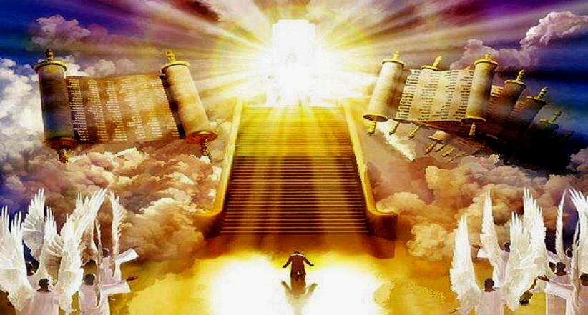
Luke 13:25
“When once the master of the house is risen up, and hath shut to the door, and ye begin to stand without, and to knock at the door, saying,
Lord, Lord, open unto us;
and he shall answer
I know you not whence ye are…
depart from me”

Slide 31
There’s no time in Eternity,
to Change your Destiny!
2 Cor 6:2 “behold, now is the accepted time;
behold, now is the day of salvation.”
Heb 3:7-8 “The Holy Ghost saith,
To day if ye will hear his voice,
Harden not your hearts”

