Slide 1
“This book of the law shall not depart out of thy mouth; but thou shalt meditate therein day and night,
that thou mayest observe to do according to all that is written therein:
for then thou shalt make thy way prosperous,
and then thou shalt have good success.”
Joshua 1:8

Slide 2
Many Mega Church pastors are encouraging members to “unhitch themselves” from the Old Testament.
As your Pastor, I’m commanded to
“Preach the Word.” 2 Tim. 4:2
Acts 20:26-27 “I am pure from the blood of all men.
²⁷ For I have not shunned to declare unto you
all the counsel of God.”

Slide 3
“All scripture is given by inspiration of God,
and is profitable for doctrine, for reproof,
for correction, for instruction in righteousness:
That the man of God may be perfect,
Ar’tios: complete
thoroughly furnished
Exartiz’o: fully equipped
unto all good works.”
2 Tim 3:16-17

Slide 4
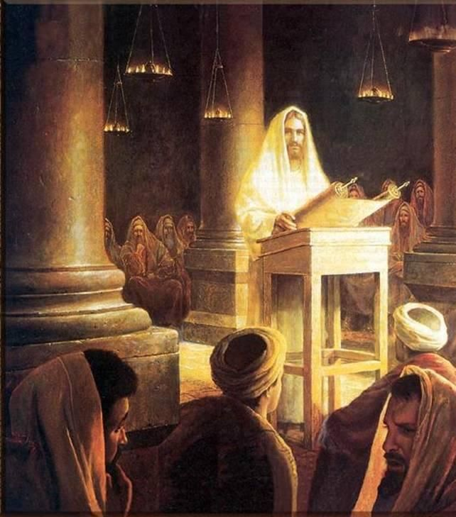
“Search the scriptures;
for in them ye think ye have eternal life:
and they are they which testify of me!
And ye will not come to me that ye might have life.”
John 5:39,40

Slide 5
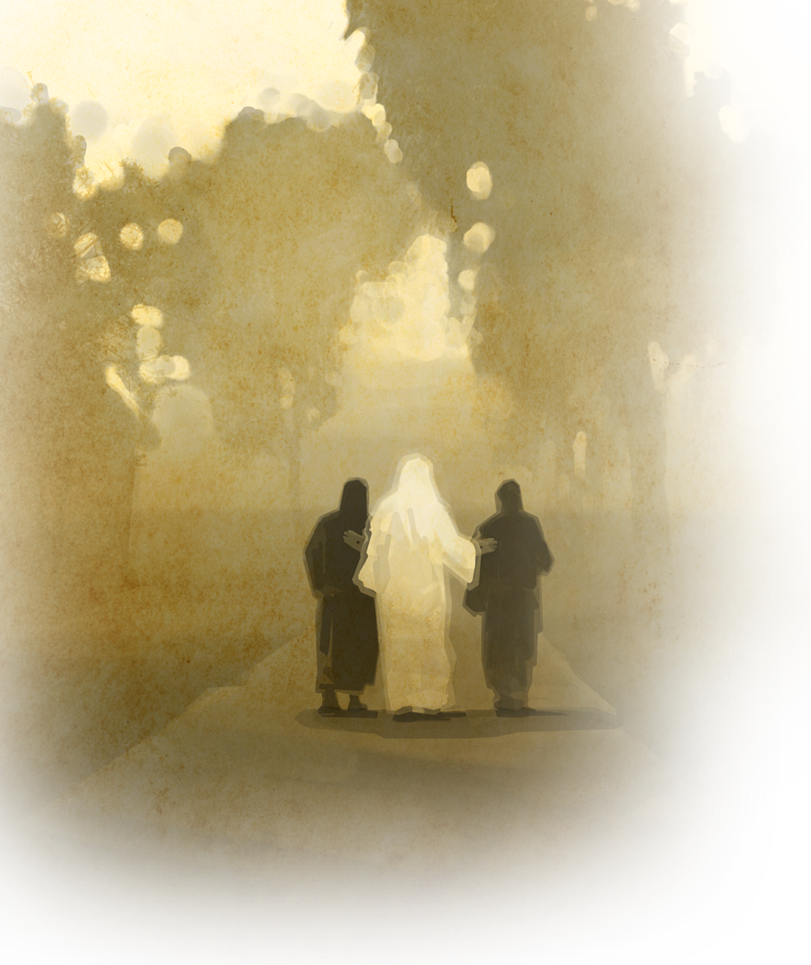
“O fools, and slow of heart to believe all that the prophets have spoken:
Ought not Christ to have suffered these things,
and to enter into his glory?
And beginning at Moses
and all the prophets,
he expounded unto them
in all the scriptures
the things concerning himself.”
Luke 24:25-27

Slide 6
Life Lessons from Ancient Israel
“Now all these things happened unto them for ensamples:
and they are written
for our admonition,
upon whom the ends of the world are come.”
1 Cor 10:11

Slide 7
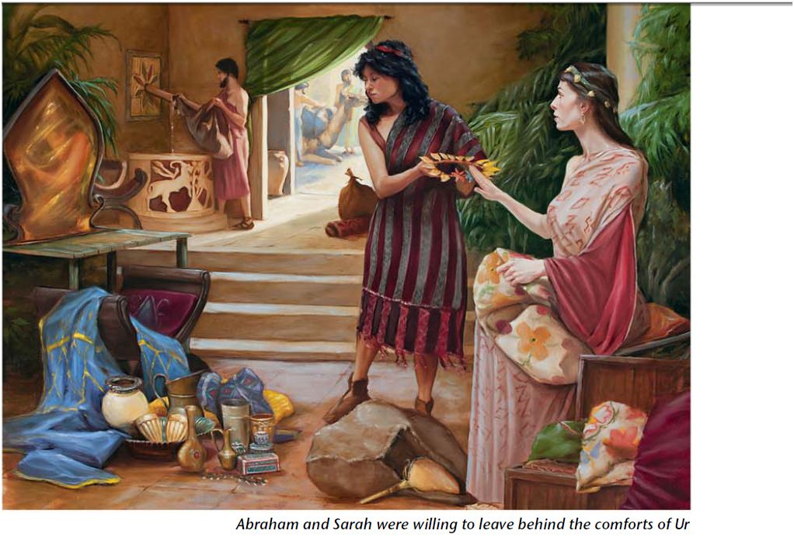
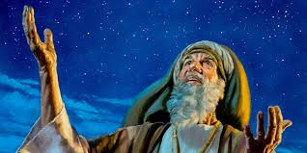
God promised the land of Canaan to Abram and his descendants. (Gen. 12, 13, 15, 26, 35, 50 )
Ge. 12:1-2 “Now the LORD had said unto Abram, Get thee out of thy country, and from thy kindred, and from thy father's house, unto a land that I will shew thee:
And I will make of thee a great nation, and I will bless thee, and make thy name great; and thou shalt be a blessing:
Ge 13:17 “walk through the land in the length of it and in the breadth of it; for I will give it unto thee.”

Slide 8
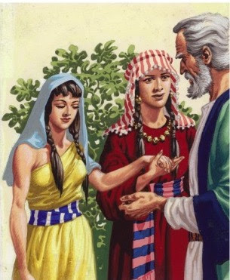
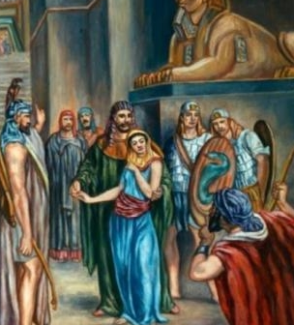
1. Egypt is a picture of spiritual bondage
During hard times, the pull of comfort drew Abram down to Egypt. Genesis 12:10-20
“And there was a famine in the land: and Abram went down into Egypt to sojourn there”
1) Immediate consequences. 12:11-15
(Trouble with Sarah!)
2) Long term consequences. Gen. 16
Ishmael: Birth of Arab nations.

Slide 9
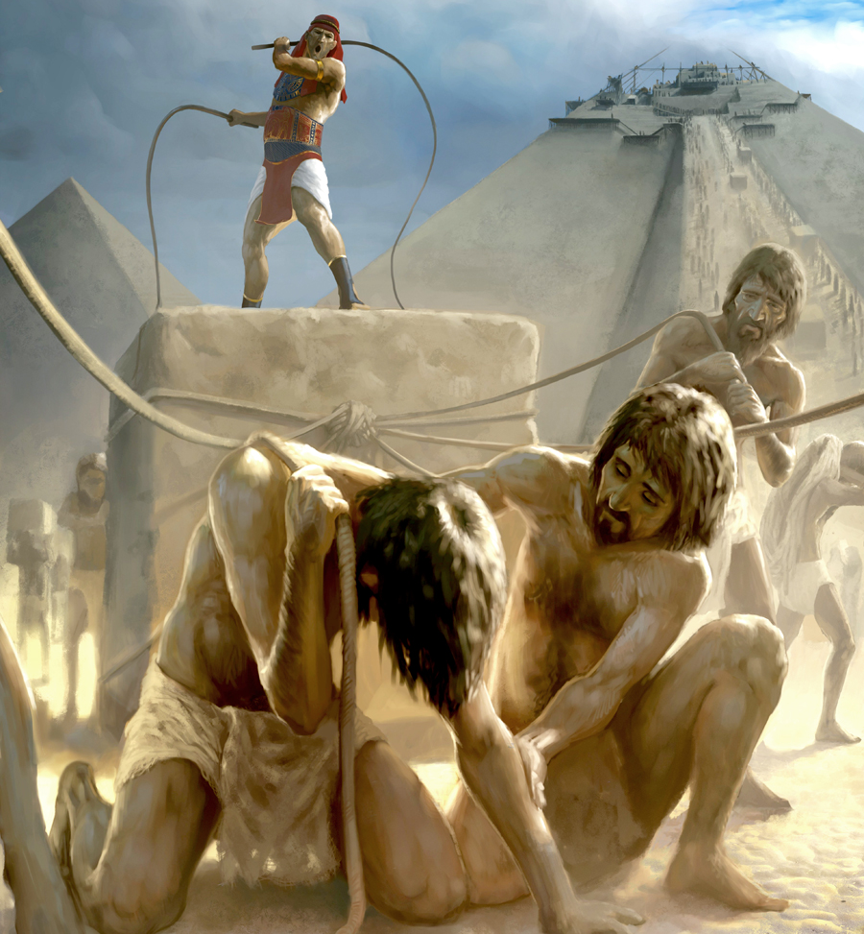
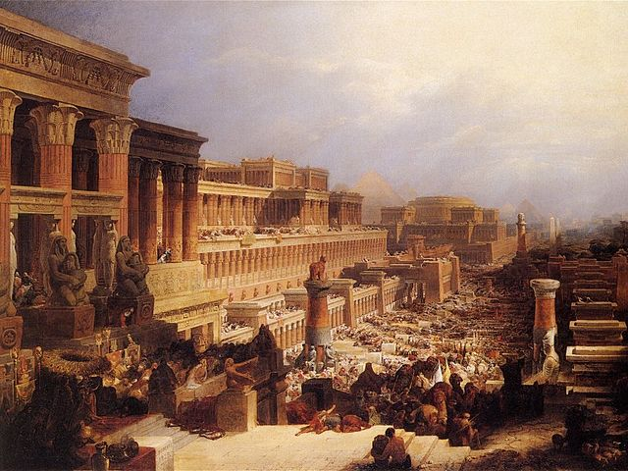
1. Egypt is a picture of spiritual bondage
B. God warned Abram of Egypt’s danger!
Gen. 15:13-16 “Know of a surety that thy seed shall be a stranger in a land that is not theirs, and shall serve them;
and they shall afflict them 400 years;
And also that nation… will I judge:
and afterward shall they come out
with great substance...
But in the fourth generation they shall come hither again:
for the iniquity of the Amorites is not yet full.”

Slide 10
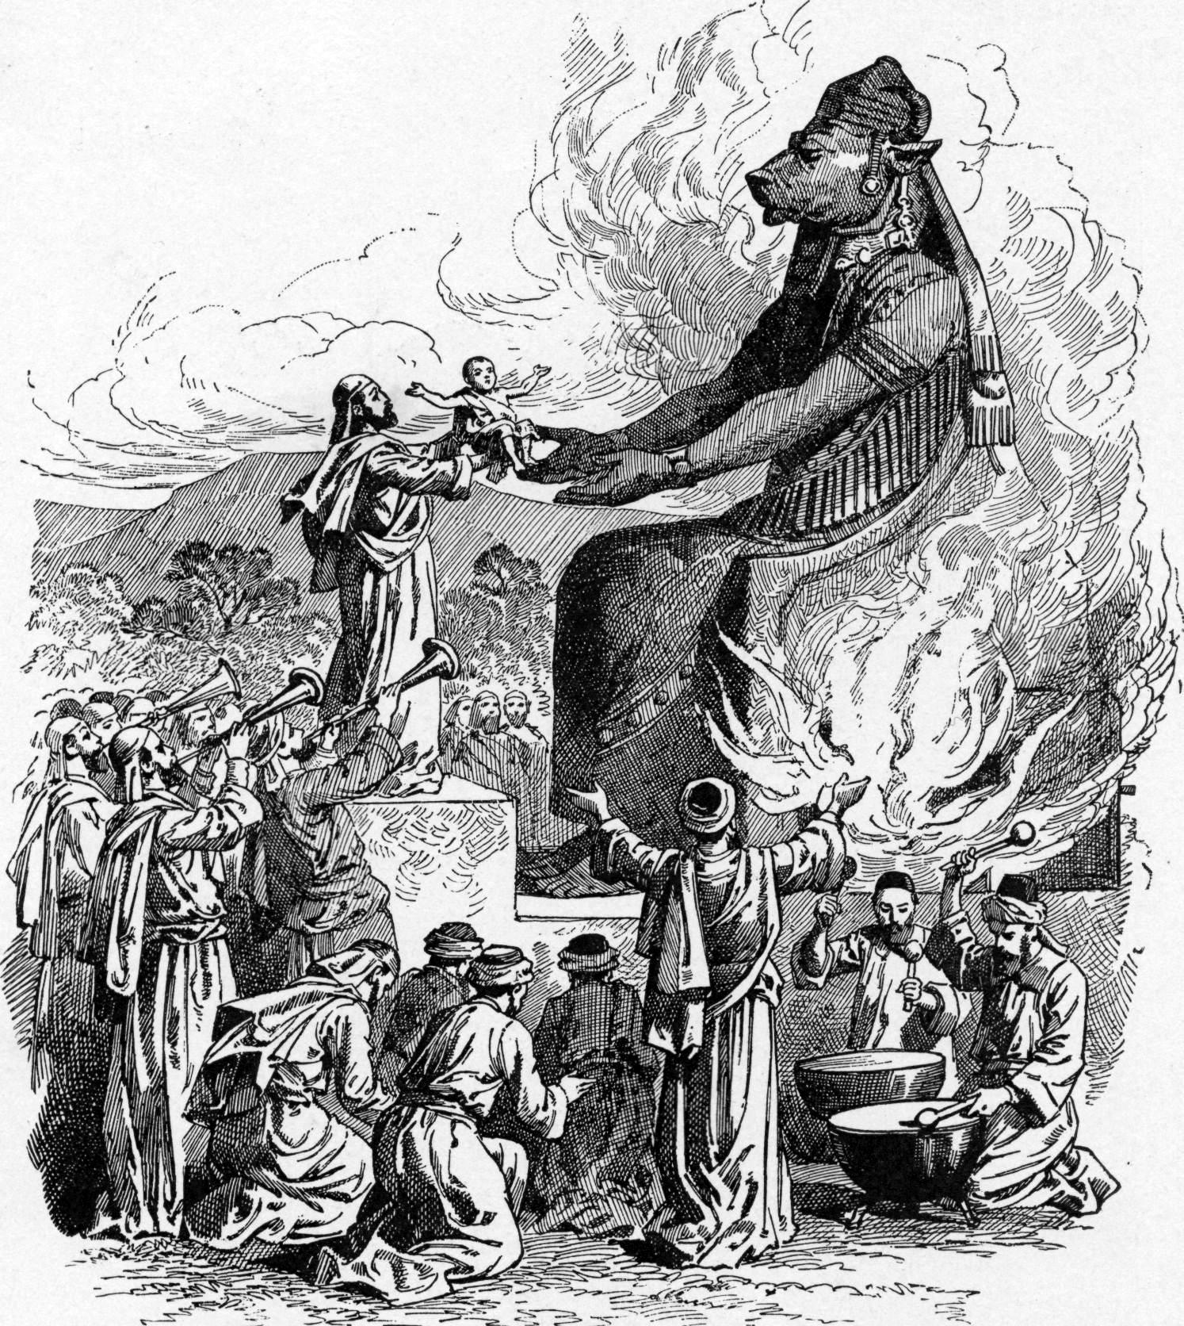
Gen15:13-16 “the iniquity of the Amorites is not yet full.”
C. While Israel was in Egypt the Canaanites multiplied
and defiled the “promised” land.
Lev 18:24-25 “Defile not ye yourselves in any of these things:
for in all these the nations are defiled which I cast out before you:
And the land is defiled:
therefore I do visit the iniquity thereof upon it,
and the land itself vomits out her inhabitants.”

Slide 11
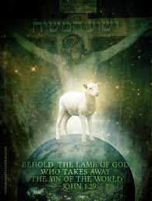
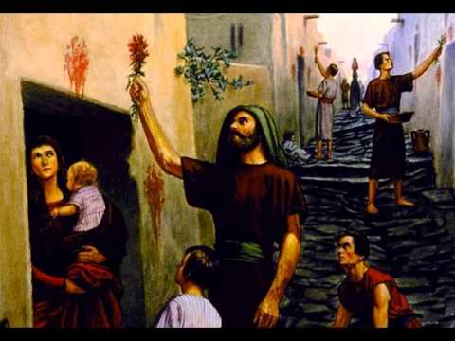
2. The Passover is a picture of Salvation.
Ex. 12:13“When I see the blood,
I will pass over you”
Yeshûʿâ = deliverance
“Christ our Passover
is sacrificed for us” 1 Cor 5:7

Slide 12
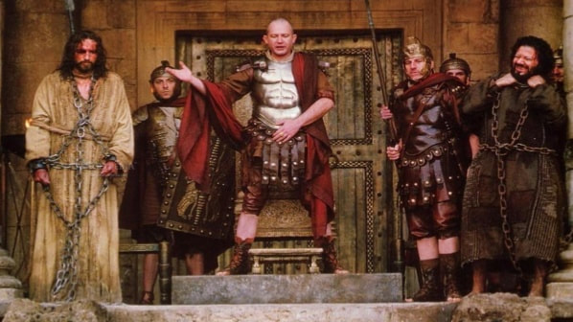
2. The Passover is a picture of Salvation. “Christ our Passover is sacrificed for us” 1 Cor 5:7
A. Choose a perfect (flawless) lamb. Ex. 12:5
1) Watched for 4 days. Ex. 12:5, 6 “without blemish”
This is what the Passion week is about!
“I find no fault in him”
Jn. 19:4

Slide 13
2. The Passover is a picture of Salvation. “Christ our Passover is sacrificed for us” 1 Cor 5:7
A. Choose a perfect (flawless) lamb. Ex. 12:5
1 Peter 1:18-20
“ye were not redeemed with corruptible things… But with the precious blood of Christ,
as of a lamb without blemish and without spot:
Who verily was foreordained before the foundation of the world, but was manifest in these last times for you”

Slide 14
“Christ our Passover is sacrificed for us” 1 Cor 5:7
B. Kill it without breaking any bones! Ex. 12:46
“But one of the soldiers with a spear pierced his side…
these things were done, that the scripture should be fulfilled, A bone of him shall not be broken.
And again another scripture saith,
They shall look on him
whom they pierced.”
(Ps. 34:20)
(Zech. 12:10)
John 19:34-37

Slide 15
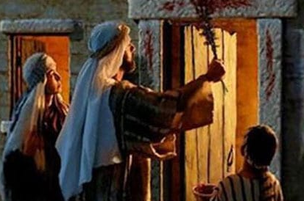
“Christ our Passover is sacrificed for us” 1 Cor 5:7
C. Apply the blood to the door! Ex. 12:7
“When I see the blood, I will Passover you!” Ex. 12:13
Eph 2:13-14 “But now in Christ Jesus ye who sometimes
were far off are made nigh by the blood of Christ.
For he is our peace…”
“Jesus Christ, who …loved us,
and washed us from our sins in his own blood…”
Rev 1:5

Slide 16
“Christ our Passover is sacrificed for us” 1 Cor 5:7
D. Eat (internalize) the lamb! Ex. 12:8
John 6:48-51 “I am that bread of life. Your fathers did eat manna in the wilderness, and are dead…
This is the bread which cometh down from heaven,
that a man may eat thereof, and not die.
I am the living bread which came down from heaven:
if any man eat of this bread, he shall live for ever:
and the bread that I will give is my flesh,
which I will give for the life of the world.”

Slide 17
“Christ our Passover is sacrificed for us” 1 Cor 5:7
D. Eat (internalize) the lamb! Ex. 12:8
Jn 6:53-54 “Verily, verily, I say unto you, Except ye eat the flesh of the Son of man, and drink his blood,
ye have no life in you.
Whoso eateth my flesh, and drinketh my blood, hath eternal life; and I will raise him up at the last day….
63 It is the spirit that quickeneth; the flesh profiteth nothing: the words that I speak unto you,
they are spirit, and they are life.”

Slide 18
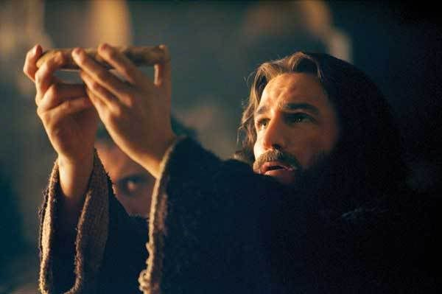
“Christ our Passover is sacrificed for us” 1 Cor 5:7
D. Eat (internalize) the lamb! Ex. 12:8
Luke 22:19 “he took bread, and gave thanks, and brake it, and gave unto them, saying,
This is my body which is given for you:
this do in remembrance of me.”

Slide 19
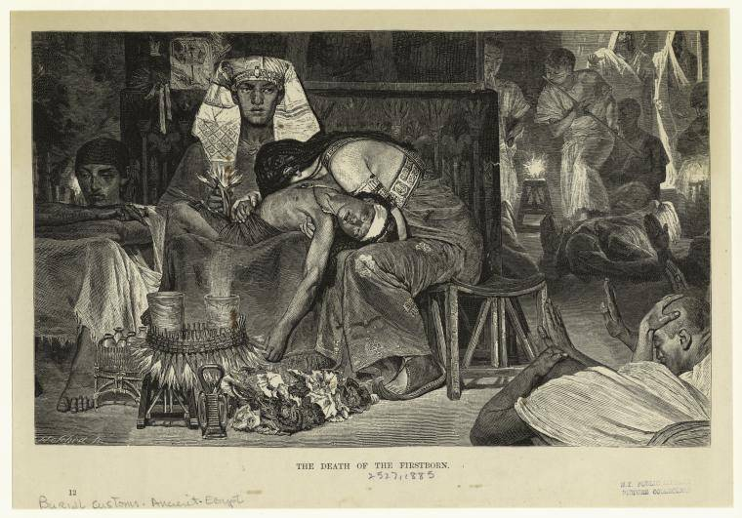
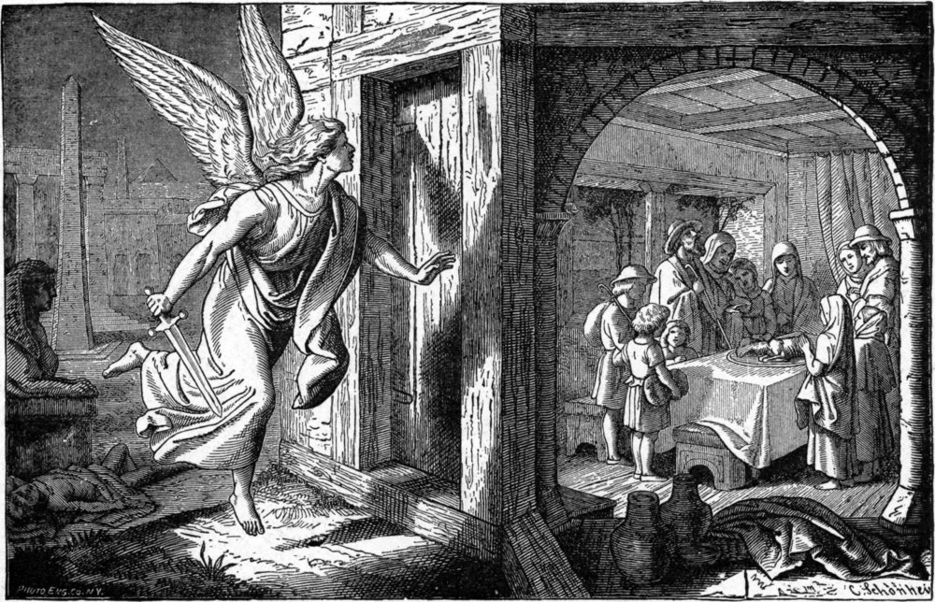
“Christ our Passover is sacrificed for us” 1 Cor 5:7
E. Get inside during the night! Ex. 12:22-24
“strike the lintel and the two side posts with the blood that is in the bason; and none of you shall go out at the door of his house until the morning.
For the LORD will pass through to smite…;
and when he seeth the blood upon the lintel,
and on the two side posts,
the LORD will pass over the door, and will not suffer the destroyer to come in unto your houses to smite you.”

Slide 20
2. The Passover is a picture of Salvation.
A. Choose a perfect Lamb. (Ex. 12:5)
B. Kill it (without breaking any bones). (Ex. 12:46)
C. Apply the blood to the door! Ex. 12:7
D. Eat (internalize) the lamb.
E. Get (and stay) inside! 12:24-22
Which of those steps were optional?

Slide 21
2. The Passover is a picture of Salvation.
Repent Lk 13:3 “except ye repent ye shall perish”
Believe Jn 8:24 “if ye believe not that I am he,
ye shall die in your sins.”
Receive Jn 1:12 “But as many as received him,
to them gave he power to become the sons of God,
even to them that believe on his name”
Which of these steps are optional?

Slide 22
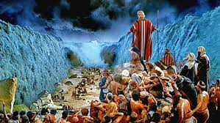
3. Red sea symbolizes a type of Baptism
1 Cor 10:1-2 “I would not that ye should be ignorant, how that all our fathers were baptized unto Moses in the cloud and in the sea”

Slide 23
3. Red sea symbolizes a type of Baptism
A. First Step of Faith after Salvation. Acts 2:37-38
“Now when they heard this, they were pricked in their heart, and said unto Peter and to the rest of the apostles, Men and brethren, what shall we do?
Then Peter said unto them, Repent, and be baptized”
B. It’s an act of simple obedience. 1 Ptr 3:21
“not the putting away of the filth of the flesh,
but the answer of a good conscience toward God”

Slide 24
3. Red sea symbolizes a type of Baptism
C. Commitment to identify with God
and walk by obedient faith Ro. 6:4,5
“Therefore we are buried with him by baptism into death: that like as Christ was raised up from the dead by the glory of the Father,
even so we also should walk in newness of life.
For if we have been planted together
in the likeness of his death,
we shall be also in the likeness of his resurrection:”

Slide 25
3. Red sea symbolizes a type of Baptism
C. Commitment to identify with God
and walk by obedient faith. Ro. 10:11
“Likewise reckon ye also yourselves to be dead indeed unto sin, but alive unto God through Jesus Christ.
Let not sin therefore reign in your mortal body,
that ye should obey it in the lusts thereof.
Neither yield ye your members as instruments of unrighteousness unto sin: but yield yourselves unto God,
as those that are alive from the dead…” Ro. 6:11-13

Slide 26
Application: 1 Cor 10:11
“Now all these things happened unto them for ensamples: and they are written for our admonition”
Are you still “stuck” in Bondage?
1 Jn 2:15-16 “Love not the world, neither the things that are in the world. If any man love the world,
the love of the Father is not in him.
For all that is in the world, the lust of the flesh, and the lust of the eyes, and the pride of life,
is not of the Father, but is of the world.”

Slide 27
Application: 1 Cor 10:11
“Now all these things happened unto them for ensamples: and they are written for our admonition”
2) Have you accepted God’s gift of Salvation?
Yeshûʿâ = deliverance
“Who hath delivered us from the power of darkness, and hath translated us into the kingdom of his dear Son:
In whom we have redemption through his blood,
even the forgiveness of sins:”
Colossians 1:13-14

Slide 28
Conclusion: 1 Cor 10:11
3) Have you obediently Identified and
followed Christ in Baptism?
Romans 6:4
“Therefore we are buried with him by baptism into death: that like as Christ was raised up from the dead
by the glory of the Father,
even so we also should walk in newness of life.”

Slide 29
Why Not?
If Not,
If not now,
When?
“What shall it profit a man if he shall gain
the whole world,
and lose his own soul?”
Mark 8:36

