Slide 1
“All scripture is given by inspiration of God,
and is profitable for doctrine, for reproof,
for correction, for instruction in righteousness:
That the man of God may be perfect,
thoroughly furnished
unto all good works.”
2 Tim 3:16-17

Slide 2
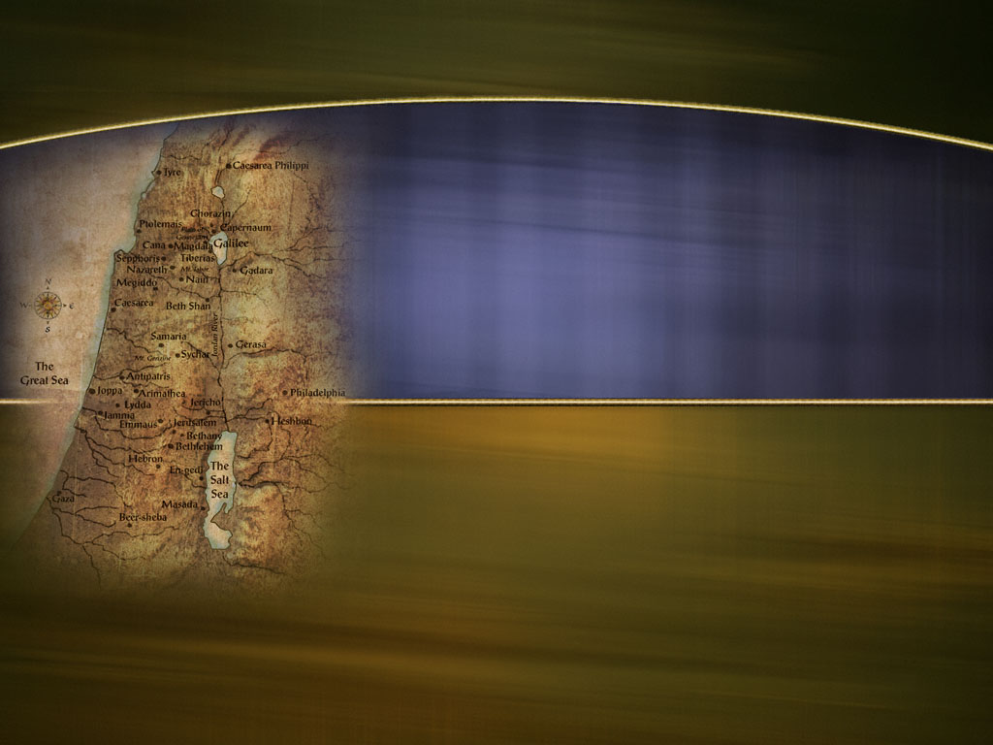
Life Lessons from Ancient Israel
“Now all these things happened unto them for ensamples:
and they are written
for our admonition.”
Νουθεσία (nouthesi’a)
Warning or attention.
1 Cor 10:11

Slide 3
Review:
Egypt: A picture of the power and pull of the
World ruled by Satan “the god of this world”.
Passover: A picture of the price required to
redeem us from the Satan’s power. Col. 1:13,14
God “delivered us from the power of darkness, and translated us into the kingdom of his dear Son:
In whom we have redemption through his blood, even the forgiveness of sins.”

Slide 4
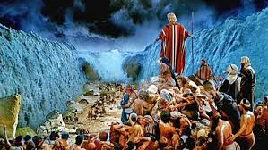
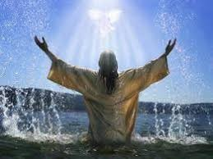
Red sea symbolizes a type of Baptism
1 Cor 10:1-2 “our fathers were baptized unto Moses in the cloud and in the sea”
Baptism represents a commitment to:
Leave “Egypt” behind!
Learn to follow God by faith.

Slide 5
Sinai (the Law) represents “Discipleship”.
A commitment to maintaining to a relationship with God through His word.
At Sinai we learn about:
1. God’s Holy standard.
2. Our own sinfulness (inability to meet God’s standard).
3. Our need for forgiveness through atonement.
4. God’s plan for a partnership with us. Ex. 19:5,6
“a peculiar treasure, a kingdom of priests…”

Slide 6
Sinai also revealed the power and pull of “Egypt”
(Our Past)!
There’s a significant difference between getting out of Egypt (the world)
and getting “Egypt” out of us!
The pressures (habits/attitudes) of our past can easily sabotage our future!
(Our Faith Journey)

Slide 7
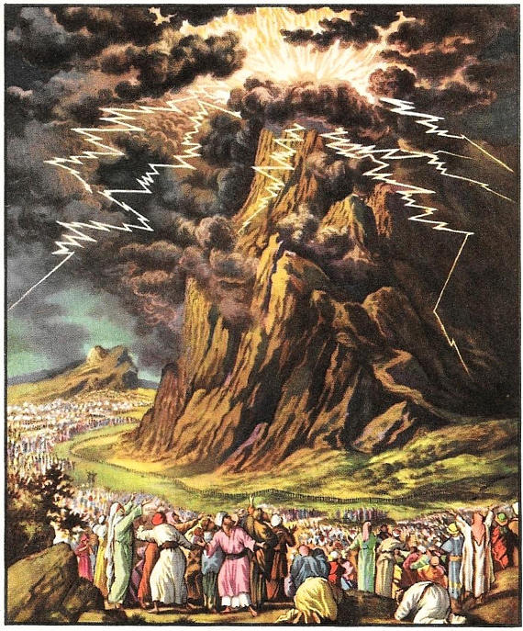
Timeline: Ex. 19:
Israel arrives and camps at the base of Sinai.
1) God reviewed His power, protection,
provision and plan. (vs 4-6)
“all the people answered together…
all that the LORD hath spoken we will do.”
2) 3 days later God descends on Sinai. 16-23
“Sinai was altogether on a smoke, because the LORD descended upon it in fire: …and the whole mount quaked greatly. …the LORD called Moses to the top…
and Moses went.” Vs 18-20
Returned to the people. Vs 25

Slide 8
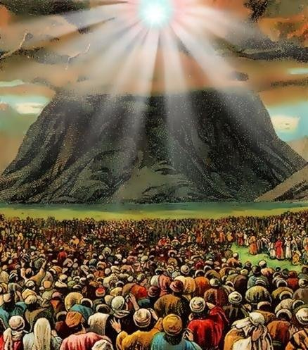
Timeline: Ex. 20:
1) God gives the 10 Commandments. Vs. 1-18
2) The people hear God speak and respond. 18-21
“the people …removed and stood afar off.
And said to Moses,
Speak thou with us, and we will hear;
but let not God speak with us, lest we die.
3) Moses Responds: 20 “Fear not: for God is come to
prove you, and that his fear may be before your faces,
that ye sin not.
21 And the people stood afar off, and Moses drew near unto the thick darkness where God was.”

Slide 9
Ex. 21-23 God gives Moses various instructions
Then returns to share them with Israel.
Ex. 24 God reveals himself to the People.
1-3 “Come up unto the LORD, thou, and Aaron, Nadab, and Abihu, and 70 of the elders of Israel;
and worship ye afar off.
And Moses alone shall come near the LORD:
9 Then went up Moses, and Aaron, Nadab, and Abihu, and seventy of the elders of Israel:

Slide 10
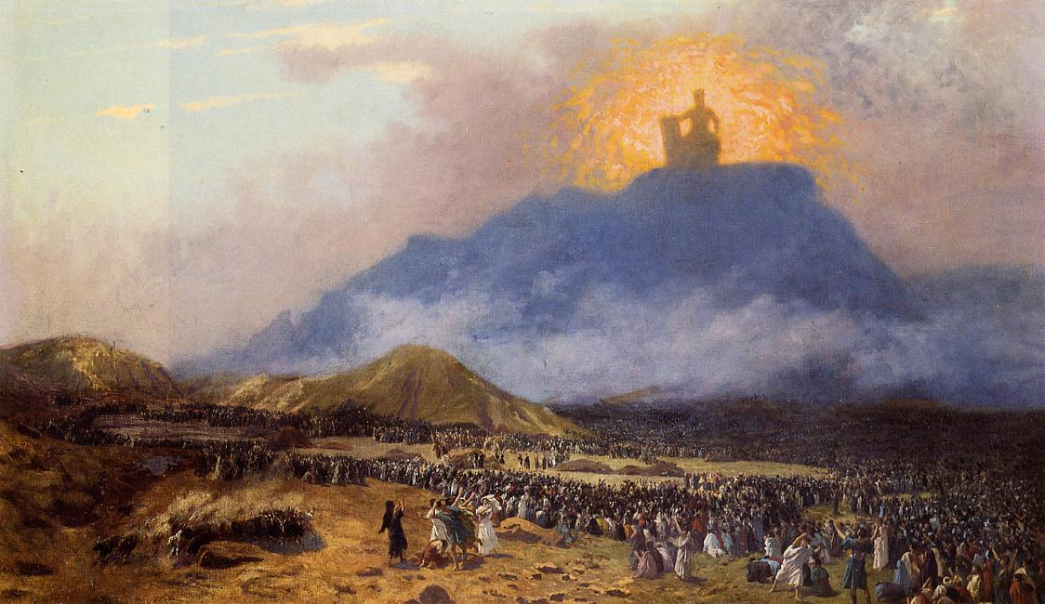
10 “And they saw the God of Israel”
And upon the nobles of Israel he laid not his hand:
also they saw God, and did eat and drink.”
Ex. 24:11
¹⁷ ”And the sight of the glory of the LORD
was like devouring fire on the top of the mount
in the eyes of the children of Israel.”

Slide 11
The Israelites had:
Experienced God’s power and provision.
Seen Moses come and go from the Mountain.
The leaders had eaten with and seen God.
All Heard (and agreed to) His commandments.
Ex 24:3 “Moses told the people all the words of the LORD, and all the judgments: and all the people answered…
All the words which the LORD hath said
will we do.”

Slide 12
Exodus 24:12-17
“And the LORD said unto Moses, Come up to me into the mount… and I will give thee tables of stone, and a law, and commandments which I have written; that thou mayest teach them.
13And Moses rose up, and his minister Joshua:
and went up into the mount of God.
14 And he said unto the elders, Tarry ye here for us, until we come again unto you:
and, behold, Aaron and Hur are with you:
18 Moses was in the mount 40 days and 40 nights.”

Slide 13
While Moses is in the Mountain receiving further directions from God (Ex 25-32)
Old habits / attitudes reassert themselves.
Whenever / wherever God is working,
Satan will also be working!
(and he uses our “past” to pressure us!)
Śāṭān’ literally means “adversary”!

Slide 14
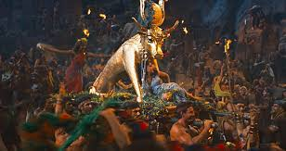
Important questions to ask when tempted.
1. Where will this take me? Ex 32:1
“And when the people saw that Moses delayed… the people gathered themselves together unto Aaron…
Up, make us gods, which shall go before us;”
A. Who were these “god’s”?
Egyptian god Apis Vs 4
B. Where would they lead them?

Slide 15
Important questions to ask when tempted.
2. Who will I follow? Ex. 32:1
A. They had followed Moses “as for Moses, that brought
us up out of Egypt, we wot not what is become of him.”
1) Who had Moses been following? Ex 13:21
“the LORD went before them by day in a pillar of a cloud,
to lead them the way; and by night in a pillar of fire…”
If God leads you somewhere,
be careful of who (what) you let lead you away!

Slide 16
2. Who will I follow? Ex. 32:1
Phil. 3:17-18 “Be followers together of me, and mark them which walk so as ye have us for an ensample.
For many walk, of whom I have told you often,
and now tell you even weeping,
that they are the enemies of the cross of Christ:
Whose end is destruction…”
Be Careful who you follow, because
Someone may be following you!

Slide 17
Important questions to ask when tempted.
3. What will it cost? (What’s at stake?)
A. There are usually immediate costs.
“break off the gold earrings” vs 2
They thought they got off easy!
B. There are always hidden costs for sin.
Jonah “running from the presence of the Lord…
paid the fare…”
had no idea of what that decision would really cost.

Slide 18
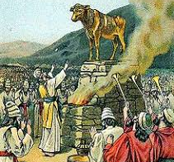
B. Hidden costs for Sin.
1) Sin’s “debt” always Corrupts! Vs 4, 5
“These be thy gods, which brought thee up out of
the land of Egypt….
Aaron proclaimed tomorrow
is a feast unto the Lord.”
They Mingled the worship of God with Satan!

Slide 19
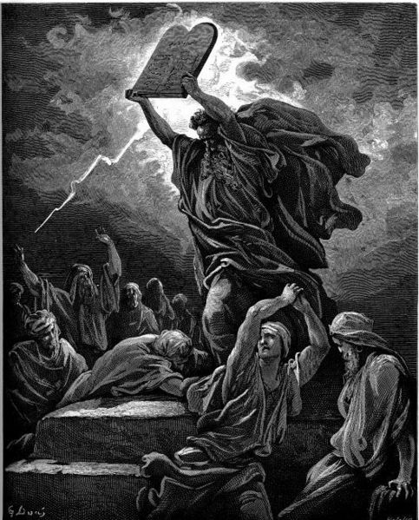
C. What will it cost? Ex. 32
2) Sin’s “debt” always compounds.
a) Self Deception. Vs 5, 24
b) Powerful illustration. 19
Broke the tablets of the “law”
c) Distasteful application. 20
“burnt it with fire, ground it to powder, strawed it on the water,
and made Israel to drink of it.”

Slide 20
What will it (my sin) Cost?
2) Sin’s “debt” always compounds.
d) Direct question. 26 “Who is on the Lord’s side…?
The sons of Levi gathered themselves unto him.”
e) Difficult Position. 27 “Slay every man his brother
…companion…neighbor”
f) Death and destruction. 3000 died. (Vs 28)
35 “And the LORD plagued the people…”
God had already warned them! Ex. 22:20

Slide 21
Why such terrible consequences?
Because willful sin gives Satan increased influence in our lives.
“rebellion is as the sin of witchcraft!”
1 Sam. 15:23
Rebellion comes from “marah” which means:
“bitterness!”

Slide 22
2) Sin’s “debt” always compounds.
g) Distance from God. (Isolation) Ex. 33:3 “I will
not go up in the midst of thee…lest I consume thee”
7 Moses took the tabernacle, and pitched afar off from the camp, called it the Tabernacle of the congregation.
C. God still made a way back to Him!
8 And …every one which sought the LORD
went out unto the tabernacle of the congregation,
which was without the camp.”

Slide 23
Israel’s time in Egypt affected /infected some of their ideas and attitudes.
During difficult times, Satan used this to
Tempt them to resist and rebel from God which:
Corrupted their relationship with God.
Compounded the consequences of their sin.
This (sin) moved them further from God,
leaving them increasingly vulnerable to more of Satan’s deception and influence.

Slide 24
In His love and mercy God made a way to restore their relationship with Him.
Ex. 33:7 “Every one which sought the LORD
went out unto the tabernacle of the congregation,
which was without the camp.”
Those that chose to seek and follow God,
discovered (like David) that:
“He restoreth my soul and leads me in the paths of righteousness” Ps. 23:3

Slide 25
Satan uses our time in Egypt (the world) to develop ideas and attitudes (thoughts) that he builds into what the Bible describe as
“strongholds” in our soul. (2 Cor 10:3-5; 1 Jn 2:15,16)
He then uses these to influence our responses to God (His Word and Will), hoping to:
Corrupt our relationship with God.
Compound the effect of our choices. 2 Tim. 2:24-26

Slide 26
Like Israel, our sin moves us away from God;
Leaving us more vulnerable to Satan’s influence.
Thankfully, God has made a way to back to a healthy relationship with Him (1 Jn 1:6-9)
and to “restore our soul”.
But we (like Israel) have to come to God
On His Terms!

Slide 27
Romans 12:1-2 “I beseech you therefore
by the mercies of God, that ye present your bodies
a living sacrifice, holy, acceptable unto God,
which is your reasonable service.
And be not conformed to this world: (Egypt)
but be transformed by the renewing of your mind,
that ye may prove what is that good, and acceptable, and perfect, will of God.”

Slide 28
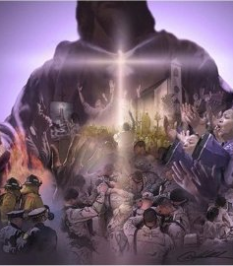
Are you willing to work with God to:
1) Identify and Remove Satan’s “strongholds”?
“Be not conformed to this world”
2) Replace them with “towers
of (God’s) Truth” in your soul?
“but be transformed by the renewing of your mind”

