Slide 1
Learning to Love
1 Corinthians 13

Slide 2
God is the author of Love.
He seeks to be both Designer and Developer of our “Love life”.
Phil 1:6 “Being confident of this very thing,
that he which hath begun a good work in you
will perform it until the day of Jesus Christ:”

Slide 3
We’re Created to Care (Love)
Insecurity keeps us from Intimacy
B/C intimacy requires vulnerability!
Intimacy: “In to me see!”
That’s why love is so risky!

Slide 4
Risk requires Faith!
Faith is foundational to love.
Heb. 11:1 “faith is the substance of things hoped for…”
1 Cor 13:13 “Now abideth Faith, Hope, Charity”
Since “Every …perfect gift is from above” (Jms 1:17)
God has gifted us with the capacity to Love!

Slide 5
God’s gifts of love include:
Physical: (Eros: erotic) Pr 5:18,19
Emotional: (Philos: Affection) Titus 2:3,4
Spiritual: (Agape: Charity) 1 Cor 13
“The greatest of these is charity”
(agape) 1 Cor. 13:13

Slide 6
What’s so Great about agape?
1 Cor. 12 deals with how we “fit” in the context of relationships.
Vs 31 promises to show “a more excellent way” to feel safe to open our hearts to others, and to be safe for others to open their hearts to us.
This Love (Charity) is unpacked in Ch. 13 and fosters intimacy, openness, security, comfort, growth, and support.

Slide 7
What’s so Great about agape?
“Eros” is restricted to lovers.
“Philos” involves “friends”.
“Agape” is universal, applying and benefiting everyone in our lives!
(Lovers, friends, and even enemies!)

Slide 8
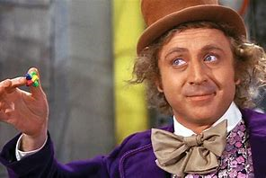
What’s so Great about agape?
Agape comes from God’s Spirit.
Gal. 5:22 “The fruit of the Spirit is Love”
Like Willy Wonka’s “Never Ending Gobstopper”
It has many flavors!
(Characteristics)

Slide 9
“charity suffereth long” vs 4
makrothyme’ō: forbearing, longsuffering, patient.
1. “Longsuffering” requires some “Suffering”
“Patience” requires “Problems”!
A. In God’s plan, the problems always
precede the (Fulfilment of the) Promise!
1) Abraham was called the “Father of Faith”
because he understood this truth! Ro 4:18
“Who against hope believed in hope…”
Notes:
See also Ecclesiastes 7:8; Galatians 5:22.

Slide 10
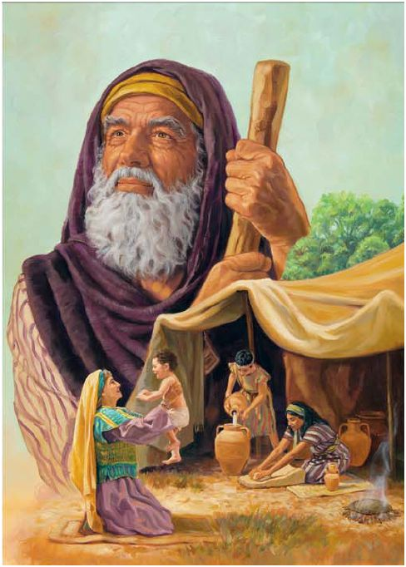
Ro 4:20,21
“He staggered not at the promise of God through unbelief;
but was strong in faith,
giving glory to God;
And being fully persuaded that, what he had promised,
He was able also to perform.”
Who’s the “He”?
Notes:
See also Ecclesiastes 7:8; Galatians 5:22.

Slide 11
“charity suffereth long” vs 4
2. God has purposes for the “long”
lessons of life! (Ro. 8:28,29)
God takes His time to prepare us for His purposes.
Eccl 3:11 “He hath made every thing beautiful
in his time:
(In our “time” we usually make a mess!)
also he hath set the world in their heart...”
ʿôlām: eternity, everlasting
Notes:
See also Ecclesiastes 7:8; Galatians 5:22.

Slide 12
“charity suffereth long” vs 4
God takes His time to prepare us for His purposes.
1) Patience is necessary for God’s Purposes. Js 1:2-4
“Count it all joy when ye fall into divers temptations,
knowing that the trying of your faith worketh patience.” (hypomonē’) Cheerful endurance!
from hypome’nō: To stay under, remain!
Notes:
See also Ecclesiastes 7:8; Galatians 5:22.

Slide 13
“charity suffereth long” vs 4
God takes His time to prepare us for His purposes.
1) Patience is necessary for God’s Purposes. Js 1:2-4
2) Patience is one of the fruits of His Spirit, that
grows slowly, but best, in the soil of suffering.
(Gal. 5:22,23) “the fruit of the Spirit is Love, Joy, Peace, Longsuffering…”
Notes:
See also Ecclesiastes 7:8; Galatians 5:22.

Slide 14
“charity suffereth long” vs 4
John 15:4
“Abide in me and I in you. As a branch cannot bear fruit of itself, except it abide in the vine,
no more can ye abide in me.”
Meno: remain, continue, endure, stay
(The root word in patience: Hypomeno)
Notes:
See also Ecclesiastes 7:8; Galatians 5:22.

Slide 15
“charity suffereth long” vs 4
B. God’s purposes involve a process! Ro 5:3-5
“we glory in tribulations also: knowing that:
1) “tribulation worketh (produces) patience;”
2) ”And patience (produces) experience;
3) “and experience, (produces) hope:
“And hope maketh not ashamed; because
the love of God is shed abroad in our hearts
by the Holy Ghost which is given unto us.”
Notes:
See also Ecclesiastes 7:8; Galatians 5:22.

Slide 16
“charity suffereth long” vs 4
A. God’s preparing us for his purposes
B. God’s purposes have a process!
C. God’s process involves people and problems.
(and people with problems!) Ro. 8:28,29
“we know that all things (and people)
work together for good to them that love God…
who are called according to His purposes…
To conform us to the image of His Son”
Notes:
See also Ecclesiastes 7:8; Galatians 5:22.

Slide 17
“charity suffereth long” vs 4
1. You Can’t develop longsuffering without suffering!
2. God has purposes for the “long” lessons of life!
3. If we “rush” this process, we’ll lack something
we’ll need to accomplish God’s Purposes.
“But let patience have her perfect (complete) work,
that ye may be perfect (mature) and entire, (equipped)
wanting (lacking) nothing.”
James 1:3-4
Notes:
See also Ecclesiastes 7:8; Galatians 5:22.

Slide 18
“charity suffereth long” vs 4
3. If we “rush” this process, we’ll lack something
we’ll need to accomplish God’s Purposes.
A. If we “bail” when the problems become difficult,
we’ll interrupt (short circuit) God’s process.
1) The qualities He’s trying to “perfect” (develop)
in our character won’t reach maturity.
2) The “fruit” (character) will be stunted or missing!
3) We’ll be “unprepared” for the future assignments.
Notes:
See also Ecclesiastes 7:8; Galatians 5:22.

Slide 19
“charity suffereth long” vs 4
3. If we “rush” this process, we’ll lack something
we’ll need to accomplish God’s Purposes.
B. God used athletics training to illustrate this!
1 Cor 9:24-27 “they which run in a race run all,
but one receiveth the prize? So run, that ye may obtain.
And every man that striveth for the mastery is temperate in all things.
Now they do it to obtain a corruptible crown;
27 but we an incorruptible.”
Notes:
See also Ecclesiastes 7:8; Galatians 5:22.

Slide 20
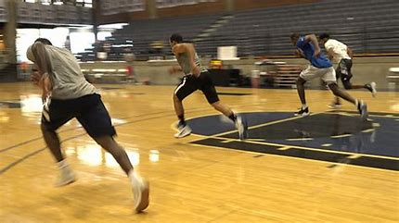
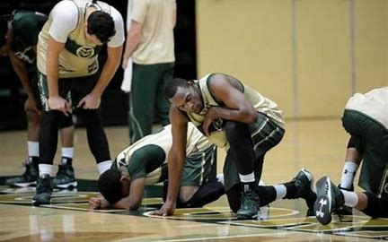
What’s the most hated Basketball drill?
Which drill best equips the players for the pace and nature of the Game?
Notes:
See also Ecclesiastes 7:8; Galatians 5:22.

Slide 21
3. Satan uses the Seduction of the Short cut.
A. Remember the Temptation of Jesus? Mt 4:
1) “Lust of the flesh”: You’re hungry:
Feed yourself. Vs 3,4
2) “Lust of the Eyes” I’ll give you the world.
“Provide for yourself!”
3) “Pride of life” Jump from the Temple:
Prove yourself. 5-7
This is the nature of Temptation. (1 Jn 2:15,16)
Notes:
See also Ecclesiastes 7:8; Galatians 5:22.

Slide 22
3. Satan uses the Seduction of the Short cut.
B. In answering each temptation, Jesus
shifted the focus off of “himself”
and back to God!
4:4 “Man shall not live by bread alone, but by every word that proceedeth out of the mouth of God.”
4:7 “thou shalt not tempt the Lord thy God.”
4:10 “Thou shalt worship the Lord thy God,
and him only shalt thou serve.”
Notes:
See also Ecclesiastes 7:8; Galatians 5:22.

Slide 23
“Charity Suffereth Long”
Heb. 10:36 “Ye have need of patience
Hypomonē: Cheerful (hopeful) endurance
that after ye have done the will of God,
ye might received the promise.
38 “Now the just shall live by faith”
Notes:
See also Ecclesiastes 7:8; Galatians 5:22.

Slide 24
“Charity Suffereth Long”
Patience is cooperating with God’s purposes
and the people/problems He’s using to accomplish them (Ro. 8:28,29),
without giving Him (or others)
a deadline to remove them!
Notes:
See also Ecclesiastes 7:8; Galatians 5:22.

Slide 25
Example of longsuffering (Patience)
James 5:10-11 “Take… the prophets, who have spoken in the name of the Lord, for an example of suffering affliction, and of patience…
we count them happy
(makariz’ō: blessed, fortunate)
which endure.”
(hypomenō: Remain under pressure)

Slide 26
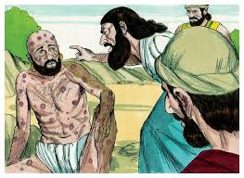
Example of longsuffering (Patience)
James 5:11 Ye have heard of the patience of Job,
and have seen the end of the Lord;
that the Lord is very pitiful, and of tender mercy.”

Slide 27
Example of longsuffering (Patience)
Job 23:10,14 “He knoweth the way that I take,
when He hath tried me,
(proved, examined, tested)
I shall come forth as gold...
For he performeth the thing
that is appointed for me.”
(ḥōq: necessary)

Slide 28
Example of longsuffering (Patience)
The Chinese Bamboo tree doesn’t break through the ground for the first four years.
It’s not until the 5th year that the first “sign” of growth occurs:
Then, In a period of just six weeks,
it can grow up to 90 feet!

Slide 29
Example of longsuffering (Patience)
This is only possible because of how deep the root system had developed over the previous 4 years!

Slide 30
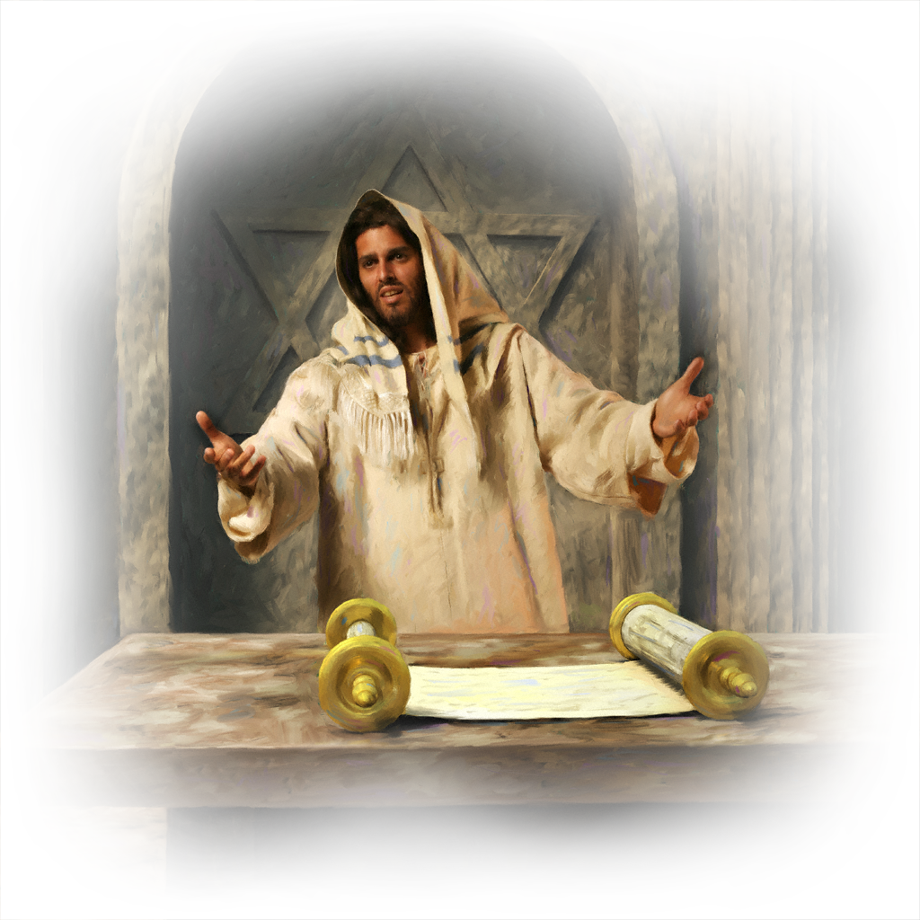
Jesus’ first sermon text: Isaiah 61
“the LORD hath anointed me to …
to bind up the brokenhearted…
To give them beauty for ashes…
Joy for mourning;
praise for heaviness”

Slide 31
Jesus’ first sermon text: Isaiah 61
Is 61:3 “That they might be called
trees of righteousness,
the planting of the LORD;
That He might be glorified!”
Trees take Time!

Slide 32
Application
Will you, like Job, “Trust” Christ enough to give Him the time and opportunity to
“perform the thing that is appointed
(Necessary) for you.”
“In that day that I make up my jewels”
Malachi 3:17

