Slide 1
John 10:10
“The thief cometh…, to steal… to kill,
and to destroy:”
“I am come that they might have life, and that …more abundantly.”

Slide 2
Satan is a master of deception.
2 Cor. 11:14
(Gen. 3:1; 2 Cor. 4:4; John 8:44)

Slide 3
God plants “eternity” in each heart.
Eccl. 3:1,11 “To every thing there is a season, and a time to every purpose under the heaven…
He hath made every thing beautiful in his time:
also he hath set the world in their heart…”
(olam: eternity)
This means that while God has placed us in time,
He has also placed the awareness (hunger) for eternity in our hearts.
Satan seeks to “satisfy” that hunger using disappointing (worldly) distractions.

Slide 4
This is ultimately what he offered Eve!
Gen. 3:5 “For God doth know that in the day ye eat thereof, then your eyes shall be opened, and ye shall be as gods, knowing good and evil.
“know” (yadah) “designating or determining.”

Slide 5
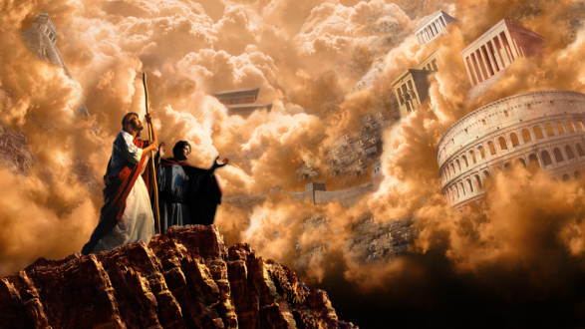
As the “god of this world”, he still uses the things of this world to distract us from focusing on the things of Eternity.
Luke 4:6-7 “All this power will I give thee,
and the glory of them: for that is delivered unto me;
and to whomsoever I will I give it.
If thou therefore wilt worship me,
all shall be thine.”

Slide 6
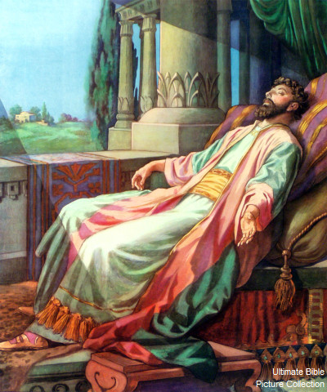
While he failed to seduce Jesus,
he has a much better track record with others!
This includes the “wisest” mortal who ever lived!
Solomon started out humbled by God’s blessing.
After offering 1,000 burnt offerings at Gibeon:
“In that night did God appear unto Solomon, and said unto him, Ask what I shall give thee?”
“Give me now wisdom and knowledge.. for who can judge this thy people,
that is so great?”
2 Chron. 1:7-10

Slide 7
God abundantly answered this prayer!
2 Chr. 1:11-12 ”Because this was in thine heart, and thou hast not asked riches, wealth, or honor, nor the life of thine enemies, neither yet hast asked long life; but hast asked wisdom and knowledge for thyself, that thou mayest judge my people, over whom I have made thee king:
Wisdom and knowledge is granted unto thee;
and I will give thee riches, and wealth, and honor,
such as none of the kings have had that have been before thee,
neither shall any after thee have the like.”

Slide 8
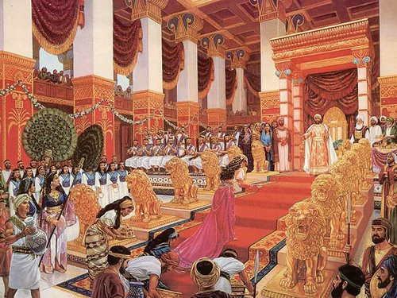
“the LORD magnified Solomon exceedingly…
and bestowed upon him such royal majesty as had not been on any king before him…”
1 Ch 29:25

Slide 9
Satan sought to “seduce” Solomon using the things of this (his) world.
Solomon began to focus on his own Kingdom and used his vast “wisdom” and “resources” to pursue meaning and satisfaction “under the sun.”
He journals his “journey” in Ecclesiastes.
Let’s examine some of the paths he thought would bring satisfaction.

Slide 10
Looking for “Life” in all the wrong places!
Eccl 1:12-14 “I …was king over Israel… And I gave my heart to search out by wisdom concerning
all things that are done under heaven.
I have seen all the works that are done
under the sun;
Solomon sought “peace” through:
1. Pleasure. Ecclesiastes 2:1-3
“I will prove thee with mirth, therefore enjoy pleasure: and, behold, this also is vanity.”

Slide 11
Looking for “Life” in all the wrong places!
Pleasure.
A. God is the very source of pleasure. Ps 16:11
“Thou wilt shew me the path of life:
in thy presence is fulness of joy; at thy right hand
there are pleasures for evermore.”
Nāʿîm: delights!
B. Satan uses temporary “pleasures” to tempt us.
1) Moses recognized this! Hebrews 11:25,26
“Choosing rather to suffer affliction with the people of God, than to enjoy the pleasures of sin for a season;
For he had respect unto the recompense of the reward.”

Slide 12
Looking for “Life” in all the wrong places!
Pleasure.
B. Satan uses temporary “pleasures” to tempt us.
2) Solomon fell into this trap. Ecclesiastes 2:10
“whatsoever mine eyes desired I kept not from them,
I withheld not my heart from any joy”
Śimḥâ’: pleasure
He used his power, position, and possessions to to pursue his pleasure,
and he did with a passion!

Slide 13
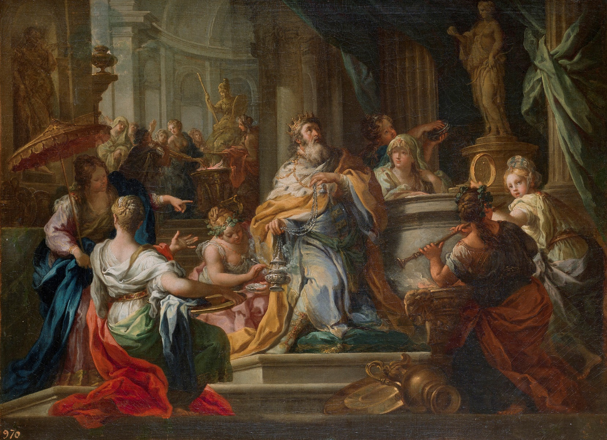
Looking for “Life” in all the wrong places!
Pleasure.
B. Satan uses temporary “pleasures” to tempt us.
2) Solomon fell into this trap. 1 Kgs 11:1,3,4
“Solomon loved many strange women…
he had 700 wives, princesses, and 300 concubines:
This “dream” turned into a nightmare!
and his wives turned away his heart after other gods…”

Slide 14
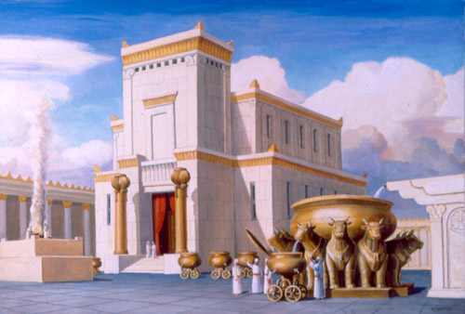
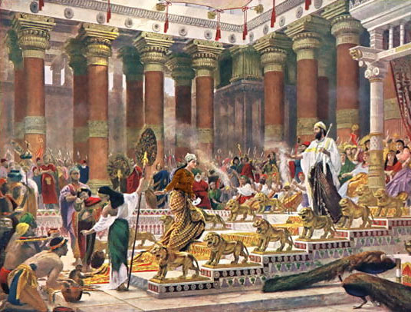
Looking for “Life” in all the wrong places!
2. Production. (accomplishment) Eccl 2:4-6,10
“I made me great works; I builded me houses…”
for my heart rejoiced in all my labor:
and this was my portion of all my labor.”

Slide 15
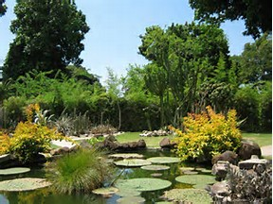
Looking for “Life” in all the wrong places!
2. Production. Eccl 2:4-6 “I planted me vineyards:
I made me gardens and orchards, and I planted
trees in them of all kind of fruits: I made me pools
of water, to water therewith the …trees”

Slide 16
Looking for “Life” in all the wrong places!
3. Profit/possessions: Ecclesiastes 2:7-9
“I got me servants and maidens, …also I had great possessions …above all that were …before me:
I gathered me also silver and gold, and the peculiar treasure of kings and of the provinces:
I gat me …the delights of the sons of men…
So I was great,
and increased more than all that were before me”

Slide 17
Looking for “Life” in all the wrong places!
A. Consider his income from Gold alone.
1) 120 Talents from King Hiram. 1 Kings 9:14
2) 420 Talent of Gold from Ophir. 1 Kings 9:27-28
3) 120 talents of God from the Queen of Sheba. 2 Chr. 9:9
4) Annual Tribute money: 1 Kings 4:21 “Solomon reigned
over all kingdoms from the river unto the land of the
Philistines, and unto the border of Egypt: they brought
presents, and served Solomon all the days of his life.”
5) Countless amounts from others. 1 Kings 10:24-25
“And all the earth sought to Solomon, to hear his wisdom, which God had put in his heart. And they brought every man his present, vessels of silver, and vessels of gold, and garments, and armor, and spices, horses, and mules, a rate year by year.”

Slide 18
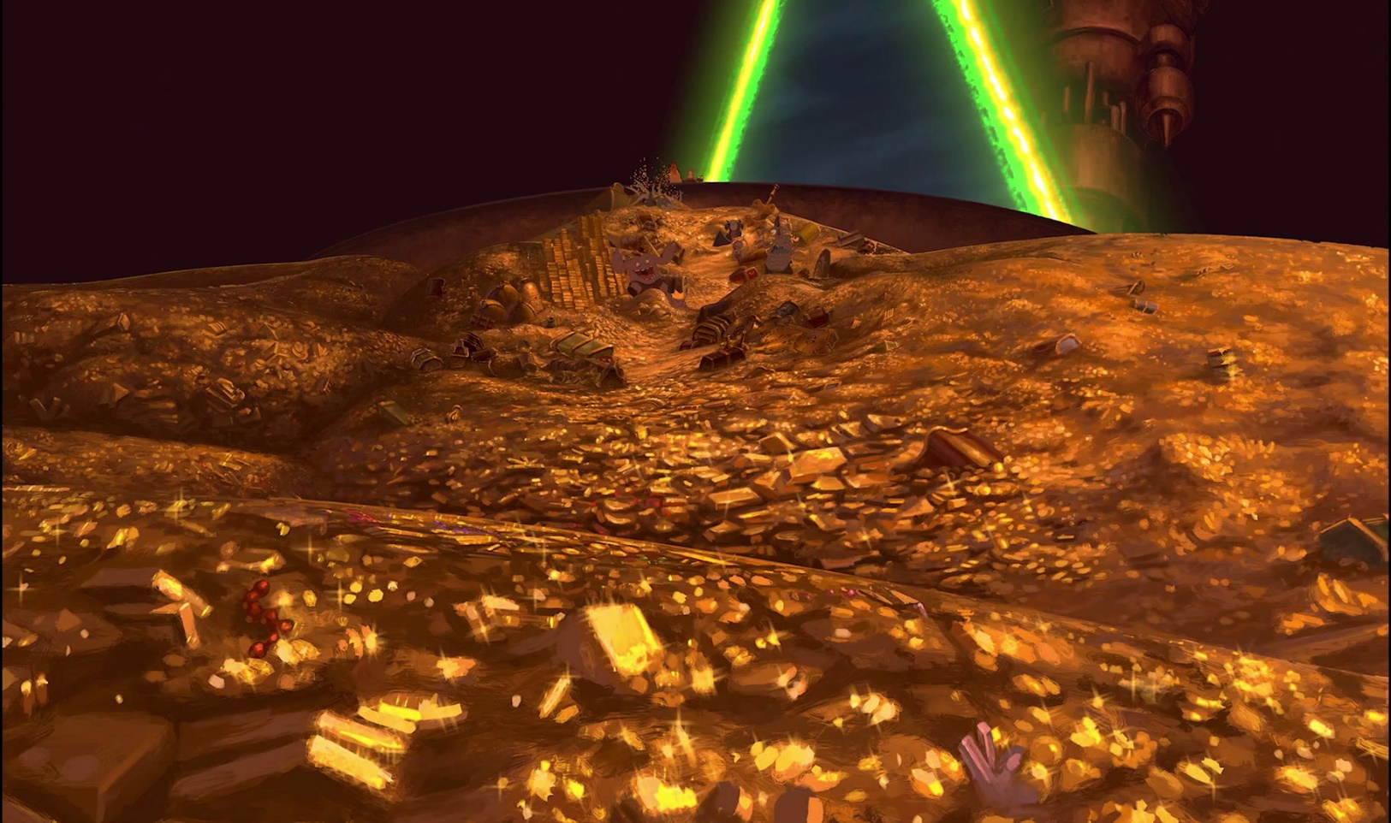
Looking for “Life” in all the wrong places!
3. Profit/possessions: 1 Kings 10:14
“Now the weight of gold that came to Solomon in one year was six hundred threescore and six talents of gold…”
One talent = 75 pounds!
666 talents each year = 50,000 pounds of gold.
At current value, that’s almost 1 Billion $ each year!
He ruled 40 years:
That’s 32,000,000 ounces of Gold!

Slide 19
Looking for “Life” in all the wrong places!
Solomon had almost unlimited:
Authority
Ability
Opportunity
Resources
With which to find “fulfilment”.

Slide 20
What did he find on his “search for significance”?
Sin’s Pleasure is “seasonal”:
He learned (too late) the truth that the pleasures of sin are “seasonal”. Heb. 11:25
Eccl 12:5 “desire shall fail: because man goeth to his long home…”
1 Jn. 2:17 “and the world passeth away, and the lusts thereof…”

Slide 21
What did he find?
2) Production also left him empty.
2:11,17-19 “Then I looked on all the works that my hands had wrought…. and, behold, all was vanity and vexation of spirit, there was no profit under the sun…
Therefore I hated life; …for all is vanity and vexation of spirit. Yea, I hated all my labor which I had taken under the sun: because I should leave it unto the man that shall be after me.
And who knoweth whether he shall be wise or a fool? yet shall he have rule over all my labor.
This is also vanity!”

Slide 22
What did he find?
3) Profit/Possessions are frustrating.
Eccl 5:10 “He that loveth silver shall not be satisfied with silver; nor he that loveth abundance with increase: this is also vanity.”
1 Timothy 6:9 “they that will be rich fall into temptation and a snare, and into many foolish and hurtful lusts, which drown men in destruction and perdition.”

Slide 23
What did he find?
By the end of his journey he realized that death was inevitable and wrote that pursuing “life under the sun” was:
“Vanity of vanities, saith the preacher; all is vanity.”
Ecclesiastes 12:8

Slide 24
Solomon was indeed the wisest man “under the sun”.
Far to many are following such “wisdom” and will find (with Solomon) that they’ve built their lives on the “wood, hay, and stubble.”
of worldly wisdom. (1 Cor 3:10-15)
1 Cor. 3:19 “the wisdom of this world is foolishness!”
Matthew 12:42
“The queen of the south … came from the uttermost parts of the earth to hear the wisdom of Solomon; and,
behold, a greater than Solomon is here.”

Slide 25
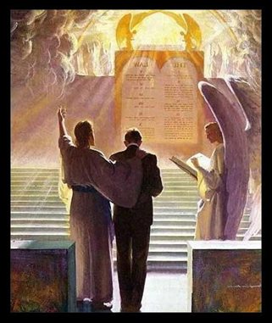
So what’s the Point?
Ecclesiastes 12:13-14
“Let us hear the conclusion of the whole matter:
Fear God, and keep his commandments:
for this is the whole duty of man.
For God shall bring every work into judgment,
with every secret thing,
whether it be good,
or whether it be evil.”

Slide 26
Application:
Solomon “wasted” most of his life in the vain pursuit of purpose “under the sun”,
only to realize that it’s what’s
“beyond the sun” that really mattered!
Mt 6:31-33 “Therefore take no thought, saying,
What shall we eat? or, What shall we drink? or, Wherewithal shall we be clothed?
For after all these things do the Gentiles seek: for your heavenly Father knows that ye have need of all these.
But seek ye first the kingdom of God, and his righteousness; and all these shall be added unto you.”

Slide 27
How do we “cross over” to experience the “abundant life” of which Jesus Spoke?
“I am come that they might have life,
and that …more abundantly.”
Jn. 10:10
“My sheep hear my voice, and I know them,
and they follow me…” John 10:27

Slide 28
Instead of pursuing temporary purpose “under the sun”, why not find it
by walking “with the Son”?
“Come unto me, all ye that labor and are heavy laden,
and I will give you rest. (Refresh)
Take my yoke upon you, and learn of me; for I am meek and lowly in heart:
and ye shall find rest unto your souls.
For my yoke is easy,
Chrēstos: usefully employed.
and my burden is light.”
Mt 11:28-30

