Slide 1
Part 2: Gideon Judges 6

Slide 2
God’s Image contains a perfect blend of both “Strength and Beauty”.
“The LORD thy God in the midst of thee is mighty; he will save, he will rejoice over thee with joy; he will rest in his love, he will joy over thee with singing.”
(Zeph. 3:17)
Many of those elements are reflected in his creation. (Gen. 1:27)

Slide 3
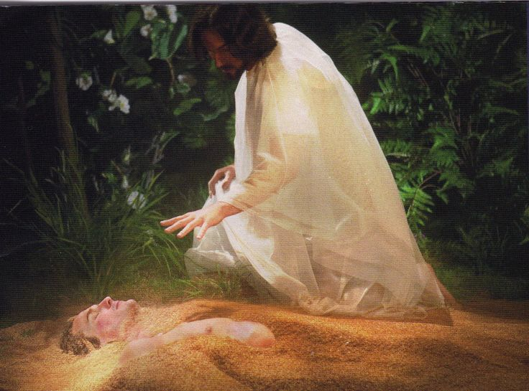
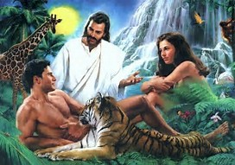
Gen 1:26 “Let us make man in our image, after our likeness:
“So God created man in his own image
Male and Female created He them.”
Gen. 1:27

Slide 4
Since “beauty” is more comfortable (safer) than “strength”, we tend to admire the gentler aspects of God’s (&man’s) nature
and avoid the more “difficult” and “dangerous” aspects of strength.
God often refers to himself as a Warrior!
(Zeph. 3:17; Ex. 15:3; Isaiah 42:13,
Jer. 20:11, Rev. 19:11-21)

Slide 5
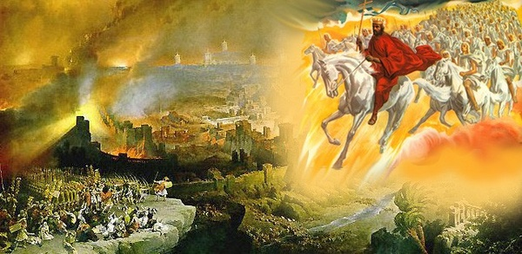
2 Thess 1:7-9 “to you who are troubled rest with us, when the Lord Jesus shall be revealed from heaven with his mighty angels,
In flaming fire taking vengeance on them that know not God, and that obey not the gospel of our Lord Jesus Christ:
Who shall be punished with everlasting destruction from the presence of the Lord, and from the glory of his power;”

Slide 6
Why is it important that we have a complete (and correct) view of God?
Because we “become” like what we “believe and behold” 2 Cor. 3:18
“Many people succeed when others don’t believe in them;
but rarely do people succeed when they don’t believe in themselves.” (Herb True)

Slide 7
GOD BELIEVES IN YOU!
That’s why He challenges us to reach beyond ourselves and our “natural” abilities and
embrace His! 2 Tim. 2:1,2
“be strong in the grace that is in Christ…
endure hardness as a good soldier of Jesus..”

Slide 8
God sees you, not just as you are,
but as a He created you to be:
A Champion! A mighty WARRIOR!
How do we get from where (what) we are to where (what) God designed us to be?
How does God transform
A “wimp” into a “warrior”?
A “civilian” into a “champion”?

Slide 9
God provides an example of this in Gideon.
His Condition Judges 6:1-9
A. Sin led to suffering. (Pain)
1) Midianites dominated Israel.
2) They always “invaded” during harvest.
B. Suffering led to supplication! (Prayer)
Vs 6 “Israel was greatly impoverished…;
and the children of Israel cried unto the LORD.”

Slide 10
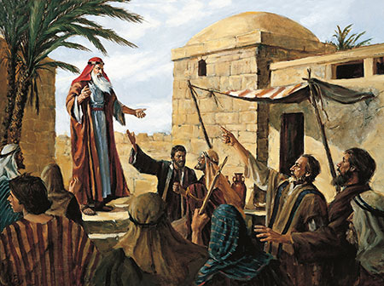
His Condition Judges 6:1-9
C. Supplication led a sermon! Vs 7-9 (Prophet)
1) Remember past blessings. vs 8,9
2) Repent of current sins. vs 10
“I am the LORD your God
… but ye have not obeyed my voice.”

Slide 11
1. His Condition.
D. The “Sermon” led to a solution. Gideon!
1) God found him “hiding” while working. 11.
2) God called him a “Mighty Man of Valor” 12
a) “Mighty”: gibbôr (powerful warrior)
b) “Valor”: Ḥayil (force)
3) Gideon responded with Frustration. 12
“Why isn’t God doing something here?”

Slide 12
2. His Commission. Judges 6:14-16
“And the LORD looked upon him, and said, Go in this thy might, and thou shalt save Israel from the hand of the Midianites:
have not I sent thee?
A. The Commission (Challenge) always
comes before the Confidence!
1) He felt “unqualified” Vs 15

Slide 13
B. God saw more in Gideon than he did.
1) Gideon felt weak –
God saw him as strong!
2) Gideon felt unqualified –
God saw him as perfect for the job!
3) Gideon felt insecure –
God saw him with boldness to lead!

Slide 14
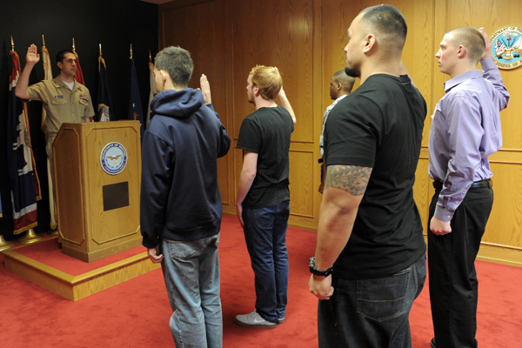
C. Committing precedes “equipping”!
Vs 16 “Surely I will be with thee”
1) Vs 24 “Then Gideon built an altar there unto the LORD, and called it Jehovahshalom”
(The Lord is my peace)

Slide 15
3. His Challenge.
A. It had to start at Home! 6:25-26
“throw down the altar of Baal that thy father hath, and cut down the grove that is by it:
And build an altar unto the LORD thy God upon the top of this rock, in the ordered place,
and offer a burnt sacrifice with the wood of the grove which thou shalt cut down.”

Slide 16
3. His Challenge.
A. It had to start at Home! 6:25-26
B. Gideon’s choice produced:
1) Conflict. 31 “Will ye plead for Baal?
…let him plead for himself”
2) Change. 32 “that day he called him
Jerubbaal, saying, Let Baal plead against him”

Slide 17
C. He was beginning to learn the truths
about himself and his God!
1 Jn. 4:4 “Ye are of God, little children, and have overcome them:
because greater is he that is in you,
than he that is in the world.”
2) Ro 8:31 “If God be for us,
who can be against us?

Slide 18
3) Ps 46:1 “God is our refuge and strength,
a very present help in trouble.”
a) He’s not just around;
He’s living inside of you (1 Jn 4:4).
You can’t get more “present” than that!

Slide 19
D. God sees us, not just as we are,
But as He made us to be!
1) God called Gideon “a mighty man of valor”
While he was hiding in fear!
2) God told Abraham he’d be the Father of
many nations, before his first child!
Gen. 12:2; 17,5 “I have made thee a father
of many nations”

Slide 20
Conclusion:
1) We serve the same God! Eph 1:3-5 “God … hath blessed us with all spiritual blessings in …Christ: According as he hath chosen us in him before the foundation of the world,
that we should be holy and without blame before him in love:

Slide 21
2) He’s already provided everything we need!
2 Pt 1:3-4 “According as his divine power hath given unto us all things that pertain unto life and godliness, through the knowledge of him that hath called us to glory and virtue:
Whereby are given unto us exceeding great and precious promises: that by these ye might be partakers of the divine nature, having escaped the corruption that is in the world through lust.

Slide 22
3) We have to cooperate with Him for victory!
2 Pt 1:5-8 “And beside this, giving all diligence, add to your faith virtue; and to virtue knowledge…temperance…patience…
godliness… brotherly kindness…charity.
For if these things be in you, and abound, they make you that ye shall neither be barren nor unfruitful in the knowledge of our Lord…”

Slide 23
4) There’s consequences for being AWOL!
2 Pt 1:9-10 “But he that lacketh these things is blind, and cannot see afar off, and hath forgotten that he was purged from his old sins.
Wherefore the rather, brethren, give diligence to make your calling and election sure:
5) There’s great honor for faithfulness!
for if ye do these things, ye shall never fall:
11 For so an entrance shall be ministered unto you abundantly into the everlasting kingdom of Christ. ”

Slide 24
God sees what he made us to be!
In Romans 8:37 God says:
“We are more than conquerors
through him that loved us”
Not, “will be, could be, might be, someday be”
WE ARE RIGHT NOW!!!
We need to start believing and behaving like it!

Slide 25
1) Conquerors are meant to Conquer!
➔What do you need to combat and
conquer in your life?
➔To conquer it you must confront it!
1 Sam 17:48 “when the Philistine arose,
…that David hasted, and ran toward
the army to meet the Philistine.”

Slide 26
2) God made you in “His Image” to be a
“Mighty Man of Valor”.
Satan knows (and fears) this!
Mt 12:29-30 “how can one enter into a strong man's house, and spoil his goods, except he first bind the strong man? and then he will spoil his house.”
What’s Satan using to “bind you”?
That’s your first battle!

Slide 27
3) Are We that different from Gideon?
Have we forsaken God in our land?
Are we honoring “idols”?
(Even in our own homes?)
Has Satan “bound” the strong men?
Is God still searching for “Gideons” to find freedom and to “step up” and fight for His Cause?

Slide 28
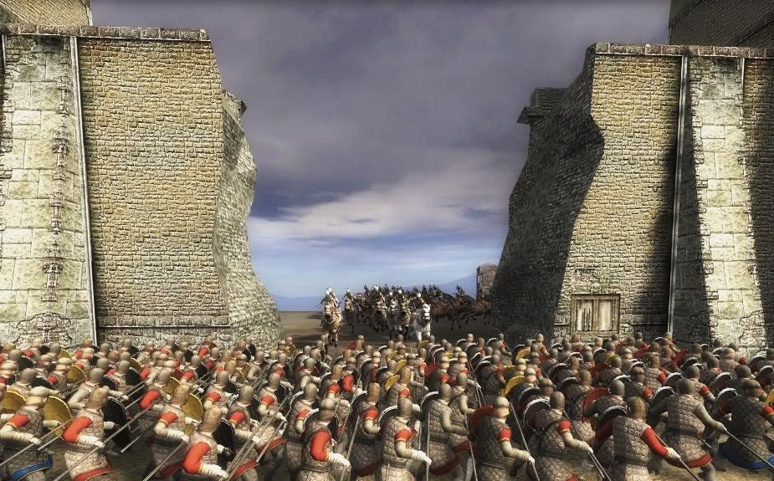
“And I sought for a man among them, that should make up the hedge, and stand in the gap before me for the land,
that I should not destroy it:
“But I found none!”
Ezek. 22:30

Slide 29
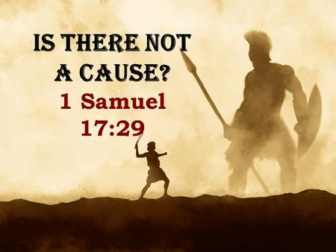
Are you willing to step up and fight for it?

