Slide 1
Matthew 11:7-15

Slide 2
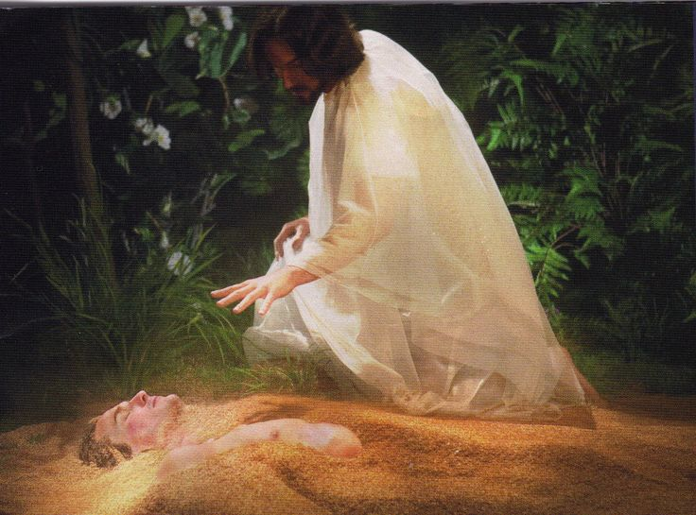
Gen 1:26 “Let us make man in our image,
after our likeness”

Slide 3
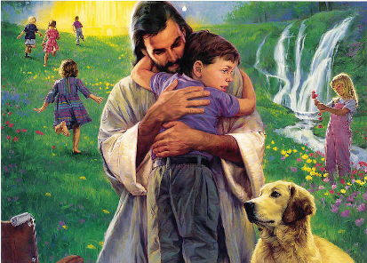
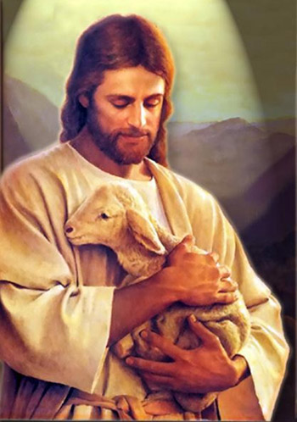
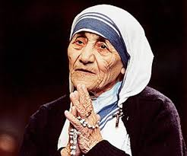
What do you think of when you think of “God’s Image?”
Many view Christianity as a type “Mother Teresa”.
Heavy on Giving, Grace, Gentleness, Goodness, etc.
Many of the popular “pictures” of Jesus reinforce this “image”.
While these are a part of God’s “image”,
they’re not the whole picture.

Slide 4
Gen 1:26 “Let us make man in our image, after our likeness:
and let them have dominion..”
Rādâ’: to conquer or subjugate.

Slide 5
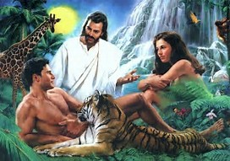
Vs 27 “So God created man in his own image
Male and Female created He them.
That means that there will be qualities in both men and women that express different dimensions of God’s “image”.

Slide 6
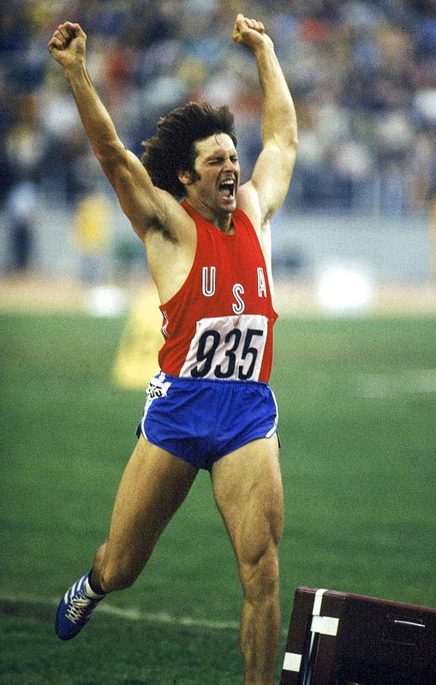
There’s been a deliberate “feminization”
of Men in our culture for decades.
This devaluing of masculine qualities leaves men uncertain or even ashamed of how God made them!
Bruce Jenner 1976

Slide 7
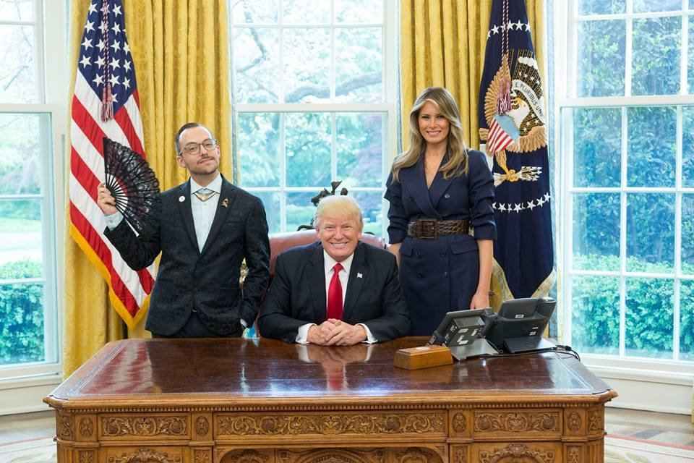
2017 Teacher of the Year
Nikos Giannopoulos

Slide 8
This cultural confusion has subtly found
it’s way into the culture of the church!
1. According to Biola research
“The feminization of the church” (Holly Pivec)
A. Women greatly outnumber men in churches.
They’re Generally more “faithful”/ committed.
23% of women attend without their husbands.

Slide 9
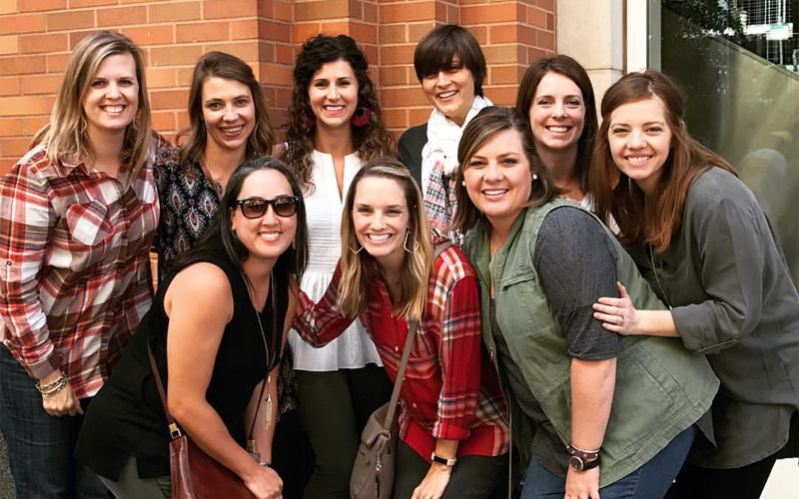
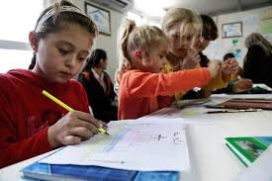
“The feminization of the church” (by Holly Pivec)
B. Most church ministries are geared for women
(Generally middle aged or older) or children.
C. Women tend to respond to security, comfort,
peace, nurturing, healing, relationships, etc.

Slide 10
Since these are legitimate needs, Churches “naturally” seek to meet these needs by focusing on these dimensions of God’s nature.
While comfort, nurture, and security are important qualities, this “culture” often leaves men feeling that church is the place where you go to learn to be “nice”. (Tame)

Slide 11
While Women respond more to nurture, healing, peace,
2. Men respond to challenge, risk, competition, etc.
A. These different “perspectives” (and strengths)
tend to be viewed as “uncomfortable” or even
detrimental to the “status quo”. (Nurturing, etc.)
1) These masculine “attributes” seem to conflict
with the “gentler” attributes of God.
2) As a result, the “needs” or strengths of men
are often minimized by churches.

Slide 12
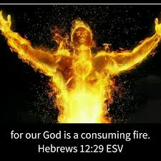
“For our God is a consuming fire.”
B. There’s a distinctly “dangerous” dimension to God’s nature! Heb 12:28-29
“let us have grace, whereby we may serve God acceptably with reverence and godly fear:

Slide 13
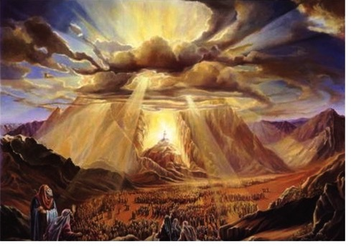
Heb 10:31 “It is a fearful thing to fall into the hands of the living God.”

Slide 14
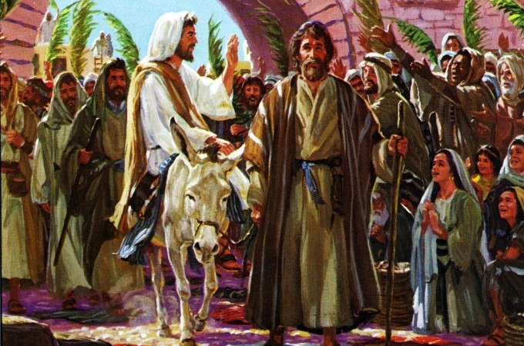
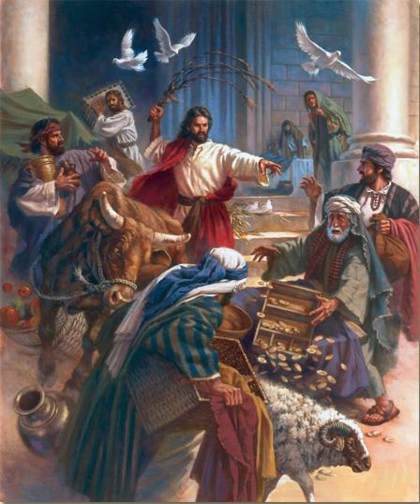
Zeph 3:17 “The LORD thy God in the midst of thee is mighty; (gibbôr: powerful warrior!)
he will save, he will rejoice over thee with joy; he will rest in his love, he will joy over thee
with singing.”
Mt 21:1-11
Mt. 21:12-17

Slide 15
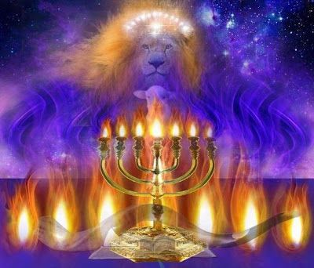
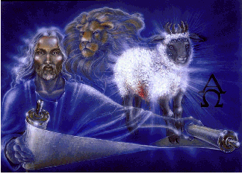
Rev 5:2-6 “who is worthy to open the book…
And I wept much, because no man was found worthy to open and to read the book, neither to look thereon…
Weep not: behold, the Lion of the tribe of Juda,
the Root of David, hath prevailed to open the book…
And I beheld, and, lo, in the midst of the throne and of the four beasts, and in the midst of the elders,
stood a Lamb as it had been slain…”

Slide 16
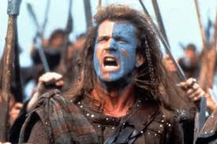
C. God is sometimes less like Mother Teresa
and more like William Wallace!
“I’m going to pick a fight!”

Slide 17
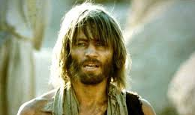
1) Jesus used John the Baptist as an example of the best of Manhood!
“Among them that are born of women
there hath not risen a
greater than John the Baptist:”
“He that hath ears to hear,
let him hear.” Mt. 11:11, 15

Slide 18
2) What Jesus said next is “alarming”!
Vs 12 “And from the days of John the Baptist until now the kingdom of heaven suffereth violence,
(biazō: to crowd, press into so as to seize)
from bia: vital force
and the violent (biastēs’: energetic)
take it by force.” (harpazō: take or seize)

Slide 19
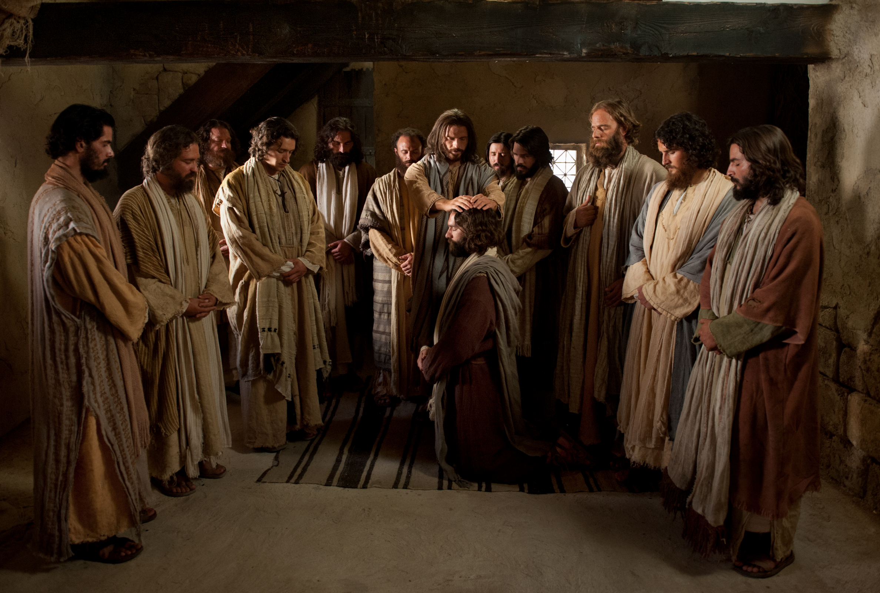
This is a very “uncomfortable” concept to most modern “Christians”.
Jesus didn’t ignore the needs of women he met,
but he invested most of his time on the men!
Mt. 4:18-22

Slide 20
1) This is still God’s pattern for the church.
“be strong in the grace that is in Christ Jesus. And the things that thou hast heard of me among many witnesses,
the same commit thou to faithful men,
who shall be able to teach others also.
Thou therefore endure hardness,
as a good soldier of Jesus Christ.”
2 Tim 2:1-3

Slide 21
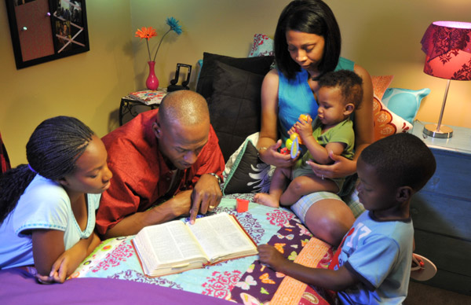
By minimizing the “masculine” strengths, we downplay a significant force for God and Good!
When a “mother” comes to Christ,
her “family” follows her 36% of the time.
When a “father” comes to Christ,
his family follows him 93% of the time!

Slide 22
Jesus is the personification of all of God’s qualities. Heb. 1:3
“Who being the brightness of his glory,
and the express image of his person,
and upholding all things by the word of his power,
when he had by himself purged our sins, sat down on the right hand of the Majesty on high;”
“Full of Grace and Truth” Jn. 1:14

Slide 23
Over the next several weeks I’d like to inject a shot of spiritual “testosterone” into our church,
by focusing on some of the more “masculine” sides of God’s image and design!

Slide 24
After commending the courage of John, challenging the hypocrites and condemning the communities that rejected him,
Jesus closes Mt. 11 with this statement:
Mt. 11:28 “Take my yoke upon you and learn of me.
I am meek (Praos: Gentle) and lowly…”
Meekness is not Weakness,
but your Strength under God’s control!

Slide 25
Are you willing to place your “Strength” under God’s Control and fight for
Your faith?
Your family?

Slide 26
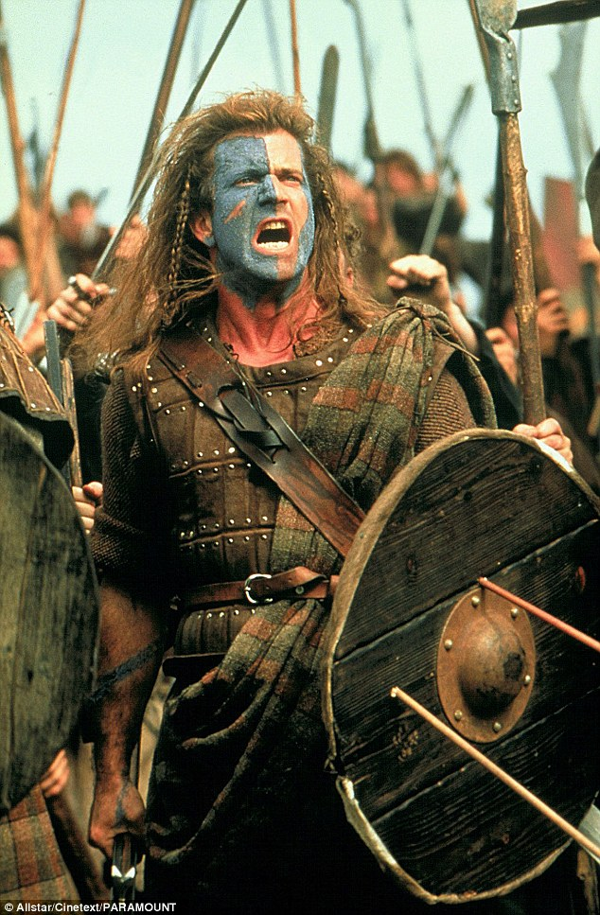
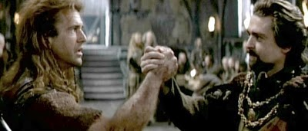
In “Brave Heart”, William Wallace challenged the injustice and corruption of his day.
He inspired “Robert the Bruce” to join him in the fight.

Slide 27
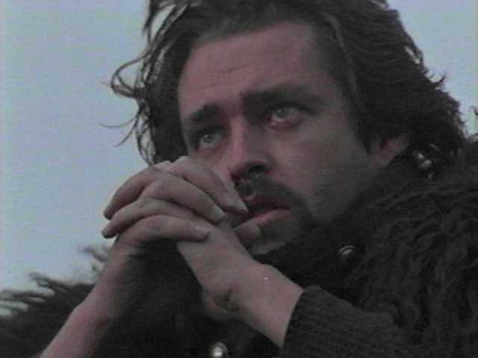
Robert betrayed William Wallace due to “political expediency.”
When his father tried to rationalize the betrayal, Robert the Bruce responded:
“Lands, titles, men, power…I HAVE NOTHING!
Men fight for me because if they do not, I throw them off my land and starve their wives and children!
Those men …fought and bled for William Wallace.

Slide 28
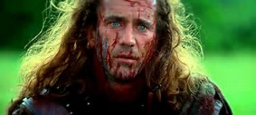
“He Fights For Something that I never had!
And I took if from him, when I betrayed him.
I saw it in his face on the battlefield,
and it’s tearing me apart!”
“I will never be on the wrong side again!”

Slide 29
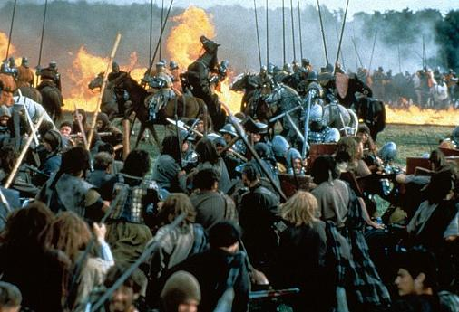
He then took up Wallace’s cause and led Scotland to freedom!

Slide 30
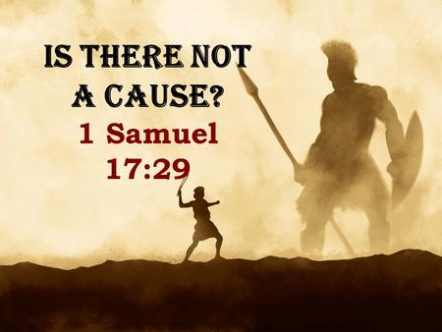

Slide 31
God made you in “His Image” to be a
“Mighty Man of Valor”.
Gideon in Judges 6:12
Satan knows (and fears) this!
Mt 12:29-30 “how can one enter into a strong man's house, and spoil his goods, except he first bind the strong man? and then he will spoil his house.

Slide 32
After warning of Satan’s plan to
“bind the strong man”,
Jesus warns in the very next verse (30) that we must take a side.
“He that is not with me is against me;
and he that gathereth not with me scattereth abroad.”

Slide 33
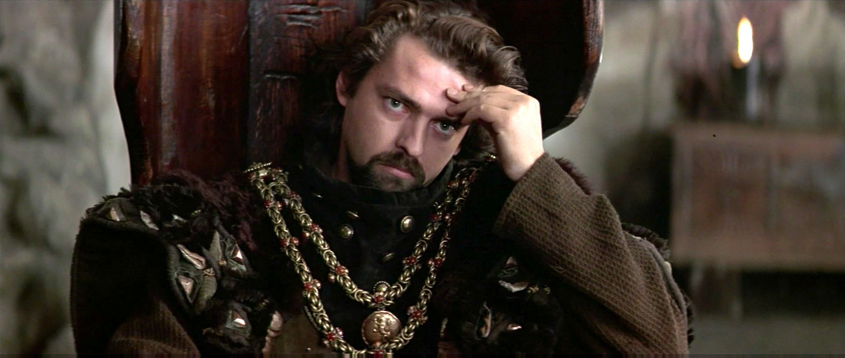
“I will never be on the wrong side again!”

Slide 34
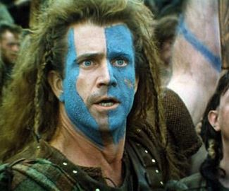
Before his death Wallace said:
“Every man dies, not every man really lives!
God makes men what they are.”
What’s God trying to make of you?

Slide 35
Am I a soldier of the cross, A follower of the Lamb,
& shall I fear to own His cause, Or blush to speak His Name?
Must I be carried to the skies On flowery beds of ease,
While others fought to win the prize,
And sailed through bloody seas?
Are there no foes for me to face? Must I not stem the flood?
Is this vile world a friend to grace, To help me on to God?
Sure I must fight if I would reign; Increase my courage, Lord.
I’ll bear the toil, endure the pain, Supported by Thy Word.
Isaac Watts 1721

