Slide 1
Navigating the New Year.
Principles for Priorities

Slide 2
How do we safely navigate through:
The deadly distractions of our day?
(The siren songs of society)
The dangerous currents of our
culture?

Slide 3
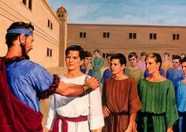
Navigating the New Year
Daniel was a young man who safely navigated the dangerous currents of a godless culture in spite of all the devil could throw at him.
Born into Jewish nobility.
Dan. 1:3 “Of the King’s seed,
and of the princes.”

Slide 4
One of the many Jewish nobility who were forcibly taken to Babylon.

Slide 5
Some were chosen with to train as counselors.
Vs 5 “the king appointed them a daily provision of the king's meat, and wine : so nourishing them three years,
that at the end they might stand before the king.
Their names (identities) were paganized!
6 Now among these were …Daniel, Hananiah, Mishael, and Azariah: ⁷ Unto whom the prince of the eunuchs gave names: for Daniel (God is my judge)
the name of Belteshazzar; (Bel protects him)

Slide 6
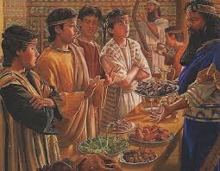
Most of the Jewish youth were relieved and even thrilled with the accommodations.
Daniel was different!
8 ”But Daniel purposed in his heart that he would not defile himself with the king's meat”

Slide 7
Pr. 29:18 "Where there is no vision,
the people perish"
Vision: Ḥāzôn; : mental sight or goal
from ḥāzâ’ to gaze at (with purpose) to contemplate.
Perish: pāraʿ: to turn back, dismiss
Most of the other Jews “dismissed” God’s law in order to get along and even ahead.
Daniel stayed focused on his purpose
to honor and please God!

Slide 8
The power of a prudent purpose
1. Most lack a clear, compelling Purpose!
They’re basically in a survival mode.
1) Their Personal protection, peace & provision
are their highest priority.
2) This may produce temporary pleasure (Heb 11:25)
but ultimately brings lasting pressure.

Slide 9
1. Most Have No Clear, compelling Purpose!
B. Without A Clear Destination, it’s
Difficult To Determine Direction or Drift!
1) Are you closer to your (or God’s) goals now
than you were last January?
2) Many confuse activity with productivity!
Most are busy producing “wood, hay, and stubble”
thinking it’s “gold, silver, precious stones”
(Mt. 7:26,27; 1 Cor. 3:12-15; Phil 3:17-20)

Slide 10
Without a clear, compelling goal
we’re like a ship without a rudder.
We will drift (with the currents of culture)
Or be blown about
(with the winds of circumstances)
but not drive toward a safe and fulfilling destination.

Slide 11
2. Some Have A Purpose That’s short-
sighted (Temporary) and Vain!
A. "Under the sun" is found 29x in Eccl.
Eccl 1:14 “I have seen all the works that are done under the sun; and, behold,
all is vanity (hebel: empty, unsatisfying)
and vexation (reʿût) of spirit.”
(Feeding on or reaching after emptiness!)

Slide 12
B. Solomon climbed The Ladder Of Success,
to find it Leaning Against The Wrong Building!
1) Pleasure. Ecc. 2:1 “I enjoyed pleasure"
2) Possessions Verse 3-6 “gathered silver and gold”
3) Pride Verse 7-8 “I was great…”
2:11 “Then I looked on all the works that my hands had wrought, and on the labor that I had
behold, all was vanity and vexation of spirit,
and there was no profit under the sun.”

Slide 13
Ecclesiastes 12:13-14
“Let us hear the conclusion of the whole matter: Fear God, and keep his commandments:
for this is the whole duty of man.
For God shall bring every work into judgment, with every secret thing,
whether it be good, or whether it be evil.”
Daniel means “God is my Judge!”

Slide 14
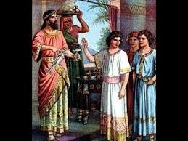
Most have no clear purpose (beyond themselves)
Some have temporary (empty) purposes
Few have a Prudent (eternal) Purpose.
Daniel 1:8 “Daniel purposed in his heart
Śûm: to put down, appoint, determine, commit!
not to defile himself with the King’s meat…or wine”

Slide 15
A. The issue wasn’t his diet,
But his determination to honor God!
He filtered every decision through this!
Pr. 3:6 “In all your ways acknowledge (know) Him,
And He shall direct
thy paths”

Slide 16
Proverbs 29:18
“Where there is no vision, the people perish:
but he that keepeth the law, happy is he.”
Keepeth (Shāmar) guards, protects, values
Happy (ʾesher) blessed: from āshar’
To make or keep straight, prosper or push forward!
Phil 3:14 “I press toward the mark for the prize of the high calling of God in Christ Jesus.”
What “mark” has God called you to pursue?

Slide 17
We never hear again about the other Jews who “went along to get along”.
17 But As for these four,
(Daniel and his friends)
God gave them knowledge and skill in all learning and wisdom:
and Daniel had understanding
in all visions and dreams.

Slide 18
19 And the king communed with them;
and among them all was found none like Daniel, Hananiah, Mishael,
and Azariah:
therefore stood they before the king.

Slide 19
Which best describes you:
No Clear compelling purpose?
A temporary, ultimately vain purpose?
A Prudent, eternal purpose?
“”Only one life will soon be passed,
Only what’s done for Christ will last.”

Slide 20
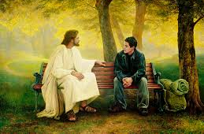
Mt. 16:24 “If any will come after me, let him deny himself, take up his cross,
and follow me.
25 For whosoever will save his life
shall lose it:
whosoever will lose his life for my sake
shall find it.”

Slide 21
26 For what is a man profited, if he shall gain the whole world,
and lose his own soul?
or what shall a man give in exchange for his soul?”

