Slide 2
“Star wars” is one of the most popular movie ideas of modern times.
9 movies over the span of 40 years!

Slide 3
It is so popular because it’s so “relatable”.
We all struggle with the “dark side”!

Slide 4
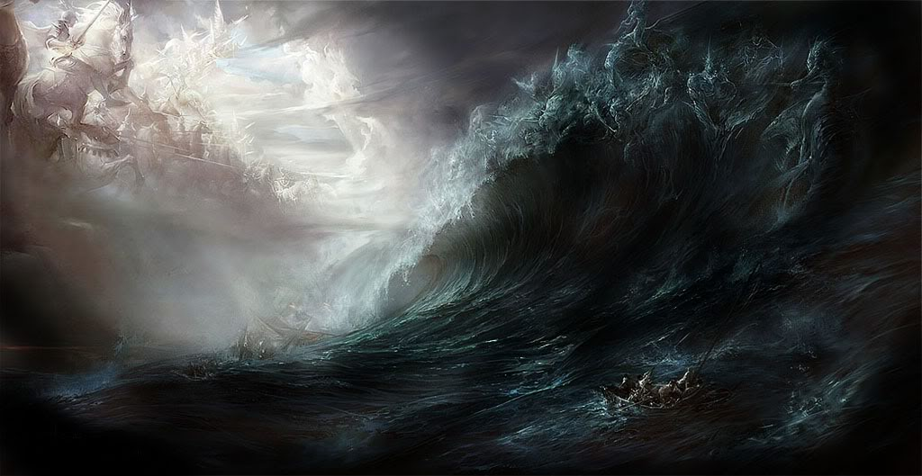
There’s an epic battle between “light” and “darkness”!
And there’s really no middle ground!
Mt 12:30 “He that is not with me is against me;
and he that gathers not with me, scatters abroad.”

Slide 5
How to Overcome the “Dark Side”
Eph. 2:1-2 “And you hath he quickened, who were dead in trespasses and sins;
² Wherein in time past ye walked according to the course of this world,
according to the prince of the power of the air,
the spirit that now worketh in the children of disobedience:

Slide 6
How to Overcome the “Dark Side”
1. Acknowledge it exists in us.
Eph. 2:3 “Among whom also we all had our conversation in times past in the lusts of our flesh,
fulfilling the desires of the flesh and of the mind;
and were by nature the children of wrath,
(orge’: passion) even as others.

Slide 7
Overcoming the “Dark” Side.
1. Acknowledge it exists!
Ro 7:18-19 “For I know that in me (that is,
in my flesh,) dwelleth no good thing:
for to will is present with me; but how to perform that which is good I find not.
¹⁹ For the good that I would I do not: but the evil which I would not, that I do.
I find then a law, when I would do good,
evil is present with me.”
Ro. 3:10,23, 5:12

Slide 8
Overcoming the “Dark” Side.
1. Acknowledge it exists!
A. This is not God’s original design!
Eccl 7:29 “Lo, this only have I found,
that God hath made man upright;
but they have sought out many inventions.”
(contrivances)
Pr 19:3 “The foolishness of man perverteth his way:
and his heart fretteth against the LORD.”

Slide 9
Overcoming the “Dark” Side.
1. Acknowledge it exists!
A. This is not God’s original design!
1) God made you in His image and purposes!
(Rev. 4:11; Jer. 29:11)
2) Sin mars and distorts God’s Image/purposes.
Sin (harmartia: offence) comes from harmartano:
“to miss the mark and so
not share in the prize!”

Slide 10
Overcoming the “Dark” Side.
2. Recognize it’s destructive!
Sin always produces:
A. Decay (entropy) Gen 6:12
“God looked upon the earth, and, behold, it was corrupt;
for all flesh had corrupted his way upon the earth.”
shāḥat’: destroy 99x, corrupt 24x, mar 7x, waste 2x

Slide 11
Overcoming the “Dark” Side.
Sin always produces:
A. Decay (entropy) in our:
1) Relationships. James 4:1-3)
Is. 59:2 “your iniquities have separated you…”
Jms 4:1 “whence come wars and fightings among you?
come they not hence, even of your lusts…?

Slide 12
Sin always produces:
A. Decay (entropy) in our:
1) Relationships. (Is. 59:1-3; James 4:1-3)
2) Reasoning. (2 Cor. 4:4; Ro. 1:28)
“Even as they did not like to retain
God in their knowledge,
God gave them over to a reprobate mind”
Adok’imos: worthless, rejected!

Slide 13
Sin always produces:
B. Destruction! Matthew 7:13-14
“Enter ye in at the strait gate:
for wide is the gate, and broad is the way,
that leads to destruction, (apōleia: ruin!)
and many there be which go in thereat:
Because strait is the gate, and narrow is the way, which leads unto life,
and few there be that find it.”

Slide 14
Sin always produces:
C. Death! Ro. 6:23 “The wages of sin is death!”
James 1:15 “Sin, when it is finished,
brings forth death!”
“There is a way which seems right unto a man,
but the end thereof are the ways of death.”
Pr. 14:12; 16:25
“He that believeth not is condemned already”
Jn 3:18

Slide 15
Overcoming the “Dark” Side.
1. Recognize it exists.
2. Recognize it’s destructive.
3. Realize there’s a solution! Ro. 6:23
“The wages of sin is death,
But the gift of God is eternal life
Through Jesus Christ our Lord”

Slide 16
Overcoming the “Dark” Side.
3. Realize there’s a solution! Eph. 2
“we were by nature the children of wrath…
A. Christ (Salvation) is the Solution.
But God, who is rich in mercy, for his great love wherewith he loved us,
Even when we were dead in sins, hath quickened us together with Christ, (by grace ye are saved;)
And hath raised us up together, and made us sit together in heavenly places in Christ Jesus:

Slide 17
Jesus is “the light…(Jn 9:5), the door…(Jn 10:9)
the way, truth, life…” (Jn. 14:6)
Col 1:12-14 “Giving thanks unto the Father…
Who hath delivered us from the power of darkness,
and translated us into the kingdom of his dear Son:
In whom we have redemption through his blood,
(He paid the wages of our sin!)
even the forgiveness of sins.”
His sacrificial death satisfied God’s Justice!

Slide 18
A. Christ (Salvation) is the Solution Eph. 2
1) Salvation must be Personally applied!
⁸ ”For by grace are ye saved through faith;
(Pistis: conviction, reliance upon)
and that not of yourselves:
it is the gift of God”
But we must “choose” to receive it!
“Being justified by faith we have peace with God”
Ro. 5:1

Slide 19
A. Christ (Salvation) is the Solution Eph. 2
2) Salvation must be Practically applied! V 10
We’re Saved to Serve!
“For we are his workmanship, created in Christ
Jesus unto good (beneficial) works,
which God hath before ordained
that we should walk in them.”
We serve by sharing the light! Mt. 5:14

Slide 20
What actually “Darkens” our hearts?
1) Sin! 1 Jn. 1:5-7
“God is light, and in him is no darkness at all.
6 If we say that we have fellowship with him, and walk in darkness, we lie, and do not the truth:
7 But if we walk in the light, as he is in the light, we have fellowship one with another, and the blood of Jesus Christ his Son cleanseth us from all sin.”
(See also 1 Jn. 2:8-11)

Slide 21
2) Selfishness: Mt. 6:19-24
Between “lay up treasures in heaven” vs 21 and
“ye cannot serve God and mammon” (money) 24
22-23 “The light of the body is the eye: (focus)
if thine eye be single, (clear)
thy whole body shall be full of light. (illuminated)
²³ But if thine eye be evil, (diseased, envy, etc)
thy whole body shall be full of darkness. (obscured)
If therefore the light that is in thee be darkness, how great is that darkness!”

Slide 22
2 Cor 4:3-6 “our gospel is hid to them that are lost.
In whom the god of this world hath blinded the minds of them which believe not,
lest the light of the glorious gospel of Christ, who is the image of God, should shine unto them.
For God, who commanded the light to shine out of
darkness, hath shined in our hearts,
to give the light of the knowledge of the glory of God in the face of Jesus Christ.”

Slide 23
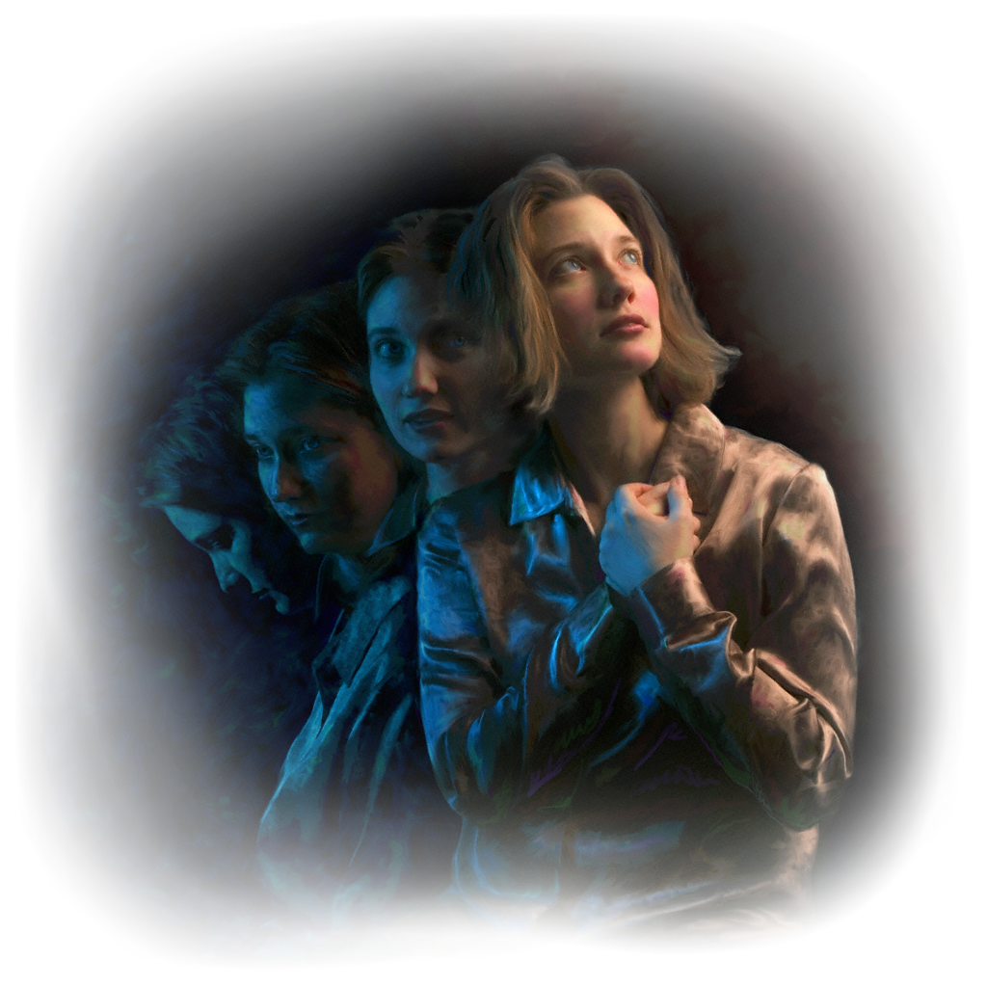
2 Cor 4:7 “But we have this treasure in
earthen vessels,
that the excellency of the power may be of God, and not of us.”

Slide 24
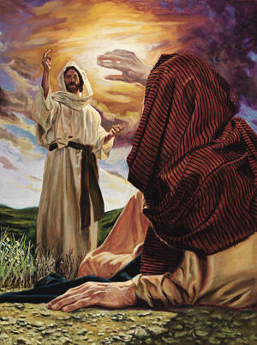
“I have appeared unto thee for this purpose,
to make thee a minister and a witness of these things which thou hast seen.
Delivering thee from the people, and the Gentiles, unto whom now I send thee,
Acts 26:16

Slide 25
To open their eyes, and to turn them from darkness to light, and from the power of Satan unto God,
that they may receive forgiveness of sins,
and inheritance among them which
are sanctified by faith that is in me.
Whereupon, O king Agrippa,
I was not disobedient unto the heavenly vision: Acts 26:17-19
Are We??????

Slide 26
Eph 5:8, 14 “For ye were sometimes darkness,
but now are ye light in the Lord:
walk as children of light:”
Wherefore he saith,
Awake thou that sleepest,
and arise from the dead,
and Christ shall give thee light.”

Slide 27
Eph 5:15-17 “See then that ye walk circumspectly, not as fools, but as wise,
Redeeming the time, because the days are evil.
Wherefore be ye not unwise, but understanding what the will of the Lord is.”

Slide 28
Are we obedient to our “Heavenly calling?”
“But ye are a chosen generation, a royal priesthood, an holy nation, a peculiar people;
that ye should shew forth the praises of him who hath called you out of darkness
into his marvelous light:
Which in time past were not a people,
but are now the people of God:”
1 Peter 2:9

Slide 29
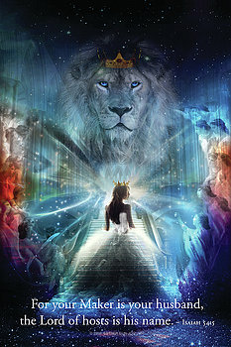
”And the Spirit and the bride say, Come.
And let him that heareth say, Come.
Let him that is athirst come.
And whosoever will,
let him take the
water of life freely.”
Rev. 22:17

Slide 30
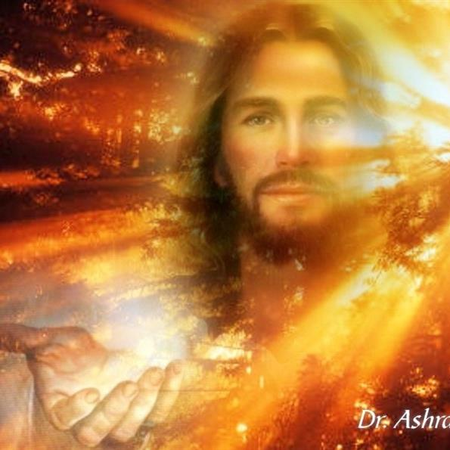
The whole world was lost in the darkness of sin.
(The Light of the World is Jesus!)
Like sunshine at noon day his glory shone in.
(The Light of the world is Jesus!)

Slide 31
“Come to the light, ’tis shining for thee;
Sweetly the light has dawned upon me;
Once I was blind, but now I can see:
The Light of the world is Jesus!”
Philip Bliss (1875)
He also wrote
the song
Almost Persuaded.

