Slide 1
God’s Plan for His People:
Unity out of Diversity.

Slide 2
“Shaped” for Service

Slide 3
God uses our differences:
To Develop us!
To Direct us!
“endeavor to keep the unity of the Spirit in the bond of peace”. Eph. 4:3
Peace involves a Partnership! (eiro: to join)

Slide 4
God has uniquely “Shaped” each of us
For His Service!

Slide 5
S: Spiritual Gifts
“Gifts’ and “Grace” 1 Peter 4:10
“As every man hath received the gift,
(char’isma: spiritual endowment)
even so minister (diakoneō: serve)
the same one to another, as good stewards
of the manifold (poikilos: different, various)
grace of God.”

Slide 6
S: Spiritual Gifts
“Gifts’ and “Grace” Romans 12:4-6
“For as we have many members in one body,
and all members have not the same office:
So we, being many, are one body in Christ,
and every one members one of another.
Having then gifts differing according to the
grace that is given to us…”

Slide 7
S: Spiritual Gifts
“Gift” char’isma:
(Spiritual Endowment)
Comes from char’is: Grace!
God’s influence on our hearts and
its reflection (manifestation) in our lives.

Slide 8
S: Spiritual Gifts
When we’re “born again” God’s Spirit:
Indwells us. (Rev. 3:21; Gal 4:4-6; Ro. 8:15,16)
Cleanses us. (Jn 16:8; Eph. 5:26; 1 Jn 1:7; Titus 3:5,6)
Seals us. (2 Cor 1:22; Eph. 1:13,14; 4:30)
Empowers (Gifts) us for Service!
Acts 1:8 ”Ye shall receive power, after that the Holy Ghost is
come upon you, and ye shall be witnesses…”

Slide 9
S: Spiritual Gifts
1 Timothy 4:14-15
“Neglect not the gift that is in thee…
Meditate upon these things; give thyself wholly to them; that thy profiting may appear to all.”
Prokopē: advancement
How might we “advance”
if we stopped neglecting God’s Gifts?

Slide 10
H: Heart (Passion)
God’s Spirit implants God’s passions in us! John 14:21
“He that hath my commandments, and keepeth them,… loveth me: and he that loveth me shall be loved of my Father, and I will love him,
and will manifest myself to him.”

Slide 11
H: Heart (Passion)
In the context of Jesus discussing the Holy Spirit in John 14
“If a man love me, he’ll keep my words: and my Father will love him,
and we will come unto him,
and make our abode with him.”
Vs 23

Slide 12
H: Heart (Passion)
Paul demonstrated this Godly passion in Gal 4:16-19
“Am I therefore become your enemy,
because I tell you the truth?...
it is good to be zealously affected (zēlo’ō: passionate) always in a good thing…
My little children, of whom I travail in birth again until Christ be formed in you”

Slide 13
H: Heart (Passion)
1 Cor 9:24-27 “Know ye not that they which run in a race run all, but one receiveth the prize?
So run, that ye may obtain.
And every man that striveth for the mastery is temperate in all things.
Now they do it to obtain a corruptible crown;
but we an incorruptible.
I therefore so run”

Slide 14
H: Heart (Passion)
How might embracing and cultivating what God is passionate about
transform our lives?

Slide 15
A: Abilities: Ps 78:70-72
“He chose David also his servant, and took him from the sheepfolds: From following the ewes great with young he brought him to feed Jacob his people, and Israel his inheritance.
he fed them according to the integrity of his heart;
and guided them by the skilfulness of his hands.”
(Tâbûwn: understanding, skill, intelligence)

Slide 16
Abilities: Psalm 78:70-72
God helps us to develop our abilities because He has some purposes for them! Ro. 8:28,29
Moses as a Wilderness shepherd (40 years)
Dorcus as a weaver. (Acts 9:36-40)
Peter as a “Fisherman”. (Mt. 5:19)
Paul as a philosopher. (Acts 17)

Slide 17
Abilities: Psalm 78:70-72
What could happen if we saw (and used) our “abilities”
in the light of Eternity?

Slide 18
Personalities: 1 Cor 4:7
God can use our unique “personalities” to “point” us in the direction of God’s plan for our lives!

Slide 19
Personalities: 1 Cor 4:7
“For who maketh thee to differ from another?”
What if we began to view our differences as stepping instead of a stumbling stones!
As Inspirations rather
than an “irritations”!

Slide 20
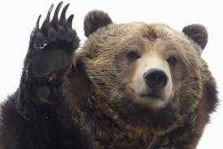
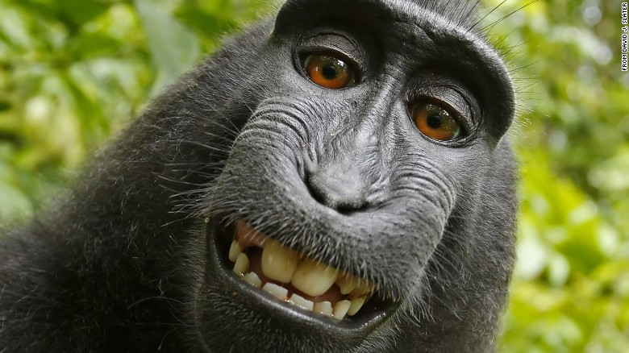
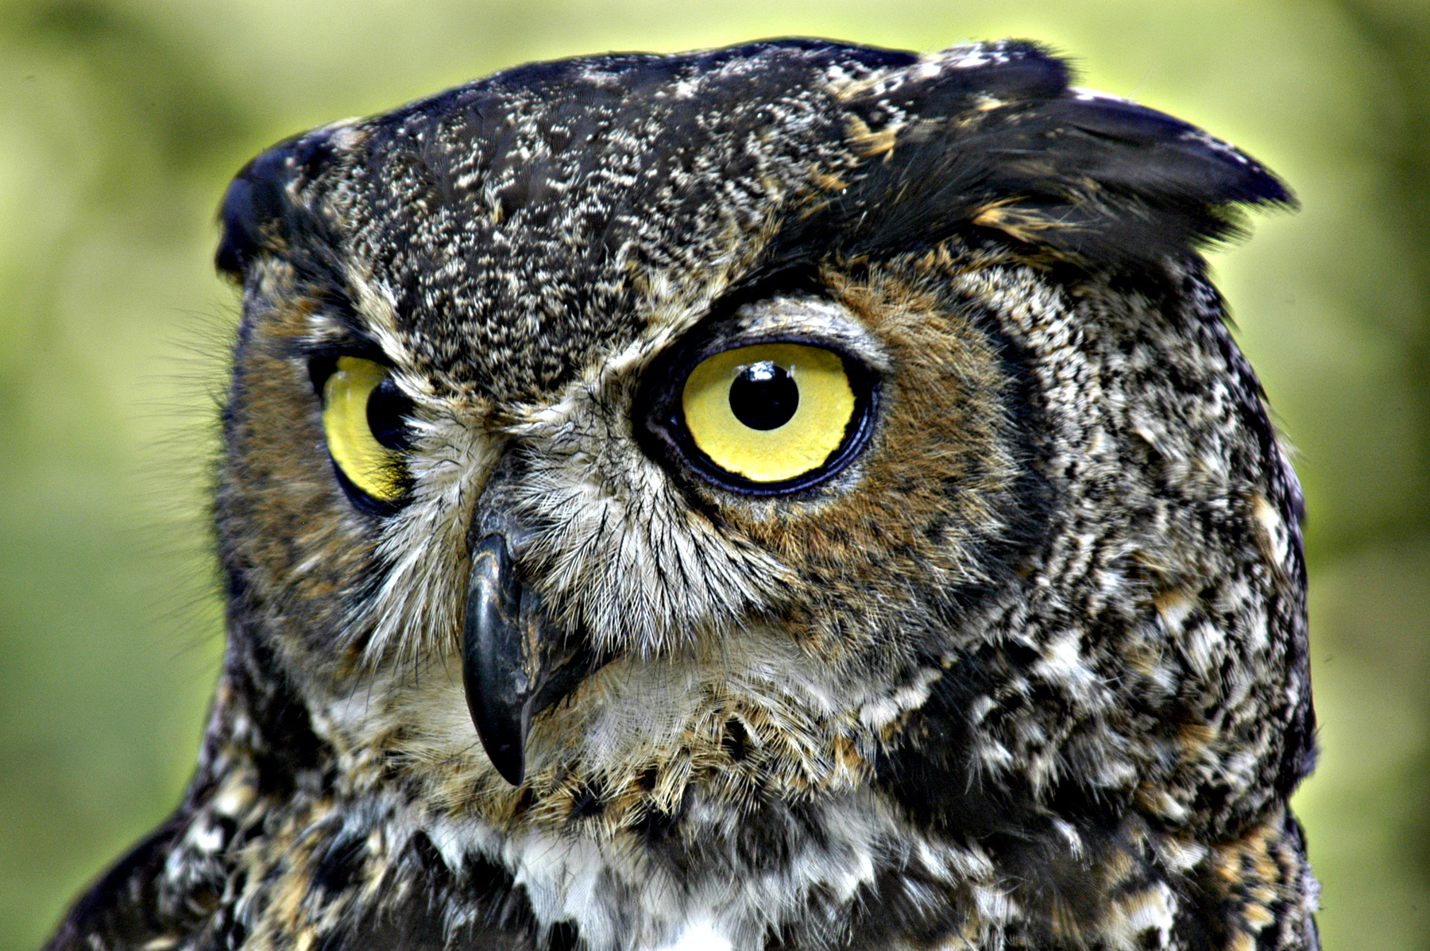
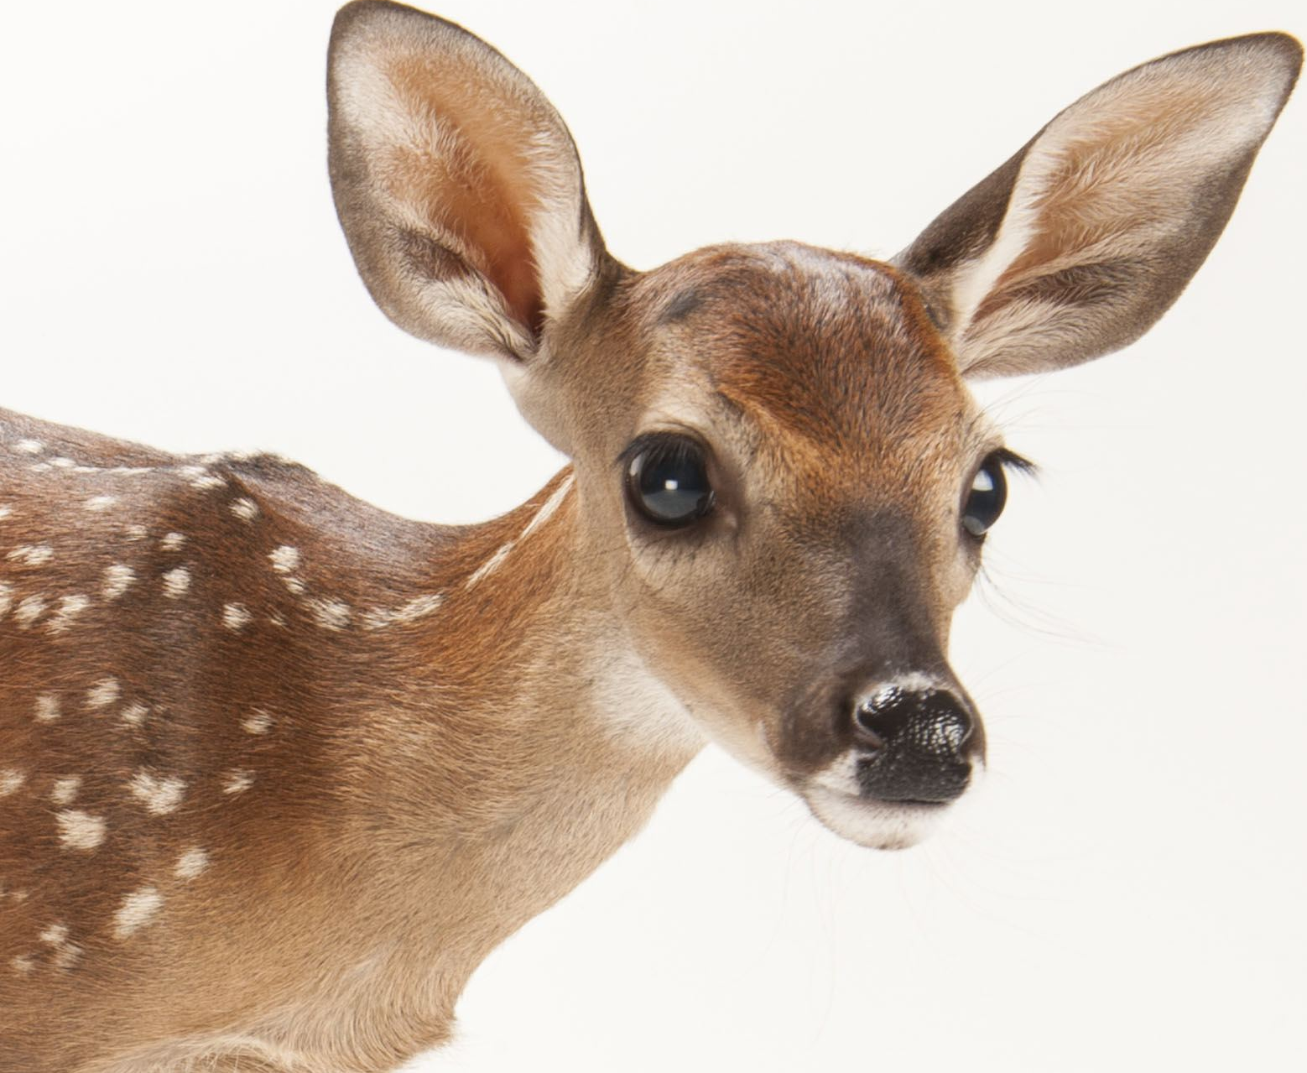
Remember the Zoo!
“Doers”
(Leaders)
“Players”
(Laughers)
Control!
Companions!
Focus on tasks.
“Territorial”
Focused on Fun.
“Talkers”
“Thinkers”
(Learners)
“Feelers”
(Lovers)
Clarity!
Comfort!
Focus on “Facts”
“Technical”
Focus on “feelings”
Tender (Timid)

Slide 21
Experiences: 2 Cor 1:3-6
“Blessed be God… the Father of mercies,
and the God of all comfort;
Who comforts us in all our tribulation,
that we may be able to comfort them which are in any trouble, by the comfort wherewith we ourselves are comforted of God.

Slide 22
Experiences: 2 Cor 1:3-6
“And whether we be afflicted,
it is for your consolation and salvation,
or whether we be comforted,
it is for your consolation and salvation.”
It’s not always about us!

Slide 23
From Prison Paul writes:
“But I would ye should understand, brethren, that the things which happened unto me have fallen out rather unto the furtherance of the gospel”
So that my bonds in Christ are manifest in all the palace, and in all other places” Philippians 1:12-13

Slide 24
Experiences: 2 Cor 1:3-6
What would happen if we really saw our “life experiences” as tools God can use to help us be channels of His Grace to others?

Slide 25
to Serve?
Are you willing to get in “Shape”

