Slide 1
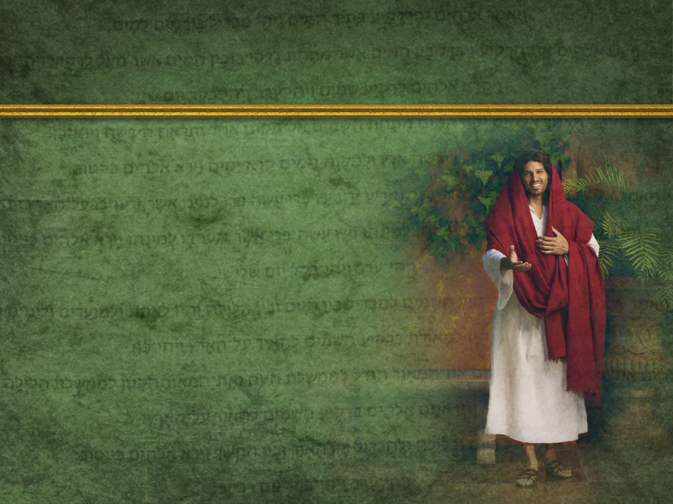
It’s God’s nature and desire to Bless us!
“But rather seek ye the kingdom of God; and all these things shall be added unto you.
Fear not, little flock; for it is your Father's good pleasure to give you the kingdom.”
Lk 12:31-32

Slide 2
Most of God’s blessings are designed as “cause and effect”; in that they are the
“biproducts” of our relationship with Him! Deut. 7:11-14
Things that strain the relationship (aka: Sin)
Affects either the “blessings” themselves,
or our appreciation for or enjoyment of them.

Slide 3
Deut. 11:26-28
“I set before you …a blessing and a curse;
A blessing, if ye obey the commandments of the LORD your God…:
And a curse, if ye will not obey the commandments of the LORD your God,
but turn aside out of the way which I command you this day, to go after other gods…”

Slide 4
It’s Satan’s nature to Curse us. Jn. 10:10
“the thief cometh not but to steal, kill, destroy.”
John 8:44-45 “Ye are of your father the devil,
and the lusts of your father ye will do.
He was a murderer from the beginning, and abode not in the truth, because there is no truth in him.
When he speaketh a lie, he speaketh of his own:
for he is a liar, and the father of it.
And because I tell you the truth, ye believe me not.”

Slide 5
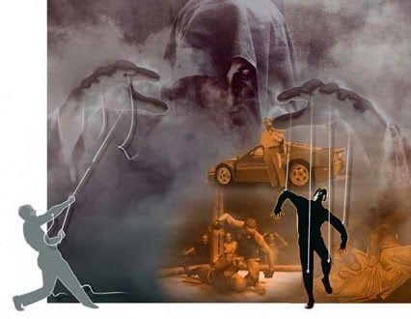
Satan “lies” and convinces us that we can “bypass” God’s conditions (relationship) and “bless ourselves” by pursuing the:
“lust of the flesh, the lust of the eyes, and the pride of life…” 1 Jn. 2:16
“Lest Satan should get an advantage of us:
for we are not ignorant of his devices.” 2 Cor 2:11
(no’ēma: purpose or disposition)

Slide 6
We’ve considered the snares of:
Pride and its relation to bitterness and
rebellion. (Heb. 12:15; 1 Sam 15:23)
Covetousness and its relation to “Idolatry”.
(Eph. 5:5; 1 Tim. 6:10; Col. 3:5,6)
Sensuality and how it numbs us to God’s voice and prompting.
(1 Thes. 5:1-7; 1 Pt. 2:11; Heb. 3:5)

Slide 7
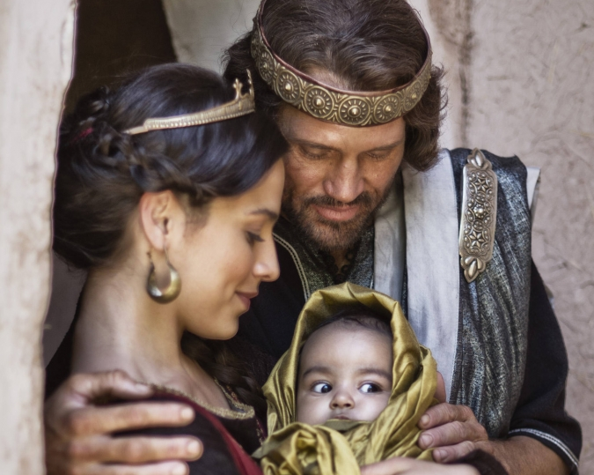
I’d like to conclude this series by examining how Satan used all three “snares” to trap the “wisest man”.
2 Samuel 12:24
“David comforted Bathsheba his wife, and she bare a son, and he called his name Solomon:
and the LORD loved him.”

Slide 8
1. The Preparation.
A. God’s Guidelines for Kings:
Deut 17:15-18 “When thou ….shalt say, I will set a king over me… Thou shalt in any wise set him king over thee, whom the LORD thy God shall choose: …
But he shall not multiply horses to himself,
nor cause the people to return to Egypt,
Neither shall he multiply wives to himself,
that his heart turn not away:
neither shall he multiply to himself silver and gold.

Slide 9
Deut 17:18-20
“he shall write him a copy of this law in a book …
And it shall be with him, and he shall read therein all the days of his life: that he may learn to fear the LORD his God, to keep all the words of this law and these statutes…:
That his heart be not lifted up above his brethren,
and that he turn not aside from the commandment,
… to the end that he may prolong his days in his kingdom, he, and his children…”

Slide 10
B. David’s charge to Solomon. 1 Kings 2:2-4
“be thou strong therefore, and shew thyself a man; And keep the charge of the LORD thy God, to walk in his ways, …that thou mayest prosper in all that thou doest, and whithersoever thou turnest thyself:
4 That the LORD may continue his word which he spake concerning me, saying, If thy children take heed to their way, to walk before me in truth with all their heart and with all their soul, there shall not fail thee (said he) a man on the throne of Israel.

Slide 11
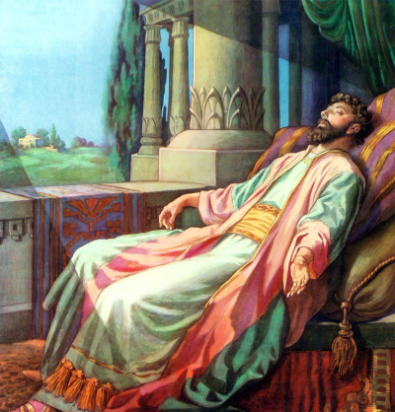
2. The Dedication: 1 Kg. 3:3-5
He started out well!
A. He initially Sought God.
“Solomon loved the LORD…and went to Gibeon to sacrifice there; … a thousand burnt offerings ...”
“the LORD appeared to Solomon in a dream:
and God said, Ask what I shall give thee.”
(God delights to bless His children!)
1) He asked for God’s blessing of Wisdom!

Slide 12
2. The Dedication: 1 Kg. 3:3-5
A. Initially sought God.
1) Valued God’s Blessing.
2) This Blessing was conditional (1 Kings 3:14)
“and if thou wilt walk in my ways,
to keep my statutes and my commandments,
as thy father David did walk,
then I will lengthen thy days.”
(You’ll live to enjoy the blessings)

Slide 13
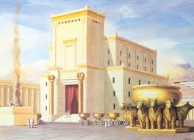
2. The Dedication: (started out strong)
B. Served God’s purposes. 1 Kings 5:4-5
“the LORD my God hath given me rest on every side, I purpose to build an house unto the name of the LORD my God, as the LORD spake unto David…, saying, Thy son, whom I will set upon thy throne in thy room, he shall build an house unto my name.”
It took him 7 years and 6 months to finish!
1 Kings 6:27,38

Slide 14
3. The Deterioration
Since God’s blessings were conditional on maintaining a relationship with Him;
Solomon began “blessing” himself.
In pursuing this path, he violated God’s clear warnings and
became entrapped in Satan’s Snares.

Slide 15
3. The Deterioration.
A. The Pride of life. Dt. 17:16, 19
“But he shall not multiply horses to himself, nor cause the people to return to Egypt…
That his heart be not lifted up above his brethren,
and that he turn not aside from the commandment”
1) 1 Kings 4:26 “And Solomon had 40,000
stalls of horses for his chariots…”

Slide 16
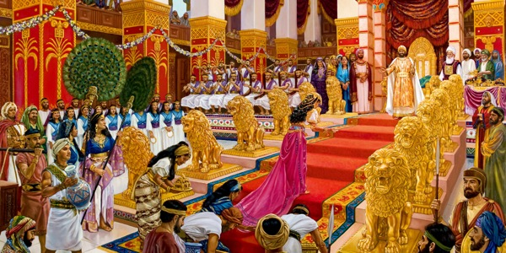
A. The Pride of Life.
1) Solomon invested 7 years building God’s house…
“But Solomon was building his own house
13 years …: 1 Kings 7:1
Eccl 2:4,9 “I made me great works; I builded me houses
So I was great, and increased more than all…”
He built also the house of the forest of Lebanon…”
1 Kings 7:1-3

Slide 17
Where did this prideful pursuit take him?
Eccl 2:11
“Then I looked on all the works that my hands had wrought, and on the labor that I had labored to do:
and, behold, all was vanity
(heb’el: empty, fleeting, unsatisfying)
and vexation of spirit.”
(reʿût: grasping, feeding on emptiness)

Slide 18
3. The Deterioration.
B. Lust of the eyes. Deut. 17:17 “neither shall
he multiply to himself silver and gold.”
1) Eccl 2:8,10 “I gathered me also silver and gold, and the peculiar treasure of kings and provinces:
whatsoever mine eyes desired I kept not from them,
I withheld not my heart from any joy;”
He gathered > 25 tons of gold each year!
(1 Kings 10:14)

Slide 19
3. The Deterioration.
B. Lust of the eyes. Deut. 17:17 “neither shall
he multiply to himself silver and gold.”
2) He forgot the lessons of his father. Ps 62:10-11
“if riches increase, set not your heart on them.
God hath spoken…have I heard this;
that power belongeth unto God.”

Slide 20
Where did this “striving for stuff” leave him?
Eccl 5:10-11
“He that loveth silver shall not be satisfied with silver; nor he that loveth abundance with increase:
this is also vanity.
Vs. 15 As he came forth of his mother's womb, naked shall he return to go as he came,
and shall take nothing of his labor,
which he may carry away in his hand.”

Slide 21
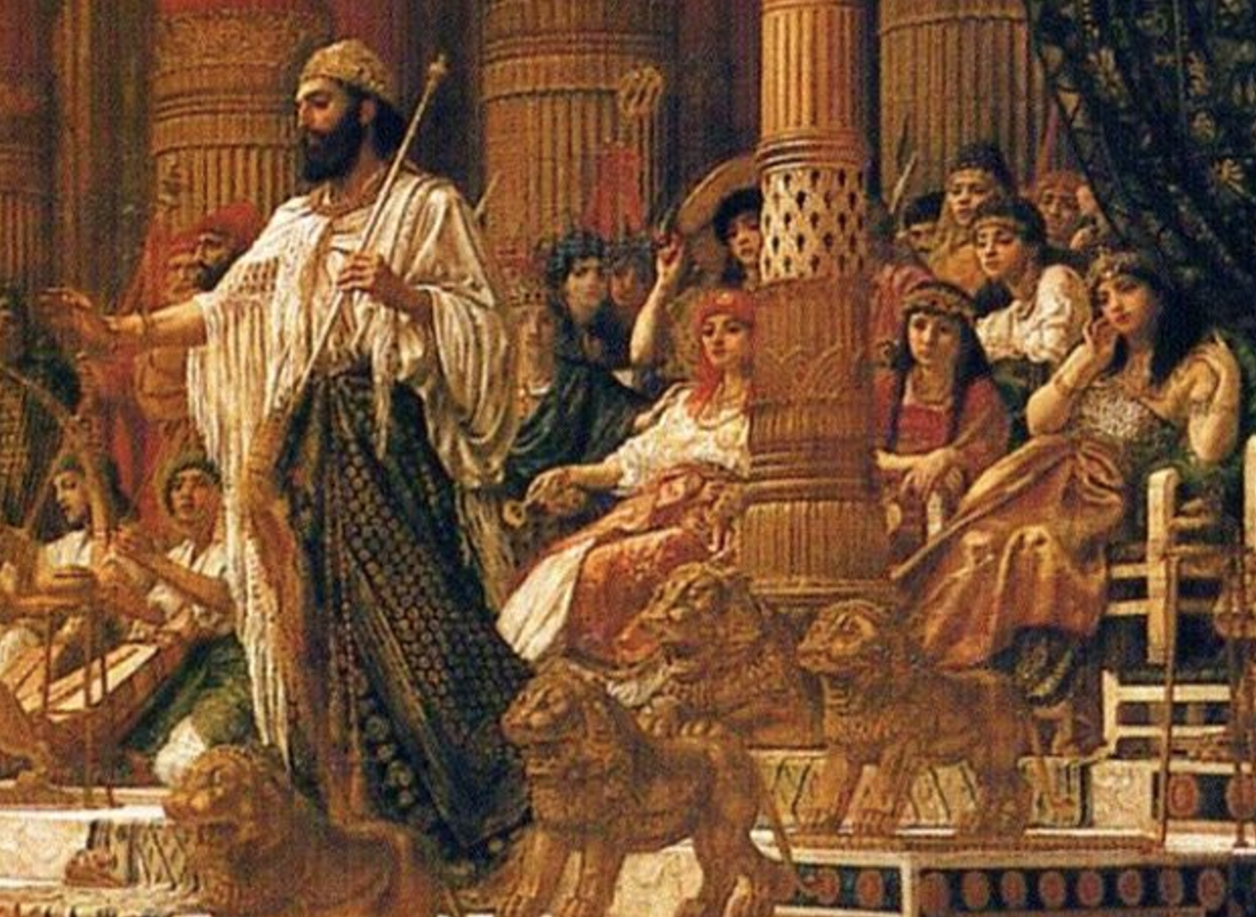
3. The Deterioration.
C. Lust of the flesh. Deut. 17:17
“Neither shall he multiply wives to himself,
that his heart turn not away:”
1 Kings 11:1-3
1) “But Solomon loved many strange women,
together with the daughter of Pharaoh…Moabites, Ammonites, Edomites, Zidonians, and Hittites;

Slide 22
1 Kings 11:2,3
“But Solomon loved many strange women…
Of the nations concerning which the LORD said…, Ye shall not go in to them, for surely they will turn away your heart after their gods:
Solomon clave unto these in love.
dābaq’: pursued and adhered to. (Gen. 2:24)

Slide 23
1 Kings 11:3-6
“And he had seven hundred wives, princesses, and three hundred concubines:
and his wives turned away his heart.
And he went after Ashtoreth the goddess of the Zidonians, and after Milcom the abomination of the Ammonites.
And Solomon did evil in the sight of the LORD,

Slide 24
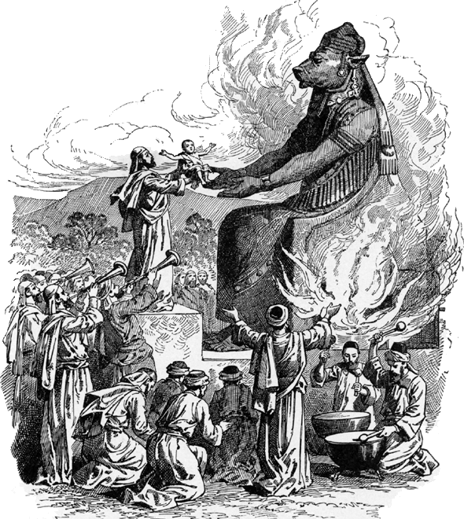
3. The Deterioration.
C. Lust of the flesh. 1 Kings 11:7
“Then did Solomon build an high place for Chemosh, the abomination of Moab, and for Molech, the abomination of the children of Ammon.”

Slide 25
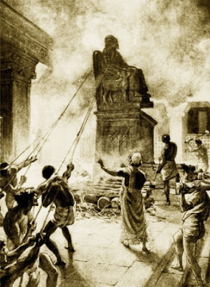
2) Solomon initiated child sacrifice in Israel
That lasted for hundreds of years until King Josiah:
“defiled Topheth, which is in the valley of the children of Hinnom,
that no man might make his son or his daughter to pass through the fire to Molech.”
2 Kings 23:10

Slide 26
How did the pursuit of Pleasure work out?
Eccl 2:1 “I will prove thee …enjoy pleasure:
and, behold, this also is vanity.”
What did Solomon discover by
pursuing these paths of “self blessing” independent of God? Eccl 12:8
“Vanity of vanities… all is vanity.”
(under the sun)

Slide 27
Solomon started so strong, but got distracted and deceived by the Snares of Satan,
leaving him disappointed and disillusioned.
Are we really that different?
This tendency to seek the “blessings of God” without cultivating an intimate relationship with the “God of the Blessings” is universal!

Slide 28
He learned (as will each eventually) that spending our time and energy investing in the wrong “kingdom” is the height of folly.
Jesus addressed this tendency in Mt. 6:19-22
“Lay not up for yourselves treasures on earth
But lay up for yourselves treasures in heaven,
For where your treasure is,
there will your heart be also.”

Slide 29
Ecclesiastes 12:13-14
“Let us hear the conclusion of the whole matter:
Fear God, and keep his commandments:
for this is the whole duty of man.
¹⁴ For God shall bring every work into judgment, with every secret thing,
whether it be good (tob: precious, valuable)
“gold, silver, precious stones” (1 Cor. 3:12)
or whether it be evil.” (raʿ: evil, harmful, distressing)
“wood, hay, stubble” ( 1 Cor. 3:12)

Slide 30
Ph 3:18-20 “many walk… that they are the enemies of the cross of Christ:
Whose end is destruction (ruin, loss) whose God is their belly (sensuality), and whose glory is in their shame, (pride of life)
who mind (focus on) earthly things.)
For our conversation (citizenship) is in heaven; from whence also we look for the Lord Jesus Christ”

Slide 31
“But seek ye first the kingdom of God,
and his righteousness; and all these things shall be added unto you” Mt 6:33
Which Kingdom are you:
Focused on?
Investing in?

