Slide 1
The Snares of Satan
(Part 2)

Slide 2
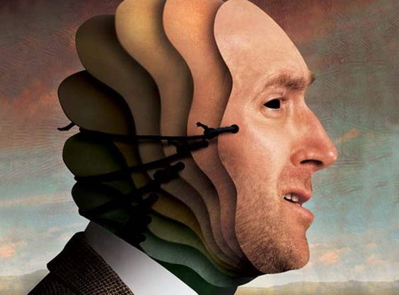
Although Satan seeks to “mask” his true nature and purposes.
God’s word exposes him as a:
Thief (Jn 10:10)
Murderer (Jn 8:44)
Accuser (Zech. 3:1; Rev. 12:10, Job 1)
Angel of Light (2 Cor. 11:14)

Slide 3
Some Biblical “images” of Satan include:
Deceiver (2 Jn 1:7)
Destroyer (John 10:10; 1 Cor. 10:10)
Tempter (Mt 4:3)
Serpent (Gen. 3:1; 2 Cor 11:3)
Roaring Lion (1 Peter 5:8)
Prince of this World (Jn 12:31; 14:30; 16:11)
god of this world (2 Cor. 4:4)

Slide 4
Last week we examined how Satan was able to “snare” Gideon and set in motion events that would destroy his family.
“Gideon made an ephod thereof, and put it in his city, even in Ophrah:
and all Israel went whoring after it:
which thing became a snare unto Gideon,
and to his house.” (Family)
Judges 8:27

Slide 5
We learned that Satan’s Snares are:
Seductive: Involve something we “want”.
Subtle: We “rationalize” our “compromises”.
Strong: They will “trap” us and lead us away
from God, His House, and His Protection.
2 Tim. 2:19-26
It appears that Gideon was “snared” because of a subtle “bitterness”.

Slide 6
Although Satan has an almost limitless “bait shop” with which to tempt or lure us into his snares,
they all fall into either the:
“the lust of the flesh,
The lust of the eyes,
The Pride of life.” 1 Jn 2:15

Slide 7
Bitterness is one of Satan’s most Subtle and Seductive Snares.
Heb 12:15 “Looking diligently lest any man fail of the grace of God;
lest any root of bitterness springing up trouble you,
and thereby many be defiled;”

Slide 8
Why is “bitterness” such a snare?
1. It usually involves some “wound”. (Offense)
A. “Wounds” are inevitable! Luke 17:11
“It is impossible but that offences will come”
1) Bitter (pikri’a: from pikros) to pierce or cut!
a) Someone will eventually “cut” you!
“offences” (skandalon) literally means: “to set (bend) a snare!”

Slide 9
The Snare of Bitterness
1. Bitterness involves some “wound”. (Offense)
B. Wounds are “memorable”. (Leave scars)
“Bitter”(pikria) comes from pikros: pierce.
1) Pikros comes from pēg’numi: to set a peg
(so as to pitch a tent) so it won’t move!
a) Emotion (pain, fear, anger, etc) acts as a “hammer” to drive the memory deep in our mind.
(Amy and Flo)

Slide 10
1. Bitterness involves some “wound”. (Offense)
C. Wounds are “vulnerable”.
(Prone to infection)
1) “Pikros” not only means to pierce, but also
to poison! (acrid, caustic)
Bacteria kills more people than bullets!
a) This poison of bitterness spreads!
“thereby many be defiled” Heb. 12:15
mi’ainō: contaminated!

Slide 11
1. Bitterness involves some “wound”. (Offense)
C. Wounds are “vulnerable”. (Prone to infection)
2) The longer the “wound” stays open, the
greater the chance of infection!
a) We’re in a “dirty” environment. (1 Jn 5:19)
b) If the wound “closes” without being cleansed,
the infection goes deeper and grows:
Often unseen!

Slide 12
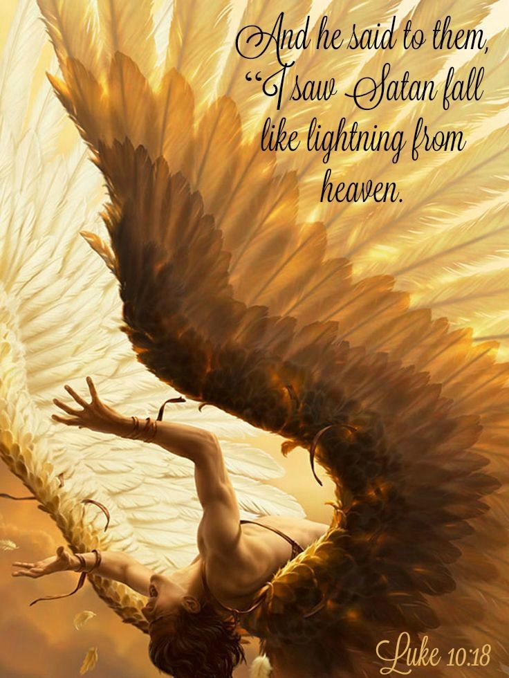
How Bitterness “snares” us.
(Moves us into Satan’s domain)
1. Bitterness is a byproduct of Pride
Pr 13:10 “Only by pride cometh contention”
A. Pride is what turned Lucifer into Satan!
Isaiah 14:12-15

Slide 13
How Bitterness snares us?
2. Bitterness is at the heart of rebellion.
A. “Rebellion” (‏מְרִי‎ : merî) comes from ‏מָרָה‎ : mārâ
Mara means Bitter!
1) How we respond to hurt/disappointment
determines if we get better or bitter!
2) Bitterness is the “bacteria” from which
Rebellion is born!

Slide 14
B. Rebellion exposes us to Satan’s Influence.
1) 1 Sam. 15:23a “Rebellion is as the sin of witchcraft;
a) Webster’s defines witchcraft as:
➔ The use of sorcery or magic
➔ Communication with the devil
➔ An irresistible influence or fascination
b) In 1 Cor. 10:20 God describes witchcraft as
“fellowship (koinōnos: partnership) with devils”
Satan was the original “rebel without a cause”.

Slide 15
B. Rebellion exposes us to Satan’s Influence.
1) 1 Sam. 15:23a “Rebellion is as the sin of witchcraft;
2) 1 Sam. 15:23b “stubbornness is iniquity & idolatry”
a) Stubbornness: (pāṣar) to press, urge, insist.
b) Iniquity: (ʾāwen) to exert in vain. Self Will Is. 53:6
Ez 28:15 “Thou wast perfect in thy ways from the day that
thou wast created, till iniquity was found in thee.”
c) Idolatry: (terāpîm) Family idol
Exactly what Gideon’s “ephod” became!

Slide 16
B. Rebellion exposes us to Satan’s Influence.
3) Under Satan’s “influence” we:
a) Make destructive decisions. 2Ti. 2:
“oppose themselves” vs 25
b) Get “caught in the snare of the devil” v 26
c) Are “taken captive by him at his will” 26

Slide 17
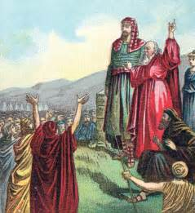
Illustrate this process with King Saul
Began full of hope and promise.
1 Sam 9:2 “a choice young man, and a goodly:
and there was not among the children of Israel a goodlier person than he:
from his shoulders and upward he was higher than any of the people.”

Slide 18
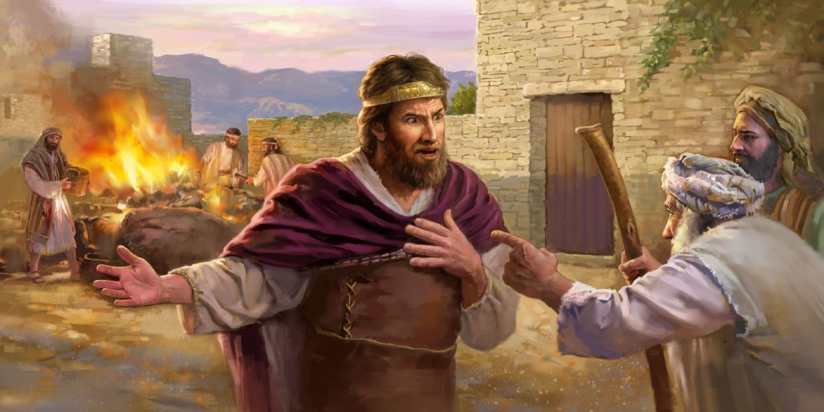
2) Eventually started to show signs of
Pride. 1 Sam. 13-15
Presumed to act as Priest.
Vs 8-14 “I forced myself”
b) Rash vow. 1 Sam 14:24
“And the men of Israel were distressed that day: for Saul had adjured the people, saying, Cursed be the man that eateth any food until evening, that I may be avenged on mine enemies. So none of the people tasted any food.”

Slide 19
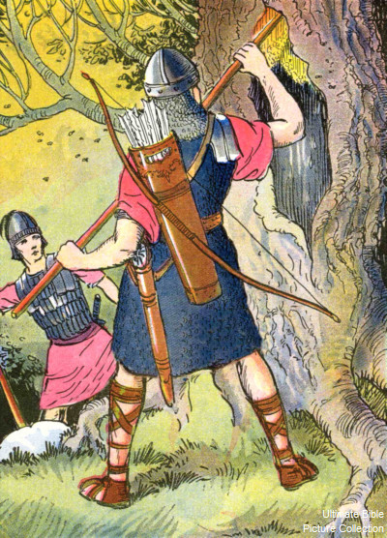
2) Signs of Pride. 1 Sam. 13-15
(1) This rash vow almost got his son killed. Ch. 14
➔ Jonathan’s courage and faith saved the day.
➔ Ignorant of the vow, he ate honey.
“Saul answered, God do so and more also: for thou shalt surely die, Jonathan.”
1 Sam. 14:44

Slide 20
3) Became disobedience to God. Ch. 15
2,3 “Thus saith the LORD of hosts, I remember that which Amalek did to Israel, how he laid wait for him in the way, when he came up from Egypt. Now go and smite Amalek, and utterly destroy all that they have, and spare them not; but slay both man and woman, infant and suckling, ox and sheep, camel and ass.”
Vs 9 “But Saul …spared Agag, and the best of the sheep, and …all that was good, and would not utterly destroy them:”

Slide 21
3) Justified his disobedience. Ch. 15
a) Didn’t “recognize” his disobedience. Vs 13
“I have performed the commandment of the Lord”
b) “Rationalized” his disobedience Vs 15
“to sacrifice unto the Lord thy God.”
c) “Redirected” the blame. Vs 15, 21
“the people spared the sheep…took the spoil”

Slide 22
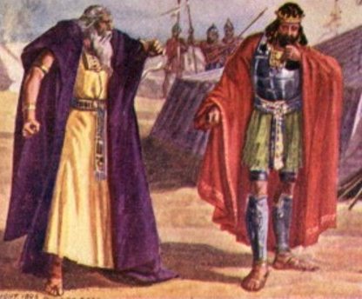
4) God confronted his Rebellion.
1 Sam. 15:23 “Rebellion is as the sin of witchcraft;
and stubbornness is iniquity and idolatry”
Vs 26 “thou hast rejected the word of the LORD”
a) Incomplete and insincere repentance.
³⁰ ”Then he said, I have sinned:
yet honor me now, I pray thee, before the elders of my people,
and before Israel…”

Slide 23
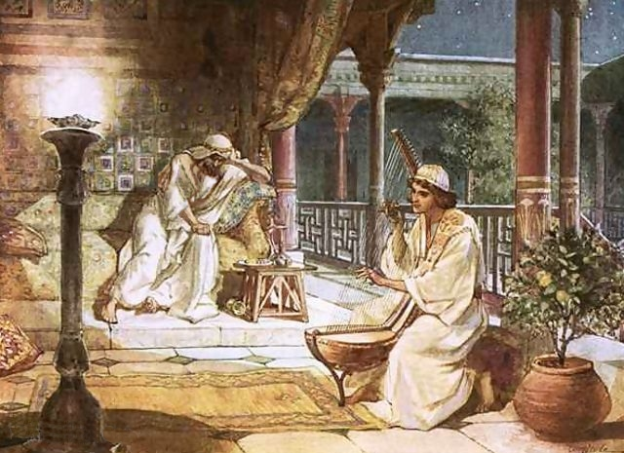
5) Saul became depressed. Ch. 16:14
“But the Spirit of the LORD departed from Saul,
and an evil spirit …troubled him.”
David’s devotion and skill helped him.
Vs 16-23

Slide 24
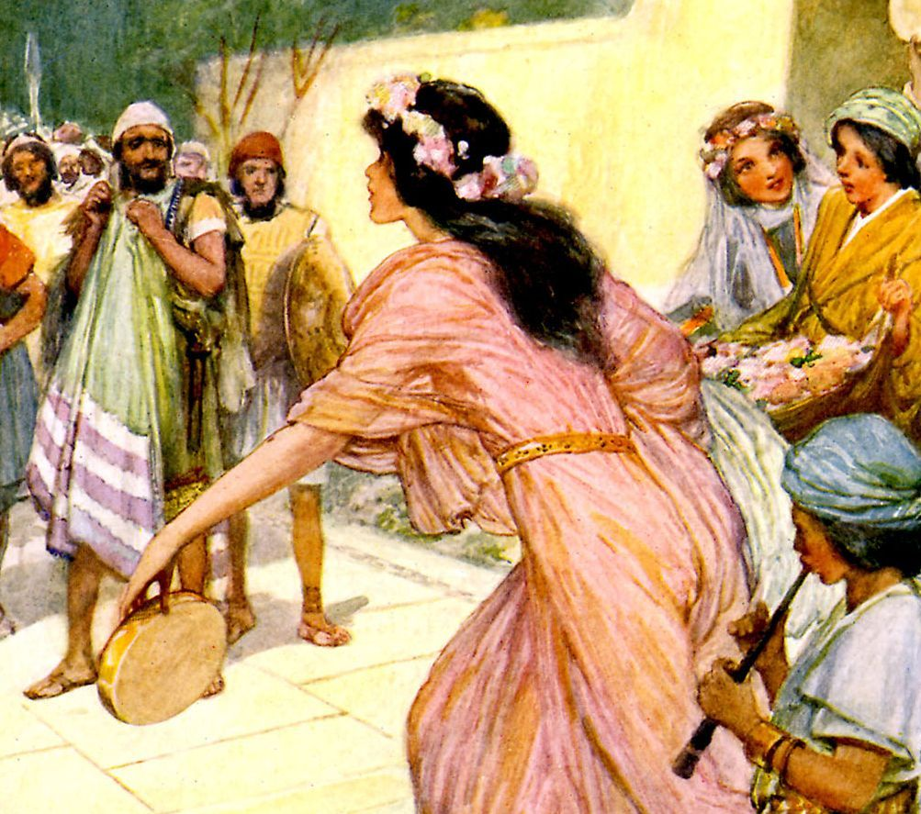
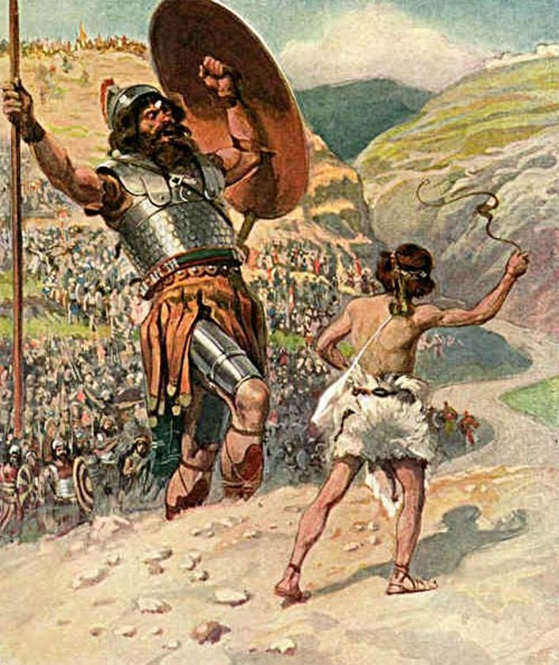
6) Became resentful of David’s success. Ch.17
18:7-8 “And the women …played, and said,
Saul hath slain his thousands,
and David his ten thousands.
⁸ And Saul was very wroth, and the saying displeased him; and he said, They have ascribed unto David ten thousands, and to me they have ascribed but thousands: and what can he have more but the kingdom?

Slide 25
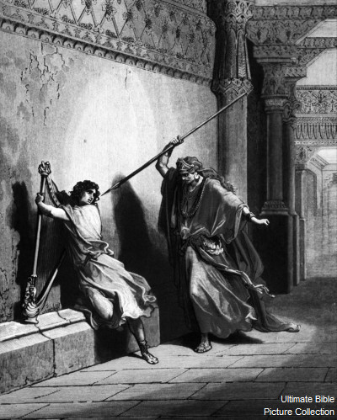
7) Tries to destroy David (Repeatedly)
1 Samuel 18:10-11
“the evil spirit …came upon Saul, and David played with his hand, as at other times: and there was a javelin in Saul's hand.
11 And Saul cast the javelin; for he said, I will smite David even to the wall with it. And David avoided out of his presence twice.”

Slide 26
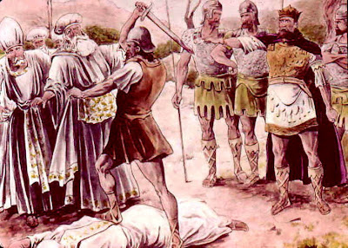
8) Murders the Priests (1 Samuel 22:18-19)
“the king said to Doeg, Turn thou, and fall upon the priests…and he fell upon the priests, and slew on that day fourscore and five.
19 And Nob, the city of the priests, smote he with the edge of the sword, both men and women, children and sucklings...”

Slide 27
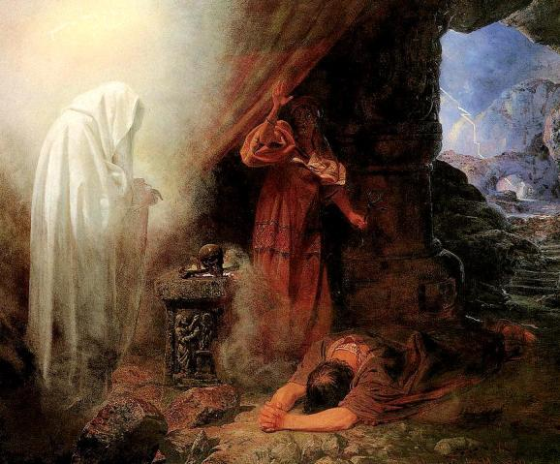
9) Forces David’s Wife Michal to marry
another. 1 Sam. 25:44
10) Repeatedly lies and Ruthlessly hunts
David. 1 Sam. 23-26
11) Consults a witch.
1 Sam 27

Slide 28
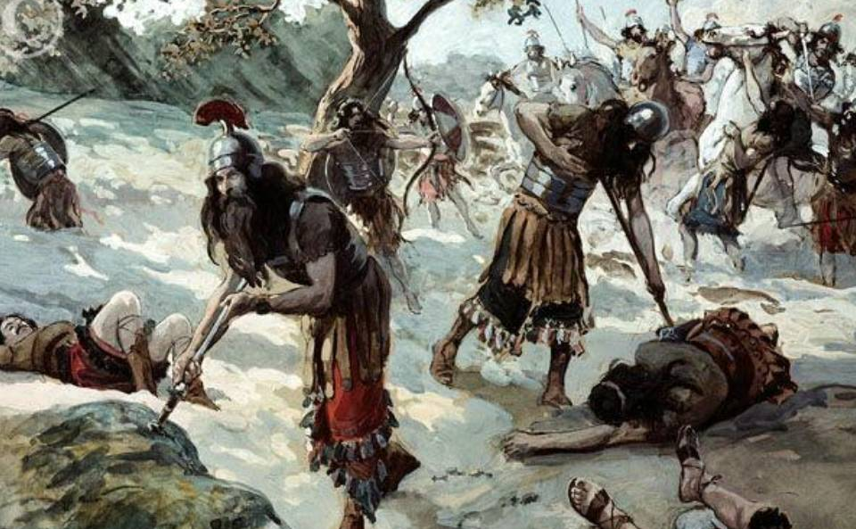
12. In despair he commits suicide. 1 Sam. 31
Saul had many opportunities to Repent, but his pride kept him caught in Satan’s snare!

Slide 29
How do we “reverse the curse?”
Recognize your responsibility. James 4:1-4
“from whence comes wars and fightings among
you…even of your own lusts…”
(Confess your sin! 1 Jn 1:9)
2. Respond to God. Jms 4:7 “Submit yourselves
therefore to God. Hypotassō: subordinate, obey.
(Cooperate with God Pr. 3:5,6)

Slide 30
How do we get out of Satan’s Snares!
3. Resist the devil, and he will flee from you. Vs 7
(Contest Satan’s claims on you. Eph. 6:10-18)
4. Reconnect with God! Vs 8“Draw nigh to God”
(Commit to God Ro. 12:1,2; Mt 11:28,29)
5. Repent! Vs. 8-10
(Clean your heart and life. 2 Ti 2:19-21)

Slide 31
James 4:8-10 “Cleanse your hands, ye sinners;
and purify your hearts, ye double minded.
Be afflicted, and mourn, and weep:
(“godly sorrow worketh repentance” 2 Cor 7:10)
Humble yourselves in the sight of the Lord, and he shall lift you up. “

Slide 32
“The servant of the Lord must not strive; but be gentle unto all men, apt to teach, patient,
In meekness instructing those that oppose themselves; if God peradventure will give them repentance to the acknowledging of the truth;
that they might recover themselves
out of the snare of the devil.
Who are taken captive by him at his will”
2 Tim. 2:24-26

