Slide 1
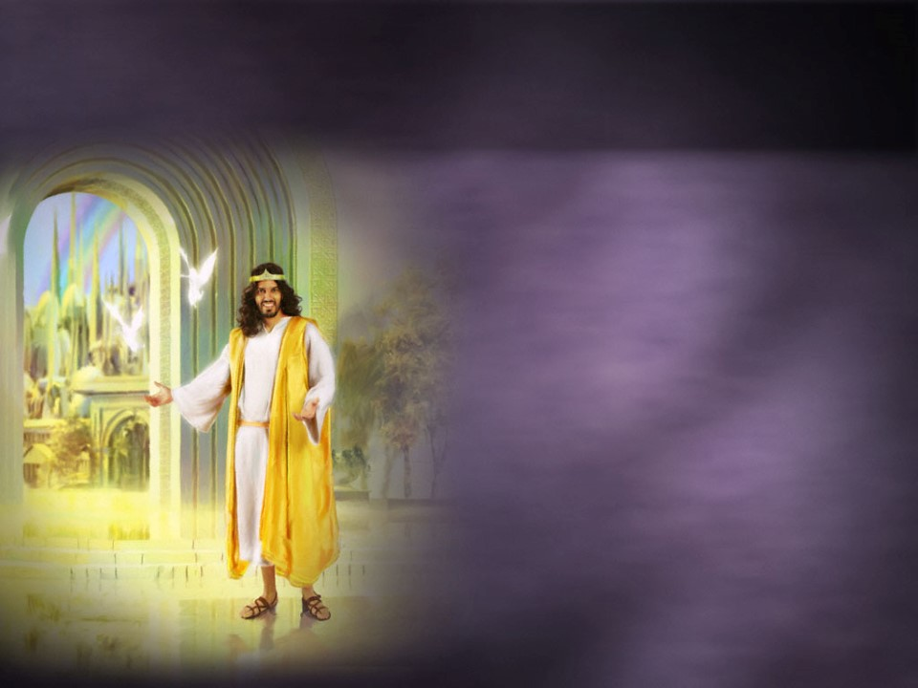
Life is filled with choices!
As Christians, we’re often “torn” between two “worlds”. Ro. 12:1
“Lay not up for yourselves treasures on earth
…but lay up for yourselves treasures in heaven…
For where your treasure is, there will your heart be also.”
Mt. 6:19,20

Slide 2
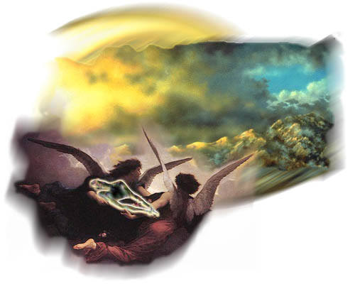
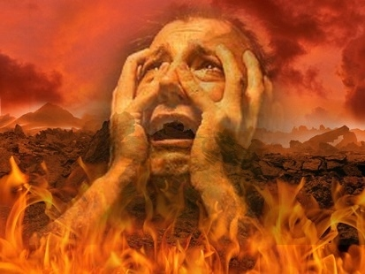
The Laodiceans chose a “Comfortable Compromise” between these two “worlds”,
And ended up nauseating God!
Last week we saw from Luke 16 how some who are “caught up” in the things of this world, end up “lost” in eternity.

Slide 3
Matthew 6:22-24
“The light of the body is the eye:
if therefore thine eye be single, (right focus)
thy whole body shall be full of light.
But if thine eye be evil, (The wrong focus)
thy whole body shall be full of darkness.
If therefore the light that is in thee be darkness, how great is that darkness!
No man can serve two masters: for either he will hate the one, and love the other; or else he will hold to the one, and despise the other.
Ye cannot serve God and mammon.”

Slide 4
This phrase has interesting roots.

Slide 5
In Nov. 13, 1861 a Pennsylvania Preacher (Rev. Watkinson) wrote the following to Secretary of the Treasury (Mr. Chase)
Dear Sir: You are about to submit your annual report to the Congress respecting the affairs of the national finances. One fact touching our currency has hitherto been seriously overlooked. I mean the recognition of the Almighty God in some form on our coins.
You are probably a Christian. What if our Republic were not shattered beyond reconstruction? Would not the antiquaries of succeeding centuries rightly reason from our past that we were a heathen nation? What I propose is that instead of the goddess of liberty we shall have …in the folds of the bars the words GOD, LIBERTY, LAW.

Slide 6
As a result, Secretary Chase instructed James Pollock, Director of the Mint at Philadelphia, to prepare a motto, in a letter dated November 20, 1861:
Dear Sir: No nation can be strong except in the strength of God, or safe except in His defense. The trust of our people in God should be declared on our national coins.
You will cause a device to be prepared without unnecessary delay with a motto expressing in the fewest and tersest words possible this national recognition.
He chose “In God We Trust”

Slide 7
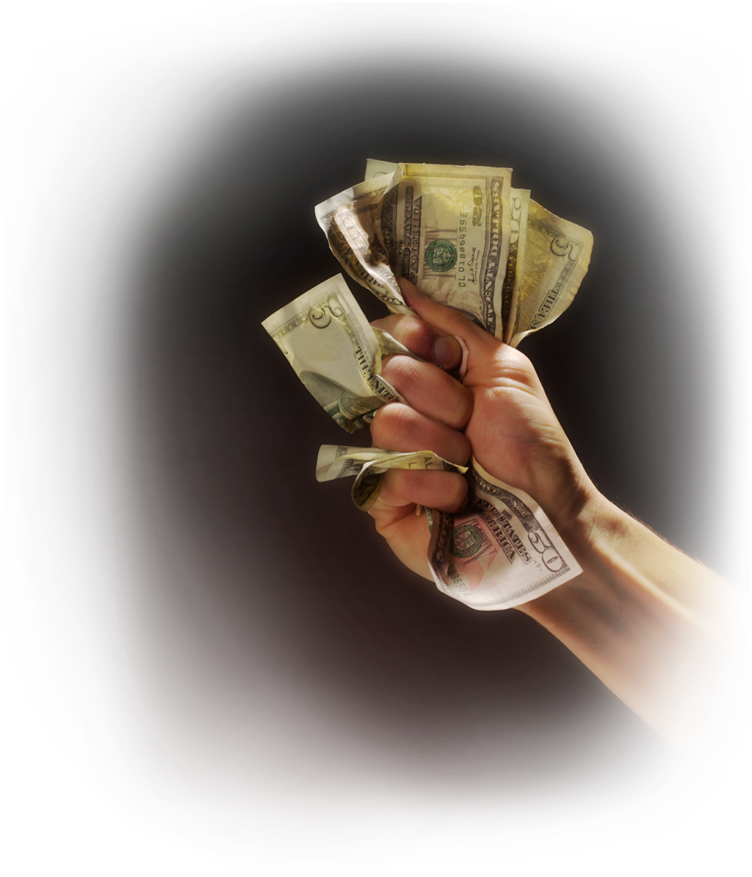
This may be our National Motto…
But This is our Natural “Motivation”!

Slide 8
Someone wisely described money as a:
Universal passport to everywhere except heaven,
Universal provider for everything except happiness.
God describes it as:
“For the love of money is the root of all evil:
which while some coveted after, they have erred from the faith, and pierced themselves through with many sorrows.“
1 Timothy 6:10

Slide 9
Because of the seductive nature of money, God commanded Pastor Timothy to:
“Charge them that are rich in this world, that they be not high minded, nor trust in uncertain riches, but in the living God,
who giveth us richly all things to enjoy;
That they do good, that they be rich in good works, ready to distribute, willing to communicate;
(koinōnikos’: liberal partnership)
Laying up in store for themselves a good foundation against the time to come, that they may lay hold on eternal life.” 1 Tim. 6:17-19

Slide 10
Investing in Eternity

