Slide 1
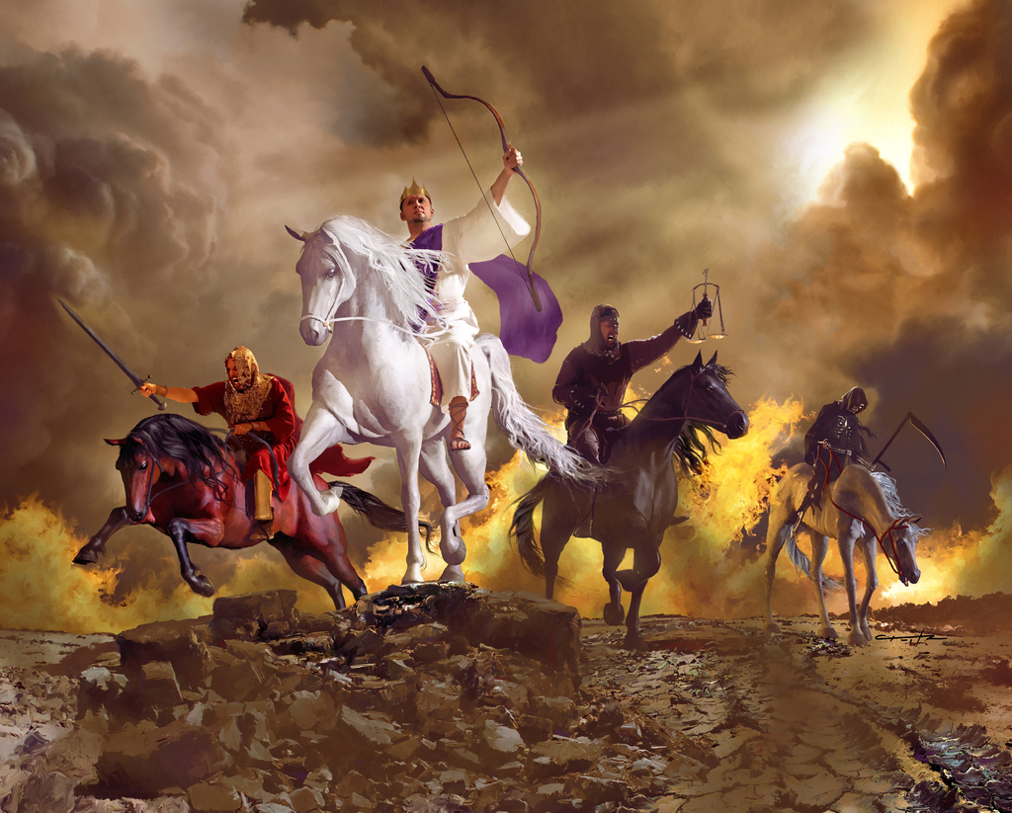
Rev 6:1 “when the Lamb opened one of the seals, and I heard, as it were the noise of thunder, …saying, Come and see.”
Anti-Christ
Death
War
Famine
Vs 2 “and behold a white horse: and he that sat on him had a bow;
and a crown was given unto him: and he went forth …to conquer.”

Slide 2
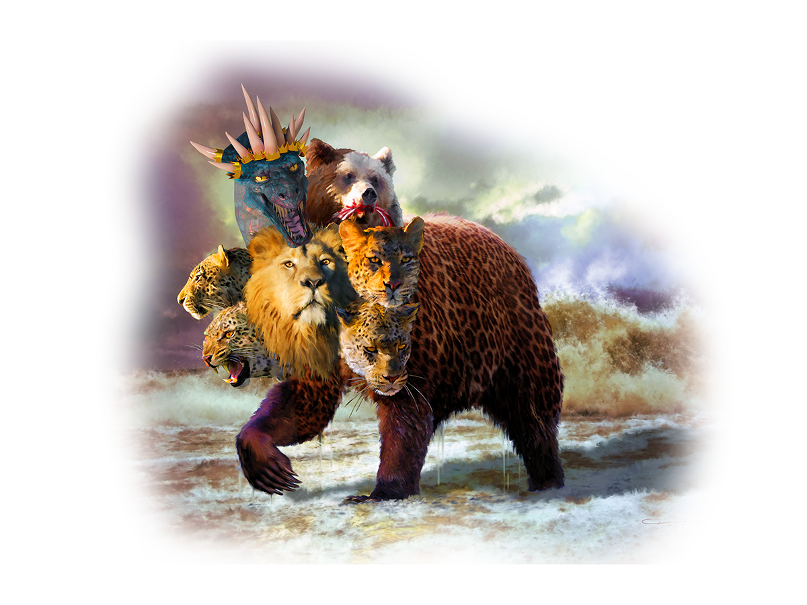
Review: 1. The Rise of the Beast
A. Charismatic leader will rise to power.
1) He’s portrayed as a peaceful rider on a
White horse in Rev. 6:2
and as a terrible
beast in Rev. 13

Slide 3
2) His rise could be initiated by a cataclysmic event
that will “launch” him into the world’s eyes.
(Perhaps the “Rapture” or War of Ezek. 38)
3) He’ll “solve” the Middle East Crisis
initiating a 7 year “Peace Treaty” with Israel.
Dan 9:27 “He shall confirm the covenant for one week”
shābûaʿ: seven

Slide 4
4) He’ll be backed by 10 major Nations in his rise
to world wide power. (Dan. 7:7,24; Rev. 17:12)
Rev 17:12-13 “the ten horns …are ten kings, which …receive power as kings …with the beast.
These have one mind,
and shall give their power and strength unto the beast.”

Slide 5
5) His kingdom will be Satanically empowered!
In Rev. 12 Satan is portrayed as a 7 headed dragon fighting God’s people and plan.
Rev 13:2 “the dragon gave him his power, and his seat, and great authority.”
2 Th 2:3,9
“whose coming is after the working of Satan”

Slide 6
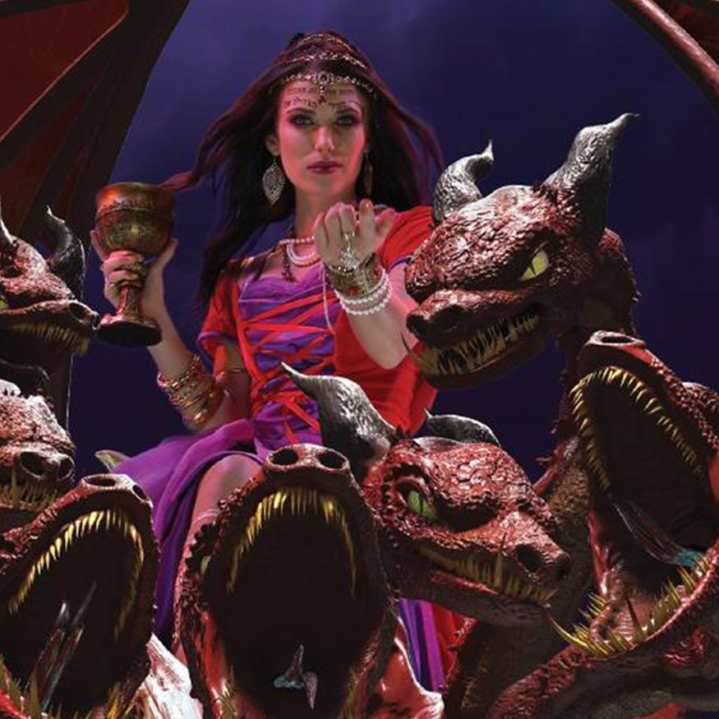
6) He’ll be backed by the “Church”,
using religion to gain the trust of the people.
(Rev. 17)
7) This period of “political
popularity” will last
3 ½ years.
(Dan. 9:27; Rev. 13:1-5)

Slide 7
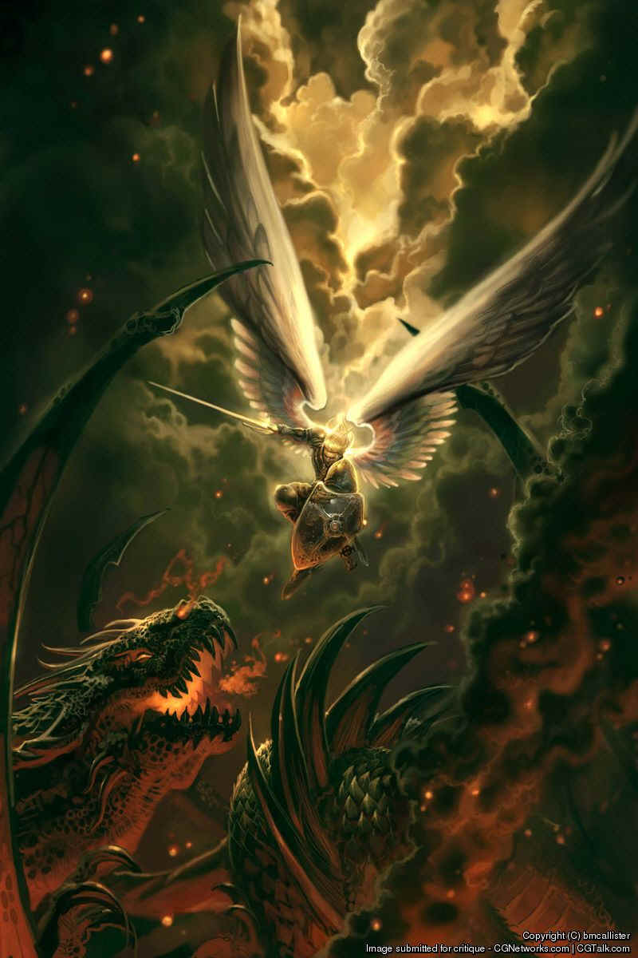
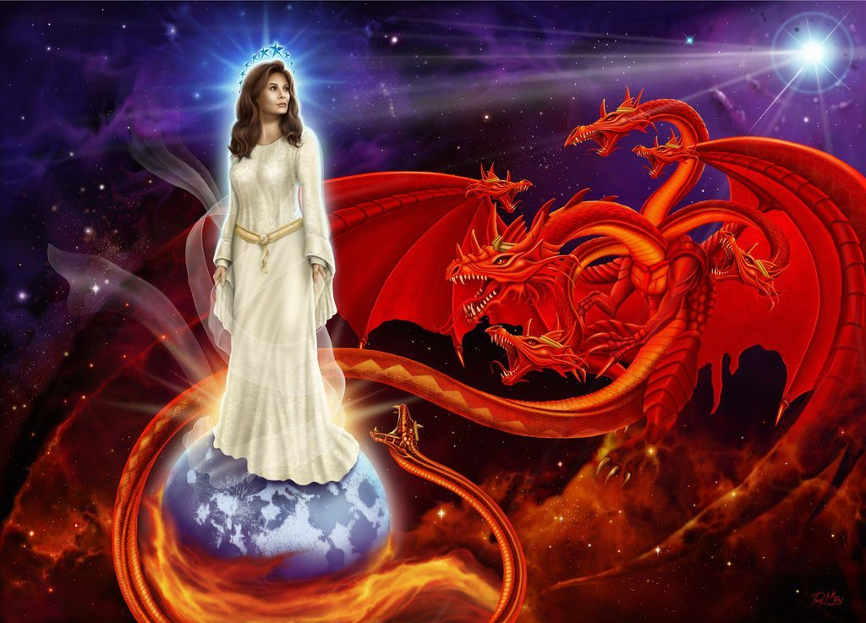
Revelation 12
Vs 1-6
VS. 7-9

Slide 8
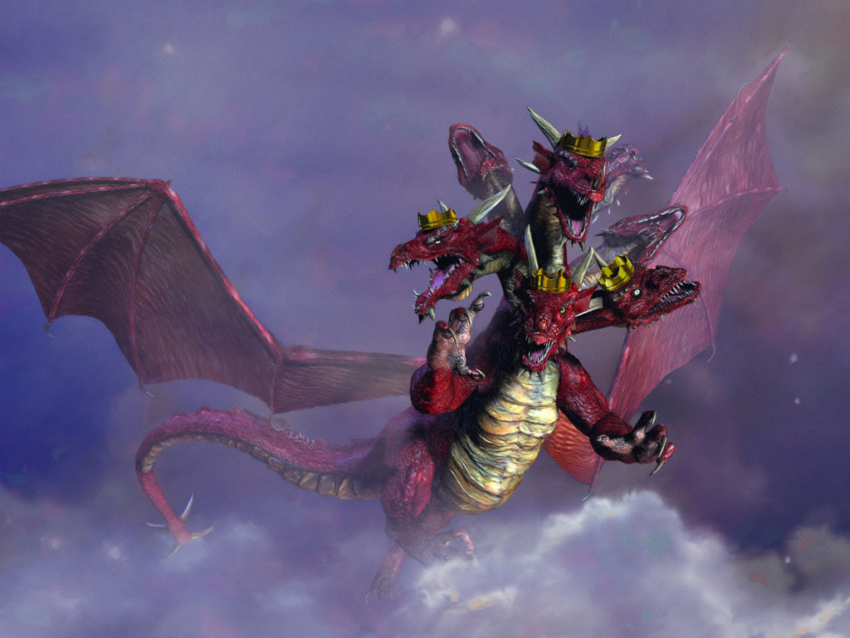
Rev 12:12 “Woe to the inhabiters of the earth!
for the devil is come down unto you, having great wrath,
because he knoweth that he hath
but a short time.”

Slide 9
2. The Transition:
A. There’ll be a possible assassination attempt.
1) Satan will possess (and apparently resurrect) him.
(Rev. 13:3) “And I saw one of his heads as it were wounded to death; and his deadly wound was healed:
and all the world wondered after the beast.”
2 Thes. 2:3,9 “the son of perdition…
whose coming is after the working of Satan”

Slide 10
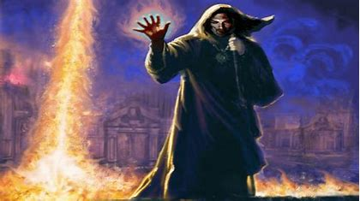
2. The Transition: “Resurrection of the Beast”
B. His “False Prophet” will do miracles. Rev 13:12-15
“he exerciseth all the power of the first beast before him, and causeth the earth and them which dwell therein to worship the first beast,
and doeth
great wonders…”

Slide 11
2. The Transition: “Resurrection of the Beast”
C. He will Desecrate the Temple demanding worship.
2 Th 2:3,4 “the son of perdition…opposeth and exalteth himself above all that is called God, or that is worshipped;
so that he as God sitteth in the temple of God,
shewing himself that he is God.”

Slide 12
This ushers in The Great Tribulation. Mt 24:15-24
“When ye therefore shall see the abomination of desolation, spoken of by Daniel the prophet, stand in the holy place, (whoso readeth, let him understand:)
Then let them …in Judaea flee to the mountains:
“for then shall be great tribulation,
(megas thlipsis: intense pressure, anguish, persecution)
such as was not since the beginning of the world to this time, no, nor ever shall be.”

Slide 13
3. The Great Tribulation will be…
A. A time of Incredible Manipulation.
(Big, oppressive, intrusive Government.)
1) Global Identification. Rev 13:16 “he causeth all
…to receive a mark in their right hand, or foreheads:”
2) Global currency Control. Rev. 13:17 “that no
man might buy or sell, save he that had the mark,
or the name of the beast, or the number of his name.”
This technology currently exists!

Slide 14
3. The Great Tribulation. Mt 24:15-24
B. A time of intentional Deception.
Rev. 13:12-15 “he …causeth the earth to worship the first beast, and doeth great wonders and deceiveth them that dwell on the earth by the means of those miracles which he had power to do…”
2 Th. 2:3,9 “whose coming is after the working
of Satan with all power and signs and lying wonders and deceivableness of unrighteousness
…because they received not the love of the truth that they might be saved.”

Slide 15
3. The Great Tribulation. Mt 24:15-24
C. A Time of Intense Persecution. Mt. 24:21,22
“then shall be great tribulation, (megas thlipsis)
(intense pressure, anguish, persecution)
such as was not since the beginning of the world to this time, no, nor ever shall be.
And except those days should be shortened,
there should no flesh be saved: ”

Slide 16
C. Intense Persecution. Da 7:7, “I beheld a beast, dreadful and terrible, and strong exceedingly; and it had great iron teeth: it devoured and brake in pieces… and had 10 horns…and another horn…speaking great things…”
21 I beheld, and the same horn made war with
the saints, and prevailed against them…”
1) The Beast is the final world Government.
2) The Horn is the Anti-Christ leading it.

Slide 17
C. A Time of Intense Persecution.
3) The False Prophet “causeth the earth to worship the first beast, and doeth great wonders…deceiveth them that dwell on the earth by the means of those miracles
and cause that as many as would
not worship the image of the beast
should be killed.”
Rev. 13:12-15

Slide 18
Rev 6:1 “when the Lamb opened one of the seals, and I heard, as it were the noise of thunder, …saying, Come and see.”
Anti-Christ
Death
War
Famine
Vs 2 “and behold a white horse: and he that sat on him had a bow;
and a crown was given unto him: and he went forth …to conquer.”

Slide 20
3. Great Tribulation. (Manipulation, Deception, Persecution)
D. A Limited Duration. Mt. 24:21
1) This period will be limited to 42 months. Rev. 12:14; 13:5
Mt. 24:22“except those days should be shortened, there should no flesh be saved:
for the elect's sake they shall be shortened.”
Daniel 7:25 “he shall speak great words against the most High, and shall wear out the saints of the most High,
…and they shall be given into his hand until a time and times and the dividing of time.” 3 ½ years

Slide 21
Conclusion: During the 7 year Tribulation God will:
Allow the Beast to have his “way” for 42 months.
Miraculously protect the faithful Jews for these 42
months. (Rev. 12:14)
Send two prophets to preach for 42 months. (Rev. 11)
Call 144,000 Jewish evangelists to preach the
gospel. (Rev. 14)
Send a special angel to preach. (Rev. 14:6)
Send a series of 28 Divine Judgments on the world.

Slide 22
Daniel 7:21-22 “I beheld, and the same horn made war with the saints, and prevailed against them;
Until the Ancient of days came, and judgment was given to the saints of the most High; and the time came that the saints possessed the kingdom.
27 And the kingdom and dominion, and the greatness of the kingdom under the whole heaven, shall be given to the people of the saints of the most High,
whose kingdom is an everlasting kingdom, and all dominions shall serve and obey him.”

Slide 23
This Great Tribulation is:
Horrible
Inevitable
Avoidable! 1 Thes. 5:2-11
“the day of the Lord so cometh as a thief in the night.
For when they shall say, Peace and safety;
then sudden destruction cometh upon them, as travail upon a woman with child;
and they shall not escape.”

Slide 24
This Great Tribulation is Avoidable! 1 Th. 5:
But ye, brethren, are not in darkness, that that day should overtake you as a thief.
5 Ye are all the children of light, and of the day: we are not of the night, nor of darkness.
6 Therefore let us not sleep, as do others;
but let us watch and be sober…
8 But let us, who are of the day, be sober, putting on the breastplate of faith and love; and for an helmet, the hope of salvation.

Slide 25
This Great Tribulation is Avoidable! 1 Th. 5:
For God hath not appointed us to wrath,
but to obtain salvation
(sōtēri’a: rescue, deliverance)
by our Lord Jesus Christ, who died for us…”
God has an “appointment”
for your salvation!
2 Pt. 3:9 “God is not willing that any should perish,
but that all should come to repentance.”

Slide 26
This Great Tribulation is Avoidable! 1 Th. 5:
God has an “appointment” for your salvation.
2 Cor 6:1-2 “We, as workers together with him, beseech you also that ye receive not the grace of God in vain.
(Grace {Char’is} God’s influence on the heart…)
For he saith, I have heard thee in a time accepted,
There may be a time he won’t hear you! Pr. 1:20-33
and in the day of salvation have I succored thee:”

Slide 27
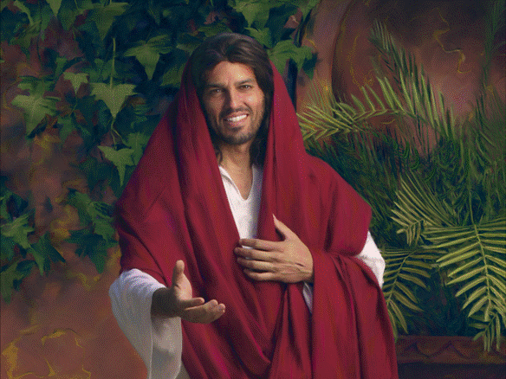
This Great Tribulation is Avoidable! 1 Th. 5:
God has an “appointment” for your salvation.
2 Cor 6:2 “behold, now is the accepted time;
behold, now is the day of salvation.”
Will you keep God’s appointment?
Rev. 3:20

