Slide 1
Our Character is fashioned by Communication.
“Be not deceived: evil communications
corrupt good manners.” 1 Cor 15:33
Good communication transforms:
Acquaintances into Friends.
Friends into Partners!

Slide 2
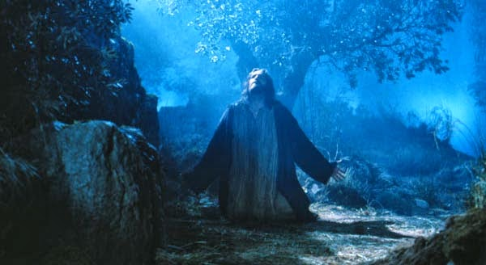
“As he was praying in a certain place, when he ceased…his disciples said…
Lord, teach us to pray.”
Luke 11:1-4

Slide 3
Mt. 6:9 “After this manner pray:”
1. “Father” (Personal Relationship)
2. “In heaven” (Eternal Perspective)
3. “Hallowed by thy name”
(Powerful Awareness)
4. “Thy Kingdom come”
(Partisan Allegiance)
5. “Thy Will be done…”
(Purposeful Submission)

Slide 4
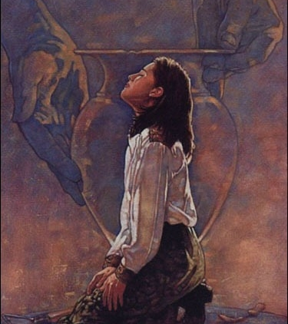
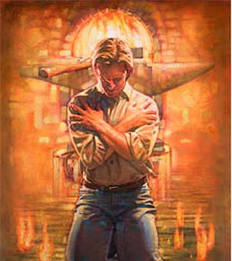
This is at the heart of Repentance!

Slide 5
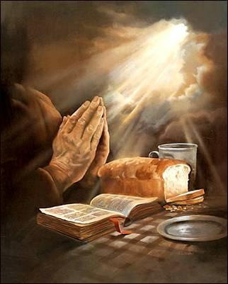
“Give us this day our daily bread”
Prayer for Practical Provision comes after we seek…
“Thy Name…(Hallowed)
Thy Kingdom…(Come)
Thy Will (Be done).

Slide 6
“Give us this day our daily bread”
1. God’s Priorities should come
before:
Personal petitions
(Our Wants)
Practical provisions
(Our “worries” {Needs})

Slide 7
1. God’s Priorities before our petitions.
A. Jesus consistently taught this. Mt. 6:19-24
“Lay not up for yourselves treasures on earth..
but lay up for yourselves treasures in heaven..
For where your treasure is,
there will your heart be also!
No man can serve two masters…
Ye cannot serve God and _______!”

Slide 8
God’s Priorities before our petitions.
1) Mt. 6:25 “Therefore...(in light of this truth)
Take no thought for your life,
(merimna’ō: full of anxiety, worry)
from meriz’o: divided and distracted.
what ye shall eat…drink…put on.
Is not the life more than meat, (Food)
and the body than raiment?” (Clothes)

Slide 9
2) Vs 26 “behold (discern clearly) the fowl…
your heavenly Father feeds them.
Vs 27 which of you by taking thought can
add one cubit...?
28 consider (learn thoroughly) the lilies…
30 “Wherefore, if God so clothe the grass…
Shall not he much more clothe you,
O ye of little faith?”
(Does worrying work?)

Slide 10
“O ye of little faith?”
B. What do our “thoughts”
(merimna’ō: worries/fears, frustrations)
have to do with faith?
Pressures often reveal Priorities!
What’s truly important to us!

Slide 11
1. God’s Priorities before our petitions.
2. Our priorities demonstrate
our persuasion.
A. Faith (pistis) means Persuasion.
B. Becoming persuaded usually
involves a process!
(Faith/Belief)

Slide 12
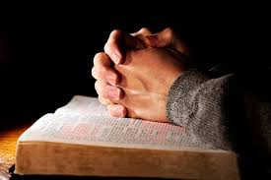
Ro. 10:17 “faith cometh by hearing,
and hearing by the word of God.”

Slide 13
Faith (persuasion) grows through:
1) Intentional Interaction. Is. 1:18
“Come now and let us reason together saith the LORD…”
Is 55:3 “Incline your ear, and come unto me:
hear, and your soul shall live; and I will make an everlasting covenant with you”
6 “Seek the Lord while He may be found”

Slide 14
Faith (persuasion) grows through:
2) Genuine consideration. Hag. 1:5
“thus saith the Lord, consider your ways”
Is. 55:8,9 “my thoughts (plans) are not your thoughts, neither are your ways, my ways.
as the heavens are higher than the earth, so are my ways higher than your ways…”

Slide 15
1) Intentional Interaction. (Time with God!)
2) Genuine consideration. (Reflection)
This is the heart of Repentance! Mt 4:17
“Repent for the Kingdom of heaven is at hand”
metanoe’ō: Literally to reconsider!
Meta: (preposition) “after, amid, with”
Noye’o: (verb) to exercise the mind,
comprehend, perceive.

Slide 16
Faith (persuasion) grows through:
3) Humble reconciliation. Is. 55:7, 8
“Let the wicked forsake his way, and the unrighteous man his thoughts…
let him return unto the LORD,
and he will have mercy upon him;
for he will abundantly pardon.”

Slide 17
C. Jesus illustrated this process of
Growing in our faith (Persuasion)
by adjusting our priorities. (Mt. 6)
1) Intentional Interaction. (Connect!)
Vs 9-15 “Our Father in heaven…
Thy name.. thy Kingdom…thy Will…”

Slide 18
2) Genuine consideration. (Reflect)
21,24 “where your treasure is, there will your heart be also…No man can serve two masters”
24-31 “is not the life more than meat?
Behold the fowls, consider the lilies…
Therefore take no thought, saying,
What shall we eat or drink or..be clothed?”

Slide 19
2) Genuine consideration. (Reflect)
32 For after all these things do the Gentiles seek:
People who don’t know God!
for your heavenly Father knoweth
that ye have need of all these things.”

Slide 20
3) Humble reconciliation (Reconcile)
Mt 6:33 “but seek ye (zeteo: desire)
first (proton: primarily)
the kingdom of God,
(basileia: realm, royalty, rule)
and his righteousness; (equity of character)
and all these things (that you need)
shall be added unto you.”

Slide 21
Connect (Intentional Interaction)
Reflect (Genuine Consideration)
Reconcile (Humble Reconciliation)
= Rest (Peaceful Restoration)
Jesus not only taught this,
but He also modeled this process.

Slide 22
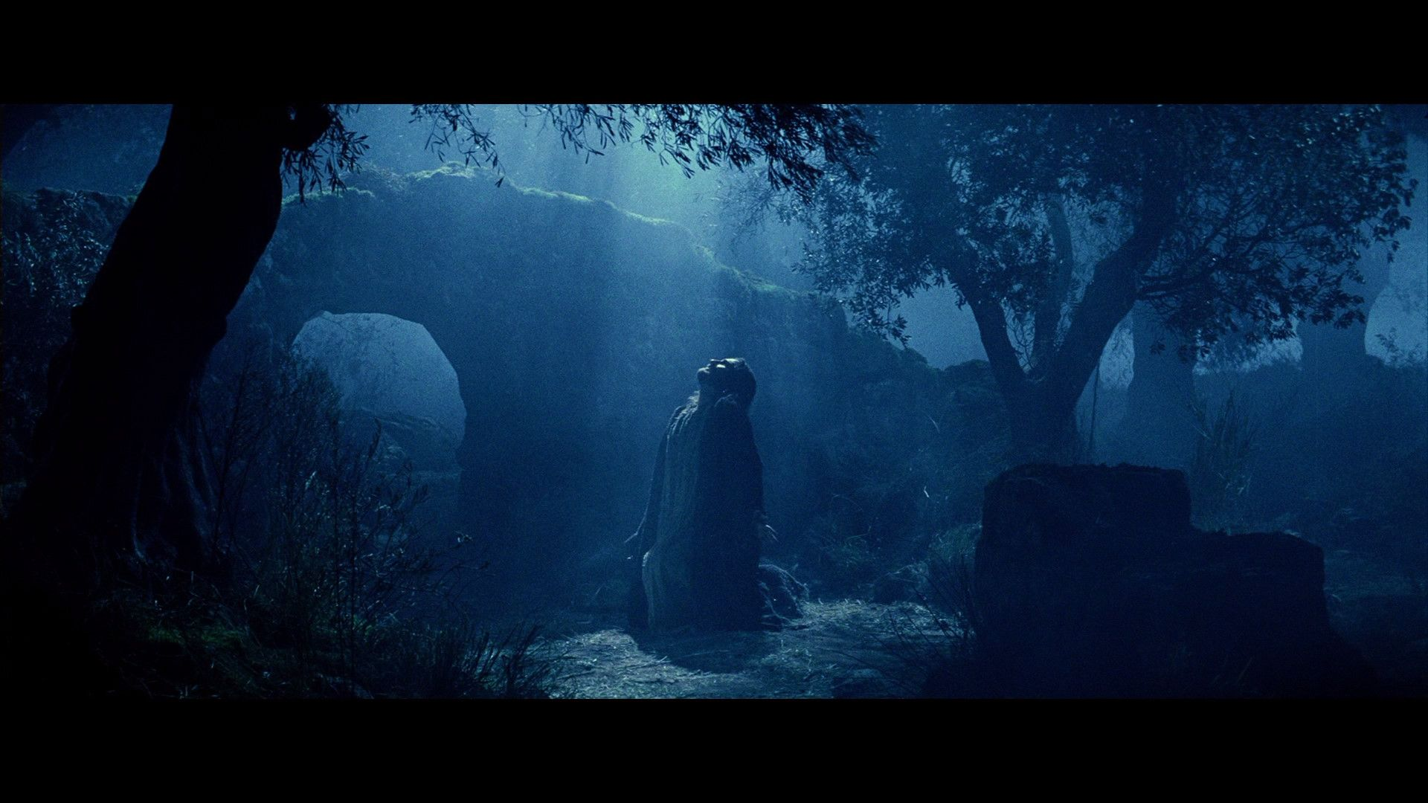
Mt 26:38 “My soul is exceeding sorrowful…”
Connect: “He prayed…O my father,
If it be possible, let this cup pass.”
Reflect: “Nevertheless, not as I will,
but as thou wilt.” Mt. 26:39

Slide 23
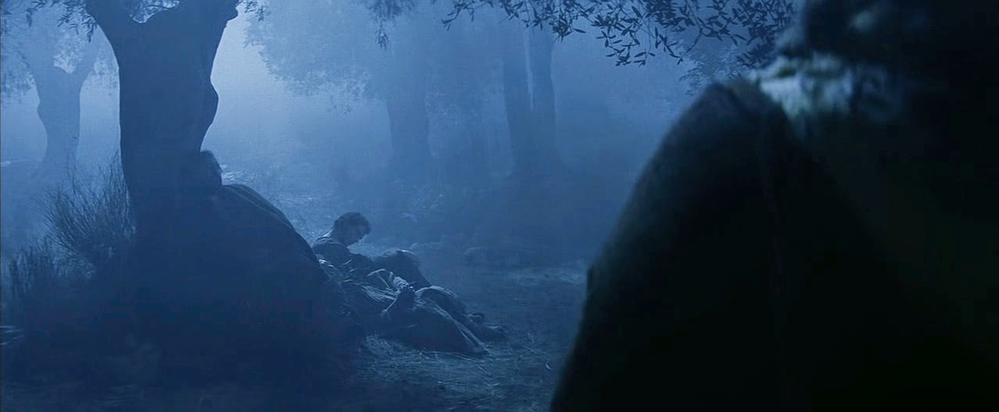
Mt 26:40 “And he cometh unto the disciples, and findeth them asleep, and saith unto Peter, What, could ye not watch with me one hour?
“Watch and pray, that ye enter not into temptation: the spirit indeed is willing,
but the flesh is weak.” Vs. 41

Slide 24
Reconcile: “He went away again the
second time, saying, O my Father,
if this cup may not pass away from me, except I drink it, thy will be done.” 42

Slide 25
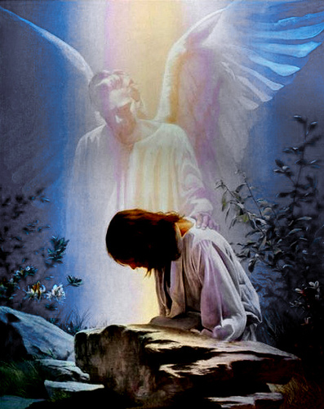
Connect + Reflect + Reconcile = Rest
“And there appeared an angel …from heaven,
strengthening him.”
Luke 22:43
Peace (from eiro: to join)
Comes through partnership (with God)
(Philippians 4:6,7)

Slide 26
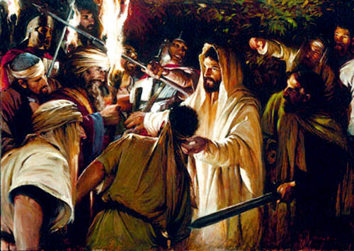
Jn 18:11 “Put up thy sword into the sheath: the cup which my Father hath given me,
shall I not drink it?”

Slide 27
Application: Mt 6:33
“seek ye first the kingdom of God
All these things shall be added”
1) Which “Kingdom” is first in
your priorities and prayers?
2) Where are you in the process of
growing your faith?

Slide 28
Are you regularly:
Connecting with God?
Reflecting on God’s priorities?
Reconciling with God’s plans?
If not, Why not?
If not now, When?

Slide 29
Notice how Jesus concluded: Mt 6:34
“Take therefore no thought for the morrow:
for the morrow shall take thought
for the things of itself.
Sufficient unto the day (arketos’ hemer’a) (enough to keep us comfortably at ease)
is the evil (kaki’a: malignity) thereof.”
The Cancer of Complacency!

