Slide 1
Learning to Love
1 Corinthians 13

Slide 2
God’s gifts of love include:
Physical: (Eros: erotic) Pr 5:18,19
Emotional: (Philos: Affection) Titus 2:3,4
Spiritual: (Agape: Charity) 1 Cor 13
Each of these types of love are gifts from the God of Love! (James 1:17)
We can (and should) learn to grow in our expression and appreciation of each of these “sacred” gifts.

Slide 3
“The greatest of these is charity”
Eros and Philos are depended on the quality of our relationship with the object of our love.
Agape is depended on the quality of our relationship with the source of this Love.
“God is Love” (1 Jn. 4:8)

Slide 4
“The greatest of these is charity”
1 Cor 13 provides a description of some of the different “dimensions” of agape love.
“Charity suffereth long
(patient endurance)
and is Kind”
(practical benevolence)

Slide 5
“The greatest of these is charity”
God uses the pressures of life (Ro. 8:28) to produce the qualities of agape Love in our lives.
Ro. 5:3-5 “Tribulation worketh patience;
and patience, experience; and experience, hope..
because the love of God is shed abroad in our hearts
by the Holy Ghost”

Slide 6
“The greatest of these is charity”
The other qualities listed in this chapter give examples of what
“practical kindness under pressure”
Actually looks (and doesn’t look) like.
So we can distinguish between the real and the counterfeit.

Slide 7
It’s sometimes easier to understand (or appreciate)
what something is,
by recognizing
what it’s not!

Slide 8
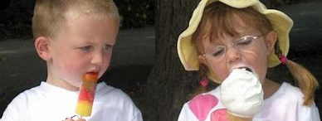
1. “Charity Envieth not”

Slide 9
1. Agape is not Envious
“Envieth not” Vs 4
Definition:
1) Webster: a feeling of discontented or
resentful longing aroused by someone
else’s possessions, qualities, or luck.
2) Greek: Zēlo’ō: To Envy or covet
From zē’los: Heat, (anger)
Jealous
Notes:
See also Psalm 37:1; Proverbs 27:4; 1 Timothy 6:4; Titus 3:3.

Slide 10
Agape is not Envious
B. Explanation: Envy:
1) Based on Selfishness.
2) Violates the 10th Commandment. (Ex. 20:17)
3) Comes from comparisons. 2 Cor 10:12
“they, measuring … by themselves, and comparing themselves among themselves, are not wise.”
4) Produces resentment and bitterness…
5) Which poisons relationships. (Heb. 12:15)
“thereby many be defiled”
Notes:
See also Psalm 37:1; Proverbs 27:4; 1 Timothy 6:4; Titus 3:3.

Slide 11
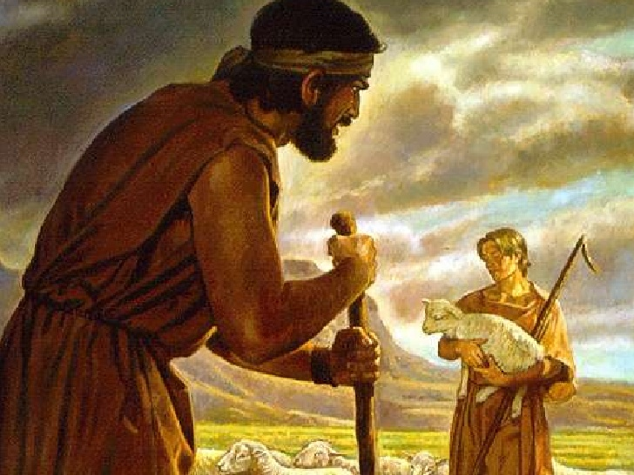
Agape is not envious…
C. Illustration: Cain. Gen. 4:3–8; 1 John 3:12
Notes:
See also Psalm 37:1; Proverbs 27:4; 1 Timothy 6:4; Titus 3:3.

Slide 12
Agape is not envious…
1 John 3:11-13 “this is the message that ye heard from the beginning,
that we should love one another.
¹² Not as Cain, who was of that wicked one, and slew his brother. And wherefore slew he him? Because his own works were evil,
and his brother's righteous.”
Notes:
See also Psalm 37:1; Proverbs 27:4; 1 Timothy 6:4; Titus 3:3.

Slide 13
“Charity vaunteth not itself, is not puffed up.” Vs 4
Notes:
See also Psalm 10:3; Proverbs 25:14.
Image ©Manuel

Slide 14
2. Agape is not Arrogant
“vaunteth not itself, is not puffed up”
A. Definition:
1) Webster’s: having an exaggerated sense of
one's own importance or abilities:
2) Greek Vaunt:(perpereu’omai)
To brag or boast.
“Puffed up” (physio’ō) inflated.
Notes:
See also Psalm 10:3; Proverbs 25:14.
Image ©Manuel

Slide 15
2. Agape is not Arrogant
B. Explanation. Agape is about giving!
1) That’s why anything done for self
glorification is empty. Vs 1-3 (Eccl.)
2) God hates pride! (Pr. 6:16-19)
3) Pride produces Conflict. Pr 13:10
“Only by pride cometh contention”
zādôn: arrogance, presumption.
Notes:
See also Psalm 10:3; Proverbs 25:14.
Image ©Manuel

Slide 16
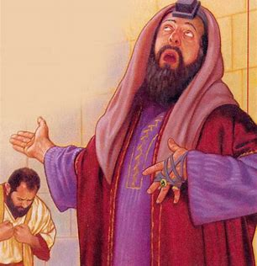
C. Illustration. Mark 12:38-40
“Beware of the scribes, which love to go in long clothing, and love salutations in the market, the chief seats in the synagogues, and the uppermost rooms at feasts:
Which devour widows' houses, and for a pretense make long prayers:
these shall receive greater damnation.”
(also Luke 18:10-14)
Notes:
See also Psalm 10:3; Proverbs 25:14.
Image ©Manuel

Slide 17
3. Agape is not inappropriate
Vs. 5 “Doth not behave itself unseemly”
A. Definition:
1) Webster: not suitable or proper in the
circumstances
2) Greek: aschēmone’ō: unattractive,
inappropriate.
Notes:
See also Psalm 10:3; Proverbs 25:14.
Image ©Manuel

Slide 18
3. Agape is not inappropriate
B. Explanation:
1) Standards of “appropriate” have changed!
a) Language (slang)
b) Dress/clothes
c) Music, Dance, art, etc.
d) Behavior.
2) Shifting standards affect our relationships
because they affect & reflect our Values!
Notes:
See also Psalm 10:3; Proverbs 25:14.
Image ©Manuel

Slide 19
3. Agape is not inappropriate
3) We must be Principled people or we’ll drift with the changing currents of our culture!
Pr. 22:28 “Remove not the ancient landmarks”
Heb. 6:19 “Which hope we have as an anchor
of the soul, both sure and steadfast”
Agape love considers the impact our actions and attitudes might have on others.
1 Cor 10:23-33
Notes:
See also Psalm 10:3; Proverbs 25:14.
Image ©Manuel

Slide 20
Israel drifted from God.
“To whom shall I speak, and give warning?
the word of the LORD is unto them a reproach; they have no delight in it.
Were they ashamed when they had committed abomination?
nay, they were not at all ashamed,
neither could they blush:” Jer 6:10,15
Notes:
See also Psalm 10:3; Proverbs 25:14.
Image ©Manuel

Slide 21
Israel drifted from God!
“Thus saith the LORD, Stand ye in the ways, and see, and ask for the old paths,
where is the good way, and walk therein,
and ye shall find rest for your souls.
But they said,
We will not walk therein!”
Jeremiah 6:16
Notes:
See also Psalm 10:3; Proverbs 25:14.
Image ©Manuel

Slide 22
C. Promoting the inappropriate.
1) Jimmy Kimmel commenting on “Best Picture” Oscar Nominations said:
"of the nine best picture nominees
only two made more than $100 million.
But that's not the point.
We don't make films like 'Call Me By Your Name' for money.
We make them to upset Mike Pence.“
Aka: Christians
Notes:
See also Psalm 10:3; Proverbs 25:14.
Image ©Manuel

Slide 23
C. Example. Hollywood agendas
2) Another 2018 “best picture nomination was for the movie “A Fantastic Woman”.
The “Fantastic Woman” is actually a man (transgendered) and played by a “Transgendered” actor/actress(?)
3) Reality show “dating naked” was finally canceled after 3 seasons!
Notes:
See also Psalm 10:3; Proverbs 25:14.
Image ©Manuel

Slide 24
Proverbs 10:32
“The lips of the righteous know what is acceptable: (rāṣôn: helpful, delightful)
but the mouth of the wicked speaketh frowardness.”
(tahpukôt’: perversity, to overturn!)
God calls us to be people of principle
in the midst of this perversity!
Notes:
See also Psalm 10:3; Proverbs 25:14.
Image ©Manuel

Slide 25
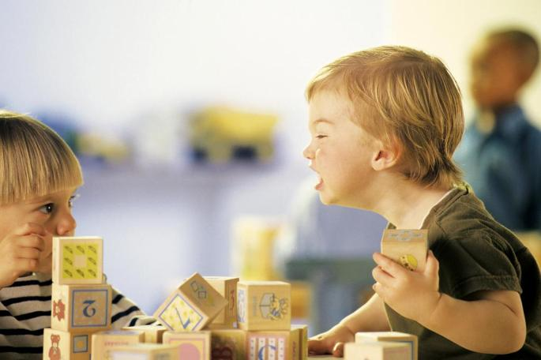
4. Agape is not selfish
vs 5 “Seeketh not her own”
A. Definition:
Lacking consideration
for others.
Concerned chiefly with
one's own interests,
profit or pleasure.
Notes:
See also Psalm 10:3; Proverbs 25:14.
Image ©Manuel

Slide 26
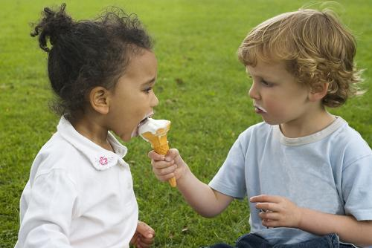
4. Agape is not selfish
vs 5 “Seeketh not her own”
B. Explanation: Agape is “other” focused.
That’s what motivates it to give!
“ye have been called unto liberty; use not liberty for an occasion to the flesh,
but by love serve one another.”
Galatians 5:13
Notes:
See also Psalm 10:3; Proverbs 25:14.
Image ©Manuel

Slide 27
Jesus is the antithesis of selfishness
Matthew 11:29
“Take my yoke upon you,
and learn of me;
for I am meek
and lowly in heart.”
praos: Humble, gentle.
Notes:
See also Psalm 10:3; Proverbs 25:14.
Image ©Manuel

Slide 28
Conclusion: Phil. 2:1-2
“If there be therefore any consolation in Christ, if any comfort of love, (agape)
if any fellowship of the Spirit,
if any bowels (sympathies) and mercies,
Fulfil ye my joy, that ye be likeminded,
having the same love, (agape)
being of one accord, of one mind.”
How can many be of “one” mind?
Notes:
See also Psalm 10:3; Proverbs 25:14.
Image ©Manuel

Slide 29
Philippians 2:3-6
“let nothing be done through strife or vainglory;
but in lowliness of mind, let each esteem other,
better than themselves….
Let this mind be in you
which was also in Christ.
Who, being in the form of God thought it not robbery to be equal with God.
Notes:
See also Psalm 10:3; Proverbs 25:14.
Image ©Manuel

Slide 30
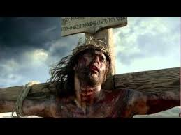
Philippians 2:7,8 “But made himself of no reputation,
and took upon him the form of a servant,
and was made in the likeness of men: And being found in fashion as a man,
he humbled himself,
and became obedient unto death,
even the death of the cross.”
Notes:
See also Psalm 10:3; Proverbs 25:14.
Image ©Manuel

Slide 31
He completely demonstrated God’s Agape Love!
Romans 5:8 “God commendeth his love toward us, in that,
while we were yet sinners,
Christ died for us.
Notes:
See also Psalm 10:3; Proverbs 25:14.
Image ©Manuel

Slide 32
God’s still looking to demonstrate His love!
Ph. 2:13-16 “it is God which worketh in you
both to will and to do of His good pleasure.
Do all things without murmurings and disputings:
That ye may be blameless and harmless,
the sons of God, without rebuke,
in the midst of a crooked and perverse nation,
among whom ye shine as lights in the world;
Holding forth the word of life…”
Notes:
See also Psalm 10:3; Proverbs 25:14.
Image ©Manuel

Slide 33
We do this by demonstrating Love that:
“suffereth long, and is kind; … envieth not; … vaunteth not itself, is not puffed up, Doth not behave itself unseemly, seeketh not her own…”
Will you allow God to develop His agape love in your life? “to will” Ph. 2:13
Will you allow Him to “demonstrate” it through your life? “to do” Ph. 2:13
Notes:
See also Psalm 10:3; Proverbs 25:14.
Image ©Manuel

