Slide 2
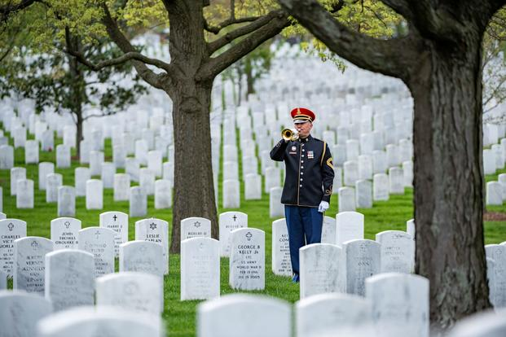
More than 1 million Americans have died
in War since our founding!.

Slide 3
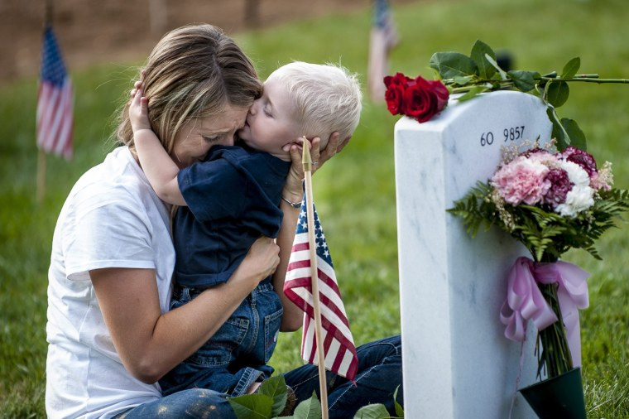
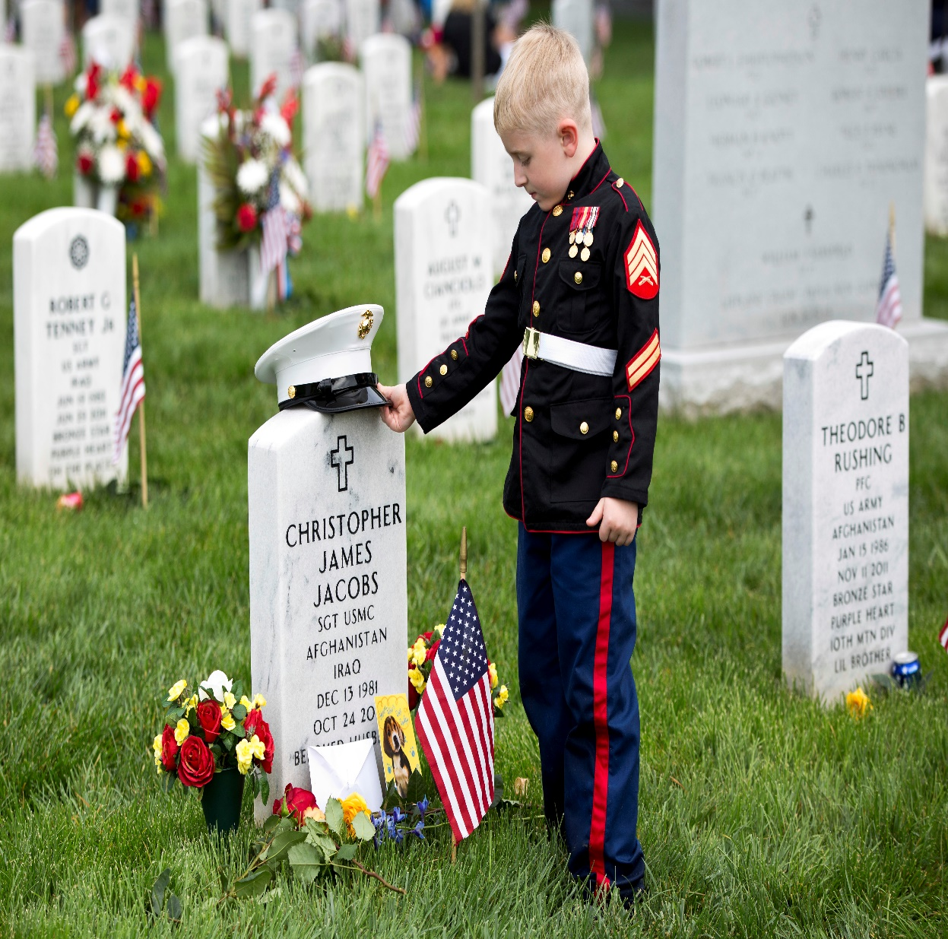
Behind each life is a story;
Behind each death/injury is a grieving family!

Slide 4
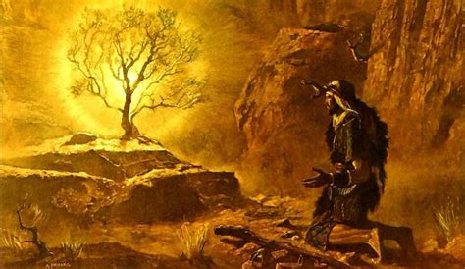
Ex 3:14-15
“I AM THAT I AM:…
this is my name for ever,
this is my memorial.”
Zēker: to remember
Dt 8:2 “thou shalt remember all the way which the LORD thy God led thee these forty years in the wilderness,
to humble thee, and to prove thee,
to know what was in thine heart,
whether thou wouldest keep his commandments, or no. “

Slide 5
Last week we discussed how God intercepted Abram at least 7 times to invite, encourage, and direct him toward God’s “Expected End”.
There were several times in which Abraham either initiated or responded to a meeting with God and erected an altar or “Memorial”
to commemorate those meetings.
Notice Abram’s Memorial Altars!

Slide 6
Altar at Sichem. Gen. 12:6,7
A. Abram’s Problems
1) He’d come through a 5 year delay/detour.
a) Would God meet and/or speak with him?
2) The land was inhospitable. (Mountainous)
“Abram passed through the land unto …Sichem,
(from Shechem: a place of burdens, to load up)
3) He was alone. (He’d left his family in Haran)

Slide 7
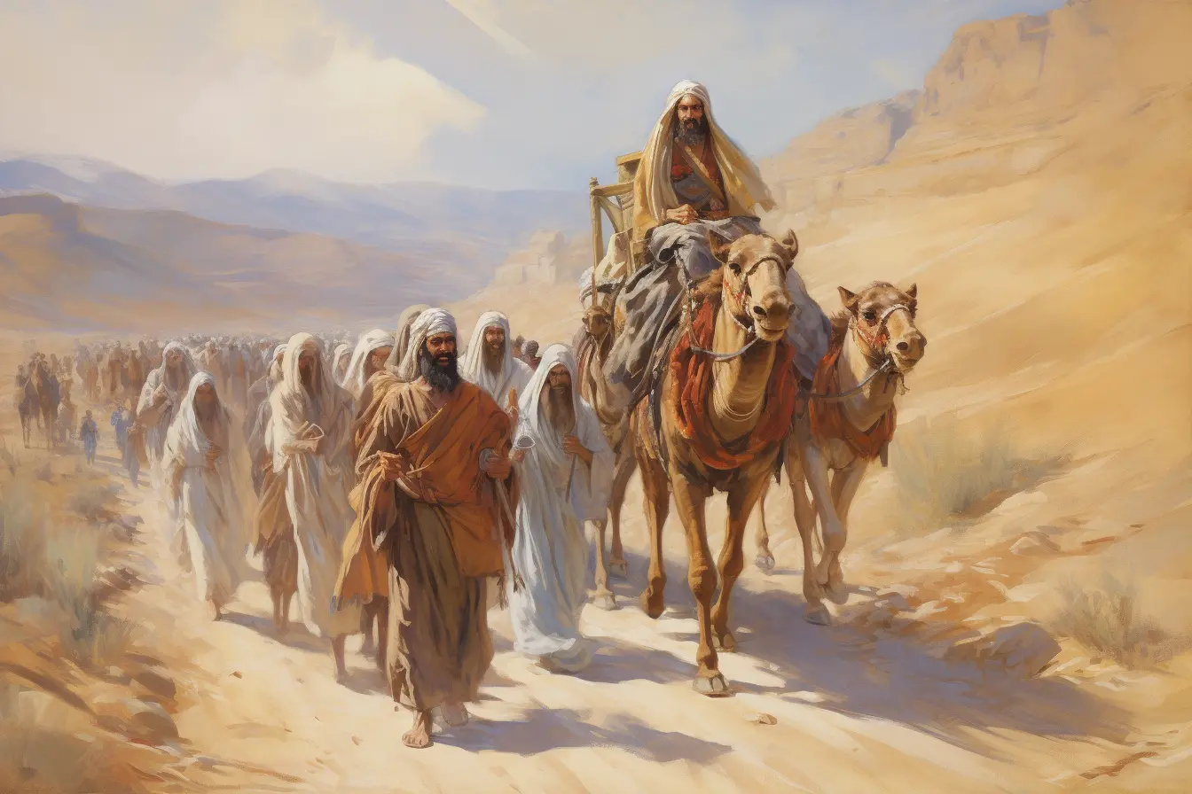
A. Abram’s Problems
4) The Canaanites were wicked/dangerous
Gen 12:6 “…Unto the plain of Moreh (archer)
And the Canaanite was then in the land.”

Slide 8
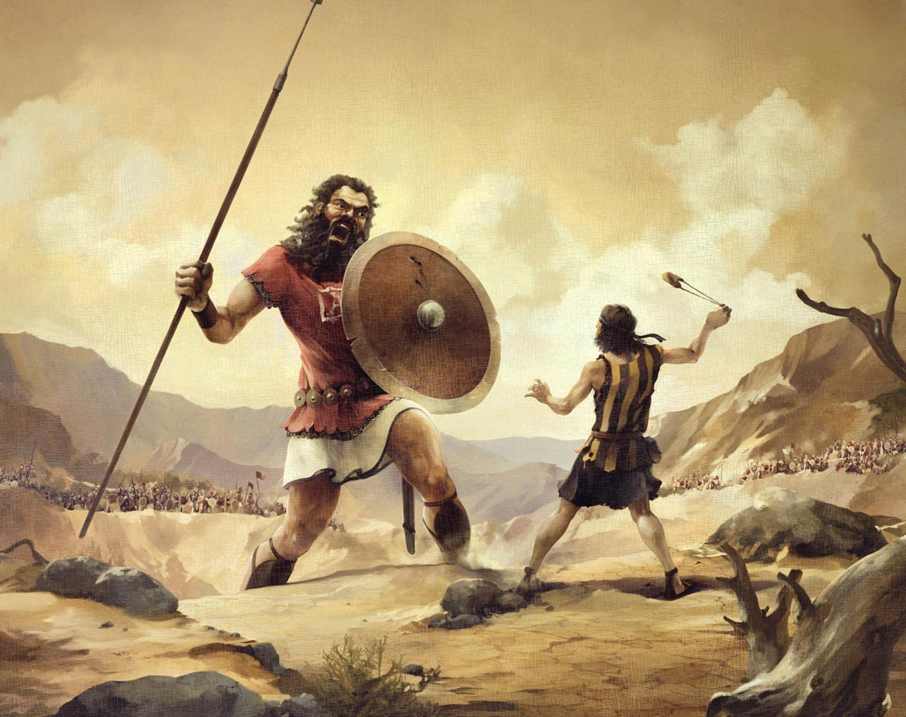
Dt 2:20-21
“That was accounted a land of giants:…
A people great, many, and tall, as the Anakims”
Remember David and Goliath?

Slide 9
Altar at Sichem. Gen. 12:6,7
B. God’s Promise Vs 7 “the LORD appeared
…and said Unto thy seed will I give this land:”
1) Why was God silent for 5 years?
2) What was God’s immediate response when
Abram was ready to really obey?
3) What was Abram’s response to
God’s Promise?

Slide 10
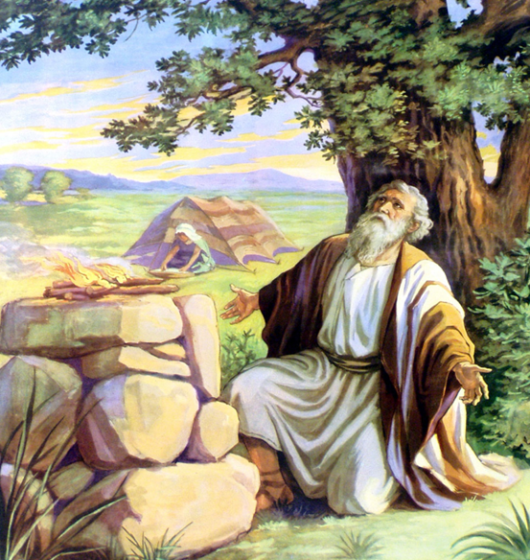
Altar at Sichem. Gen. 12:6,7
A. Abram’s Problems B. God’s Promise
C. Abram’s Praise: Vs 7 “there builded he an altar unto the LORD, who appeared unto him.”
Mizbēah:̣ from zābaḥ: to kill, sacrifice
1) He didn’t ask God for anything
but simply offered Him:
“The sacrifice of Praise”
Jer. 33:11; Heb. 13:15

Slide 11
2. Altar at Bethel. Gen. 12:8
A. Abram’s Problem. 8a “he removed from thence unto a mountain on the east of Bethel, and pitched his tent, having Bethel (house of God) on the west,
and Hai (ruin) on the east:”
1) Things (circumstances) weren’t improving!
a) “The Canaanite was (still) in the land” vs 6
b) “but Sarai was (still) barren.” 11:30
c) “There was famine in the land” Vs 10

Slide 12
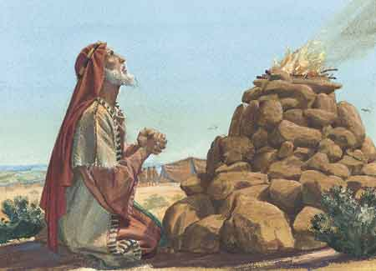
2. Altar at Bethel. Gen. 12:8
B. Abram’s Purpose. In his disappointment
Vs 8b“and there he builded an altar unto the LORD,
C. Abram’s Prayer 8c
“and called (qārāʾ: to cry out)
upon the name (shem: name,
honor, authority)
of the LORD.”

Slide 13
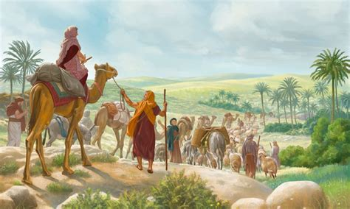
D. Abram’s Parenthesis. Gen. 12:10-20
1) When God didn’t change his circumstances,
he began to drift toward Egypt (Vs 9)
In an attempt to change his own circumstances and meet his own “needs”. 10-20
2) After some horrible
decisions and God’s
providential intervention,
he returns to Bethel 13:3,4

Slide 14
Genesis 13:3-4 “And he went on his journeys from the south even to Bethel, unto the place where his tent had been at the beginning,
between Bethel (House of God) and Hai; (Ruin)
⁴ Unto the place of the altar, which he had made:
and there Abram called on the name of the LORD.”

Slide 15
Abram’s Memorial Altars
Shechem: Praise Gen. 12:6,7 Bethel/Hai. Prayer Gen. 12:8
3. Hebron Genesis 13:3-18
A. Abram’s Problems.
1) Family Conflict. 13:3-7 “there was strife…”
rîb (contention);
Pr 13:10 “Only by pride cometh contention:
but with the well advised is wisdom.”
from rûwb (to contend, grapple)

Slide 16
3. Hebron Genesis 13:3-18
A. Abram’s Problem.
1) Family strife. 13:3-7 “there was strife…”
2) Cultural Corruption. 13:7 “and the Canaanite
and the Perizzite dwelled then in the land…
13 But the men of Sodom were wicked
and sinners before the LORD exceedingly”

Slide 17
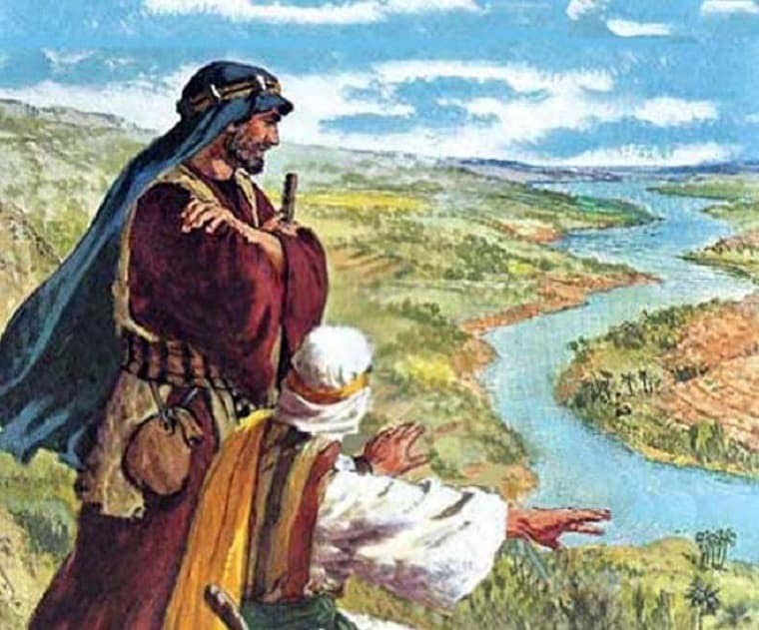
3. Hebron Genesis 13:3-18
B. Abram’s Proposal:
1) Give Lot first choice. Vs 8-9
11 “Then Lot chose him all the plain of Jordan; …and they separated themselves the one from the other.”
12 Abram dwelled in the land of Canaan,
and Lot dwelled in the cities of the plain,
and pitched his tent toward Sodom….
13 But the men of Sodom were wicked
and sinners before the LORD exceedingly”

Slide 18
C. God’s Renewed Promise. Genesis 13:14-17
“And the LORD said unto Abram,
after that Lot was separated from him,
Lift up now thine eyes, and look ...
For all the land which thou seest,
to thee will I give it, and to thy seed for ever.
And I will make thy seed as the dust of the earth…
Arise, walk through the land in the length of it
and in the breadth of it;
for I will give it unto thee.”

Slide 19
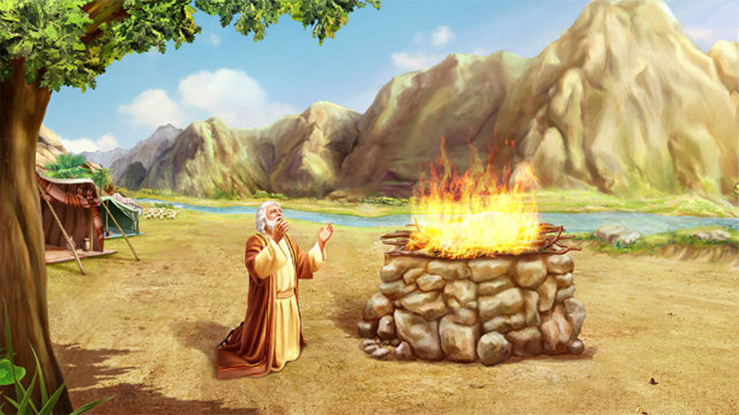
3. Altar at Hebron
D. Abram’s Peace Gen 13:18 “Then Abram removed … and dwelt in the plain of Mamre, (vigor)
which is in Hebron, (association)
and built there an altar unto the LORD.”
1) Our Peace is related
to our “association”.
a) Lot associated with Sodom
b) Abram associated with the LORD.

Slide 20
4. Altar (Memorial) at Moriah Gen. 22
mōriyyâ: from Raa (consider, see) and Jah (God)
A. Abraham’s Problem:
B. God’s Promise:
Gen 17:21 “my covenant will I establish with Isaac..”
C. Abraham’s Purpose:
D. God’s Provision. Vs 8
“My son God will provide himself a lamb
for a burnt offering”
Sacrifice Isaac to God. 2
Isaac was the promised son.
Trust and Obey vs 12

Slide 21
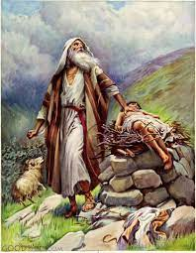
1) God Provided a Prophetic Picture. 11-14
13 “And Abraham lifted up his eyes, and behold behind him a ram caught in a thicket by his horns:
and Abraham took the ram,
and offered him up for a burnt
offering
14 And Abraham called the name of that place Jehovahjireh:
as it is said to this day,
in the stead of his son.

Slide 22
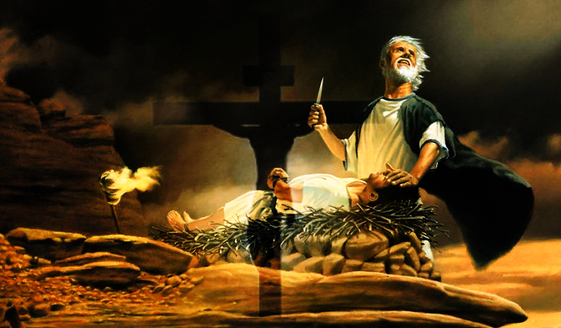
15 “In the mount of the LORD it shall be seen.”
Heb 11:19
“Accounting that God was able to raise him up,
even from the dead;
from whence also he received him in a figure.

Slide 23
At Abraham’s altars he exchanged:
His vacillation for Dedication (Praise)
at Sichem (place of burdens).
His frustration for Supplication (Prayer)
at Bethel (House of God).
His past perplexity for God’s Peace
at Hebron (Association).
4. His Personal hopes for God’s Practical and
Prophetic Provision At Moriah (God sees).

Slide 24
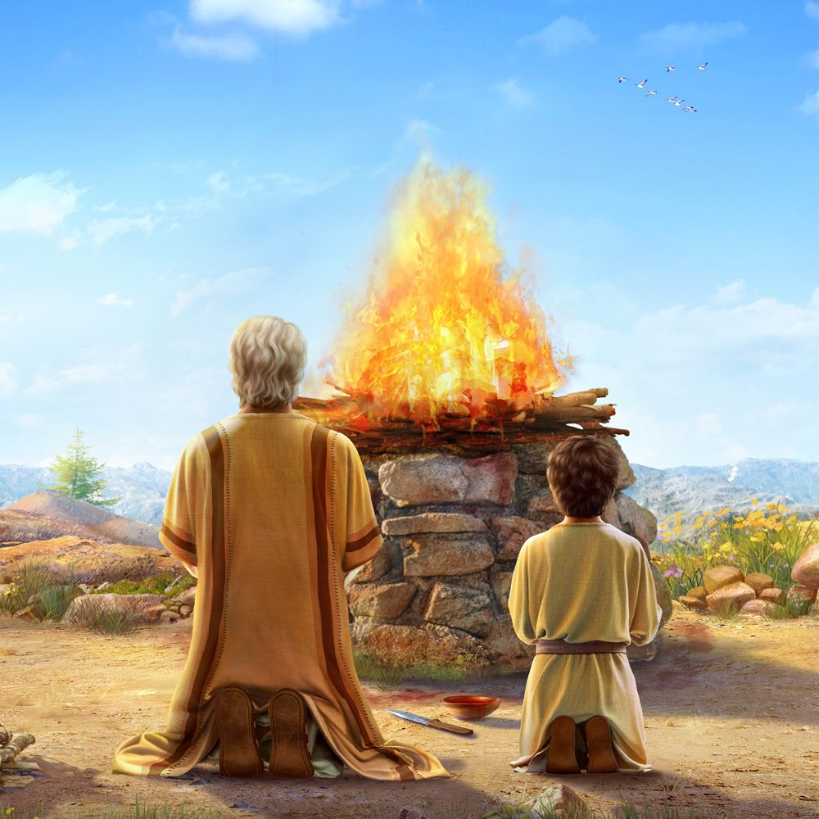
An altar is a place of sacrifice;
where something dies
and something else lives!
God didn’t really want Isaac (to die),
But Abraham To live:
To delight in God;
And live/walk by Faith.

Slide 25
Pr.23:26 “My son give me thine heart, and let thine eyes observe my ways.”
(Rāṣâ: delight in)
Ps 37:3-5 “Trust in the LORD, and do good; …
Delight thyself also in the LORD;
and he shall give thee the desires of thine heart.
Commit thy way unto the LORD;
trust also in him;
and he shall bring it to pass”.

Slide 26
What altars (sacrifice/dedication)
have you made to the Lord?
(1st time the word “Worship” is used was at Moriah)
Gen 22:5 “I and the lad will go yonder
and Worship!”

Slide 27
What “sacrifice” does God expect from us?
Rom 12:1 “I beseech you therefore…by the mercies of God,
that ye present your bodies a living sacrifice,
holy, acceptable unto God,
which is your reasonable service. “
logikos (logical) latreia (act of worship)

