Slide 2
“Follow Me and I will make you…
Fishers of men.”
You can’t follow Christ and stay where/what you are!
Since God’s ways are not our ways (Is. 55:8),
Adjustments are Necessary!

Slide 3
Mt 16:24-25
“If any man will come after me, let him deny himself, take up his cross, and follow me.
For whosoever will save his life shall lose it:
and whosoever will lose his life for my sake shall find it.”

Slide 4
Matthew 28:18-20 “All power is given unto me in heaven and in earth.
Go ye therefore, and teach all nations, baptizing them …:
Teaching them to observe all things whatsoever I have commanded you,
And Lo I am with thee always.”

Slide 5
Missionary: “One Sent” John 20:21
“as my Father hath sent me, even so send I you.”
God calls all of His people to “follow Him” and to be willing to make any adjustments that may be necessary in order to do so. (Ro. 12:1,2; Heb. 12:1,2)
I’d like to introduce some men that demonstrated this and changed the course of eternity for countless others as a result.
Their decisions set in motion events that rippled through time and eternity.

Slide 6
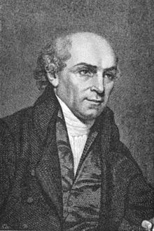
1. William Carey: 1761-1834
In 1785, Carey was the schoolmaster for the village of Moulton.
He also became the pastor to the local Baptist church.
During this time he read Jonathan Edwards' Account of the Life of the Late Rev. David Brainerd and became deeply concerned with propagating the Christian Gospel throughout the world.
He addressed a preacher’s convention about the need to take the Great Commission seriously when an older and more respected preacher said:
"Young man, sit down!
When God pleases to convert the heathen, he'll do it without consulting you or me."

Slide 7
He argued that the Great Commission applied to all Christians, and he rebuked fellow believers of his day for ignoring it:
"Multitudes sit at ease and give themselves no concern about the far greater part of their fellow sinners, who to this day, are lost in ignorance and idolatry."
In 1792 he organized a missionary society, and at its inaugural meeting preached a sermon with the call,
"Expect great things from God;
attempt great things for God!"

Slide 8
“Pas
Pastor Andrew Fuller had said: “There is a gold mine in India; but it seems as deep as the centre of the earth; who will venture to explore it?"
Carey responded: "I will go down, but remember
you must hold the rope."
1783 Carey and his family of 5 (+1 on the way) and Dr. John Thomas (former Surgeon) became pioneer missionaries and sailed to Calcutta, India.

Slide 9
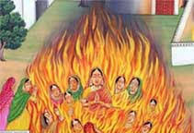
In addition to translating the scriptures into Bengali, he formed a school and saw the formation of many Churches.
His influence extended beyond the church,
affecting the Indian culture.
In 1829 the Indian government outlawed the Hindu practice of Sati.
“I can plod!”

Slide 10
2. David Livingstone: 19 March 1813 – 1 May 1873
Born in Blantyre, Scotland in 1813.
His father would read Missionary Stories to Him.
One of his favorites was that of Karl Gützlaff, the Dutch missionary who was a medical missionary.
One day African Missionary Robert Moffit visited David’s boyhood church and preached:
"Many a morning have I stood on the porch of my house, and have seen the smoke arise from thousand villages—villages whose people are without Christ, without God, and without hope in the world ... “

Slide 11
David surrendered to serve the Lord, writing:
“God, send me anywhere, only go with me.
Lay any burden on me, only sustain me.
And sever any tie in my heart
save the tie that binds my heart to Yours.
Lord Jesus, my King, I dedicate my life to thee.”
He began studying Latin, Greek, Bible, and Medicine to prepare for a future ministry.

Slide 12
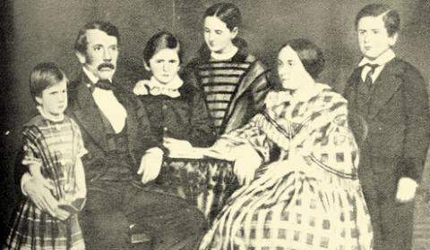
David Livingstone: 19 March 1813 – 1 May 1873
God eventually led him to Africa.
There he met and married Mary Moffit

Slide 13
David Livingstone: 19 March 1813 – 1 May 1873
David kept pushing deeper into Africa to share the gospel despite dangers from beasts, sickness, natives and slave traders.
Because of these mounting dangers, he sent his family home as he pushed forward.
This meant long periods (up to 5 years) of separation!
In addition to planting many churches, David’s books, maps, reports of Africa made him famous.

Slide 14
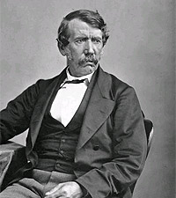
“Forbid that we should ever consider the holding of a commission from the King of Kings a sacrifice,
so long as other men esteem the service of an earthly government as an honor.
I am a missionary, heart and soul.
God Himself only had one son,
and He was a missionary
and a “physician.”

Slide 15
“A poor, poor imitation I am, but in this service I hope to live. In it I wish to die.
I still prefer poverty and missions
service to riches and ease. This is my Choice.”
David Livingstone
One of Livingstone’s greatest achievements was to stir up public support against slavery.

Slide 16
David Livingstone: 19 March 1813 – 1 May 1873
After decades of missionary service, “discovery”, and suffering a variety of tropical illness, Livingstone died of dysentery in 1872, aged 59.
He passed away while kneeling in prayer.
His body was ordered to England and buried in Westminster Abbey. However, the local African attendants were somewhat reluctant to him give up
In the end they cut out his heart and gave back his body saying:
“You can have his body,
but his heart belongs in Africa!”

Slide 17
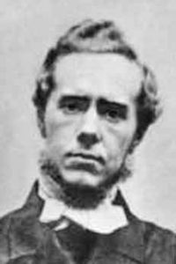
3. J. Hudson Taylor: 1832-1905
Left a widowed mother and fiancé in England to go to the inland of China as a missionary.
Here’s an excerpt from his reflections on the day he left.
“My beloved mother had come to see me off from Liverpool. Never shall I forget that day, nor how she went with me into the little cabin that was to be my home for nearly six months.
With a mother’s hand she smoothed my bed and sat
by my side as we sang the last hymn we would ever
sing together.
We knelt down, and she prayed-
the last mother’s prayer I was to hear.

Slide 18
J. Hudson Taylor: reflections on the day he left.
When notice was given for guests to leave and we had to say goodbye, never expecting to meet on earth again.
For my sake she restrained her feelings …
She went on shore, giving me her blessing.
I stood alone on the deck and she followed as we moved toward the dock gates.
I shall never forget the cry of anguish wrung from her heart as we passed the gates.
It went through me like a knife. I never knew so fully, until then, what “God so loved the world” really meant.

Slide 19
God used him to found the China Inland Mission, financing by faith 205 missions,
849 missionaries and the conversion of 125,000 Chinese Christians.
“All God’s giants have been weak men who did great things for God because they reckoned on
God being with them.”

Slide 20
“It doesn’t matter how great the pressure is.
What really matters is where the pressure lies;
whether it comes between you and God,
or whether it presses you nearer His heart.”
“If I had a thousand pounds China should have it-
if I had a thousand lives, China should have them.
No! Not China, but Christ.
Can we do too much for Him?
Can we do enough for such a precious Savior?”
J. Hudson Taylor

Slide 21
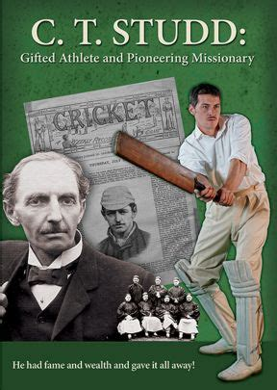
4. CT Studd (1860-1931) left all to serve as a Missionary to China, India and Africa.
While serving in China,
he received his inheritance at the age of 25.
He gave it all away to other Ministries!

Slide 22
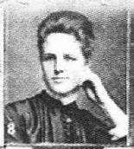
When he learned that he still had 3,400 pounds left after his gifts to others;
He decided to give it to his new wife as a wedding present.
Priscilla Livingstone Stewart was as sure of God as her husband.
Determining to "start clear" at her wedding she gave that away, too!

Slide 23
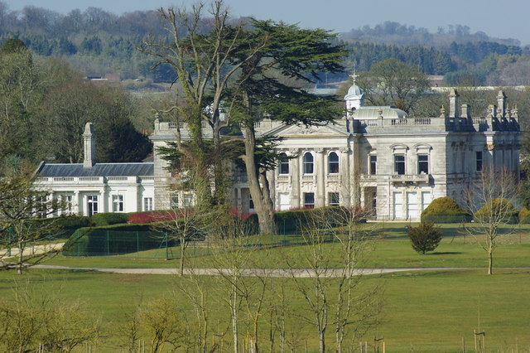
The Home he grew up in.

Slide 24
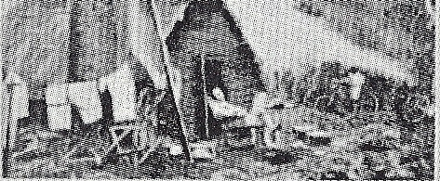
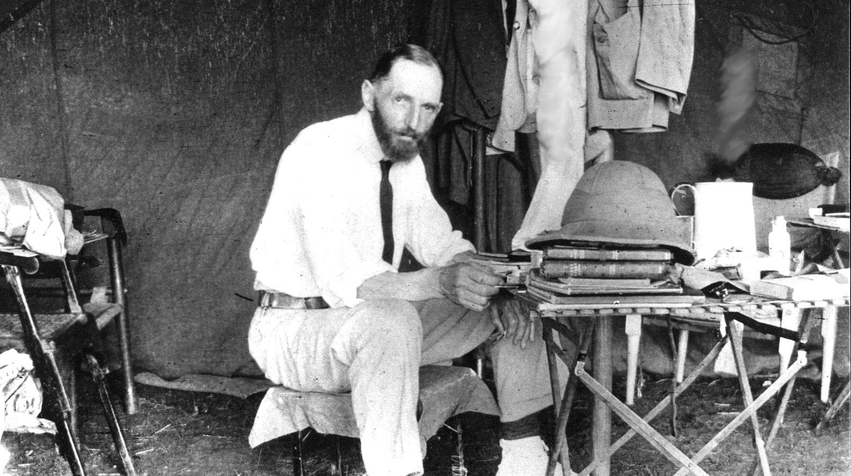
His home in Africa.

Slide 25
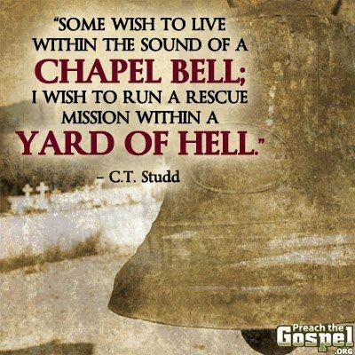
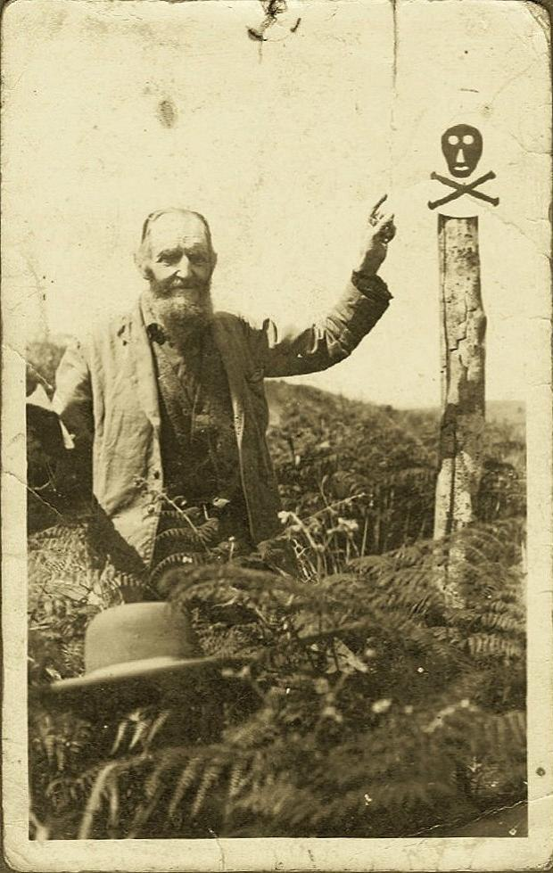

Slide 27
Collectively, >$14 billion has been spent on this recent election.
Bloomberg spent > 900 million on his own Presidential run, and > 100 million to support Democrats in Fl, Ohio, & TX
LeBron James & Michael Jordan paid off 40,000 Fl. Felons fines so they could vote in this election.
https://sports.yahoo.com/lebron-james-michael-jordan-help-bloomberg-pay-felons-fees-florida-amendment-4-voting-rights-election-day-024025571.html?guccounter=1&guce_referrer=aHR0cHM6Ly93d3cuZ29vZ2xlLmNvbS8&guce_referrer_sig=AQAAANVxOaBhAw5Vb6fa8CCaxZ3fplHx0jsDH8JyfecCIlMTcV16gxZGUIQADFslQgyTrT53l3O2LI6nOwwQPA2MnQlidhT1wR1pjl6NsRr2thRK1S447G8CbbxD2WUjZ1oOzcsyTwZ6-Fx1oudnfOZp8JBq_AQ3ZsvCxfEMFT64v47t

Slide 28
“Two little lines I heard one day,
Traveling along life’s busy way;
Bringing conviction to my heart,
And from my mind would not depart;
Only one life, ’twill soon be past,
Only what’s done for Christ will last.”

Slide 29
“Only one life, yes only one,
Soon will its fleeting hours be done;
Then, in ‘that day’ my Lord to meet,
And stand before His Judgement seat;
Only one life, ’twill soon be past,
Only what’s done for Christ will last.”

Slide 30
“Only one life, the still small voice,
Gently pleads for a better choice.
Bidding me selfish aims to leave,
And to God’s holy will to cleave;
Only one life, ’twill soon be past,
Only what’s done for Christ will last.”

Slide 31
“Only one life, a few brief years,
Each with its burdens, hopes, and fears;
Each with its claims I must fulfill,
living for self or in His will;
Only one life, ’twill soon be past,
Only what’s done for Christ will last.”
C.T. Studd

Slide 32
Heb.12:1-3 “Wherefore seeing we are compassed about with so great a cloud of witnesses,
let us lay aside every weight, (onkos: hindrance)
and the sin which doth so easily beset us
(Euperis’tatos: to stand against, compete)
and run with patience the race set before us,
Looking unto Jesus the author (archēgos’: Captain)
and finisher (from teleios: to complete, perfect)
of our faith…”
What weights are “standing against” your following Jesus?

Slide 33
vs 2,3 “…who for the joy that was set before him endured the cross, despising the shame,
and is set down at the right hand
of the throne of God.
For consider him that endured such contradiction of sinners against himself,
(Analogiz’omai: accurately estimate, proportion)
lest ye be wearied and faint in your minds.”

Slide 34
What “adjustments” is God calling us to make?
➔ Priorities?
➔ Relationships?
➔ Thinking?
➔ Commitments?
➔ Actions?
What are you investing in that will truly last?
“Lay up for yourselves treasures in heaven…
For where your treasure is, there will your heart be also.”
Mt. 6:20,21
Vs 33 “Seek first the kingdom of God…”

Slide 35
“Only one life, a few brief years,
Each with its burdens, hopes, and fears;
Each with its claims I must fulfill,
living for self or in His will;
Only one life, ’twill soon be past,
Only what’s done for Christ will last.”
C.T. Studd

