Slide 1
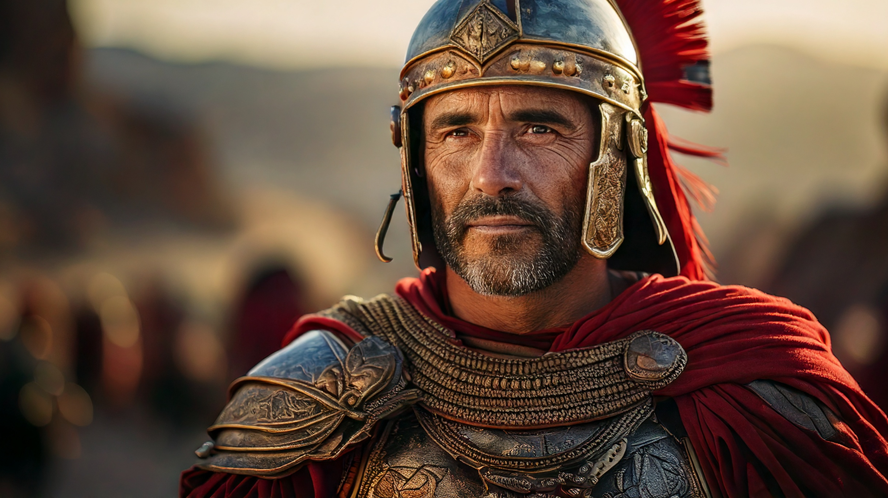
Amazed by a Solid Faith
By Joseph Peters

Slide 2

Goal
Everyone Should Trust that Jesus Can do the Impossible
For These Three Reasons

Slide 3
Reasons
The Centurion Believed in Jesus’ Authority to do the Impossible
The Centurion’s Faith Amazed Jesus
The Centurion’s Faith was proved

Slide 4
The Royal Official
So Jesus came again into Cana of Galilee, where he made the water wine. And there was a certain nobleman, whose son was sick at Capernaum. When he heard that Jesus was come out of Judaea into Galilee, he went unto him, and besought him that he would come down, and heal his son: for he was at the point of death. Then said Jesus unto him, Except ye see signs and wonders, ye will not believe (John 4:46–48).

Slide 5
The Royal Official
The nobleman saith unto him, Sir, come down ere my child die. Jesus saith unto him, Go thy way; thy son liveth. And the man believed the word that Jesus had spoken unto him, and he went his way. And as he was now going down, his servants met him, and told him, saying, Thy son liveth. Then inquired he of them the hour when he began to amend. And they said unto him, Yesterday at the seventh hour the fever left him. So the father knew that it was at the same hour, in the which Jesus said unto him, Thy son liveth: and himself believed, and his whole house. This is again the second miracle that Jesus did, when he was come out of Judaea into Galilee (John 4:49–54).

Slide 6
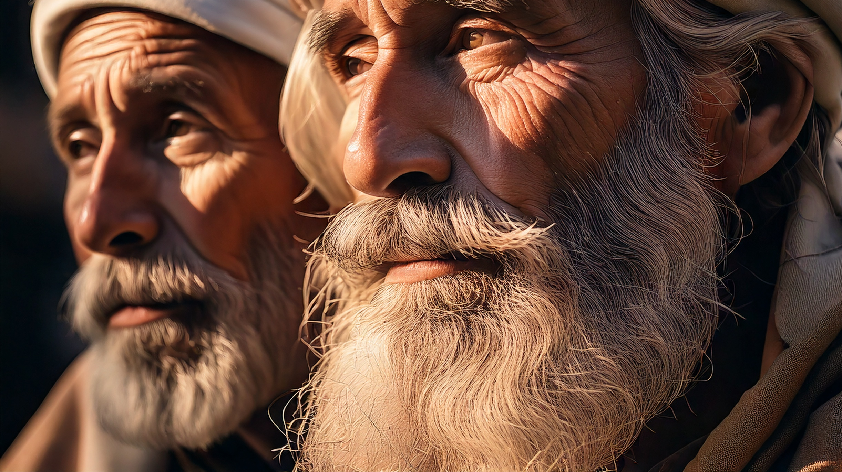
The Centurion Believed in Jesus’ Authority to do the Impossible

Slide 7
Matthew’s Account
And when Jesus was entered into Capernaum, there came unto him a centurion, beseeching him (Matt 8:5–8).

Slide 8
Luke’s Account
Now when he had ended all his sayings in the audience of the people, he entered into Capernaum. And a certain centurion’s servant, who was dear unto him, was sick, and ready to die. And when he heard of Jesus, he sent unto him the elders of the Jews, beseeching him that he would come and heal his servant. And when they came to Jesus, they besought him instantly, saying, That he was worthy for whom he should do this: For he loveth our nation, and he hath built us a synagogue (Luke 7:1–5).

Slide 9
Luke’s Account
Then Jesus went with them. And when he was now not far from the house, the centurion sent friends to him, saying [singular] unto him, Lord, trouble not thyself: for I am not worthy that thou shouldest enter under my roof: Wherefore neither thought I myself worthy to come unto thee: but say in a word, and my servant shall be healed. For I also am a man set under authority, having under me soldiers, and I say unto one, Go, and he goeth; and to another, Come, and he cometh; and to my servant, Do this, and he doeth it (Luke 7:6–8).

Slide 10

The Centurion’s Faith Amazed Jesus

Slide 11
His Faith VS Israel’s Faith
When Jesus heard it, he marvelled, and said to them that followed, Verily I say unto you, I have not found so great faith, no, not in Israel. And I say unto you, That many shall come from the east and west, and shall sit down with Abraham, and Isaac, and Jacob, in the kingdom of heaven. But the children of the kingdom shall be cast out into outer darkness: there shall be weeping and gnashing of teeth (Matt 8:10–12).

Slide 12
Different Responses
Then said Jesus unto him, Except ye see signs and wonders, ye will not believe (John 4:48).
When Jesus therefore saw her weeping, and the Jews also weeping which came with her, he groaned in the spirit, and was troubled (John 11:33).
Then Jesus answered and said, O faithless and perverse generation, how long shall I be with you? how long shall I suffer you? bring him hither to me (Matt 17:17).

Slide 13
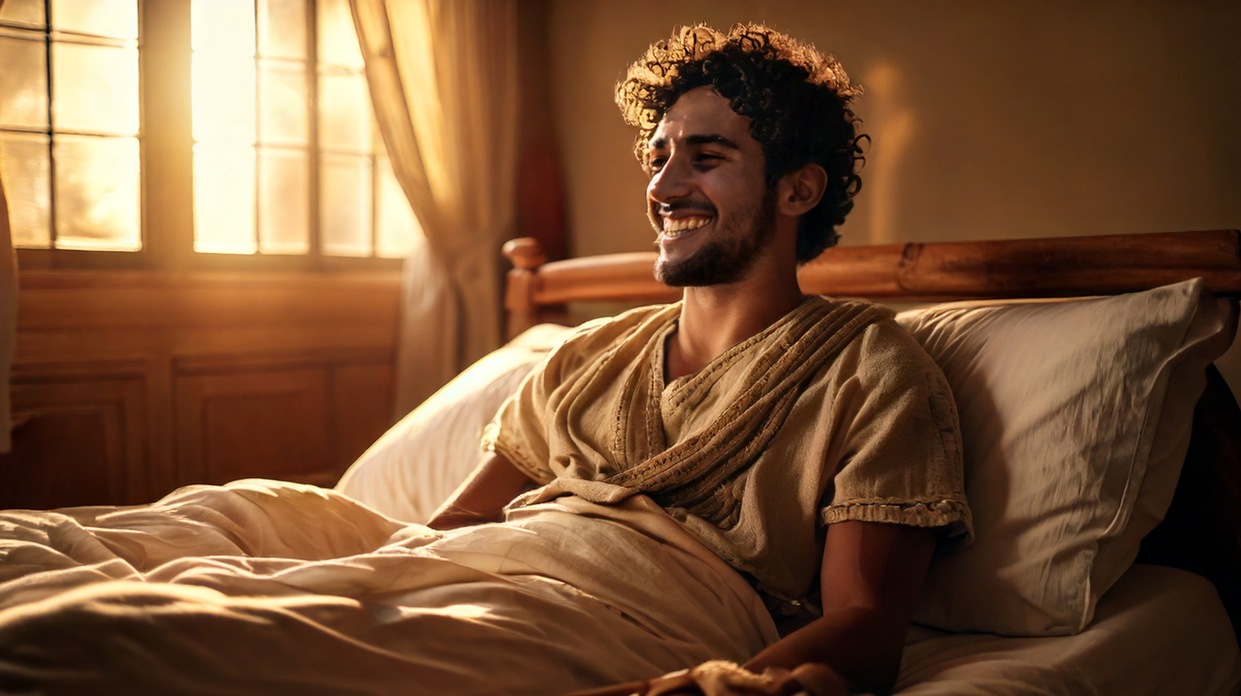
The Centurion’s Faith was proved

Slide 14
The Healing of the Servant
And to the centurion Jesus said, “Go; let it be done for you as you have believed.” And the servant was healed at that very moment (Matt 8:13).
And they that were sent, returning to the house, found the servant whole that had been sick. Luke 7:10).

Slide 15
Conclusion
Everyone Should Trust that Jesus Can do the Impossible
For These Three Reasons

Slide 16
Reasons
The Centurion Believed in Jesus’ Authority to do the Impossible
The Centurion’s Faith Amazed Jesus
The Centurion’s Faith was proved

