Slide 2
2020
Jeremiah 5:25-28 “Your iniquities have turned away these things,
and your sins have withholden good things from you.
For among my people are found wicked men: they lay wait, as he that sets snares... As a cage is full of birds,
so are their houses full of deceit:
therefore they are become great, and waxen rich.
They are waxen fat, they shine: yea, they overpass the deeds of the wicked: they judge not the cause…,
yet they prosper”

Slide 3
2020
Jer 5:29-31 “Shall I not visit for these things? saith the LORD: shall not my soul be avenged on such a nation as this?
A wonderful & horrible thing is committed in the land;
The prophets prophesy falsely,
and the priests bear rule by their means;
and my people love to have it so:
and what will ye do in the end thereof?”

Slide 4
2020
Jer 6:13-15 “from the least of them even unto the greatest of them every one is given to covetousness; and from the prophet even unto the priest every one dealeth falsely.
They have healed the hurt of the daughter of my people slightly, saying, Peace, peace; when there is no peace.
Were they ashamed when they had committed abomination?
nay, they were not at all ashamed, neither could they blush:
therefore they shall fall among them that fall: at the time that I visit them they shall be cast down, saith the LORD.

Slide 5
2020
Jer 6:16,17 16 “Thus saith the LORD, Stand ye in the ways, and see, and ask for the old paths, where is the good way, and walk therein,
and ye shall find rest for your souls.
But they said, We will not walk therein.
Also I set watchmen over you, saying,
Hearken to the sound of the trumpet.
But they said, We will not hearken.”

Slide 6
2020
History has a way of repeating itself!
1 Cor 10:11-12 “all these things happened unto them for ensamples: and they are written for our admonition,
upon whom the ends of the world are come.
Wherefore let him that thinketh he standeth take heed lest he fall.”
The current of “popular culture”
is always away from God! 1 Jn 2:15,16

Slide 7
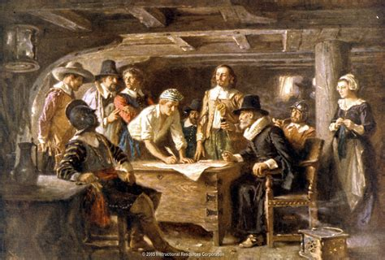
America began with noble intentions.

Slide 8
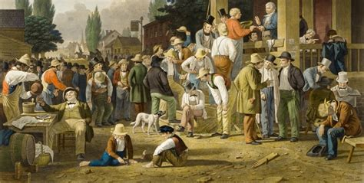
Prosperity brought Pride. (See Deut. 8)

Slide 9
Second Generation Americans were drifting from God! (See Judges 2)

Slide 10
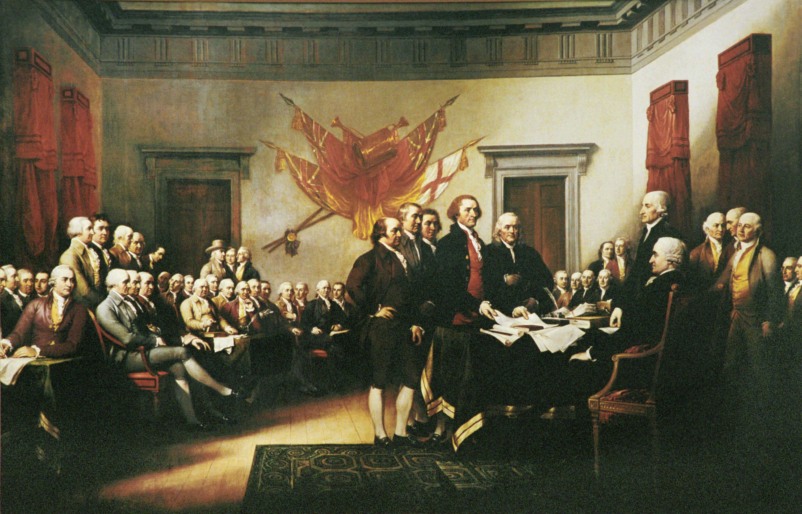
The Declaration of Independence July 1776
The Signers declared both our Independence from Britain
and our Dependence upon God!
“for the support of this Declaration, with a firm reliance on the protection of divine Providence,
we mutually pledge to each other our Lives, our Fortunes and our sacred Honor.”

Slide 11
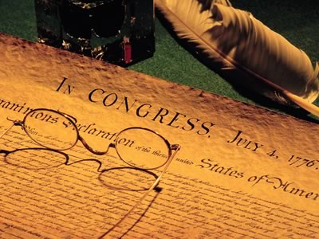
The Declaration of Independence Refers to God Four Times!
“laws of nature and nature’s God”
“endowed by their Creator”
“the Supreme Judge of the world”
“firm reliance upon Divine Providence”
Why did they feel God held such an integral part in our struggle for independence?

Slide 12
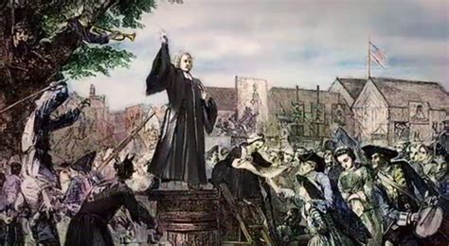
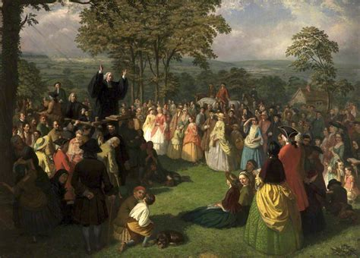
2020
These men had been influenced by the preaching of Jonathan Edwards and George Whitefield during the Great Awakening. (1730’s)

Slide 13
“Pulpit oratory ran like a shock of electricity through the whole colony.”
Thomas Jefferson

Slide 14
"The Philadelphia ministers ‘thunder and lighten’ every Sabbath against George III's despotism."
John Adams

Slide 15
“No body of men are so extremely injurious to peace and tranquility as the clergy.
They preach sedition openly from their pulpits.“
British Col. Hugh Percy

Slide 16
Paul Revere's Ride
April 18, 1775

Slide 17
Hancock
Adams
Rev. Jonas Clarke

Slide 18
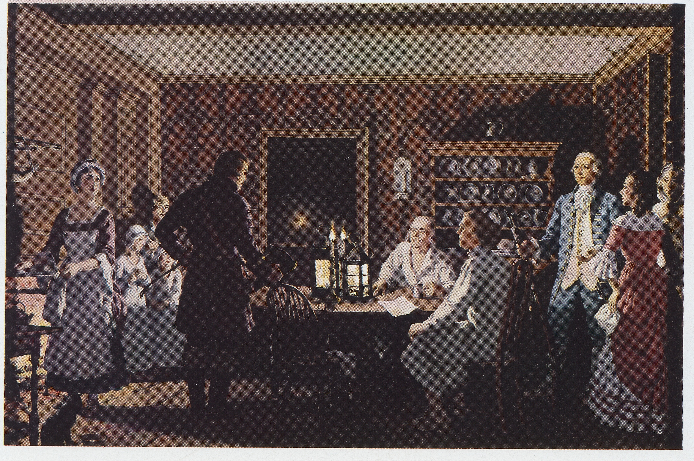
“Will the men of Lexington fight?”
Hancock
Adams
Revere
Pastor Clarke:
“I have trained them for this very hour.”

Slide 19
Pastor Clarke called it: “A door to numberless evils”
Stamp Act

Slide 20
Pastor Clarke condemned it as: “An infringement of their natural, constitutional, and chartered rights.”
Quartering Act

Slide 21
Pastor Clarke declared that anyone who purchases British Tea, “should be looked upon as an enemy of the town.”
Tea Act

Slide 22
"The Importance of Military Skill,
Measures for Defence, and a Martial Spirit
in a Time of Peace"
June 6, 1768

Slide 23
“We shall be ready to sacrifice…everything dear in life, yea and life itself, in support of the common cause.”
Pastor Jonas Clarke

Slide 24
Captain John Parker

Slide 25
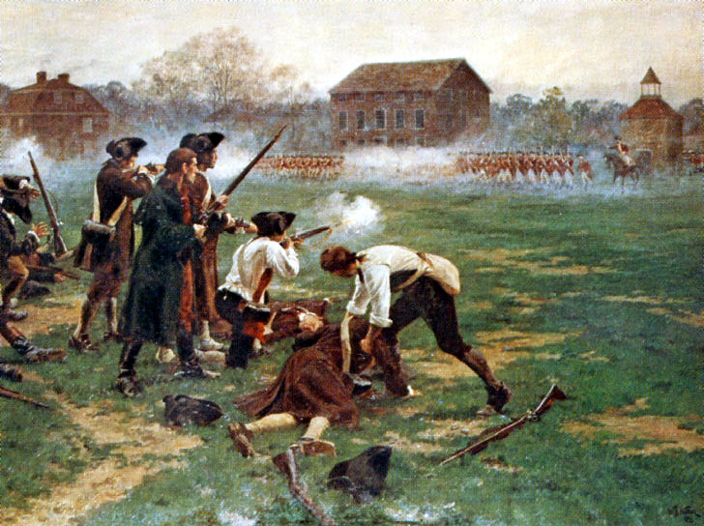
Minutemen at Lexington
Lexington Green
April 19, 1775

Slide 26
“From this day will be dated
the liberty or the slavery
of the
American world."
Rev. Clarke
Lexington Green
April 19, 1775

Slide 27
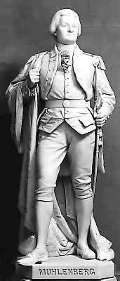
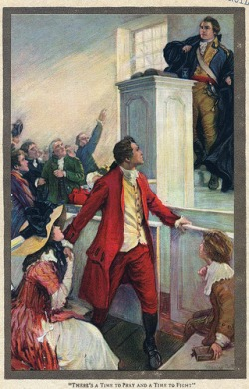
Peter Muhlenberg, after preaching from Eccl. removed his robes revealing, to the shock of his congregation, a military uniform.
Marching to the back of the church he declared, 'Who among you is with me?’
On that day 300 men from his church stood up and joined Pastor Muhlenberg.
They eventually became the 8th Virginia Brigade fighting for liberty.

Slide 28
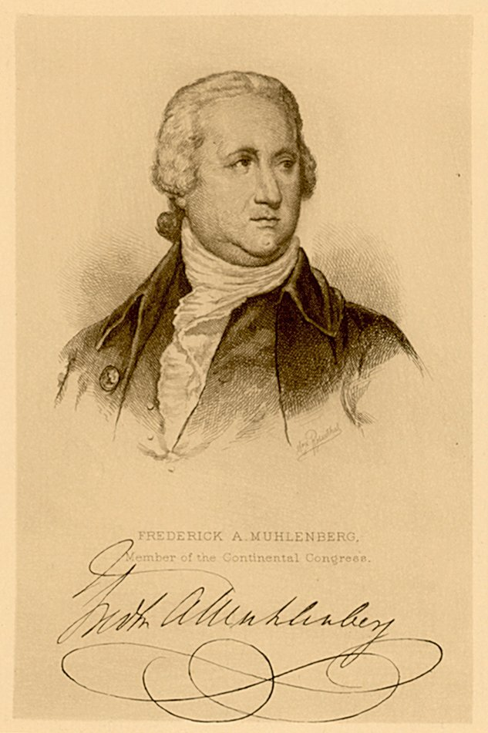
Peter’s brother Frederick was a pacifist pastor,
Until his church was burned by the English.
He then joined the cause, eventually becoming the first Speaker of the House and the first to sign the Bill of Rights.

Slide 29
The price these 56 Signers paid.
Nine died of wounds or hardships during the war
Five were captured, imprisoned, and tortured
Several lost wives, children or entire families
One lost his thirteen children
Two wives were brutalized by the British
All were the subjects of manhunts
Twelve had their homes burned
Seventeen lost everything they owned

Slide 30
The Sacrifices of the 56 Signers
These men not only pledged
but gave their lives, and their fortunes,
and not one went back on his sacred honor!
Pastor John Witherspoon was among them.

Slide 31
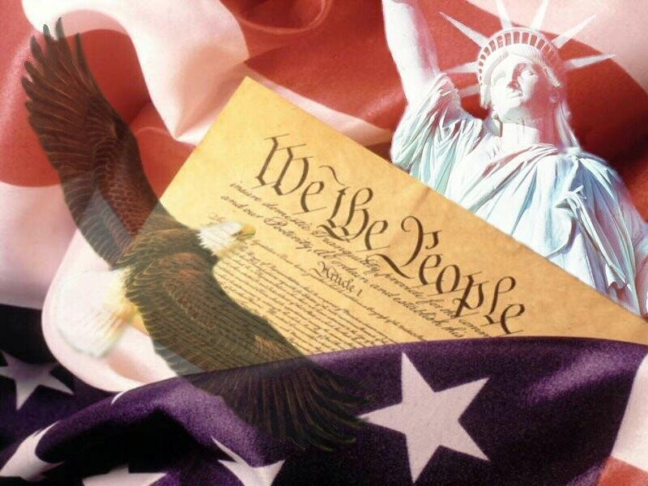
What should we be willing to “Pledge” as Christian Citizens of such a great nation?

Slide 32
2020
Ponder your position. (with God and Government)
1 Kings 18:21 “How long halt ye between two opinions?
Çâʿîph: divided mind (See James 1:8)
if the LORD be God, follow him:
but if Baal, then follow him.
And the people answered him not a word.”

Slide 33
2020
Ponder your position. (with God and Government)
This election is about more than differing personalities or even policies
It’s about Biblical Principles!
A. Faith: “Congress shall make no law respecting an establishment of religion,
or prohibiting the free exercise thereof “

Slide 34
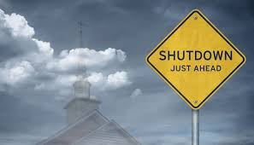
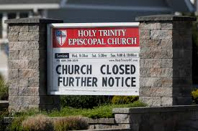
2020
Ponder your position. (with God and Government)
It’s about Biblical Principles!
A. Biblical Faith is under Fire!

Slide 35
2020
The following has been Declared Unconstitutional:
For Kindergarteners to recite: "God is great, God is good”
For an Elementary student to ask and for the teacher to answer whose birthday is being celebrated at Christmas
For two Middle School students to bring their Bibles to class, which were confiscated, called “garbage,” and trashed!
For an Honor Guardsman to say: “God bless you, this family, and may God bless this country” at a veteran’s graveside
For a county government building exterior to display our national motto: “In God We Trust”

Slide 36
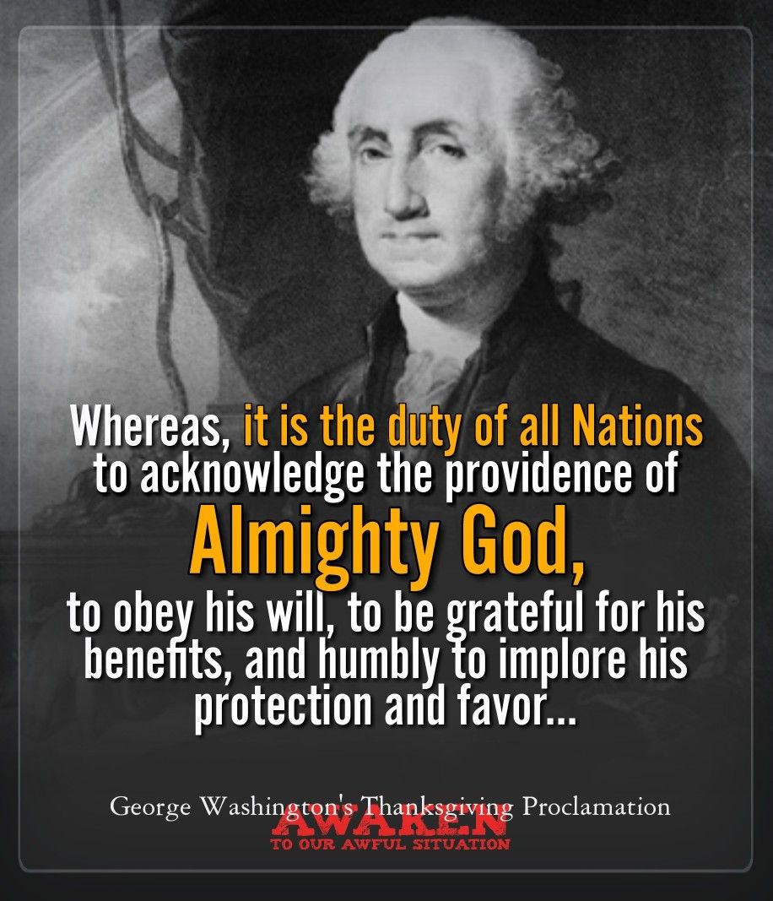
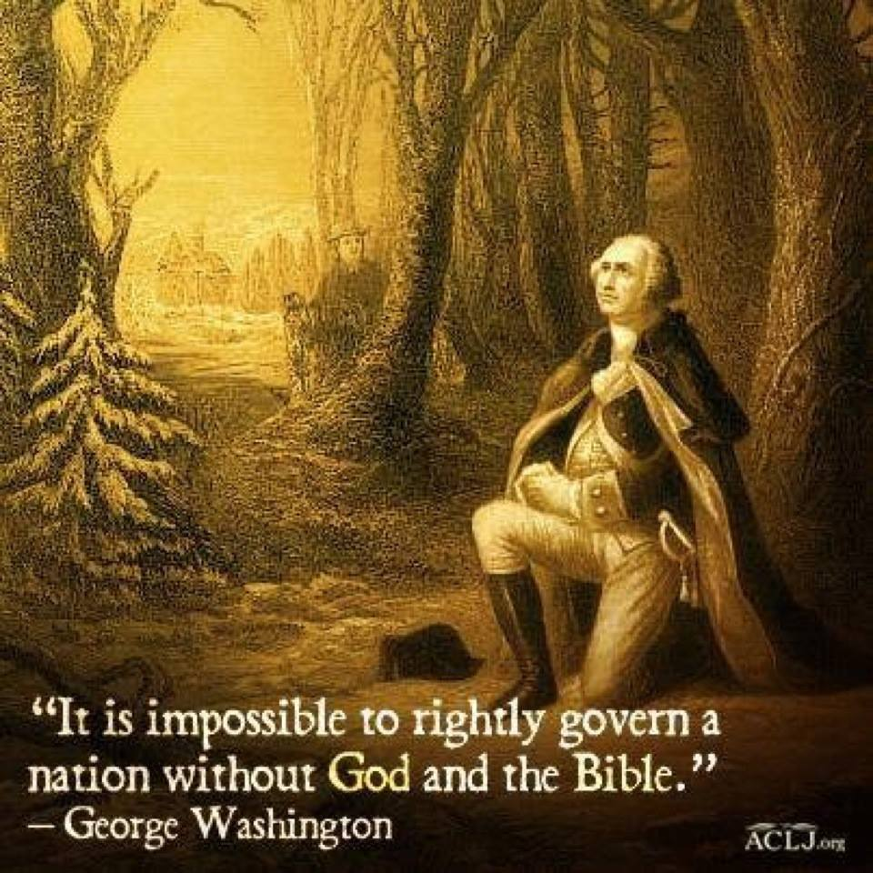
2020

Slide 37
2020
Ponder your position. (with God and Government)
This election is about more than personalities;
It’s about Biblical Principles.
A. Faith: Freedom to Worship God.
B. Family:
1) Sanctity of Marriage.
2) Rights/responsibility of Parents.
3) Gender dysphoria. (DSM-IV: Gender Identity Disorder)

Slide 38
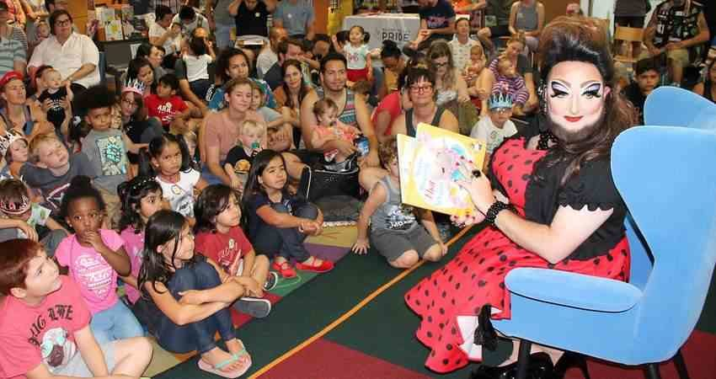
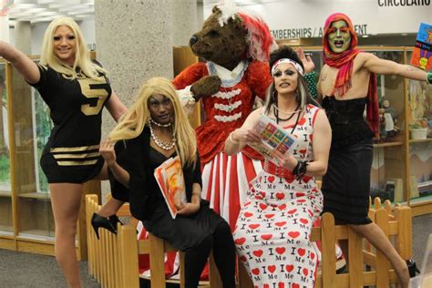
2020
Drag Queen Story Hour is glorifying and promoting this!

Slide 39
2020
https://dailycaller.com/2020/10/16/joe-biden-eight-year-old-child-decide-transgender-town-hall/

Slide 40
2020
“How many genders are there?”
Tumblr has a list of total 112 genders currently.

Slide 41
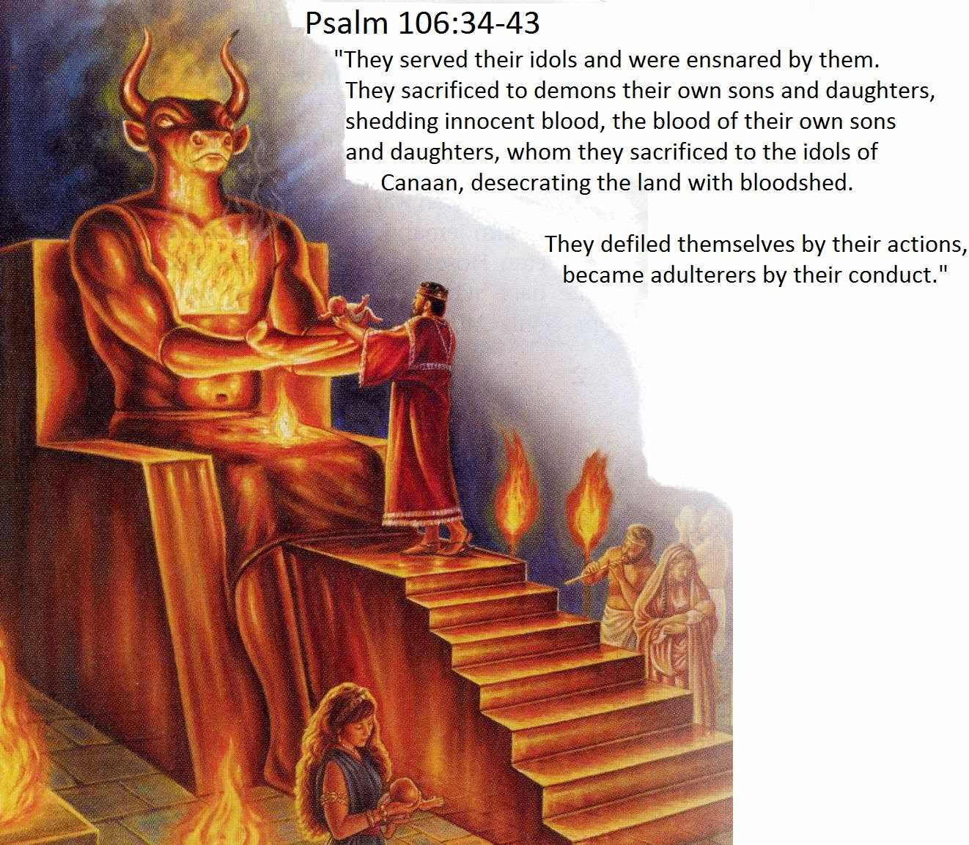
C. Freedom: “Life, Liberty, pursuit of happiness”
2020
You can’t “Follow” Both!
2 Cor 6:14-18;
1 Jn 1:5-7
61,628,584 American Babies have
been sacrificed since 1973 www.lifenews.com
“if the LORD be God, follow him:
but if Baal, then follow him.”
1 Kings 18:21

Slide 42
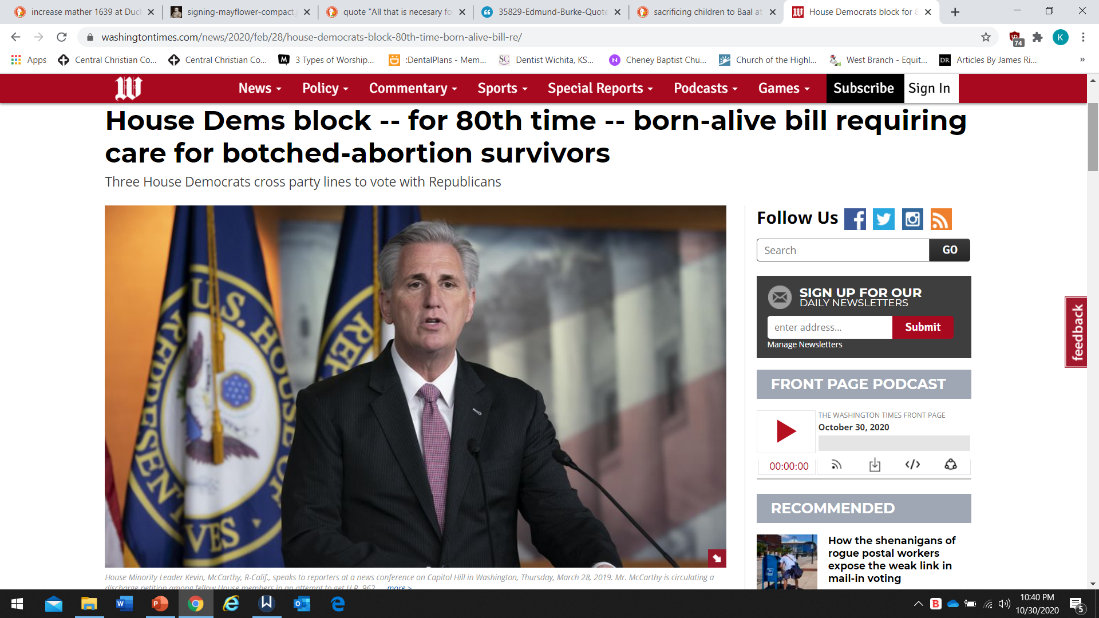
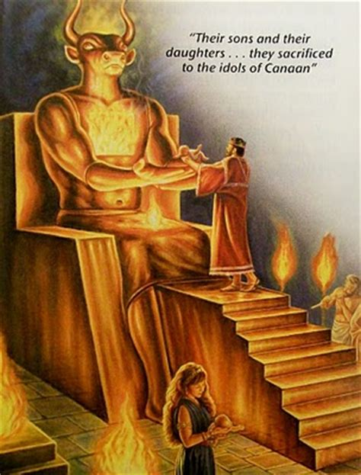
C. Freedom: “Life, Liberty, pursuit of happiness”
2020
Over 61,628,584 American Babies have been sacrificed since 1973!
www.lifenews.com
One modern alias
for “Baal” is
“Planned Parenthood”!

Slide 43
C. Freedom: “Life, Liberty, pursuit of happiness”
2020
Over 61,628,584 American Babies have been sacrificed since 1973!
www.lifenews.com
One modern alias
for “Baal” is
“Planned Parenthood”!

Slide 44
2020
Honest pondering should lead to repentant
2. Prayer!
2 Chr 7:14 “If my people, which are called by my name, shall humble themselves, … pray, … seek my face, and turn from their wicked ways;
then will I hear from heaven, and will forgive their sin, and will heal their land.”

Slide 45
2020
2. Pray 1 Tim. 2:1-4 “I exhort therefore, that, first of all, supplications, prayers, intercessions, and giving of thanks, be made for all men;
…for all that are in authority; that we may lead a quiet and peaceable life in all godliness and honesty.
For this is good and acceptable in the sight of God…
Who will have all men to be saved,
and to come unto the knowledge of the truth.”

Slide 46
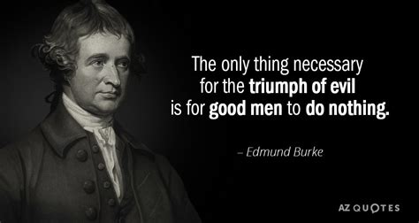
2020
3. Participate!
1729-1797

Slide 47
2020
3. Participate!
“Let each citizen remember at the moment he is offering his vote… that he is executing one of the most solemn trusts in human society
for which he is accountable to God and his country.”
Samuel Adams – Founding Father

Slide 48
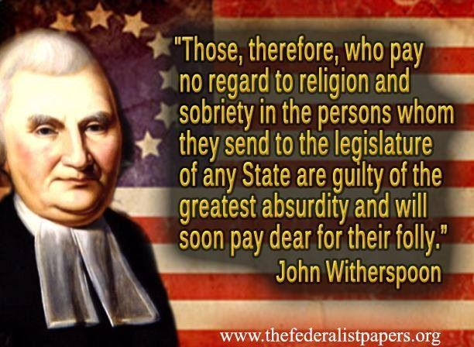
2020
3. Participate!

Slide 49
2020
1792-1875

Slide 50
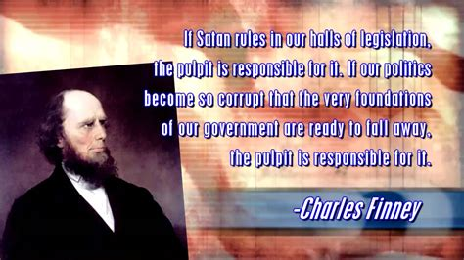
2020
“If Satan rules in our halls of legislation,
The Pulpit is responsible for it!
If our politics become so corrupt that the very foundations of our Government are ready to fall away,
The pulpit is responsible for it!”
1792-1875

Slide 51
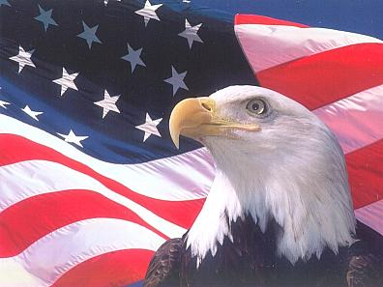
The Value of Freedom
“If we do not use our freedom to defend our freedom, we will lose our freedom.”
Dr. Kenyn Cureton

Slide 52
2020
Jer 6:16,17 16 “Thus saith the LORD, Stand ye in the ways, and see, and ask for the old paths, where is the good way, and walk therein, and ye shall find rest for your souls. But they said,
We will not walk therein.
Also I set watchmen over you, saying,
Hearken to the sound of the trumpet. But they said,
We will not hearken.”

Slide 53
2020
Jer 6:18-19 “Therefore hear, ye nations, and know,
O congregation, what is among them.
…behold, I will bring evil upon this people,
even the fruit of their thoughts,
because they have not hearkened unto my words,
nor to my law,
but rejected it.”
‏מָאַס‎ (māʾas): spurned, despised, refused.

Slide 54
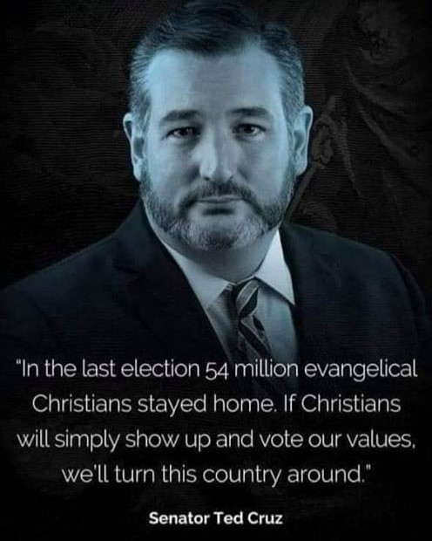
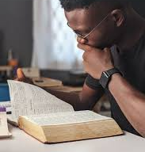
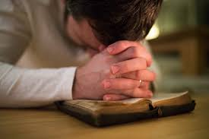
2020
Will you Ponder, Pray,
And Participate?

Slide 55
2020
Deut 30:19,20 “I call heaven and earth to record this day against you,
I have set before you life & death, blessing and cursing:
therefore choose life, that thou and thy seed may live.
That thou mayest love the LORD thy God, and that thou mayest obey his voice, and …cleave unto him:
for he is thy life, and the length of thy days:”

