Slide 1
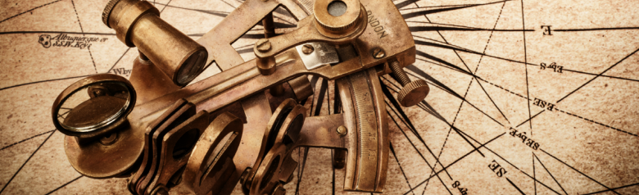
Back to Basics
(or) Recalibrating our GPS
(God Positioning Sensor)

Slide 2
If Satan can’t keep us from a personal faith in Christ,
He’ll seek to keep us from
practically Following Him!
(John 10:10; 2 Cor 11:2,3; Col. 2:6-10;
Phil. 3:17-20; Gal. 2:20-3:1; etc.)

Slide 3
Sin (hamartanō) by its very nature implies that we’re drifting from God.
Jms 1:13-16 “every man is tempted, when he is drawn away of his own lust, and enticed.
When lust has conceived, it brings forth sin:
and sin, when it’s finished, brings forth death.
¹⁶Do not err, (drift) my beloved brethren.”

Slide 4
To avoid the drift of sin, we need to be able to accurately “plot” our position
Using reliable reference points.
Without such “reference points”
we’ll not recognize how far we’ve drifted from God’s original course/purpose for us. (Heb. 12:1,2)

Slide 5
Every believer has the same
Basic Priorities (Points of Reference) revealed in:
The Great Commission (Mt. 28:18-20)
The Great Commandment (Mt. 22:36-39)
This morning we’ll consider the first of these “Priorities”!

Slide 6
The Priorities of God’s People:
Acts 1:8 "But ye shall receive power,
after the Holy Ghost is come upon you:
and ye shall be witnesses unto me…”
This is the first element of the Great Commission.
Mk 16:15 “Go into all the world
and preach (share) the gospel” (good news!)

Slide 7
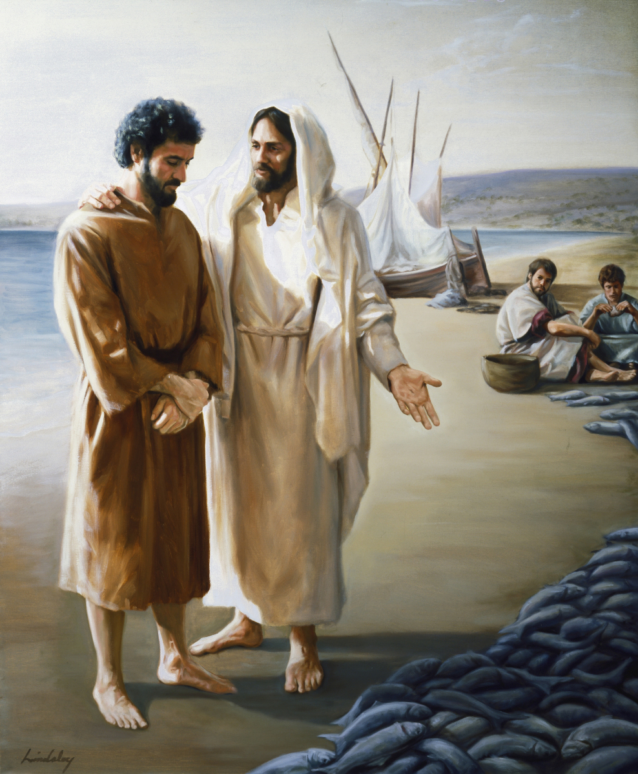
Mt 4:19; Mark 1:17 “Follow me,
and I will make you
(to become)
fishers of men!”
A few weeks ago we examined a story from Ancient Israel that illustrated this priority.

Slide 8
In 2 Kings 6 & 7 Ancient Israel
faced a terrible Distress. (Famine)
Four lepers faced a Dilemma;
eventually learning that God had provided a Great (but unknown) Deliverance.
This Discovery led them to a
Point of Decision.
(whether they would share what they knew!)

Slide 9
I closed this message with this challenge:
This week, Spend some time in 2 Kings 6,7 and ask yourself (and your God):
1) What does this have to do with me?
2) Who/Where am I in this story?
If you’ve made the “Great Discovery”
It should lead to a “Great Decision!”

Slide 10
1 Cor 10:11 “Now all these things happened unto them for ensamples: and they are written for our admonition, upon whom the ends of the world are come.”
What does this ancient Story
have to do with us?

Slide 11
We, like Israel in 2 Kings 6,7 face:
1. A Great Distress.
A. Famine Amos 8:11 "the days come, saith the Lord GOD, that I will send a famine, not of bread or of water,
but of hearing the words of the LORD:"
Hos 4:6 “My people are destroyed for lack of knowledge:

Slide 12
A Great Distress. 2 Tim. 3:1-3
“in the last days, perilous times will come
men shall be lovers of their own selves
…without natural affection…”
1) 1/5 kids conceived in U.S. are aborted.
(862,320 in 2017: Guttmacher institute)
2) >1/4 kids don’t have Father at home.

Slide 13
A Great Distress:
a) Kids from fatherless homes account for:
63 % of youth suicides;
90 % of all runaways
85 % of all behavioral disorders;
71 % of High School dropouts
70 % of juveniles in state-operated institutions
75 % of patients in substance abuse centers
75 % of rapists motivated by displaced anger
https://www.liveabout.com/fatherless-children-in-america-statistics-1270392

Slide 14
We, like Israel in 2 Kings 6,7 face:
A Great Distress.
B. Fear : Lk 21:26
"Men's hearts failing them for fear."
1) Heart disease is still the # 1 killer
2) We’re seeing American Born
terrorism at work!

Slide 15
FRUSTRATION: "Wherefore do ye … labor for that which satisfies not? (Isa 55:2
Haggai 1:6-7 “Ye have sown much, and bring in little; ye eat, but ye have not enough;
ye drink, but ye are not filled with drink;
ye clothe you, but there is none warm; and he that earns wages earns wages to put it into a bag with holes. Thus saith the LORD
Consider your ways.”

Slide 16
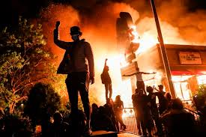
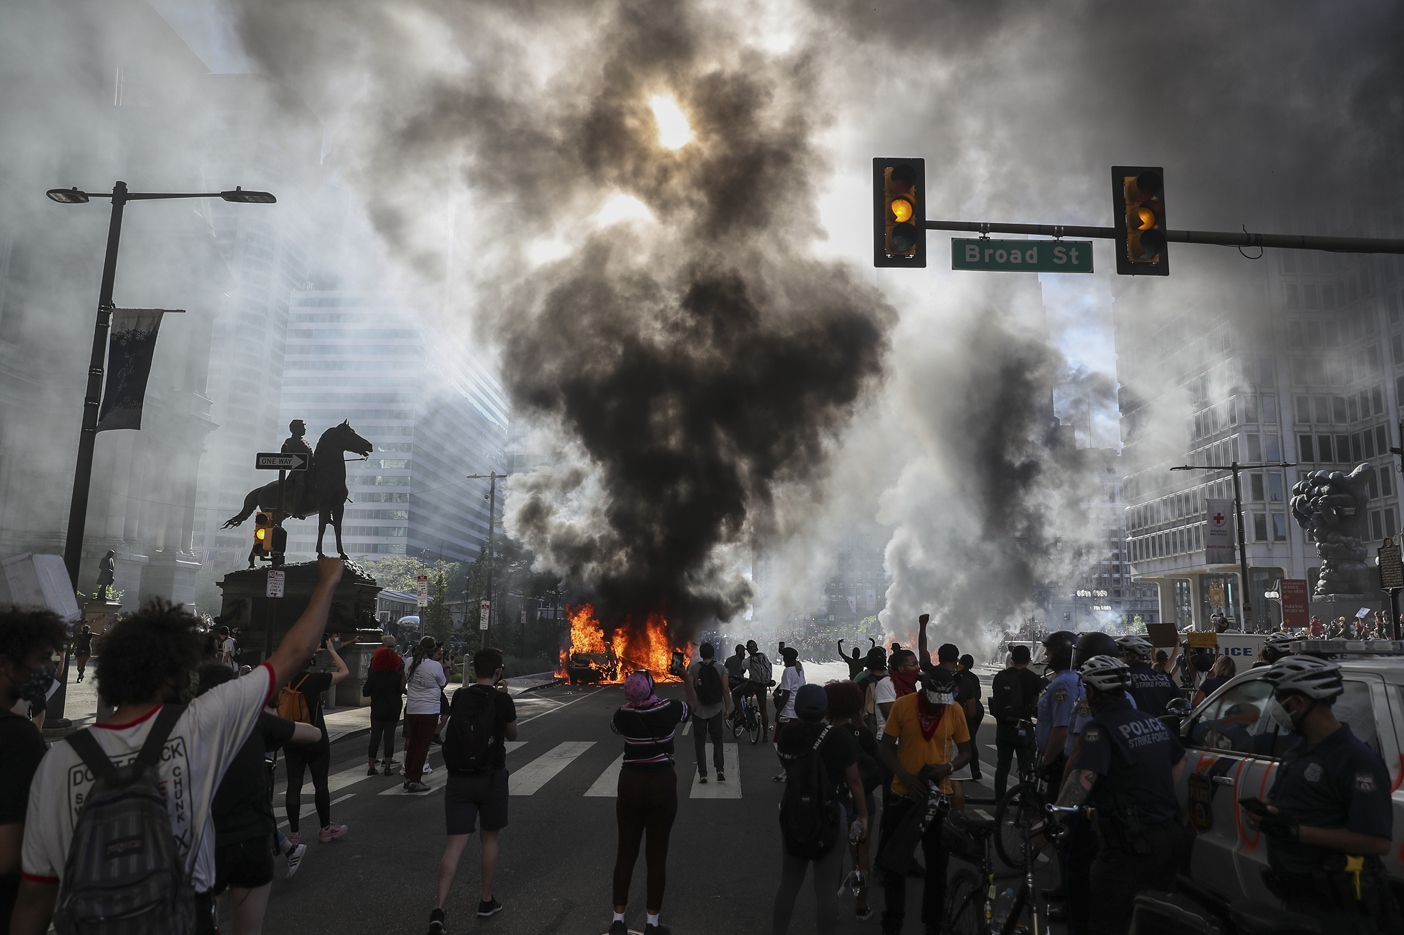
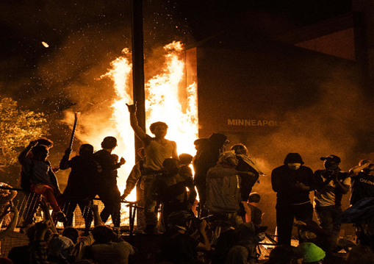
1. A Great Distress.
Fury: Looking to blame others!
“If this country doesn’t give us what we want, then we’ll burn down this system.
I could be speaking figuratively or literally
…it’s a matter of interpretation.”
Hawk Newsome NYC BLM

Slide 17
1. A Great Distress.
Famine, Fear, Frustration Fury:
Faithlessness: John 5:40
“And ye will not come to me,
that ye might have life.”
Instead of turning back to God
many turn to drink, drugs, deception.
Jn 10:10

Slide 18
We, like Israel in 2 Kings 6,7 face:
1. A Great Distress.
2. A Great Dilemma.
A. Like the lepers, each must decide:
What can I do?
Who can I trust?
Where can I go?

Slide 19
3. God has already provided a
Great Deliverance! Mt. 11:28
“Come unto me, all ye that are heavy laden,
and I will give you rest.”
John 10:10 “The thief comes…
to steal, and to kill, and to destroy:
I am come that they might have life, and that they might have it more abundantly”

Slide 20
A. Those who come in faith to Jesus find:
1) Pardon: Ro. 8:1 “There is therefore
now no condemnation…”
2) Peace: Ro. 5:1 “We have peace with
God through our Lord Jesus Christ.”
3) Protection: Jn 10:28
“I give unto them eternal life
and they shall never perish…”

Slide 21
A. Those who come in faith to Jesus find:
4) Provision Phil. 4:19 “My God
shall supply all your need…”
5) Purpose Acts 1:8 “my witnesses…”
2 Cor 5:19,20 “God was in Christ, reconciling the world unto himself… and hath committed unto us the word of reconciliation.
Now then we are ambassadors for Christ…
Be reconciled to God!

Slide 22
Application:
We Face the same choice as the lepers
who experienced God’s Great Deliverance,
while those back “in the city” were starving!
1) Will we horde God’s Pardon, Peace, Protection and Provision for ourselves
and so miss His Purpose?

Slide 23
2) Or will we Partner with God in
sharing His provision, peace, plan, etc. with others regardless of the:
Risks
Ridicule
Rejection?

Slide 24
They didn’t have to convince them,
But they did have to tell them!
Ez. 3:17,18 “I have made thee a watchman …therefore hear the word at my mouth,
and give them warning from me.
When I say unto the wicked, Thou shalt surely die; and thou givest him not warning, …to save his life;
the same wicked man shall die in his iniquity;
but his blood will I require at thine hand. “

Slide 25
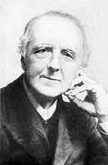
“If there is one thing which pierces the Master’s heart with unutterable grief,
it is not the world’s iniquity,
but the Churches
indifference.”
FB Meyer.

Slide 26
Like the starving citizens of Samaria, Each must decide what they will do with the message of hope.
Heb 2:3 "How shall we escape,
if we neglect (amele’ō: careless of)
so great salvation?“
Sōtēri’a: deliverance, rescue

Slide 27
“Lonely faces looking for the sunrise Just to find another busy day. Lonely faces all around the city; Men afraid but too ashamed to pray. Lonely faces do I see;
Lonely faces haunt my memory.”

Slide 28
Lonely eyes--I see them in the subway; Burdened by the worries of the day. Men at leisure, but they're so unhappy; Tired of foolish roles they try to play. Lonely people do I see; Lonely people haunt my memory.

Slide 29
Abundant life He came to truly give man; But so few His gift of grace receive. Lonely people live in every city;
Men who face a dark and lonely grave. Lonely faces do I see; Lonely voices calling out to me.”
Words & Music by Billie Hanks, Jr. (c) 1967

Slide 30
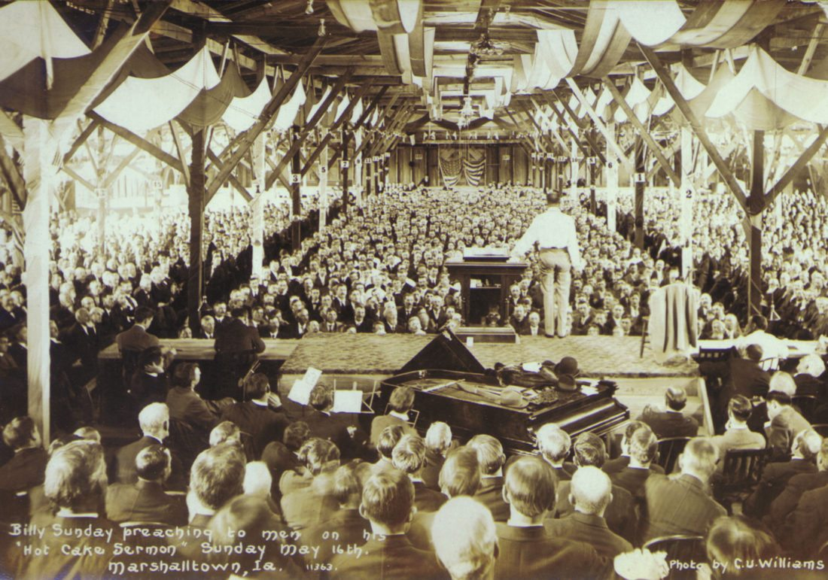
“I never see a man or a woman or boy or girl but I do not think that God has a plan for them
… He will use each of us to His glory
if we will only let Him.” Billy Sunday

Slide 31
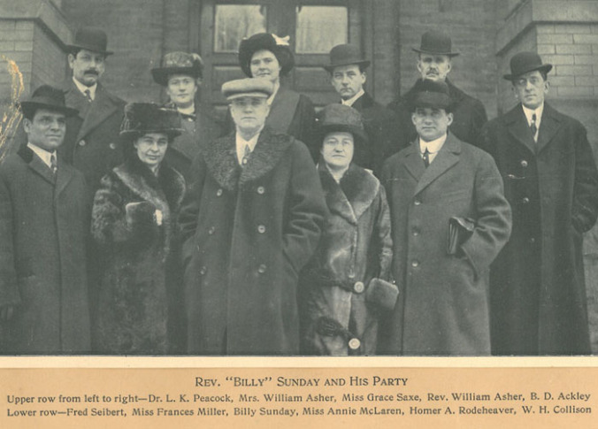
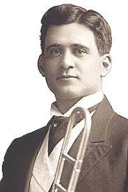
Homer Rodeheaver and little Joey

Slide 32
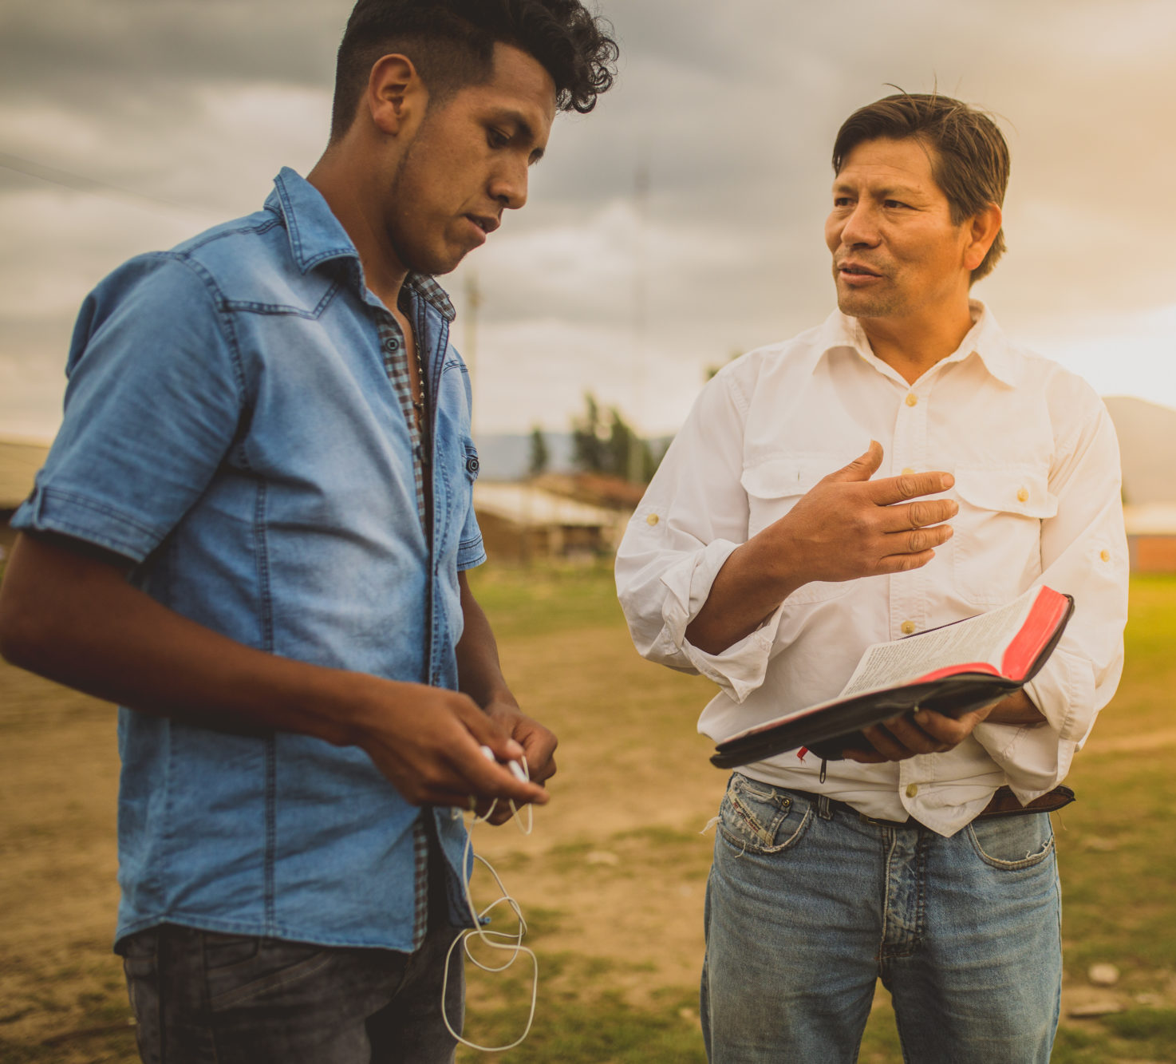
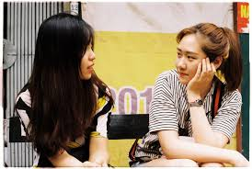
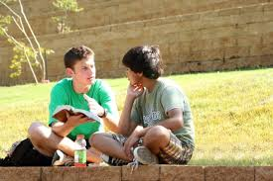
Acts 1:8 “Ye shall be witnesses unto me…”
Who will be in heaven
because of your witness?

