Slide 1
The Journey of Faith!
“For we walk by faith” 2 Cor 5:7

Slide 2
Life is filled with choices that require “faith”.
Life’s most important choice involves where we’ll spend eternity.
Ps. 16:11 reminds us that God wants to show us “the path of life”.

Slide 3
Jesus described himself as the “good shepherd” who is:
“the way, the truth and the life.”
(Jn. 10:10; 14:6; Acts 4:12)
As contrasted with Satan who comes:
“to steal, kill, destroy.”

Slide 4
The Choice is not really between “heaven and hell”.
Even a fool knows that’s an easy choice.

Slide 5
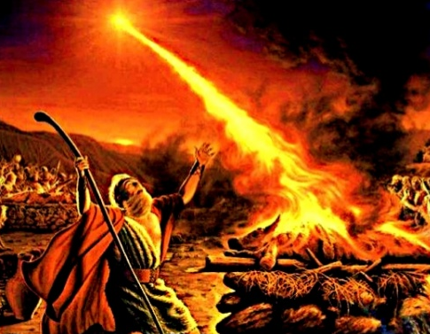
The difficult choice is between heaven
(God’s Kingdom) and “earth” (ours).
“How long halt ye between two
opinions?
“If the Lord be God, follow Him!”
1 Kings 18:21

Slide 6
Earth is an “in between” world touched by both heaven and hell!
It leads inevitably to either heaven or hell, affording a choice between the two.
The best on Earth is a foretaste of heaven.
The absolute worse on Earth is a dim foretaste of Hell!
Randy Alcorn

Slide 7
2 Cor. 4:4 reminds us that Satan seeks to
“Blind” us from recognizing God’s “path of life”
“Block” us from responding to it.
He erects “barriers” to belief in order to keep us from seriously considering and “connecting” with God.

Slide 8
Some Barriers to belief include:
I Can’t believe! This is a matter of the mind or our understanding as we contrast God’s truths to the lies we’ve believed.
(2 Cor. 4:4-6; Jn 8:32, 44,45)
I Won’t Believe! This is a matter of the will as we struggle with our passions,
problems and pride to decide whether we
are willing to acknowledge Christ as Lord.

Slide 9
Another barrier he erects is:
“I Don’t know WHAT to believe!”
1. Satan is a master at Confusion.
“God is not the author of confusion,
but of peace” 1 Cor 14:33
Confusion (Akatastasi’a) Disorder.
Peace (eirē’nē) to join

Slide 10
“I Don’t know what to believe!”
1. Satan is a author of Confusion.
A. He’s the master of Doubt!
שָׂטָן‎ (śāṭān) Adversary.
Σατανᾶς (Satanas) Accuser, slanderer.
“whatsoever is not of faith is sin”
Romans 14:23

Slide 11
A. He’s the master of Doubt!
1) Eve in Gen. 3:1 “The serpent was
more subtile than any …
and he said…
“yea hath God said..?”

Slide 12
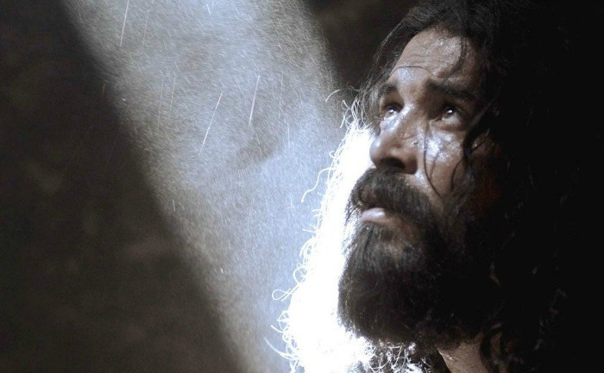
A. He’s the master of Doubt!
2) John the Baptist Mt. 11:2,3
“Art thou he that should come,
or do we look for another?”

Slide 13
1. Satan is a master at Confusion.
B. Doubt leads to Doublemindedness
James 1:8 “A double minded man is unstable in all his ways.”
Dipsychos: literally “two-souled”.
Mt. 6:24 “no man can serve two masters”

Slide 14
B. Doubt leads to Doublemindedness
2 Tim. 4:10 “Demas hath forsaken me,
having loved this present world.”
Rev 3:16 “because thou art lukewarm,
and neither cold nor hot,
I will spue thee out of my mouth.”

Slide 15
C. Doublemindedness is affected by
our personal preferences.
1) Disobedience brings darkness!
2) Our “priorities” can obscure our
“Perspective”!
“That’s just your interpretation!”
How do teens “interpret” curfews?

Slide 17
“I don’t want to believe!”

Slide 18
1. Satan is a master at Confusing.
2. Satan is a Master at Counterfeiting
2 Cor 11:13-15 “such are false apostles, deceitful workers, transforming themselves into the apostles of Christ. And no marvel;
Satan is transformed into an angel of light.
Therefore it is no great thing if his ministers also be transformed as the ministers of righteousness;”

Slide 19
2. Satan is a Master at Counterfeiting
A. He does this by mixing “error” with
some “Truth.”
1) Eve Gen. 3:4,5 “ye shall not die…
your eyes will be opened…”
2) Israel 2 Kings 17:33 “They feared the Lord,
and served their own gods…”

Slide 20
2. Satan is a Master at Counterfeiting
A. Mixing “error” with some “Truth.”
3) Judaizers Acts 15:1 “certain men came
down from Judaea taught …and said,
Except ye be circumcised after the manner of Moses,
ye cannot be saved.”

Slide 21
2. Satan is a Master at Counterfeiting
A. He mixes “error” with some “Truth.”
B. The “error” contaminates the Truth.
Gal 5:7-9 “Ye did run well; who did hinder you that ye should not obey the truth?
This persuasion cometh not of him that calleth you. A little leaven
leaveneth the whole lump.”

Slide 22
2. Satan is a Master at Counterfeiting
B. The “error” contaminates the Truth.
“Say a prayer for Jimmy Brown,
poor Jimmy is no more.
For what he thought was H2O
was H2SO4!”

Slide 23
2. Satan is a Master at Counterfeiting
B. The “error” contaminates the Truth.
1) Modern Religions!
Faith in Christ
+ Anything else
= Counterfeit Christianity!

Slide 24
Eph. 2:8,9 “By grace are ye saved through faith…not of yourselves.
It is the gift of God. Not of works…”
Gal 2:21
“I do not frustrate the grace of God:
for if righteousness come by the law,
then Christ is dead in vain.”

Slide 25
Gal 1:6-8 “I marvel that ye are so soon removed from him that called you into the grace of Christ unto another gospel:
…there be some that trouble you, and would pervert the gospel of Christ.
But though we, or an angel from heaven, preach any other gospel…
let him be accursed.”

Slide 26
What’s Satan’s End Game?
To provide so many alternative and conflicting “paths” to God
(aka: the “Broad Way”)
that the only real path to peace
(aka: the Strait Gate)
is cluttered or neglected!

Slide 27
Mt 7:13-14 “wide is the gate, and broad is the way, that leadeth to destruction,
and many there be which go in thereat:
Because strait is the gate, and narrow is the way, which leadeth unto life,
and few there be that find it.”
Strait: stenos’: Narrow because of obstacles standing close about!

Slide 28
“I don’t want to believe!”
Lk 13:24 “Strive to enter in
at the strait gate:
Agōniz’omai: to struggle,
literally: to compete for a prize,
figuratively: to contend with an adversary!

Slide 29
How to Contend with Satan
Honestly and earnestly seek for the truth.
2 Tim. 2:15; Jer. 29:13, 14; Proverbs 2:4-5
“If thou seekest her as silver, and searchest for her as for hid treasures;
Then shalt thou understand the fear of the LORD, and find the knowledge of God.

Slide 30
How to Contend with Satan
Obediently respond to the truth God reveals to you! John 7:17
“If any man will do his will,
he shall know of the doctrine, whether it be of God, or whether I speak of myself.”
(See John 14:21)

Slide 31
How to Contend with Satan
3) Make the pursuit and practice of
truth your greatest priority! Lk 14:33
Col. 1:17-18 “he is before all things, and by him all things consist. And he is the head…who is the beginning,
that in all things
he might have the preeminence.”

Slide 32
How to Contend with Satan
4) Recognize the opportunity to
respond will pass! Heb 3:7-8
“Wherefore (as the Holy Ghost saith, To day if ye will hear his voice,
Harden not your hearts”
(erect barriers to belief)

Slide 33
Strive to enter the strait gate
“for many...will seek to enter in,
and shall not be able.
When the master hath shut to the door, and ye begin to say, Lord, open unto us;
and he shall answer… I know you not…
depart from me ye workers of iniquity!”
Luke 13:24-25

