Slide 1
Pr 3:5,6; Heb. 11:6; 1 Jn 5:4

Slide 2
Satan’s a master at Distraction, Deception and Seduction.
(Mt 7:14; John 8:44; 2 Cor 4:4; 11:3)
He seeks to move us away from the safety of God’s will and ways (Jms 1:13-16)
In order to accomplish his actual goal
of our ultimate Destruction!
Mt. 7:13; John 10:10

Slide 3
1 Timothy 1:18,19
“This charge I commit unto thee, …according to the prophecies which went before on thee,
that thou by them mightest war a good warfare;
Holding faith, and a good conscience;
Agathos (useful) synei’dēsis: (co-perception)
which some having put away
concerning faith (pistis: conviction)
have made shipwreck:”

Slide 4
If we hope to avoid spiritual shipwreck, we need clear answers to critical questions to enable us to navigate our Faith Journey with Clarity
and Confidence!

Slide 6
Existence: Why am we here?
We were created to:
Have a consummate relationship with God. Jer 31:3
Cooperate (partner) with God in accomplishing His
plans and purposes. Mt 11:29; 2 Cor 3:9; Eph 2:8-10
Conquer Satan’s attempts to seduce, sidetrack, and sabotage you. Ro. 8:35-39; 1 Jn 4:4; 5:4

Slide 7
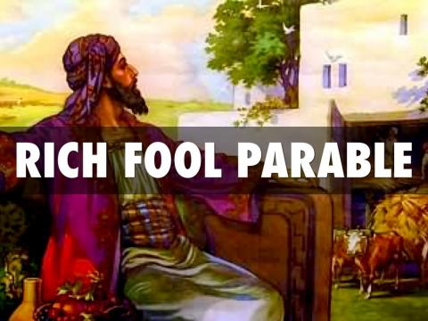
2. Significance: Do I really matter?
We weren’t created for just survival,
Or even temporary success;
but for eternal Significance!
Ro. 8:37; Eph. 1-2:10
Luke 12:16-21

Slide 8
3. Intention: The Point (Purpose) of life!
A. Life Without Purpose Is Pointless.
Phil. 1:21 “for me to live is Christ,
1) Without a creator God,
we’re just random “accidents”
with no purpose beyond survival and pleasure.
If “For you to live is anything but Christ,”
Then to die is the ultimate loss!
to die is gain…”

Slide 9
3. Intention: The Point (Purpose) of life!
A. Life Without Purpose Is Pointless.
B. If You Don’t Know The Purpose Of Something,
You’ll Usually end up misusing
or even Abusing It.
1) Toys, tools, treasure (money)
2) Rules, relationships
3) Pleasure, Property, PEOPLE!

Slide 10
3. Purpose: What does God intend for me?
C. To Find Something’s Purpose You Must:
1) Ask the Creator/designer. Pr. 9:10
“The fear of the LORD is the beginning of wisdom:
and the knowledge of the holy is understanding.”
2) Read the “Owners” Manual. 2 Tim. 3:16,17
“All scripture is given by inspiration of God, and is profitable for doctrine, for reproof, for correction, for instruction in righteousness:
That the man of God may be perfect, throughly furnished unto all good works.”
2 Tim 2:15

Slide 11
3) Follow the instructions. James 1:22-25
“But be ye doers of the word, and not hearers only, deceiving your own selves.
For if any be a hearer of the word, and not a doer, he is like unto a man beholding his natural face in a glass:
For he beholdeth himself, and goeth his way, and straightway forgetteth what manner of man he was.
But whoso looketh into the perfect law of liberty,
and continueth therein, he being not a forgetful hearer, but a doer of the work,
this man shall be blessed in his deed.”

Slide 12
a) This requires some “re-education” Ro 12:1,2
“I beseech you therefore, brethren, by the mercies of God, that ye present your bodies a living sacrifice, holy, acceptable unto God, which is your reasonable service.
And be not conformed to this world: but be ye transformed by the renewing (anakainōsis: renovating)
of your mind, (nous: understanding, soul)
that ye may prove (dokimazō: recognize, approve)
what is that good and acceptable
and perfect will (purpose and pleasure) of God.”

Slide 13
Solomon was the “Wisest” man to ever live.
With unparalleled resources, he set out to find purpose and meaning to life by pursuing his own purposes, pleasures and priorities.
He recorded his “Search for Significance”
in Ecclesiastes, eventually discovering that:
pursuing these things “Under the sun”
(apart from God) results “vanity” (Emptiness)
“Vanity of Vanity! All is vanity”
Ecc. 2:1; 12:8 (mentioned 33 x in Eccl.)

Slide 14
He concludes his journey with this final lesson.
“Let us hear the conclusion of the whole matter:
Fear God, and keep his commandments:
for this is the whole duty (Kol: purpose, goal) of man.
(From kalal’: to complete or perfect)
For God shall bring every work into judgment,
with every secret thing,
whether it be good, or whether it be evil.”
Ecclesiastes 12:13-14

Slide 15
2 Cor 5:10-11 warns of the same inevitable end.
“For we must all appear before the judgment seat of Christ; that every one may receive the things done in his body, according to that he hath done,
whether it be good or bad.
Knowing therefore the terror of the Lord,
we persuade men;…
20 Now then we are ambassadors for Christ, …
we pray you… be ye reconciled to God.”
Katallassō: changed mutually

Slide 16
Gen. 1:1 says: “In the beginning, God….”
Not, “In the beginning me (or you)!”
It doesn’t start with our happiness, ambitions, goals, dreams, etc.
It starts with God and why he put us on this earth.
It’s all sustained by God. (Col 1:16,17)
Someday this old world is going to end with God
(Rev. 20-22) and you’ll be in eternity either
with or without God.
It’s all about God!

Slide 17
Col 1:16-19 “For by him were all things created,
…all things were created by him, and for him:
he is before all things, and by him all things consist.”
And he is the head of the body, the church…
that in all things he might have the preeminence.
(Prōteuō: first in rank, position, influence)
For it pleased the Father that in him should
all fulness dwell” (plēr’ōma: Fulfilment)
The reason so many are not “fulfilled” is because they’re seeking it apart from Christ!

Slide 18
On Mars Hill (Acts 17:27-28) in Athens Paul stood addressed the “philosophers” who were searching for significance and told them:
“That they should seek the Lord, if haply they might feel after him, and find him,
though he be not far from every one of us:
For in Him we live, and move,
and have our being” (esmen’: Hope!)
Who’s your hope really in?

Slide 19
APPLICATION:
The question of intention is two fold.
1) What is God’s intention for my creation?
Remember Romans 12:1 (Dedication)
“Present your bodies a living sacrifice…”
comes before Romans 12:2 (Discovery)
“That ye might prove what is that good, and acceptable, and perfect will of God”

Slide 20
1) What is God’s intention for my creation?
2) In light of that, what is my intention? Will I
a) Partner (Cooperate) with God; This Requires
Faith and a renovation of my soul (Ro. 12:2)
b) Pursue (Concentrate on) my own purposes?
➔ Naturalist: Purpose is to survive (1 Cor 2:14)
➔ Hedonist: Purpose is to enjoy (Lk 12:19)
➔ Materialist: Purpose is to accumulate
“thou fool…” (Luke 12:20)

Slide 21
Acts 17:28 “For in him we live, and move,
and have our being” (esmen’: Hope!)
What’s Your Purpose?
How would (will) you honestly answer this
Fundamental question:
“In _____ I live, and move,
and have my being.” (Hope)

Slide 22
What is your actual Purpose?
While Jailed for his faith, Paul was able to affirm:
“For to me to live is Christ,
and to die is gain.” Phil 1:21
How would you fill in these blanks?
“For me to live is ______________?
Therefore, to die is ______________?

Slide 23
What is your actual Purpose?
Is the path you’re on and the purposes you’re pursue taking you closer to Christ and His plans,
Or further away?
Proverbs 4:18-19 “the path of the just is as the shining light, that shineth more and more
unto the perfect day.
The way of the wicked is as darkness:
they know not at what they stumble.”

Slide 24
Your job is what you’re paid for.
God’s calling is what you’re made for!

Slide 25
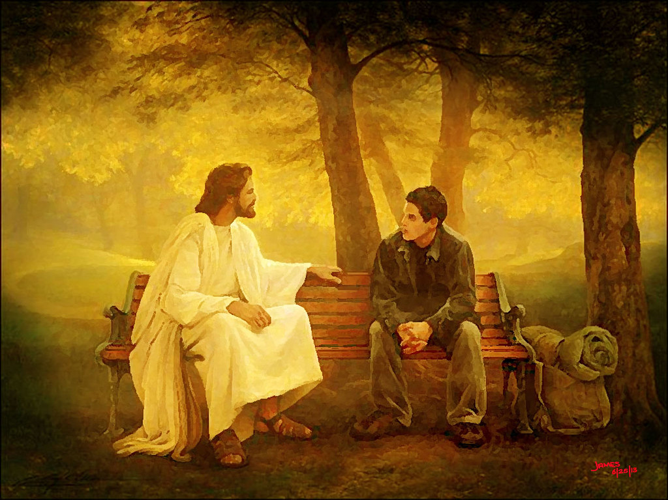
Eph. 4:1,2 “I beseech you that ye walk worthy of the vocation wherewith ye are called.”
John 10:27; 15:16

