Slide 1
Pr 3:5,6; Heb. 11:6; 1 Jn 5:4

Slide 2
In order to plan any successful journey,
you need to answer some questions:
Where are you starting from?
Where do you want to end up?
What’s the best route to get you there?
How will you navigate the dangers,
detours, and distractions you encounter?

Slide 3
Navigating your Faith journey also requires some clear answers to some critical questions.

Slide 5
Satan is a Master at both Deception and Distraction! Mt. 7:14; 2 Cor. 4:4; 11:13,14
Most people live reactively, going through life either asking the wrong questions,
or accepting the wrong answers to the right questions!

Slide 6
You can’t expect the right answers
Unless you ask the right questions!
Three of life’s most important
questions are about:
Existence: Why am I here?
Significance: Does my life really matter?
Intention: What does God want from me?

Slide 7
Existence: “Why Am I Here?”
A. Life Can Seem Frustrating Without This Answer.
Many have struggled with this.
1) Jeremiah: Jer. 20:18 “Wherefore came I forth out
of the womb to see labor and sorrow?”
2) Job: 3:11 “Why died I not from the womb?”
Job 5:7 “man.. is born unto trouble, as the sparks fly”
3) Solomon: Ecc 1:2 “Vanity of vanities…
All is vanity”. (heḇel: Empty)
“vanity” Mentioned 99 x in Bible, 38x in Ecclesiastes

Slide 8
B. We Look For Answers In the Wrong Places!
Looking for “Life” in all the wrong places!
If we reject the reality of a creator, we’re left to pursue:
1) The Mystical Approach: Look within:
Discover Yourself…
a) Create your own dreams/goals and pursue them.
b) This makes you the “god” of your own goals.
Oprah’s show about the meaning of life concluded with: “You’ve got to figure it out yourself!”
Invent a purpose!

Slide 9
1) The Mystical Approach: “Look within”
Jer 17:9 “The heart is deceitful above all things and desperately wicked. Who can know it?
10 I the LORD search the heart, I try the reins, even to give every man according to his ways,
and according to the fruit of his doings.
Ro 7:18 “I know that in me …dwelleth no good thing: for to will is present with me;
but how to perform that which is good I find not.”

Slide 10
If we reject the reality of a creator, we’re left to pursue:
1) The Mystical Approach: “Look within”
2) The Methodical approach: “Look around”
until you find something you like,
then Adopt a purpose!
a) This leads to Doubleminded thinking
and reactive, unstable living. (James 1:5-8)
“A double minded man is unstable in all his ways.”

Slide 11
If we reject the reality of a creator, we’re left to:
3) The Philosophical Approach. “Ask the experts”
“Accept” a (their) purpose.
a) Philosophy professor Dr. Huge Morehead asked 250
leading philosophers, intellectuals, and influencers to define:
“The meaning/purpose of life.”
In 1988 he compiled their answers and published “The Meaning of Life!”
They didn’t all agree ➔ best guesses.
Review: “Too many have no real meaning to be either entertaining or interesting, but a few are worth reading.”

Slide 12
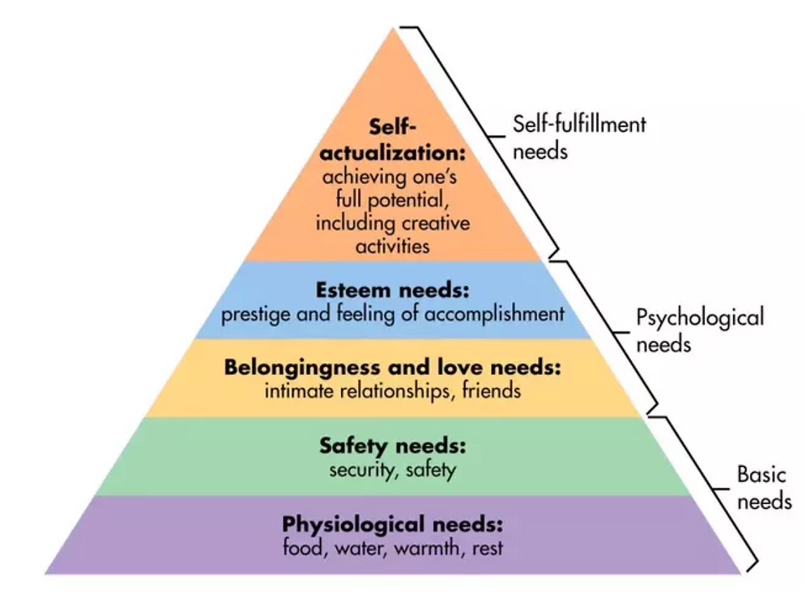
What if your actual purpose isn’t really just about you?
b) Maslow's hierarchy of needs 1943

Slide 13
1. Existence: “Why Am I Here?”
C. We won’t find the answer to why we were created
without consulting the Creator!
Heb 11:6 “But without faith it is impossible to please him:
for he that cometh to God must believe that he is,
and that he is a rewarder of them that diligently seek him.”
1) It’s not really just about you or me!
Pro 16:4 “The LORD hath made all things for himself“
a) We were not created simply for our own
purposes, pleasures, priorities,
but for God’s!
Rev. 4:11

Slide 14
2. Significance: “Do I Matter?”
A. Levels Of Life: (Where are YOU?)
1) Survival: (Reactive Living or “existing”)
a) Satan is a master at using circumstances to
distract us from focusing on what’s important.
“The Tyranny of the Urgent” Mk 4:19
“the cares of this world, and the deceitfulness of riches, and the lusts of other things entering in,
choke the word,
and it becometh unfruitful.”

Slide 15
A. Levels Of Life: (Where are YOU?)
1) Survival: (Reactive Living or “existing”)
2) Success: (Proactive living toward temporary goals)
Mt 6:19-21 “Lay not up for yourselves treasures upon earth, where moth and rust doth corrupt,
and where thieves break through and steal:”
a) To “succeed” at the wrong thing is ultimate
failure! (1 Cor 3:9-15)
Mt 7:13 “broad is the way which leads to destruction”
apōleia: waste! (Pr 14:12; 16:25)

Slide 16
2. Significance: “Do I Matter?”
A. Levels Of Life: (Where are YOU?)
1) Survival: (Reactive Living or “existing”)
2) Success: (Proactive living toward temporary goals)
3) Significance: Working toward Eternal Purposes.
“having a particular meaning; indicative of something.”
Vs 20: “but lay up for yourselves treasures in heaven…
For where your treasure is, there will your heart be also”
John 15:16 “I have chosen you, and ordained you,
that ye should go and bring forth fruit,
and that your fruit should remain…”

Slide 17
2. “Do I Matter?” Search for Significance:
B. The Search For Significance begins when we:
1) Recognize God created you for His Purposes.
Is. 42:1“my servant, whom I uphold; mine elect, (chosen) in whom my soul delights; I’ve put my spirit upon him:”
Jer. 1:5 “Before I formed thee in the belly I knew thee;
and before thou camest forth out of the womb
I sanctified thee, and I ordained thee a prophet…”
God uses “all things” to prepare you for His fulfilling purposes. (Ro. 8:28,29)

Slide 18
B. The Search For Significance begins when we:
2) Realize God loves you actively and Intimately.
(YOU MATTER TO HIM!)
Ps 40:17 “I am poor and needy; yet the Lord thinketh
(ḥāšaḇ’: prioritizes, ponders, plans) upon me.”
Isaiah 43:1-4 “thus saith the LORD that created thee, and he that formed thee, Fear not: for I have redeemed thee, I have called thee by thy name; thou art mine….
Since thou wast precious in my sight,
… and I have loved thee…” (also Jer. 31:3)

Slide 19
B. The Search for Significance begins when we:
1) Recognize God created you for His purposes.
2) Realize that God loves!
3) Relinquish our claim to “run” our lives. Pr 3:5,6
1 Cor 6:19,20 “What? know ye not that your body is the
temple of the Holy Ghost which is in you, which ye have of God, and ye are not your own?
For ye are bought with a price: therefore glorify God in your body, and in your spirit,
which are God’s.”
Romans 12:1,2

Slide 20
3) Relinquish our claim to “run” our own lives.
Mt 16:24-27 “If any man will come after me, let him deny himself, and take up his cross, and follow me.
For whosoever will save his life shall lose it: and whosoever will lose his life for my sake shall find it.
For what is a man profited, if he shall gain the whole
world, and lose his own soul?
or what shall a man give in exchange for his soul?
For the Son of man shall come in the glory of his father,
then he shall reward every man according to his works.”

Slide 21
Significance ➔ Recognize…Realize…Relinquish
4) Rededicate your life to God’s purposes.
a) Life/Time is preparation for eternity!
1) God compares this earthly life to a “Tent”
and eternity to a “Building”. (2 Cor 5)
2 Cor 4:17-18 “For our light affliction, which is but for a moment, worketh for us a far more exceeding & eternal weight of glory;
While we look not at the things which are seen,
but at the things which are not seen:
for the things which are seen are temporal;
but the things which are not seen are eternal.”

Slide 22
Existence: Why am I here?
We were created to:
Have a consummate relationship with God. Jer 31:3
Cooperate (partner) with God in accomplishing His
plans and purposes. Mt 11:29; 2 Cor 3:9; Eph 2:8-10
Conquer Satan’s attempts to seduce, sidetrack, and sabotage you. Ro. 8:35-39; 1 Jn 4:4; 5:4

Slide 23
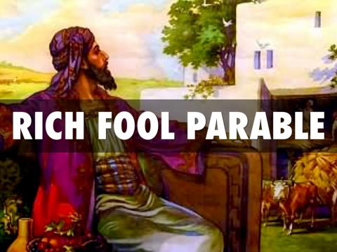
2. Significance: Do I really matter?
We weren’t created for just survival,
Or even temporary success;
but for eternal Significance!
Luke 12:16-21

Slide 24
Eph 1:4-6 “He hath chosen us in him before the
foundation of the world,
that we should be holy and without blame
before Him in love .
⁵Having predestinated us unto the adoption of children by
Jesus Christ to himself,
according to the good pleasure of his will, ⁶To the praise of the glory of his grace,
wherein he hath made us accepted in the beloved.”
(God Planned You)
(God has plans for You!)
(God Loves You!)
(God wants to Adopt you!)
(For our Good and His Glory!)
(God accepts you in Christ!)

Slide 25
Jer. 29:11 “For I know the thoughts (plans) that I think toward you,
saith the LORD,
thoughts of peace, and not of evil,
to give you an expected end.”
Tiqvâ 'aḥărîṯ:
(hope and purpose!)

Slide 26
Jer. 29:12 “Then shall ye call upon me,
and ye shall go and pray unto me,
and I will hearken unto you.
13 And ye shall seek me, and find me,
when ye shall search for me with all your heart.
14 And I will be found of you, saith the LORD:
And turn away your captivity…”

Slide 27
If you will do your part
“Call…, Pray…, Seek”
He will do His!
“Hearken unto you…
be found of you…,
turn away your captivity”

