Slide 1
Eph 6:10-18; 2 Cor 10:3-5; 2 Cor 2:11
“Lest Satan should get an advantage of us:
for we are not ignorant of his devices.”

Slide 2
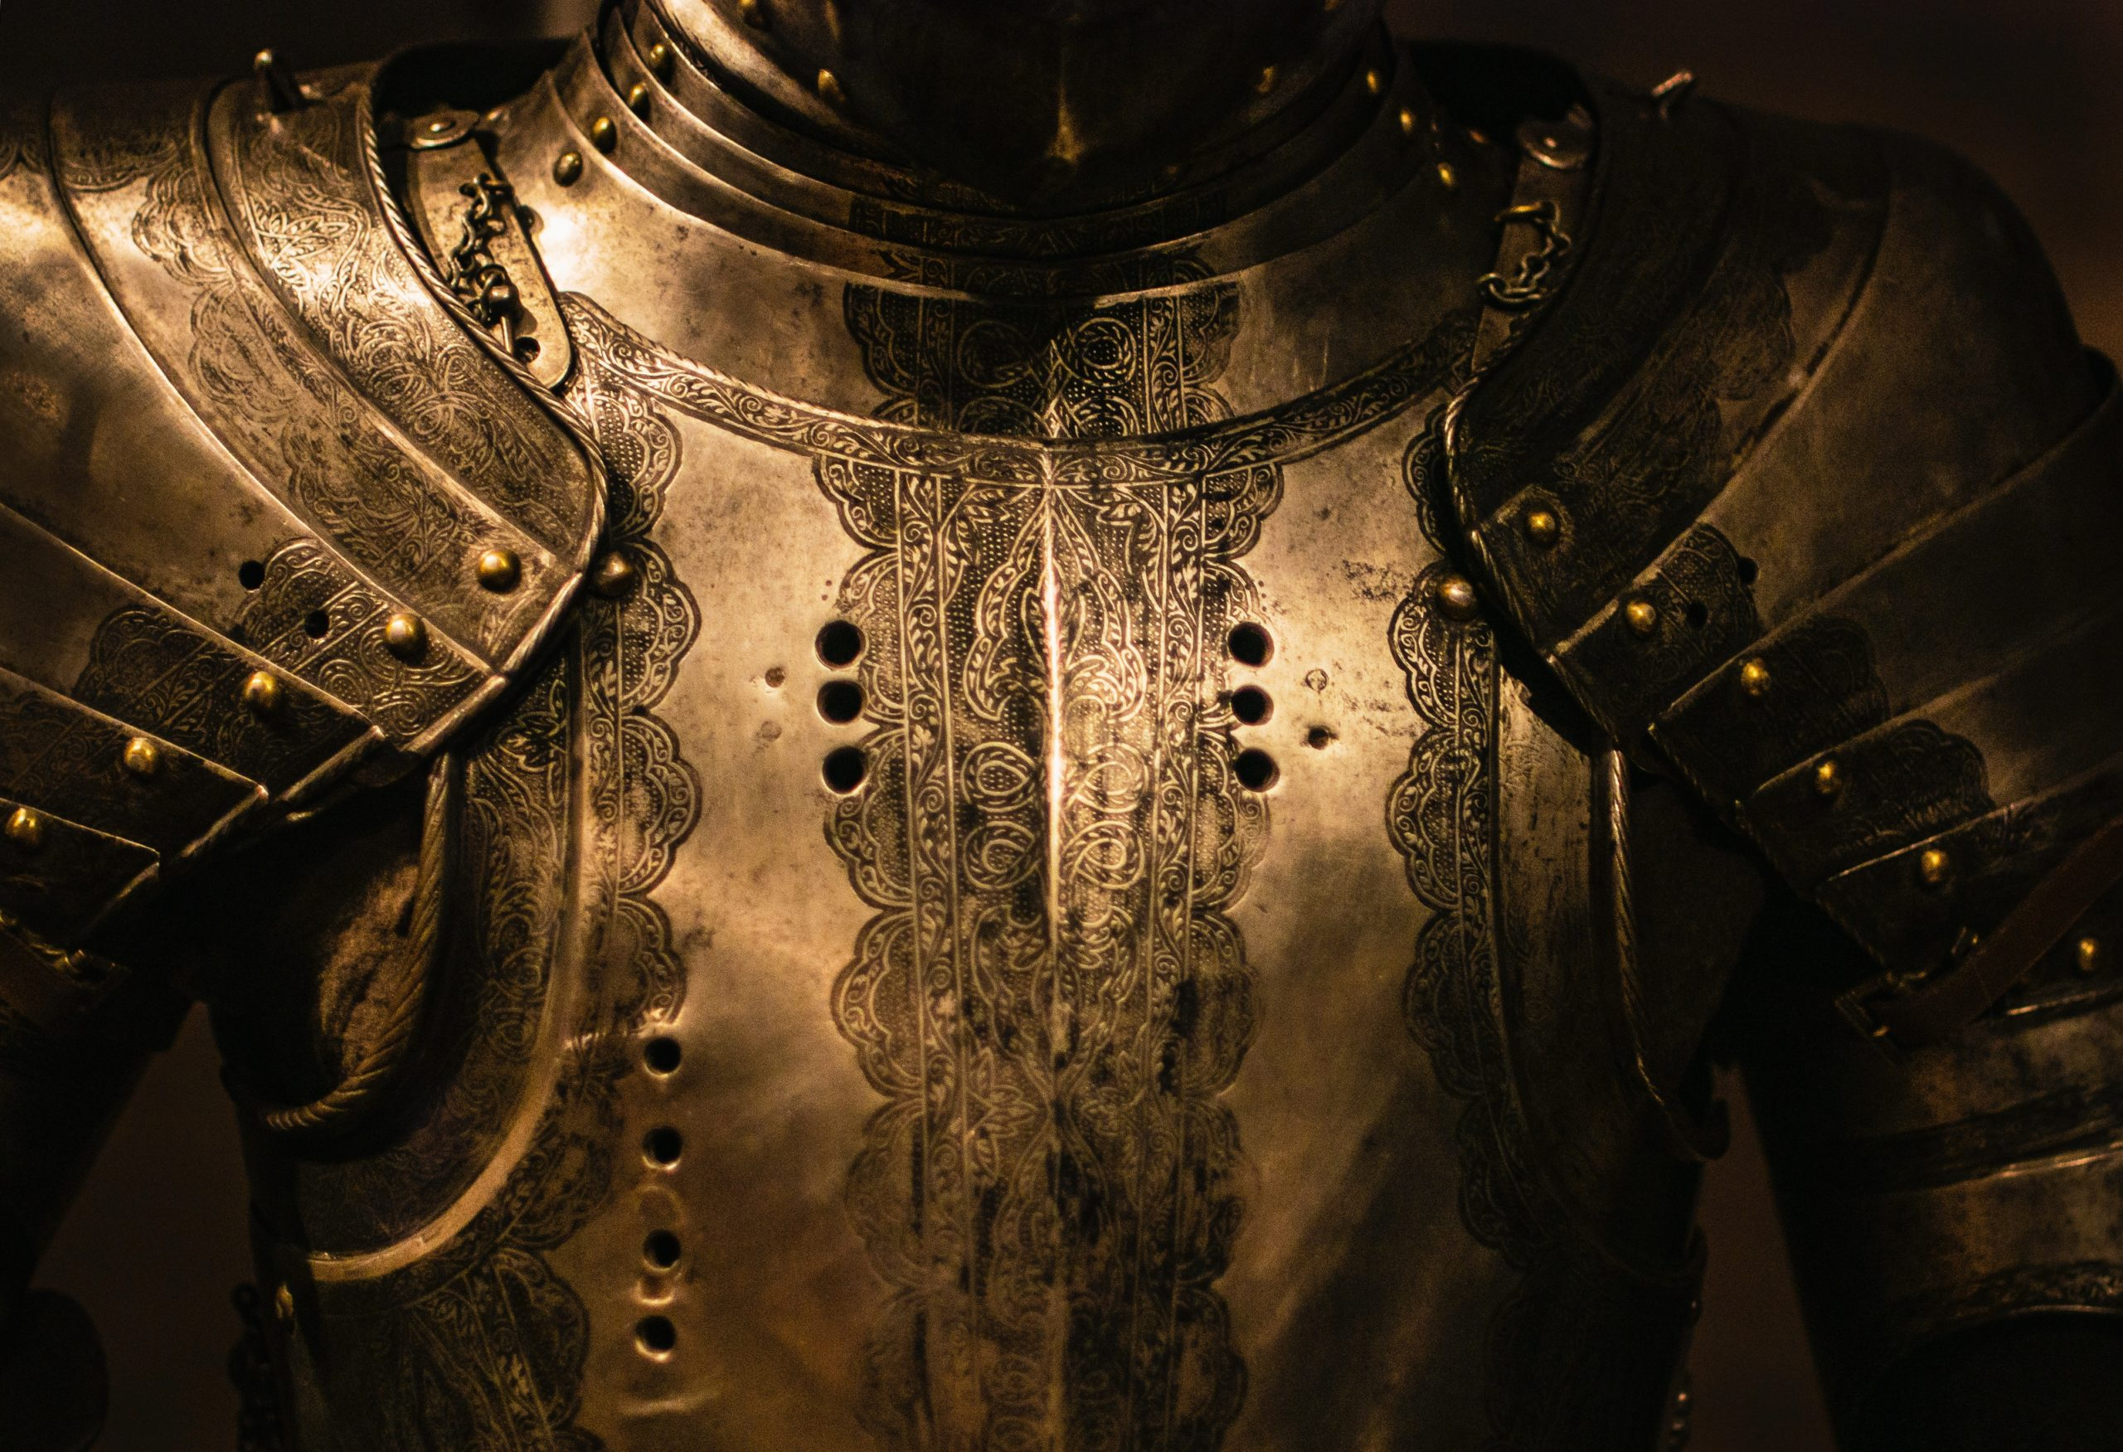
While warfare is the inevitable conflict between opposing forces;
The Goal of any Righteous Warfare is
eventual and lasting Peace.
This is why Jesus came!

Slide 3
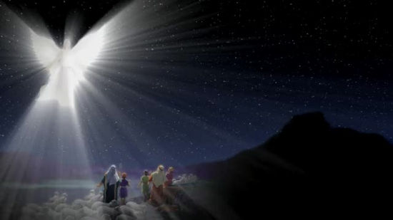
Luke 2:10 “Fear not:
for, behold, I bring you good tidings of great joy,
which shall be to all people.
11 For unto you is born this day …a Savior, (Sōtēr’: deliverer)
{From soz’o: heal, protect, save;
“make whole” }
which is Christ the Lord.”
Ps 23:3!?!

Slide 4
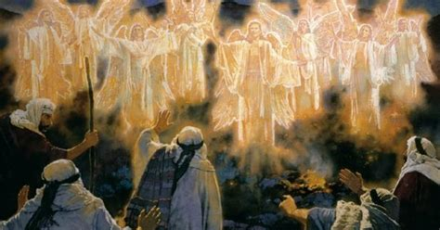
Luke 2:13-14 “And suddenly there was with the angel a multitude of the heavenly host praising God, and saying, 14 Glory to God in the highest,
and on earth peace, good will toward men.”

Slide 5
Peace is not the absence of Pain or Problems,
but an awareness that we’re on the right side of this cosmic conflict,
in partnership with
“The Prince of Peace”!
(Is. 9:6; Mt 11:28,29)

Slide 6
Since “Peace” (from eiro) means to join;
Our Peace (Or lack thereof)
is related to who or what we Join.

Slide 7
Isaiah 7:14 “the Lord himself shall give you a sign;
Behold, a virgin shall conceive, and bear a son,
and shall call his name Immanuel.”
God is
with us!

Slide 8
Isaiah 9:6 “Unto us a child is born,
unto us a son is given:
and the government shall be upon his shoulder: and his name shall be called:
Wonderful,
Counsellor,
The mighty God,
The everlasting Father,

Slide 9
Shālôm: Peace, safety
from shalem: to pay
Peace has a price!

Slide 10
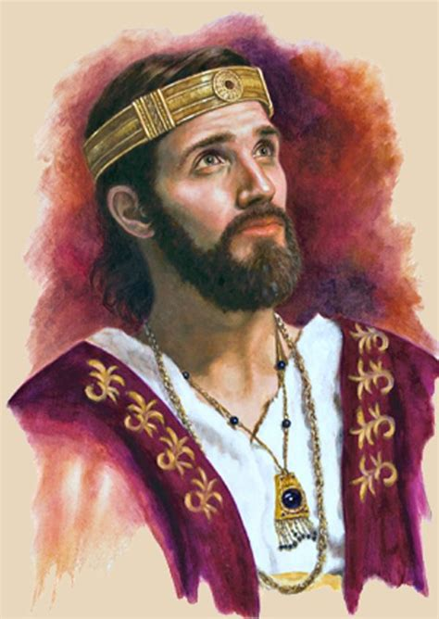
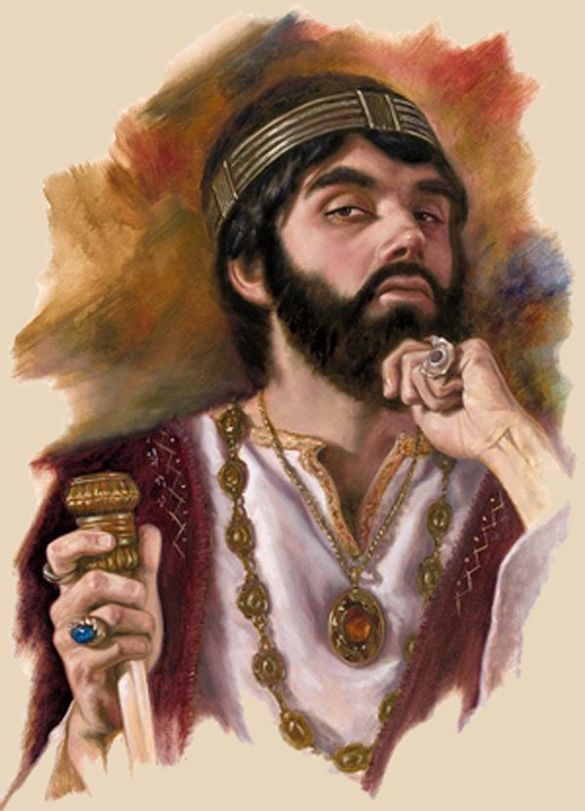
These two incredible promises were originally given to King Ahaz (735-715 BC)
who faced choices/challenges similar to our own.
His Father Jotham and he
had some interesting similarities. Both:
Became Kings in their mid 20’s. (25 and 26)
Ruled Judah for 16 years.

Slide 11
But they had one important difference.
2 Chr. 27:2 Jotham “did that which was right in the
sight of the LORD, according to all that his father Uzziah did:…
6 So Jotham became mighty,
because he prepared his ways
before the LORD his God.”

Slide 12
Ahaz chose a very
different path,
resulting in a very
different
“Partnership”
(and posterity!)

Slide 13
1. The Choice(s) of Ahaz.
A. Our early choices are important,
because they set us in motion.
Newton’s 1st law of motion (inertia)
“an object at rest (or in motion) will tend to remain (at rest or in motion)
until acted on by an equal/opposite force.”

Slide 14
1. The Choice(s) of Ahaz.
A. Our early choices set us in motion.
1) He chose to rejected God’s ways…
2 Kings 16:2 “twenty six years old was Ahaz when he began to reign, and reigned sixteen years in Jerusalem,
and did not that which was right
in the sight of the LORD his God…

Slide 15
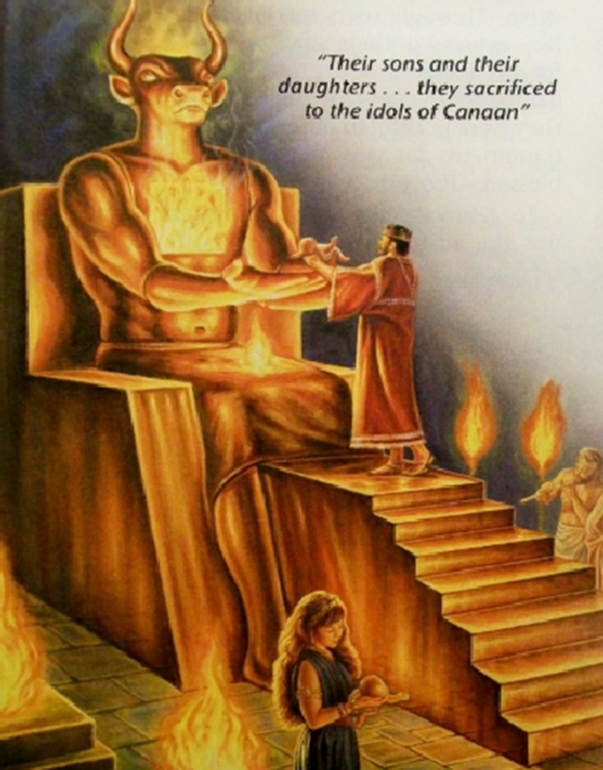
2) One choice tends to produce others.
a) Rejecting God led him to embrace the gods
(values) of his time.
2 Kings 16:3 “he walked in the way of the kings of Israel,
yea, and made his son to pass through the fire,
according to the abominations
(idols) of the heathen”

Slide 16
B. Choices lead to Consequences Gal. 6:7,8
“Be not deceived; God is not mocked:
for whatsoever a man soweth,
that shall he also reap.
For he that soweth to his flesh
shall of the flesh reap corruption;
but he that soweth to the Spirit
shall of the Spirit reap life everlasting.”

Slide 17
2. Ahaz’s Challenges/Chastening
A. God chastens those he loves! Heb. 12:6,7
1) This principle is timeless. God said of Solomon
2 Sam 7:14 “ I will be his father, and he …my son.
If he commit iniquity,
I will chasten him with the rod of men…”
2) Since God loved Ahaz, He allowed conflicts
(consequences) to come.

Slide 18
2. Ahaz’s Challenges/Chastening
A. God chastens those he loves! Heb. 12:6,7
B. This “chastening” came in the form of war.
Isaiah 7:2 “And it was told (Ahaz) saying,
Syria is confederate with Ephraim. (Israel)
3 And his heart was moved, (nûaʿ: shaken, wavered)
and the heart of his people.”
1) His sin (and ours) affects others! (Ro 14:7)
How much will our sin cost others?

Slide 19
3 “And his heart was moved” (nûaʿ: shaken, wavered)
C. God often has to shake us up
to wake us up!
1) God’s goal is not condemnation, but restoration!
Rev. 3:21 “As many as I love I rebuke
and chasten, be zealous therefore
and repent.
22 Behold I stand at the door and knock…”

Slide 20
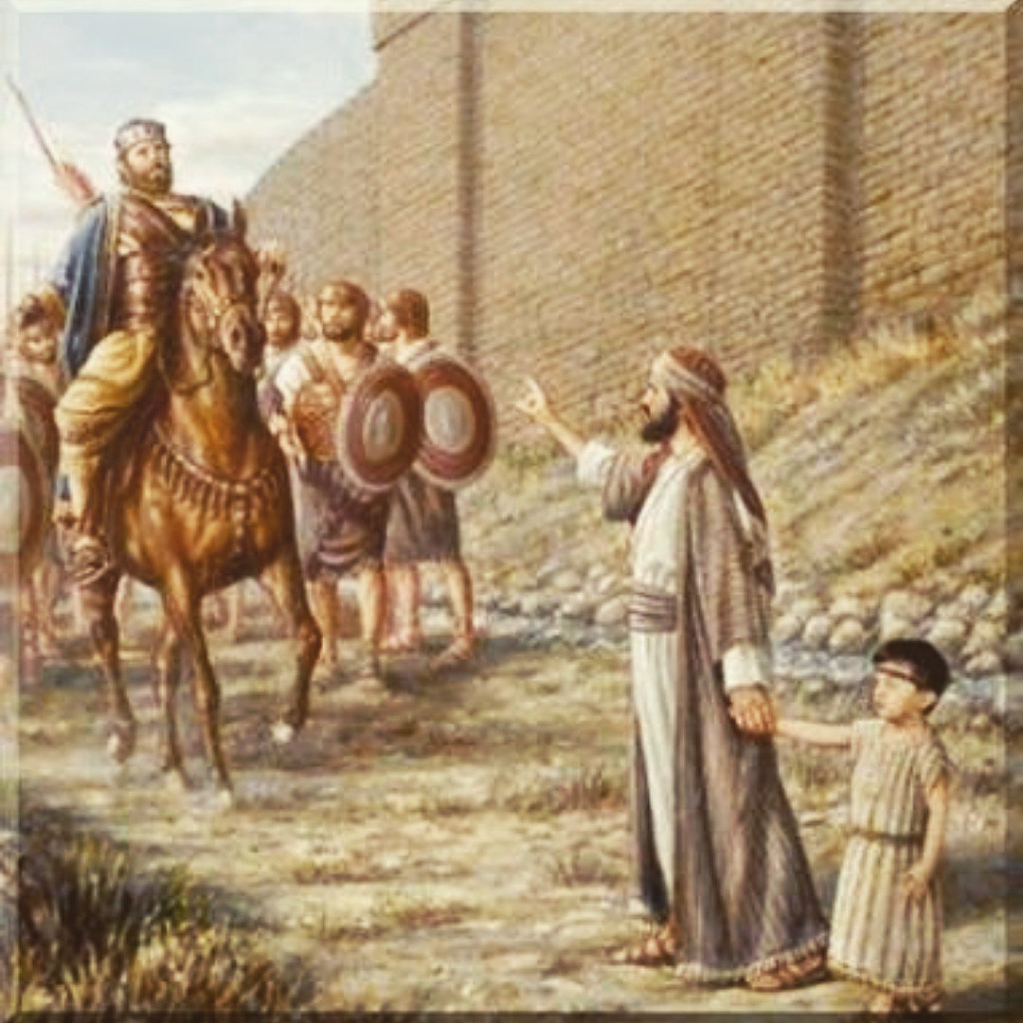
2) God sent Isaiah to Confront, Counsel
and even Comfort Ahaz. Isaiah 7:4-11
4 “say unto him, Take heed, and be quiet; fear not, neither be fainthearted…, for the fierce anger of Rezin with Syria,
and of (Pekah) the son of Remaliah…
5 …hath taken evil counsel against thee…”
7 Thus saith the Lord, It shall not stand, neither shall it come to pass.
11 Ask a sign of the LORD thy God; ask it either in the depth, or in the height above.”

Slide 21
7:12 “But Ahaz said, I will not ask,
neither will I tempt the LORD.”
3) He rejected God’s offer of peace (partnership) because he had already accepted Satan’s!
a) He Robbed God’s Temple to pay the Assyrian King
to fight his battles! 2 Kgs 16:7-8
b) This led to a poisonous partnership that brought pain, treachery and conflict for decades.
Such conflict has become the norm in this world that consistently rejects God’s word and ways.

Slide 22
Conclusion:
Like Ahaz, we tend to panic in the face of problems, and trust the “reasonable” offers (solutions)
that come from the world, but result in
debt, doubt, and disappointment.
Jn 10:10 “The thief commeth not
but for to steal…kill…destroy”

Slide 23
We too tend to look to the wrong sources for Peace, Protection and Provision.
“should not a people seek unto their God?
...to the Law and to the testimony?
If they speak not according to this word,
it is because there is no light in them.”
Is 8:19-20
Our choices produce partnerships!
(with God or the “gods” of this world)

Slide 24
Application
Newton’s 1st law: “…tends to stay in motion
until acted upon by an…opposite force”
Even after our short-sighted, selfish choices,
resulting in poisonous partnerships,
God often comes to us
with his counsel and comfort
and invites us to return to him.
Mt 11:28,29

Slide 25
Since Peace is related to Partnership,
Which King’s choices
most accurately reflect yours?
Jotham
2 Chr. 27:2 “did that which was right in the sight of the LORD…,
6 So Jotham became mighty,
because he prepared his ways
before the LORD his God.”

Slide 26
Since Peace is related to Partnership,
Which King’s choices
most accurately reflect yours?
2 Kings 16:2 “…Ahaz did not that which was right
in the sight of the LORD his God…
Ahaz
3 ..he walked in the way of the kings of Israel,
and made his son to pass through the fire,
according to the abominations
(idols) of the heathen”

Slide 27
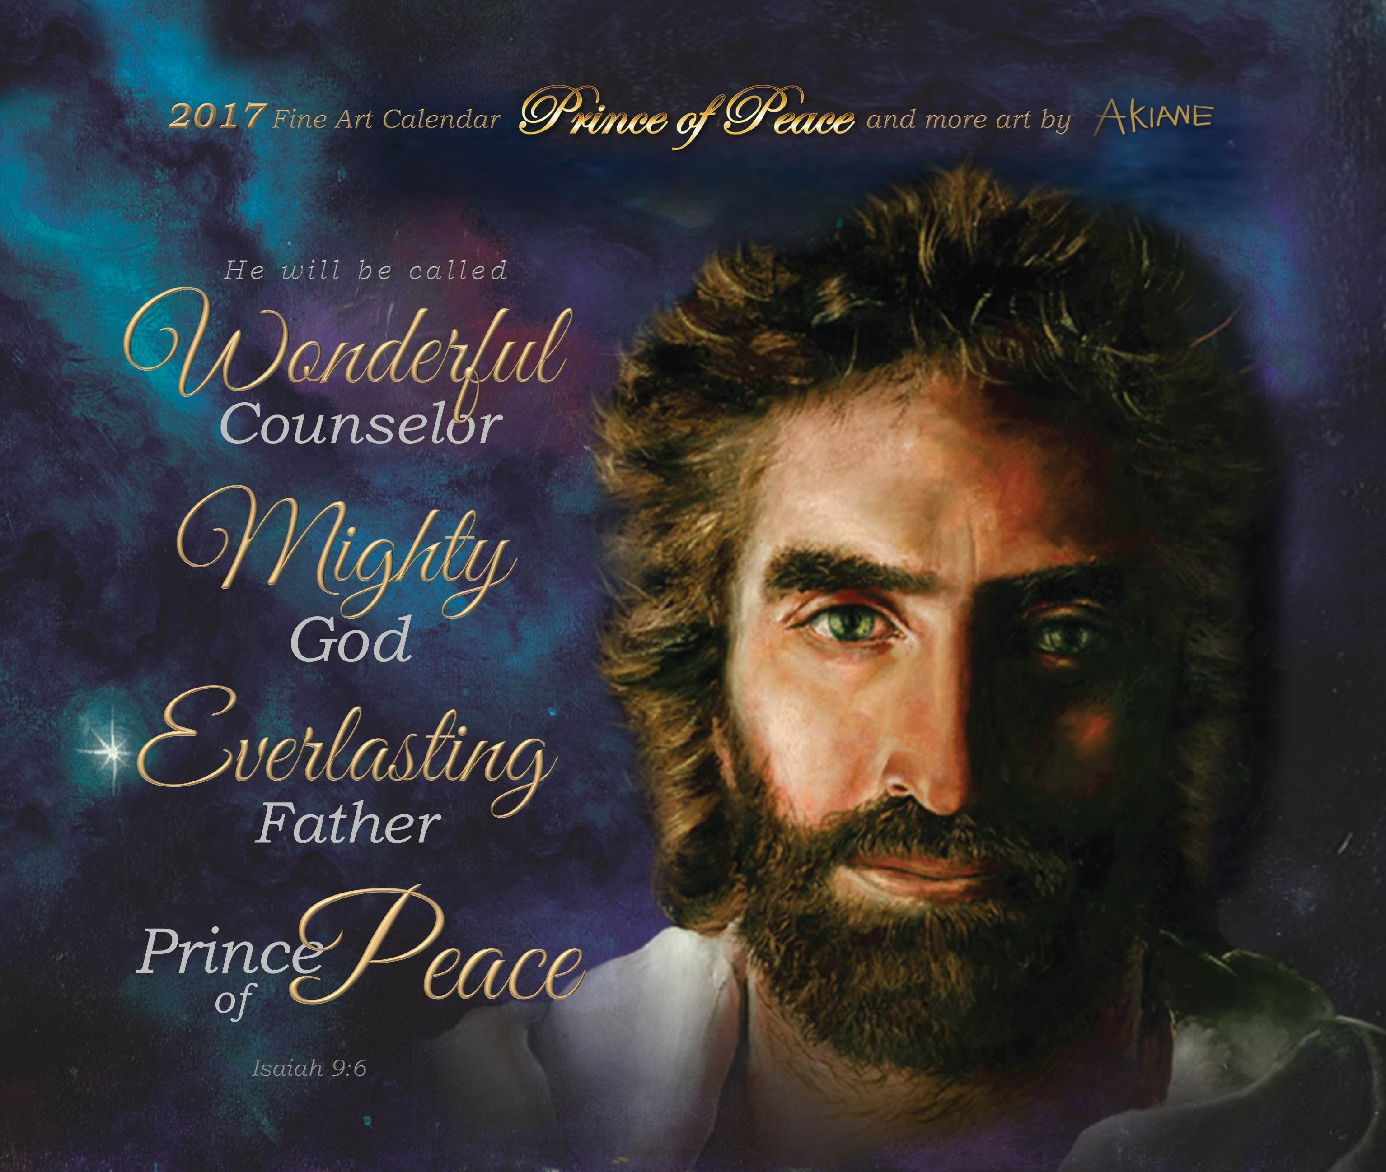
God is wanting to introduce you this holiday Season
to the promise
and privilege of
partnering with
Painted by Akiane Kramarik when she was 8
https://akiane.com/shop/

