Slide 2
Isaiah 7:14 “the Lord himself shall give you a sign;
Behold, a virgin shall conceive, and bear a son,
and shall call his name Immanuel.”
God is
with us!

Slide 3
“Unto us a child is born, unto us a son is given: and the government shall be upon his shoulder: and his name shall be called
Wonderful,
Counsellor,
The mighty God,
The everlasting Father,

Slide 5
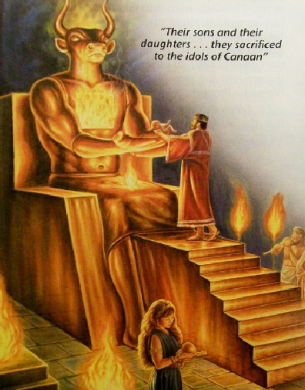
These two incredible promises were originally given to King Ahaz (700 BC) who rejected God, embracing the god’s (values) of the time.
2 Kings 16:2-3 “Twenty years old was Ahaz when he began to reign, and reigned sixteen years in Jerusalem, and did not that which was right in the sight of the LORD his God…
But he walked in the way of the kings of Israel,
yea, and made his son to pass through the fire,
according to the abominations of the heathen, whom the LORD cast out from before …Israel.”

Slide 6
Heb 12:6 “For whom the Lord loveth he chasteneth…”
Since God loved Ahaz,
He allowed conflicts to come. Gal. 6:7
2 Sam. 7:14 “I will be his father, and he shall be my son.
If he commit iniquity,
I will chasten him with the rod of men”
This “chastening” came in the form of war. Is. 7:2
“And it was told (Ahaz) saying, Syria is confederate
with Ephraim. (Israel)
3 And his heart was moved, (nûaʿ: shaken, wavered)
and the heart of his people.”

Slide 7
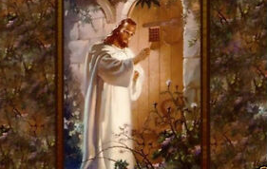
3 And his heart was moved, (nûaʿ: shaken, wavered)
and the heart of his people.”
God often has to shake us up
Rev. 3:21 “As many as I love I rebuke and chasten,
be zealous therefore and repent.
to “wake us!”
22 Behold I stand at the door and knock…”

Slide 8
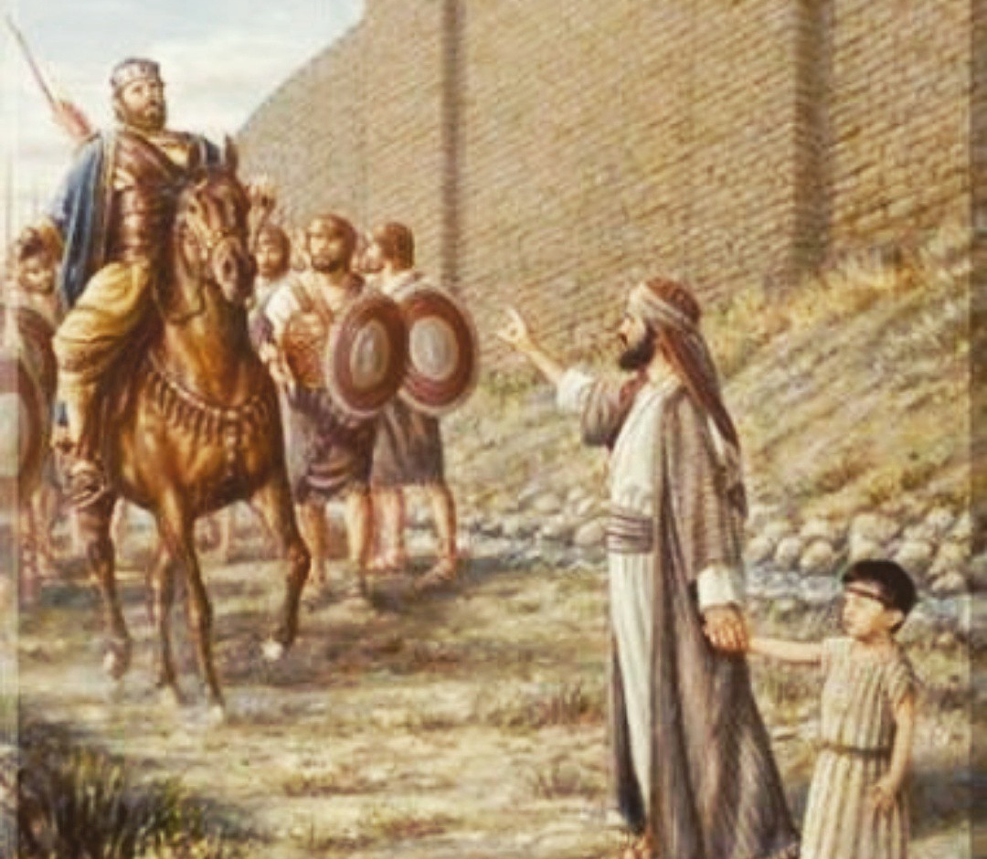
God sent Isaiah to Counsel and Comfort Him. 3-9
4 “say unto him, Take heed, and be quiet; fear not, neither be fainthearted…, for the fierce anger of Rezin with Syria, and of the son of Remaliah….5 …hath taken evil counsel against thee…”
7 Thus saith the Lord, It shall not stand, neither shall it come to pass.
11 Ask a sign of the LORD thy God; ask it either in the depth,
or in the height above.”

Slide 9
7:12 But Ahaz said, I will not ask,
neither will I tempt the LORD.”
He had already made his own arrangements!
He Robbed the Temple to pay the Assyrian King
to fight his battles! 2 Kgs 16:7-8
This led to a treacherous partnership that brought pain, treachery and conflict for decades.
Such conflict has become the norm in this world that consistently rejects God’s word and ways.

Slide 10
Like Ahaz, we tend to panic in the face of problems, and trust the “reasonable” offers (solutions) that
come from the world, but that usually result in
debt, doubt, and disappointment.
The problems and promises of this passage are as relevant to us as they were to Ahaz.

Slide 11
We, like the Ahaz, tend to Look to the wrong sources for Peace,
Protection and Provision. Is 8:19-20
“should not a people seek unto their God?
...to the Law and to the testimony?
If they speak not according to this word,
it is because there is no light in them.”

Slide 12
1. We tend to choose Practical Compromise
over Principled Character.
A. He Robbed God’s Temple to do this. (Mal. 3:10) 2 Kgs 16:8
“So Ahaz took the silver and gold in the house of the LORD… and sent it for a present to the king of Assyria.”
1) He also robbed God of an opportunity to
demonstrate His Power! (2 Chr 16:9)
Do we not fall into this same snare? (Mal. 3:10)

Slide 13
2. Doing the wrong thing will often “work”
in the short term.
A. Ahaz’s “Choice” Seemed To Work!
1) Assyria fought against Syria and defeated them.
2) Assyria went to war against Israel and eventually
defeated them as well. (2 Kings 17)
Asaph struggled over this paradox. Ps 73
The Pleasures of Sin only last for a season. Heb. 11:25,26

Slide 14
3. Compromise Brings Consequences.
“Politics makes strange bedfellows”
comes from Shakespeare’s play “The Tempest”:
“Misery acquaints a man with
strange bedfellows.”
It was spoken by shipwrecked man who finds
himself seeking shelter beside a sleeping monster.

Slide 15
3. Compromise Brings Consequences:
A. In our “Feelings” (Thinking/Reasoning)
1) Compromising (principles) produces “callouses”.
a) We “cloud” (or cauterize) our conscience.
1 Tim 4:1-2 “The Spirit speaketh expressly, that in the latter times some shall depart from the faith,
giving heed to seducing spirits, and doctrines of devils;
Speaking lies in hypocrisy; having their conscience
(Synei’dēsis: perception) seared with a hot iron…”
Pr. 20:27 “spirit …is the candle of the LORD”

Slide 16
3. Compromise Brings Consequences.
B. In our Faith: 2 Kings 16
1) Ahaz replaced the Altar in God’s Temple with
one similar to what the Syrians used in their temple
to worship devils!
a) If the Syrian “gods” couldn’t help them
against the Assyrians,
why would he trust and worship them?

Slide 17
3. Compromise Brings Consequences.
C) In Our Family. (Ex. 20:5)
1) His compromise produced an alliance that
required “Tribute” to be paid each year.
2) Hezekiah eventually capitulated when:
“Sennacherib king of Assyria come up against all the fenced cities of Judah, and took them. And Hezekiah king of Judah sent to the king of Assyria to Lachish, saying, I have offended; return from me: that which thou puttest on me will I bear.
And the king of Assyria appointed unto Hezekiah three hundred talents of silver and thirty talents of gold. “ 2 Kings 18:13-14

Slide 18
3. Compromise Brings Consequences.
C) In Our Family. (Ex. 20:5)
a) Hezekiah also robbed God’s Temple.
2 Kings 18:15,16 “Hezekiah gave him all the silver that was found in the house of the LORD…”
b) Assyria took the money and came anyway!
17 And the king of Assyria sent …
a great host against Jerusalem…”
You can’t win in a deal with the devil! Jn 10:10

Slide 19
Isaiah met Ahaz with God’s promise by the “conduit of the upper pool…in the highway of the fuller’s field” (Isaiah 7:3)
Notice where the Assyrians met Hezekiah!
“And the king of Assyria sent Tartan and Rabsaris and Rabshakeh from Lachish to king Hezekiah with a great host against Jerusalem. And they went up and came to Jerusalem. And when they were come up, they came and stood
by the conduit of the upper pool, which is in the highway of the fuller's field.” 2 Kings 18:17

Slide 20
Many, like Ahaz, try to “buy” their own
“stairway to heaven”
not realizing who’s actually “selling it”.
(Peace)
Led Zeppelin – 1971 Stairway To Heaven
“There's a lady who's sure, All that glitters is gold,
And she's buying a stairway to heaven…
There's a sign on the wall, But she wants to be sure;
Cause you know sometimes words have two meanings…
And it's whispered that soon, If we all call the tune,
Then the piper will lead us to reason.

Slide 21
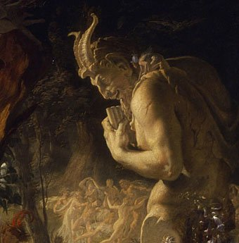
Led Zeppelin – 1971 Stairway To Heaven
And a new day will dawn For those who stand long And the forests will echo with laughter…
there are two paths you can go by, But in the long run,
There's still time to change the road you're on!?
Your head is humming and it won't go
In case you don't know
The piper's calling you to join him!”

Slide 22
“there are two paths you can go by, But in the long run,
There's still time to change the road you're on!?
Hezekiah decided to “change the road” he was on and look to the LORD for help. 2 Kings 19:1
“when king Hezekiah heard it, that he rent his clothes, and covered himself with sackcloth, and went into the house of the LORD.”
God sent 1 angel and destroyed the 186,000 Assyrians camped against Jerusalem.
2 Kings 19:31

Slide 23
Both Ahaz &Hezekiah faced an overwhelming force.
God sent Isaiah to counsel and comfort both.
Both heard the same promises of Is. 7:14 and 9:6.
⁶ ”For unto us a child is born, unto us a son is given: and the government shall be upon his shoulder: and his name shall be called Wonderful, Counsellor, The mighty God,
The everlasting Father, The Prince of Peace.”
Only one Chose to believe God!

Slide 24
In Our Troubles, God Comes to Offer His Help.
As "Wonderful" he can bring COLOR to the
DULLNESS of life. (Jn. 10:10)
As "Counselor" he can bring CLARITY to the
DECISIONS of life. (Jn. 8:32)
As "Mighty God" he can bring COMFORT for the
DEMANDS of life. (Jn. 14:8)
As "Everlasting Father" he brings COMMITMENT
for the DIMENSIONS of life. (Heb. 13:5)

Slide 25
As "Prince of Peace" he adds CONTROL
for the many DISTURBANCES of life. (Jn 14:27)
Isaiah 9:7 “Of the increase of his government and peace there shall be no end…”
Your “government” and (ability to maintain) peace will eventually end.
So why not submit to His Authority and Receive His Help and Peace. (Mt. 11:28,29)

Slide 26
Is 30:15-17 “For thus saith the Lord GOD…
In returning and rest shall ye be saved;
in quietness and in confidence shall be your strength:
and ye would not.
But ye said, No; for we will flee upon horses…
We will ride upon the swift;
therefore shall they that pursue you be swift. “

Slide 27
“Yes, there are two paths you can go by,
But in the long run,
There's still time to change the road you're on (?)
…The Piper’s calling you to join him”?
Led Zeplin “Stairway to heaven”

Slide 28
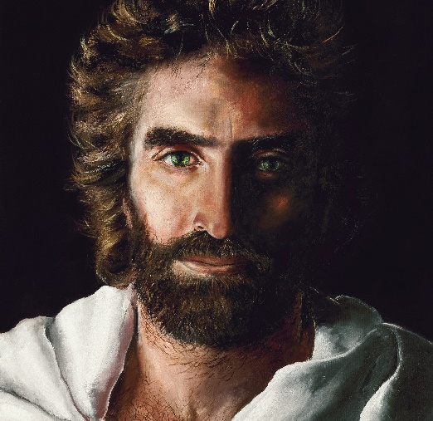
Who will you follow?
“The Piper”?
Or the “Prince of Peace”?

Slide 29
Akaine Kramarik painted “The Prince of Peace” at the age of 8!

