Slide 1
On Palm Sunday Jesus presented himself to Israel, who heralded Him as their King.
Zech 9:9 “Rejoice greatly, … Zion; behold, thy King comes to thee:
he is just,
and having salvation;
lowly, and riding upon an ass, and upon a colt
the foal of an ass.”

Slide 2
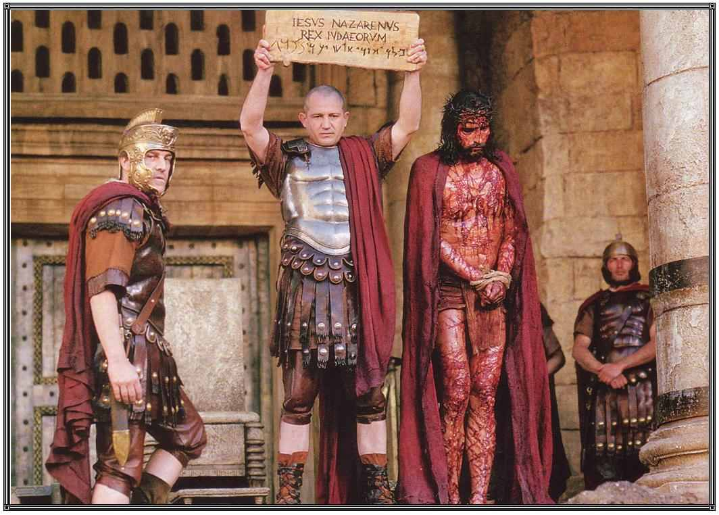
This “Passion week” that started with such hope,
Ended with disillusionment and Horror!
Jn 19:14 “it was the preparation of the passover...
and he saith unto the Jews,
Behold your King!”
15 “Crucify him!
We have no king but Caesar”

Slide 3
John records the Triumphal entry in Jn. 12:12-19
Then Jesus says: 23 “The hour is come,
that the Son of man should be glorified.
24 Verily, verily, I say unto you, Except a corn of wheat fall into the ground and die, it abideth alone:
but if it die, it bringeth forth much fruit…
27 Now is my soul troubled; and what shall I say? Father, save me from this hour:
but for this cause came I unto this hour.
28 Father, glorify thy name.”

Slide 4
John records little of what happened during the next few days of Jesus’ Passion week,
But rather focuses the next 6 chapters {13-18} recording the events of one evening.
Most of these chapters cover Jesus’ teaching in the upper room and take place in the context of the Passover feast.
Here he seeks to Prepare his disciples and explain his Purposes for the Cross.

Slide 5
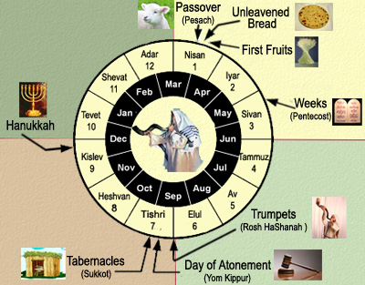
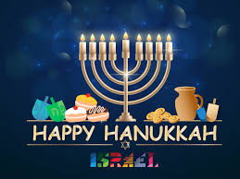
Biblical Feasts in Lev 23
Vs 6-8
Vs 4
Vs 10-14
Vs 15-22
Vs 23-24
Vs 33-43
Vs 27-32

Slide 6
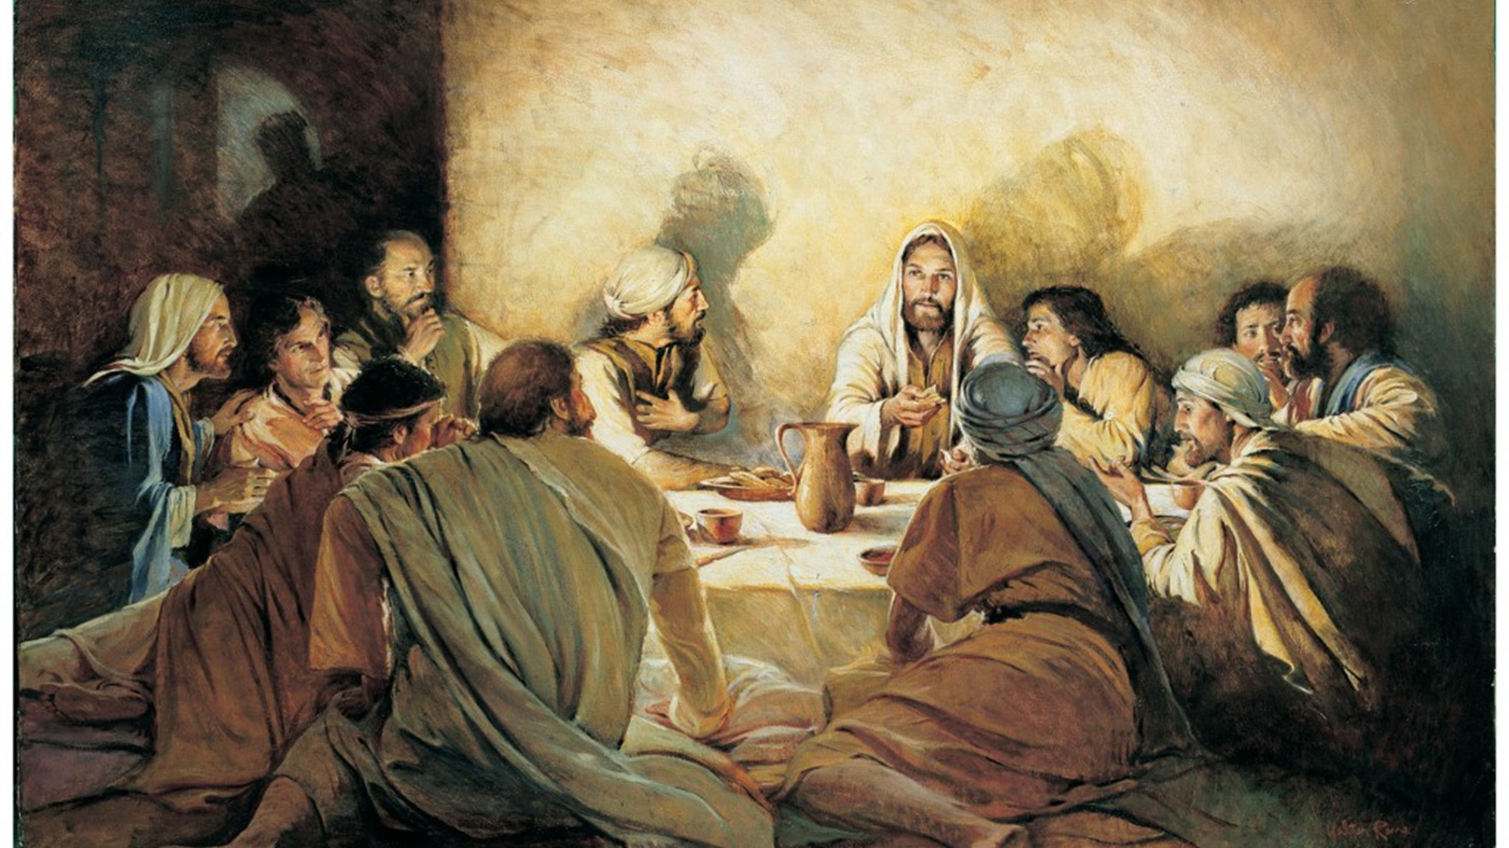
Luke 22:15-16 “With desire I have desired to eat this passover with you before I suffer:
I say unto you, I will not any more eat thereof, until it be fulfilled in the kingdom of God.”

Slide 7
Then he explains the significance of the Passover and implements the “Lord’s Supper”.
(Communion)
“This do in remembrance of me.”

Slide 8
Passover is a 3500 year tradition Commemorating the 10th plague and the process God used to deliver Israel from Egyptian bondage.
Ex 12:14 “this day shall be unto you for a memorial; and ye shall keep it a feast to the LORD throughout your generations”

Slide 9
Passover Overview (Ex. 12)
Choose a lamb on 10th day. (Vs 3,6)
“In the tenth day of this month they shall take to them every man a lamb, …, a lamb for an house:”
A. Watch it for 4 days to ensure it was “spotless”.
6 “Keep it until the 14th day of the month”

Slide 10
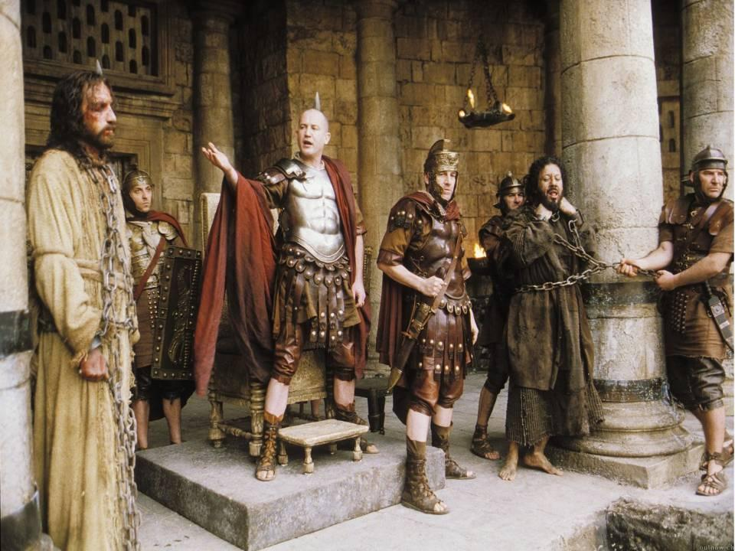
B. Jesus is: “The lamb of God that taketh away
the sin of the world” (Jn 1:29;36)
“as a lamb without blemish and spot.” 1Pt 1:18
(Rev. 5:6; 7:17; 14:10; 15:3; 19:9; 21:22, 23; 22:1,2)
He asked: “which of you convinceth me of sin?”
John 8:46
2) Even Pilate said 3x:
“I find no fault in him” Jn 18:38; 19:4,6

Slide 11
Remove all leaven from the home. (7 days) (vs 15)
“the first day ye shall put away leaven out of your houses: for whosoever eats leavened bread from the first day until the seventh day, that soul shall be cut off from Israel.”
A. This begins the feast of “Unleavened Bread”.
B. Leaven is symbolic of sin! (1 Cor. 5:7)
“A little leaven leaveneth the lump.
Purge out therefore the old leaven…
that ye may be a new lump, as ye are unleavened. “

Slide 12
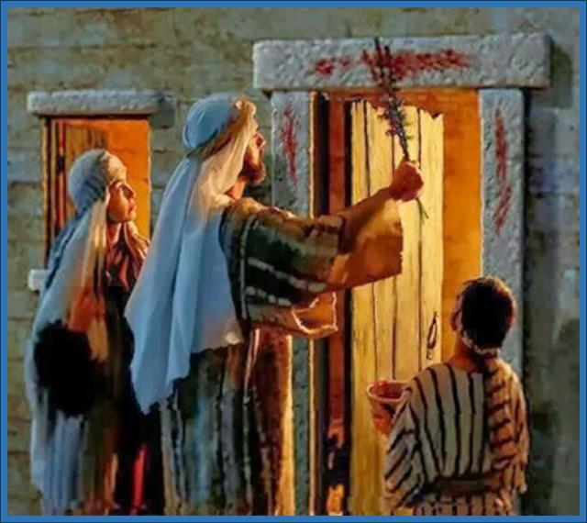
3. Kill the lamb and apply the blood. (Vs 7)
7 “take of the blood,
and strike it on the two side posts and on the upper door post of the houses”
vs 46 “neither shall ye break a bone thereof.”

Slide 13
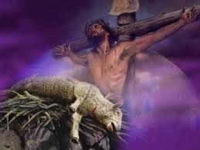
1 Cor 5:7 “Christ our passover
is sacrificed for us:”
Ex 12:46 “neither shall ye
break a bone thereof.”
Jn 19:33-37 “they brake not his legs:
But one of the soldiers with a spear pierced his side…
That the scripture should be fulfilled,
a bone shall not be broken and again they shall look on him whom they pierced.” (Ps. 22:14; Zech. 13:6; Is. 53)

Slide 14
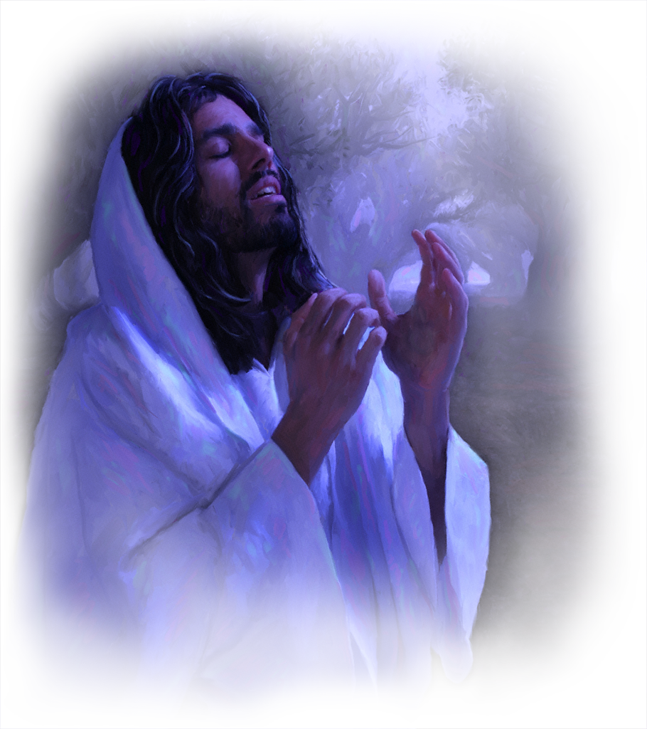
4. Eat roasted with “bitter herbs”. (Vs 8)
Reminder of the bitterness of slavery!
Jn 12:27-28 “Now is my soul troubled; and what shall I say?
Father, save me from this hour:
but for this cause came I unto this hour.
Father, glorify thy name. “
Jn 18:11 “Put up thy sword …:
the cup which my Father hath given me,
shall I not drink it?”

Slide 15
5. Concluded with the Feast of First fruits.
First Sunday after Passover Sabbath. (Lev. 23:9-14)
This occurred Easter Sunday!
1 Cor. 15:20, 23 “Christ (is) risen from the dead,
and become the firstfruits of them that slept. ..
Christ the firstfruits;
afterward they that are Christ’s
at his coming.”

Slide 16
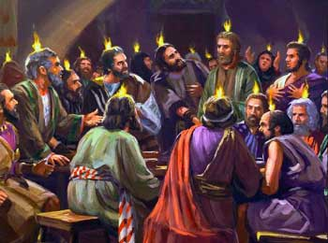
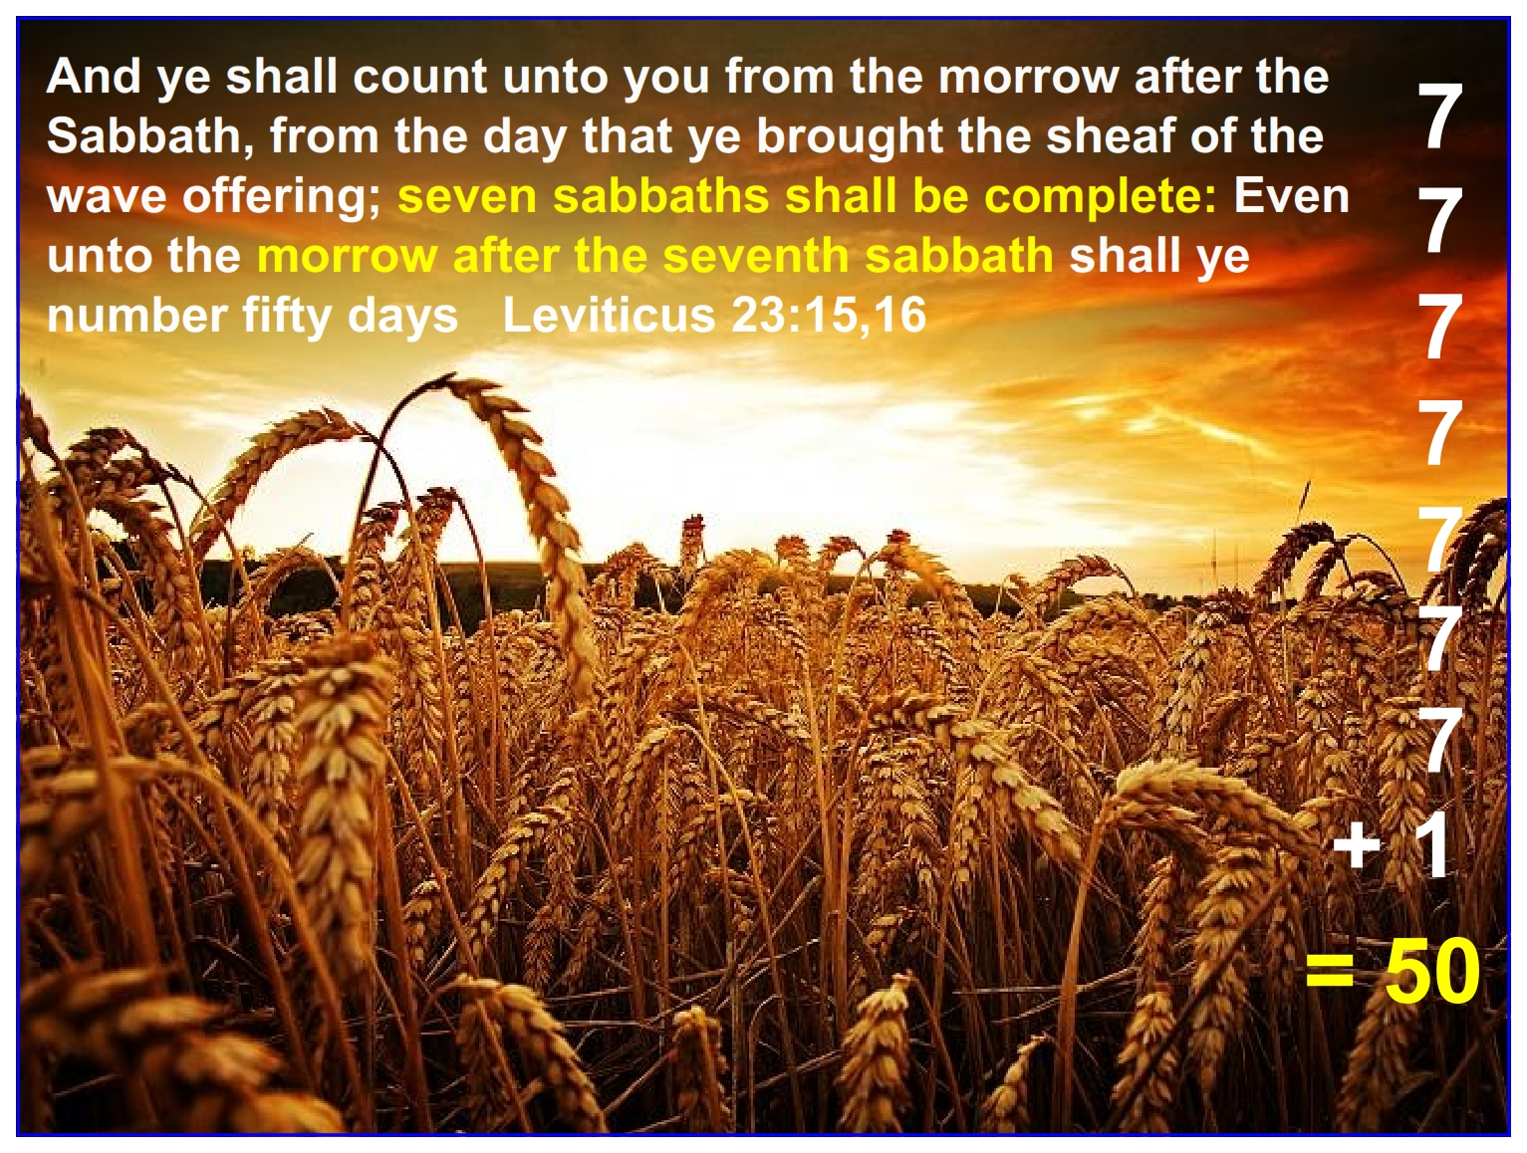
6. 50 days later they celebrated Pentecost!
(Shavuot) (Lev. 23:15,16)
(Celebrate the harvest and giving of the Law!)

Slide 17
With the destruction of the Temple,
the Passover has changed and is now
Celebrated according to the Haggadah!
The Haggadah (order) is a guide used by Hebrews containing the 14 steps of the Seder.
My version (Hebrew/English)
Is 51 pages long!

Slide 18
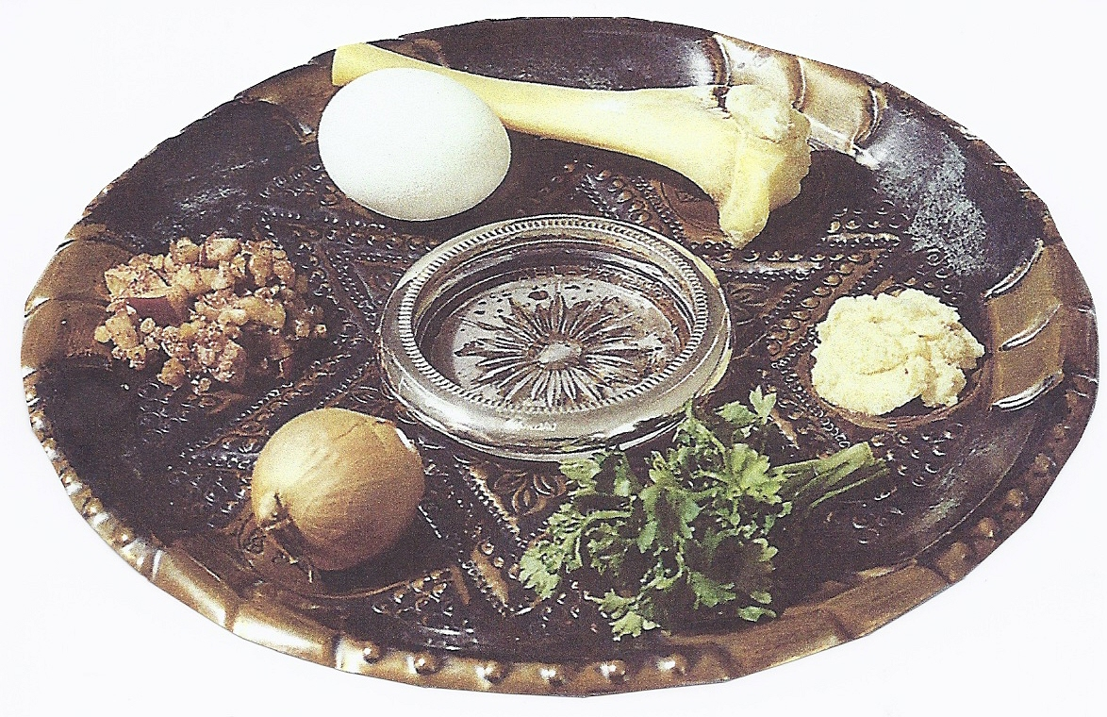
Symbolism of the traditional “Seder Plate”
Shank bone (Zerah) Symbolizing the lamb as picture of redemption.
Egg (Betzah) symbolizes
Hope (Winter giving way to spring life)
2) Mourning: (the Death of lamb.)
Bitter Herbs (Maror) Symbolize the bitterness of bondage.
Parsley (Karpas) Symbolize the hyssop used to apply the blood.
Charoset: (Clay) Sweet mixture symbolizing mortar they made.
Onion: (root vegetable) Symbolizes the hard work of slavery.

Slide 19
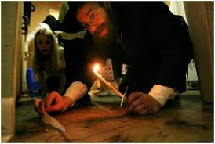
1. Seder Begins with a Ceremonial Cleansing!
A. Clean house to remove any leaven. (hametz)
Ex. 12:15 Everyone’s involved in Spring Cleaning!
B'dikath Chametz Feather Spoon And Candle Kit
“Let a man examine himself, so let him eat…”
1 Cor 11:28

Slide 20
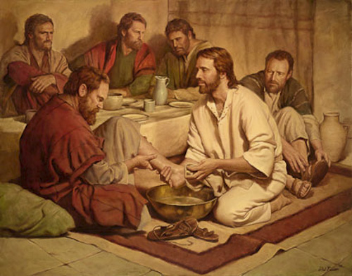
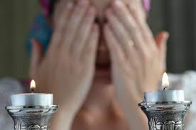
1. Seder Begins with a Ceremonial Cleansing!
B. Ceremonial Washing of Hands.
Jesus actually washed their feet!
(Jn 13:1-7)
C. Lighting of the candles.
The mother would do this!
(Because of Gen. 3:15!)
“I am the light of the world” (Jn 8:12; 9:5)

Slide 21
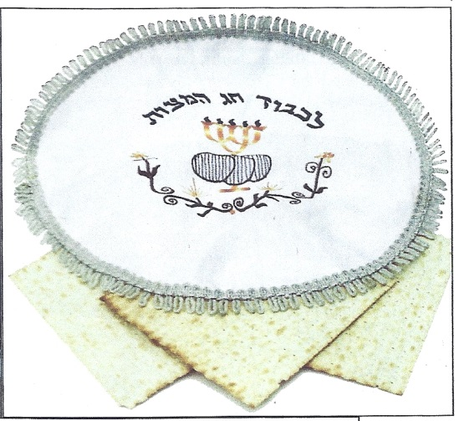
2. The Passover involves three separate “matzahs” (Unleavened Bread)
(Cloth has 3 compartments!)
A. The Matzah is always pierced and stripped!
Is. 53:5,6 “He was wounded for our transgressions..”
B. During the Passover, the leader removes the middle “Matzah” from the bag, breaks it in half and places in a linen cloth.
C. Then the “Afikomen” is hidden.
This is known as the “Afikomen”.

Slide 22
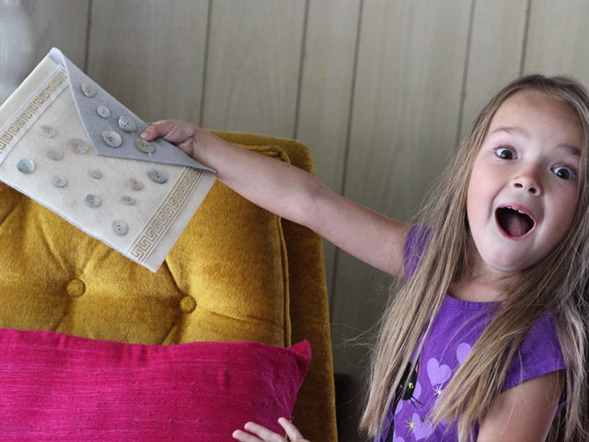
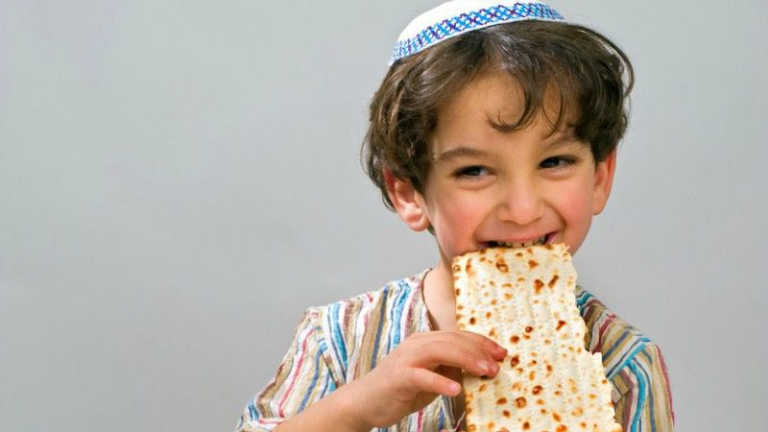
a) Later the children try to find the “Afikomen” and
the one who does receives a redemption reward.
b) The Afikomen is then divided and eaten.
“The rabbis say the afikomen replaces the Passover lamb”
Haggadah pg 30

Slide 23
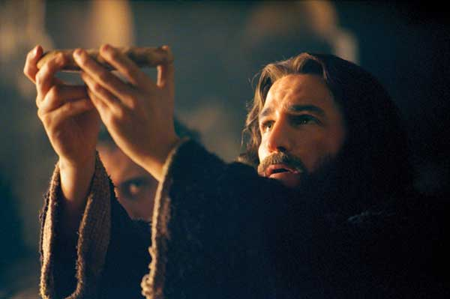
Jesus is the “Afikomen” whose body is broken, wrapped in linen and “hidden.”
“Take, eat, this is my body which is broken for you:
this do in remembrance of me.” 1 Cor. 11:24 (Lk 22:19)
John 19:40 “Then took they the body of Jesus, and wound it in linen clothes with the spices, as the manner of the Jews is to bury.”

Slide 24
3. There are four times that wine or grape juice is received during the Passover.
Each corresponds to one of the “I Will” statements in
Ex 6:6,7
Cup of Sanctification: (qadash) “I will bring you out from under the Burdens of the Egyptians.“ vs 6
They read Ps. 114 together.
2) Cup of Praise: (After 4 questions and the Exodus story)
“I will rid you out of their bondage.” Vs 6

Slide 25
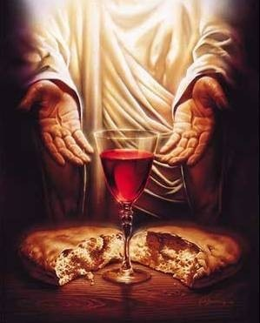
3) Cup of Redemption: (gaal’) vs 6b
(After the Afikomen is found!)
“I will redeem you with…great judgments”
This is the cup Jesus used when He said:
“This cup is the new testament
in my Blood,
which is shed for you.”
(Luke 22:20)

Slide 26
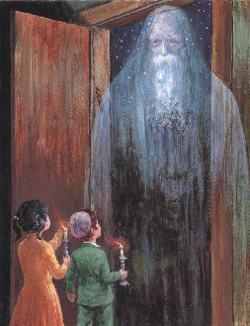
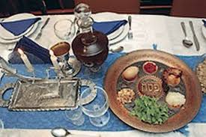
There’s always an extra place for Elijah
After the 3rd cup and afikomen, the leader draws everyone’s attention to the empty seat and reminds them of God’s promise
to send Elijah.
The children are sent to open the door
to invite Elijah in.
Mal 4:5 “I will send you Elijah the prophet before the coming of the great and dreadful day of the LORD:”

Slide 27
Mt 17:10-13 “Why then say the scribes that Elias must first come? ¹¹ And Jesus answered and said unto them,
Elias truly shall first come, and restore all things. ¹² But I say unto you, That Elias is come already, and they knew him not, but have done unto him whatsoever they listed.
Likewise shall also the Son of man suffer of them. ¹³ Then the disciples understood that he spake unto them of John the Baptist.”

Slide 28
The Last Cup is the “Cup of Anticipation”.
vs 7 “I will take you to me for a people…
vs 8 “I will bring you into the land which I did swear”
They read Ps 118:21-26 “the stone which the builders refused is become the head of the corner.”
and Ps. 126 “The Lord hath done great things for us…
They that sow in tears shall reap in joy…”
Jews conclude every Passover with this toast:
“Next Year in Jerusalem!”
In anticipation of the Messiah’s Kingdom.

Slide 29
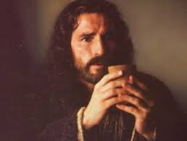
The Last Cup is the “Cup of Anticipation”. Ps 126
It was of this cup Jesus said in Mt 26:29:
“I will not drink henceforth of this fruit of the vine,

Slide 30
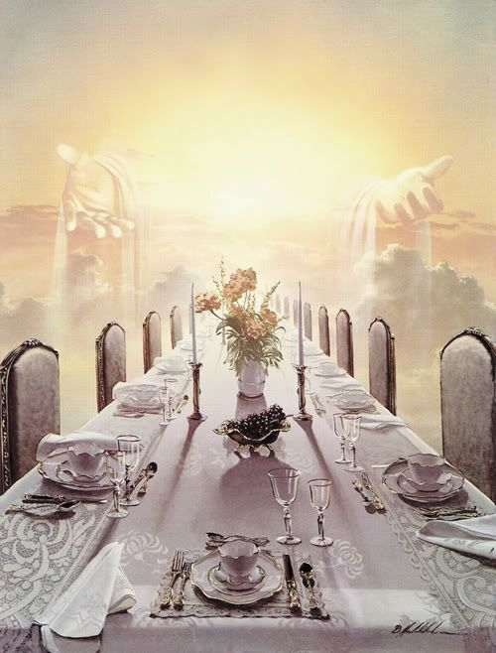
“until that day when I drink it new with you in my Father's kingdom.”
Mt 26:29

Slide 31
Jesus transformed the Jewish Passover
Into “The Lord’s Supper” or Communion.
Lk 22:19 “This is my body which is given for you: this do in remembrance of me.
20 Likewise also the cup after supper, saying,
This cup is the new testament
in my blood,
which is shed for you.”

Slide 32
Jesus transformed the Jewish Passover
Into “The Lord’s Supper” or Communion.
1 Cor 10:16 “The cup of blessing which we bless,
is it not the communion of the blood of Christ?
The bread which we break,
is it not the communion of the body of Christ?”
Koinōnia: Fellowship, Communion, From Koinonos: Partnership!

Slide 33
“The Lord’s Supper” or Communion.
1 Cor 11:26 “For as often as ye eat this bread,
and drink this cup, ye do shew the Lord's death
till he come.
27 Wherefore whosoever shall eat this bread, and drink this cup of the Lord, unworthily,
shall be guilty of the body and blood of the Lord.
28 But let a man examine himself,
and so let him eat of that bread,
and drink of that cup.

Slide 34
“The Lord’s Supper” or Communion.
1 Cor 11:29 “For he that eateth and drinketh unworthily,
(anaxi’os: irreverently, unfit) eateth and drinketh
damnation (krima: a decision) to himself,
not discerning (diakrino) the Lord's body.
31 For this cause many are weak and sickly among you,
32 For if we would judge ourselves,
we should not be judged.”
and many sleep.

Slide 35
“Let a man examine himself, so let him eat of that bread and drink of that cup. For he that eateth and drinketh unworthily, eateth and drinketh damnation to himself…”
What was the result of failing to follow God’s directions on that first Passover?
Ex 12:13 “the blood shall be to you for a token upon the houses where ye are:
when I see the blood, I’ll pass over you,
and the plague shall not be upon you to destroy you…”
What part was Optional?

Slide 36
Jesus’ sacrifice made “communion” (Freedom, Fellowship, Partnership) Possible.
Eph 1:6-7 “To the praise of the glory of his grace, wherein he hath made us accepted in the beloved.
In whom we have redemption through his blood, the forgiveness of sins,
according to the riches of his grace”
Has his blood been applied to “door” of your heart?
“When I see the blood, I will pass over you” Ex. 12:13

Slide 37
He paid the ultimate price for you.
Are you taking his Grace for Granted?
1 Cor 5:6-8 “Your glorying is not good. Know ye not that a little leaven leaveneth the whole lump?
Purge out therefore the old leaven, that ye may be a new lump, as ye are unleavened.
For even Christ our passover is sacrificed for us:
Therefore let us keep the feast, not with old leaven, neither with the leaven of malice and wickedness;
but with the unleavened bread of sincerity and truth.”

Slide 38
Are you walking in “communion” with Him?
1 Jn 1:6-9 “If we say that we have fellowship with him, and walk in darkness, we lie, and do not the truth:
But if we walk in the light, as he is in the light,
we have fellowship one with another, and the blood of Jesus Christ his Son cleanseth us from all sin.
If we say that we have no sin, we deceive ourselves,
and the truth is not in us.
If we confess our sins, he is faithful and just
to forgive us our sins,
and to cleanse us from all unrighteousness.”

Slide 39
“This do in remembrance of me”
Luke 22:19

