Slide 1
The Trust Test

Slide 2
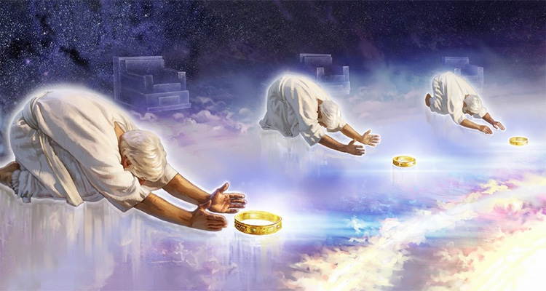
We’re created for God’s Purposes and Pleasure. Rev 4:11
“Thou art worthy, O Lord, to receive glory and honor and power: for thou hast created all things,
for thy pleasure (Thelema: purposes) they are created.”
Our fulfilment is in proportion to accomplishing our purposes!
(Pleasing/Glorifying God!)
1 Cor 3:9; Ps. 148:8; 50:6
“Let everything that hath breath praise the LORD..”

Slide 3
If we’re created to please God
(fulfil His purposes);
Heb. 11:6 “But without faith (pistis: conviction, reliance) (From Peitho: trust, obey)
it is impossible to please him:
for he that cometh to God must believe that he is,
and that he is a rewarder of them that diligently seek him.”
(John 15:1-8; 1 John 5:4)
What actually does this?

Slide 4
Since Faith (trust) is the primary path to accomplishing God’s purposes for our lives,
He uses “TRUST tests” to develop our faith,
in order to enable us to do this! (Pr. 3:5-10)
T: Take Personal Inventory vs 5
(Determine where your faith actually is?)
R: Recognize God vs 6
(Realize His Presence, Purposes, Power are available)
U: Understand Stewardship vs 9a
(Realize we’re here for “such a time as this” {Est. 4:14})

Slide 5
S: Surrender to God’s Will. Pr 3:9
“Honor the LORD with…the firstfruits of all…”
Ro 6:13 “yield yourselves unto God, …
and your members as instruments of righteousness unto God.”
T: Test God’s Promises
Mal. 3:6 “Prove me now saith the LORD,
If I will not open the windows of heaven and pour you out a blessing…”

Slide 6
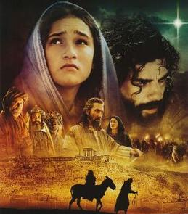
While there are countless examples of
Trust Test failures and successes;
(See Hebrews 11 for a brief list)
Perhaps none are quite as impactful as the key actors in the Christmas Story.
While each played their role,
Mary was certainly
“The leading lady”.

Slide 7
The Christmas Trust Test
“Behold, a virgin shall conceive and bear a son, and shall call his name Immanuel.”
(God with us!) Isaiah 9:6; Mt 1:23

Slide 8
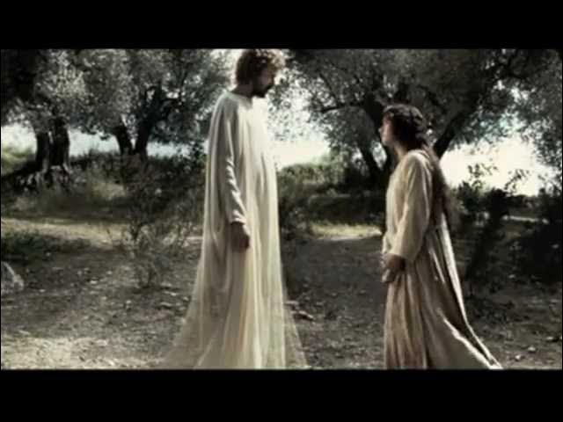
1. T: Take a Personal Inventory. Lk 1:26-38
26,27 “Gabriel was sent from God …unto a virgin named Mary.
29 And when she saw him, she was troubled at his saying…
30 …Fear not, Mary: for thou hast found favour with God.
31 behold, thou shalt conceive in thy womb,
and bring forth a son, and shalt call his name JESUS.
34 Then said Mary unto the angel, How shall this be,
seeing I know not a man?”
(Who was Mary initially Trusting?)

Slide 9
28 “… thou that art highly favored, the Lord is with thee:
2. R: Recognize God. Lk 1:26-38
(His Presence, Purposes, Power are available)
34 …How shall this be, seeing I know not a man?
35 And the angel answered and said unto her,
The Holy Ghost shall come upon thee,
and the power of the Highest shall overshadow thee:
therefore also that holy thing which shall be born of thee shall be called
the Son of God.” (Is. 7:14)

Slide 10
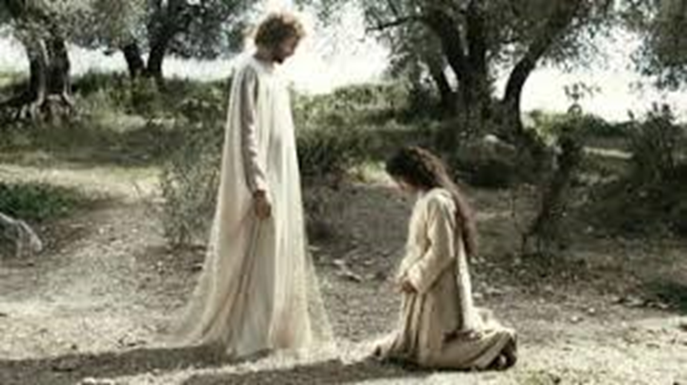
3. U: Understand Stewardship Lk 1:26-38
We’re all managers of God’s Resources!
38 “And Mary said,
behold the handmaid
(doulē: servant)
of the Lord;…”

Slide 11
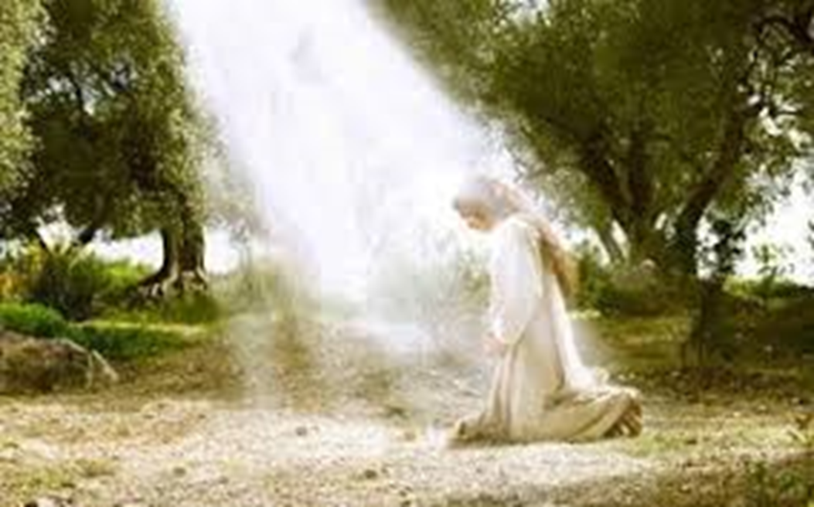
S: Surrender to God’s Will.
Allowing Him to accomplish His purposes in & through you! (Mt 11:28,29; 1 Cor 3:9)
38 “Behold the handmaid of the Lord…
(Kurios: supreme authority)
Be it unto me according to thy word.”

Slide 12
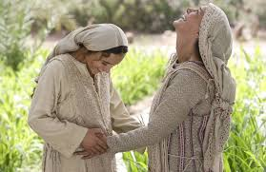
T: Test God’s Promises Lk 1:39-56
She traveled to verify God’s promise. 39-56
42 “Blessed art thou among women, and blessed is the fruit of thy womb. 43 And whence is this to me, that the mother of my Lord should come to me? 44 For, as soon as the voice of thy salutation sounded in mine ears, the babe leaped in my womb for joy.
45 And blessed is she that believed:
for there shall be a performance of those things which were told her
from the Lord.”
Blessed (Makarios) Supremely fortunate!

Slide 13
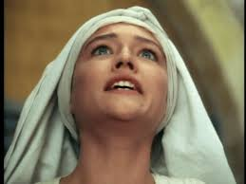
T: Test God’s Promises
2) Notice her response to God’s confirmation. 46-49 “Mary said, My soul doth magnify the Lord,
And my spirit hath rejoiced in God my Savior.
For he hath regarded the low estate of his handmaiden:
for, from henceforth all generations shall call me blessed.
(Makarizo: fortunate!)
For He that is mighty
hath done to me great things;
and holy (hagios: sacred) is his name.”

Slide 14
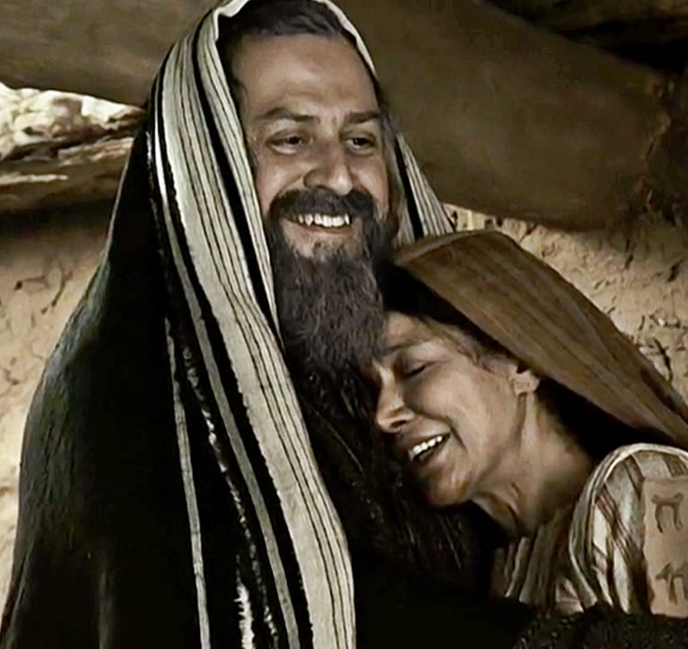
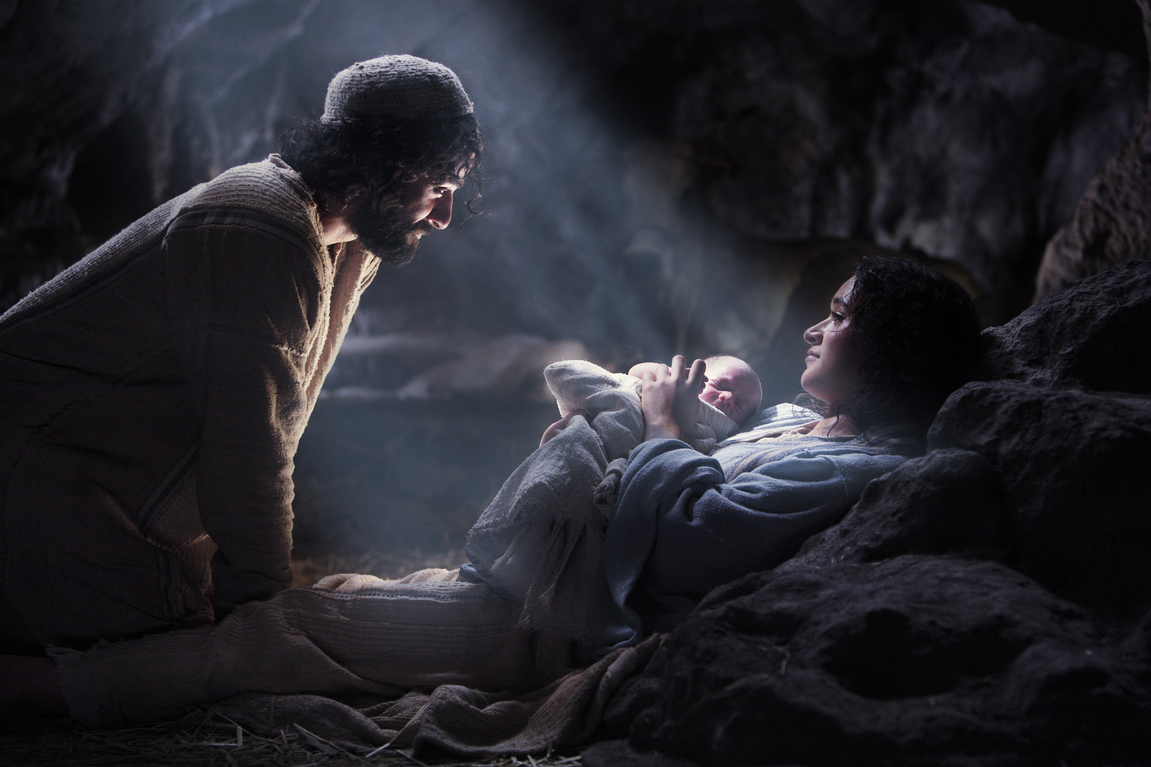
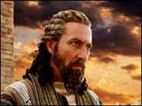
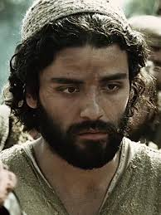
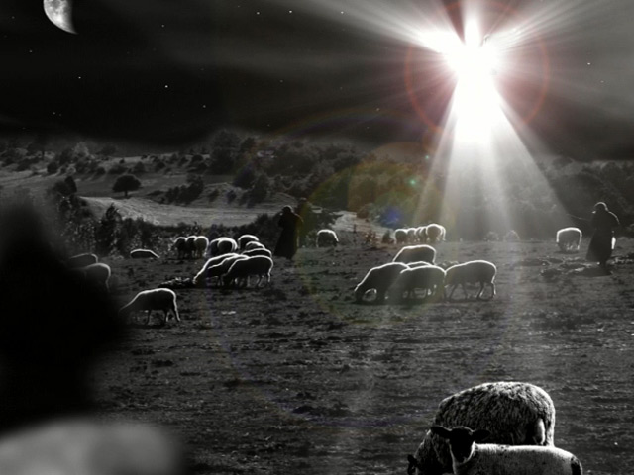
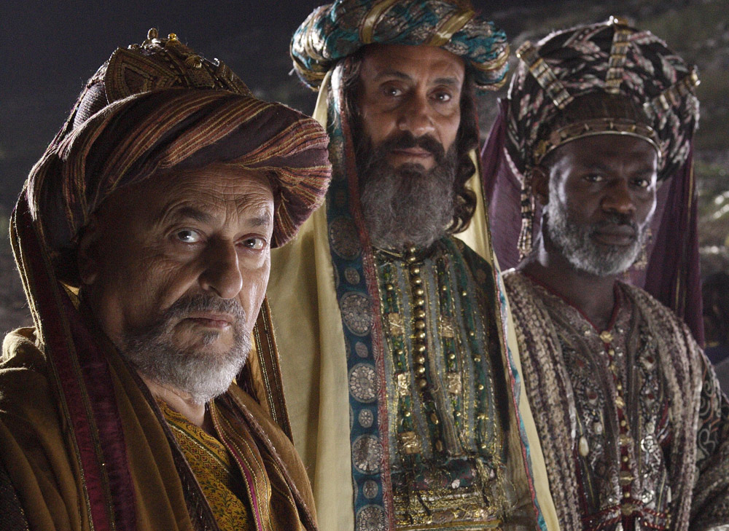
There were many “supporting actors” in this great
Drama of the incarnation; each faced
“Trust Tests”
With mixed results.
Luke 1
Matthew 2
Luke 2
Mt 1:18-24

Slide 15
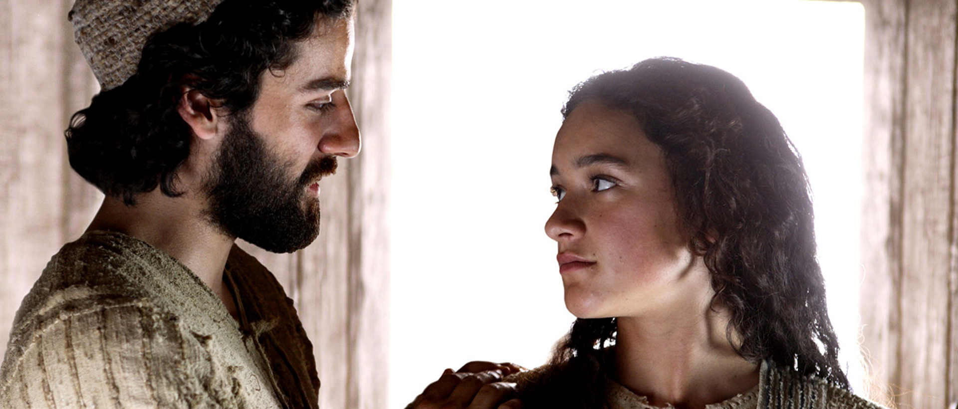
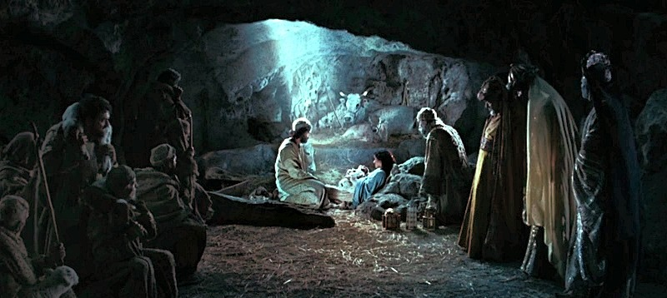
Do you suppose Mary and Joseph had their own plans
for their lives?
What if they had chosen to pursue them instead of God’s?

Slide 16
It was only after Mary passed her TRUST test
That she was able to really say:
Lk 2:46 “My soul doth magnify the Lord,
And my spirit hath rejoiced in God my Savior.”
And truly see:
“For He that is mighty
hath done to (and through) me great things;
and holy (hagios: sacred) is his name.” vs 49

Slide 17
Is it possible that God may want to do great things to and through you?
“For I know the thoughts (maḥăšāḇâ: plans)
that I think toward you, saith the LORD,
thoughts of peace, and not of evil,
to give you an expected end.”
(tiqvâ: the thing that I long/hope for!)
Jer. 29:11

Slide 18
Is it possible that God may want to do great things to and through you?
Phil. 1:6 “Being confident of this very thing,
that he which hath begun a good work in you
will perform it until the day of Jesus Christ:…
2:13 For it is God which worketh in you
both to will and to do of his good pleasure.”
Will you let him?

Slide 19
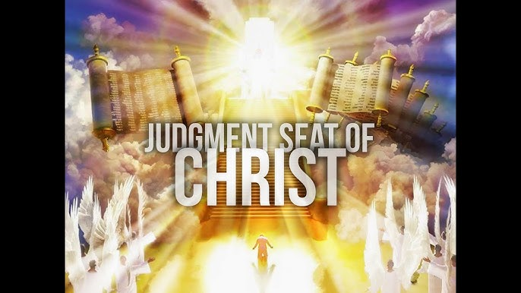
“When I stand at the judgment seat of Christ
And He shows me His plan for me;
The plan of my life as it might have been
Had He had His way, and I see
How I blocked Him here and I checked Him there
And I would not yield my will,
Shall I see grief in my Savior’s eyes;'
Grief though He
loves me still?

Slide 20
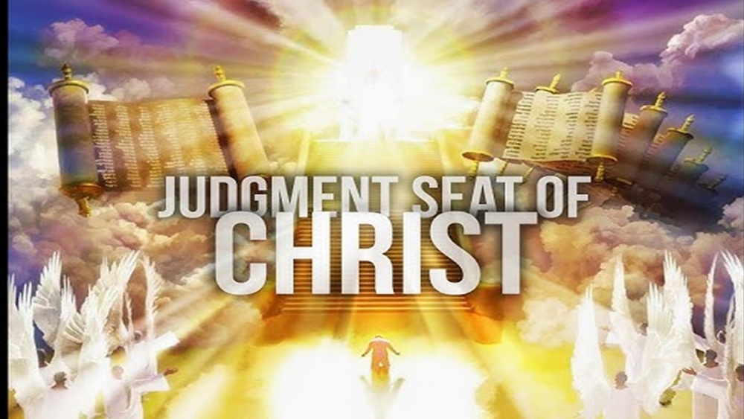
Oh, He’d have me rich, and I stand there poor,
Stripped of all but His grace,
While my memory runs like a hunted thing
Down the paths I can no longer retrace.

Slide 21
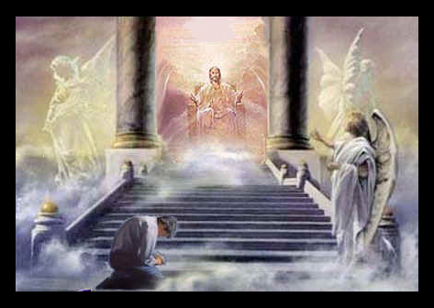
Then my desolate heart will well-nigh break
With tears that I cannot shed.
I’ll cover my face with my empty hands
And bow my uncrowned head.
No!!!!!

Slide 22
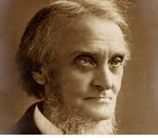
No!!!!!
Lord of the years that are left to me
I yield them to Thy hand.
Take me, make me, mold me
To the pattern Thou hast planned.”
Alexander Maclaren, 1826-1910.
2 Cor 5:10;
Romans 12:1,2

