Slide 1
Climbing with Christ
Mountain moving faith (Mt 17:20)
requires mountain climbing faith!

Slide 2
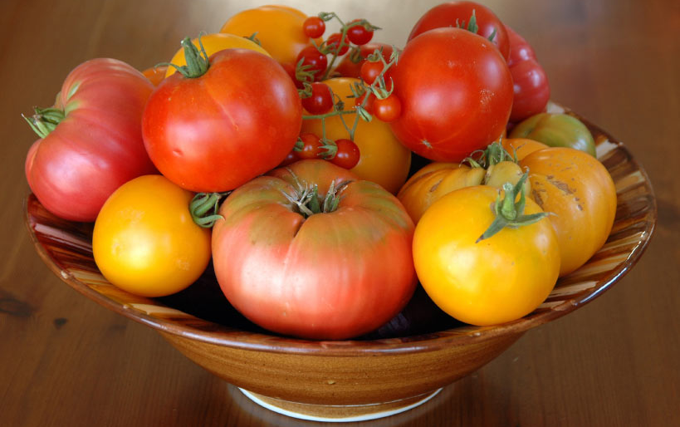
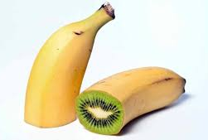
Scientists have learned how to cross breed various plants to produce hybrid fruits/vegetables/grains,
in an attempt to improve flavor, hardiness, etc.
Unfortunately, the seeds from these hybrid plants are usually sterile!

Slide 3
In much the same way, the attempt to mix human philosophy (or pleasure) with godly directives tend to produce a type of “Hybrid Christianity”
That is also spiritual “sterile”.
See 2 Cor 6:14-18 and Col. 2:8
“Beware lest any man spoil you through philosophy and vain deceit…after the rudiments of this world…”
“I have chosen you …that ye should bring forth fruit,
and that your fruit should remain.”
Jn 15:16

Slide 4
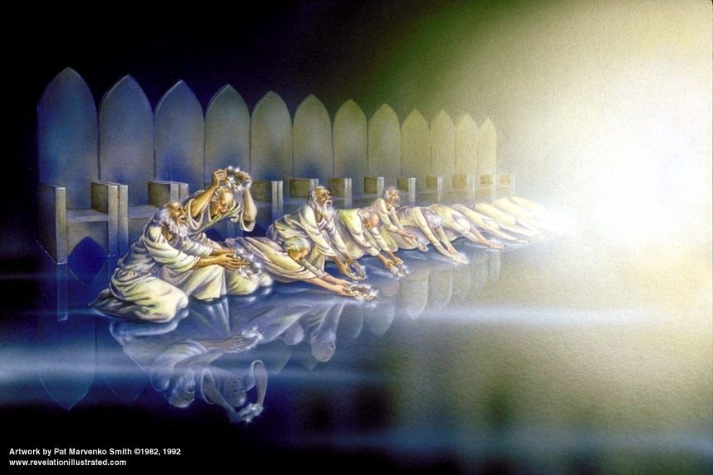
Modern Christianity seems enamored with what God can (and should) do to serve us,
Rather than what we can (and should)
do to serve God! Mal 3:14-15; Rev. 4:11
(kyrios: supreme authority)
“Thou art worthy,
O Lord,
to receive glory, honor, power: for thou hast created all things,
and for thy pleasure they are and were created. “

Slide 5
The focus of such a hybrid faith seems to be on the ability to verbally repeat and mentally believe the right information.
Belief is important, but we must define terms.
“Believe” in English can mean to either accept (or suppose) an idea or opinion is true.
The word “Believe” in the Bible (pisteuō) literally means to “trust and commit to!”
“Believer” pistos': trustworthy!

Slide 6
Heb. 11: reminds us that
“without faith (pistis: Trust, conviction)
it is impossible to please him:
for he that cometh to God
must believe that he is,
and that he is a rewarder
of them that diligently seek him.”
Eph. 2:8 “By grace ye are saved through faith”

Slide 7
What’s the Difference?
(Between hybrid & Holy Faith)
(It may be as different as Heaven or Hell!)
Mt. 7:21-23 “Not every one that saith unto me, Lord, Lord, shall enter into the kingdom of heaven;
but he that doeth the will of my Father which is in heaven.
22 Many will say to me in that day, Lord, Lord, have we not prophesied in thy name? and in thy name have cast out devils? and in thy name done many wonderful works?
And then will I profess unto them, I never knew you:
depart from me, ye that work iniquity. “

Slide 8
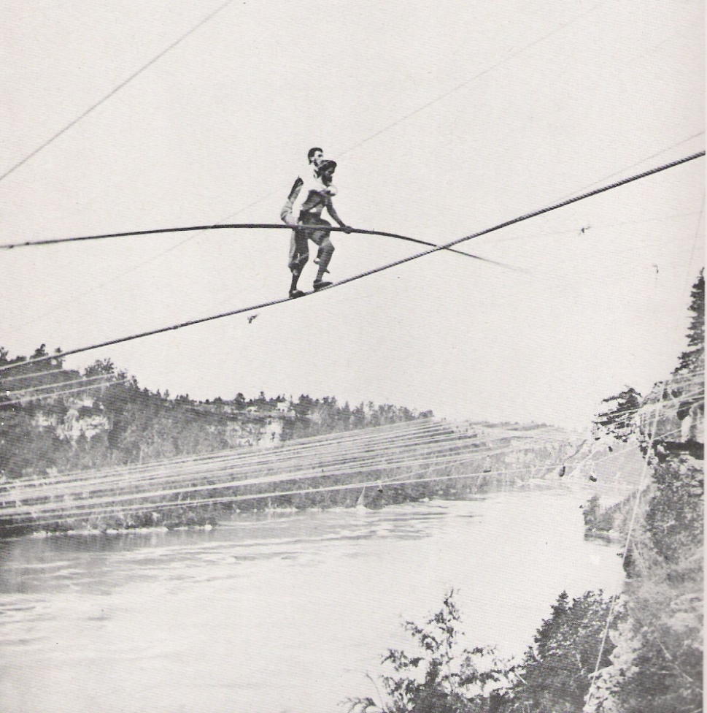
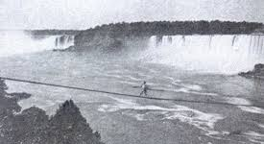
Charles Blondin became the first man to walk on a tightrope the Niagara gorge in 1859.
After repeated successes, everyone “believed” he could actually carry a man across on his back.
When asked for volunteers, no one was willing…
Except his manager
Harry Colcord.

Slide 9
The emphasis (or outcome) of Biblical faith
Is committed ACTION!
James 1:22 “But be doers of the word, and not hearers only, deceiving your own selves.”
James 2:18-20 “shew me thy faith without thy works,
and I will shew thee my faith by my works.
Thou believest that there is one God; thou doest well:
the devils also believe, and tremble.
But wilt thou know, O vain man,
that faith without works is dead?”

Slide 10
“Believer” is found only 2x in the NT.
Acts 4:14 and 1 Tim. 4:12
Ro 10:10 “with the heart man believeth unto righteousness”
A genuine heart trust should motivate us
to become a “disciple.” (used 255 X!)
Mathētēs: to learn, understand, follow!
John 14:21 “He that hath my commandments, and keepeth them, he it is that loveth me…and I will love him,
and will manifest myself to him. “

Slide 11
It was in the parable of the sower and seeds that Jesus mentioned the seed (God’s word) that fell on rocky soil and “had not root in themselves…”
and so withered under hardship. (Mt 13:21)
There is a way we can “deepen” the soil of our devotion to God’s word and ways!
“Sow to yourselves in righteousness, reap in mercy;
break up your fallow ground:
for it is time to seek the LORD,
till he come and rain righteousness upon you.”
Hosea 10:12 and Jer. 4:3

Slide 12
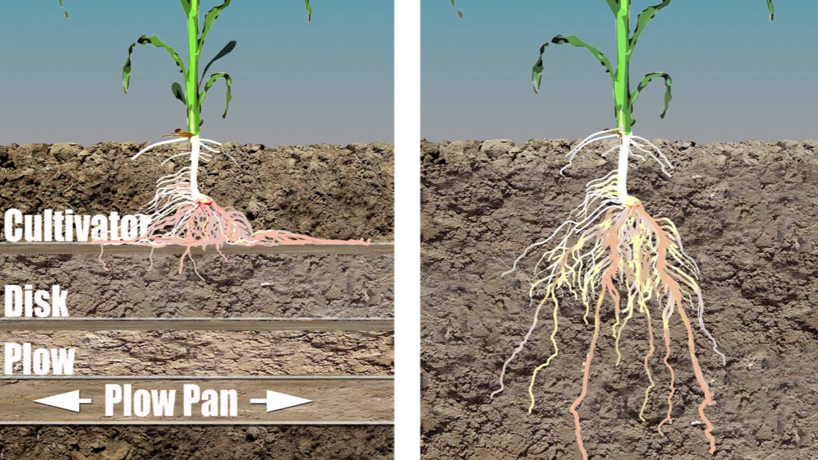
“Fallow ground” has been repeatedly,
but shallowly plowed (forming a plow pan)
And must be broken up with a deep plow.

Slide 13
This is part of what becoming a disciple is all about!
Matthew 4 records the effects of Jesus ministry to the multitudes such that Vs. 24,25 reveal that:
“his fame went throughout all Syria: and they brought unto him all sick people that were taken with …diseases and torments, and those which were possessed with devils, those which were lunatic, and those that had the palsy; and he healed them.
And there followed him great multitudes of people”
(Therapeuō: waited on, relieved)

Slide 14
Mt 5:1“And seeing the multitudes, he went up into a mountain:
and when he was set, his disciples came unto him:
2 And he opened his mouth, and taught them, saying,
3-12 Blessed (Makarios: supremely fortunate)
Are the poor in spirit…They that mourn…The meek…
They which hunger and thirst for righteousness…
The merciful…the pure in heart…the peacemakers…
They which are persecuted for righteousness sake…
Rejoice and be exceeding glad
for Great is your reward in Heaven!”

Slide 15
Only those who were willing to climb the mountain heard the remarkable truths about God’s Kingdom.
Mountain Climbing Is Difficult!
That’s Why Crowds tend to
Thin Out Along The Way.
Notice the Process that took them to the top to hear the truths of God’s Kingdom.

Slide 16
1. Curious DESIRE:
A. We’ve Met The Master And Want To
Know More About Him. Proverbs 18:1
"Through desire a man, having separated himself,
seeketh and intermeddleth with all wisdom."
Desire (taʾawâ’) a longing and delight.
Seeketh: (bāqash’) To search out or strive after.
1) This is when a vision (hope) is born in our
hearts. (Jer. 29:11-13)

Slide 17
1. Curious DESIRE:
B. God initiates this invitation / desire.
Ps 27:8 “When thou saidst, Seek ye my face;
my heart said …Thy face, LORD, will I seek.”
Jn 6:36-37 “ye have seen me, and believe not.
All that the Father gives me shall come to me;
and him that comes to me I will in no wise cast out…
44 No man can come to me, except the Father which hath sent me draw him:”

Slide 18
B. God initiates this invitation / desire.
1) God’s invitation can be (often is) ignored!
Pr. 1:24 “Because I have called, and ye refused;
I have stretched out my hand, and no man regarded; “
They would none of my counsel: … despised my reproof.
31 Therefore shall they eat of the fruit of their own way, and be filled with their own devices. (môʿēṣâ’: Purposes)
32 For the turning away of the simple shall slay them…
32 Whoso hearkens to me shall dwell safely…”

Slide 19
B. God initiates this invitation / desire.
1) God’s invitation can be (often is) ignored!
Heb 3:7-8 “Wherefore (as the Holy Ghost saith)
To day, if ye will hear his voice,
Harden not your hearts”
Repeated in Heb. 3:15 and 4:7
Ro. 10:10 “with the heart man believes unto righteousness”

Slide 20
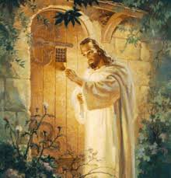
1. Curious DESIRE should lead to a:
2. Committed Decision. (To follow Him)
A. We must respond to God’s invitation.
Rev. 3:20 “Behold I stand at the door and knock.
If any…hear my voice
I will come into them!”
and open the door,
Gal 4:6 “God hath sent forth the Spirit of his Son into your hearts, crying, Abba, Father. “
See also Ro. 8:16 and John 3:3

Slide 21
2. Committed Decision. (To follow Him)
B. A Decision Is Made When Our Desire For
Christ > Than Our Desire For Complacency!
This involves an Exchange! Mt 16:24-25
“Then said Jesus unto his disciples, If any man will come after me, let him deny himself, and take up his cross,
and follow me.
For whosoever will save his life shall lose it:
and whosoever will lose his life for my sake shall find it.”

Slide 22
This (discipleship) involves an Exchange!
a) Paul understood this principle.
Phil. 3:7 “what things were gain (important) to me,
those I counted loss for Christ.“
Gal 2:20 “I am crucified with Christ:
nevertheless I live; yet not I, but Christ liveth in me:
and the life which I now live in the flesh I live by the faith of the Son of God, who loved me,
and gave himself for me.”

Slide 23
In fact in Ro. 12:1,2 God calls this exchange
“our reasonable service!”
Logikos (logical) latrei’a (act of worship)
And a prerequisite to recognizing
“what is that good, and acceptable,
and perfect will of God”

Slide 24
Conclusion:
Christianity is based on an exchange of gifts.
It begins with a desire and decision to accept God’s gift to us; His Salvation.
(Jesus means Salvation!)
As we grow in our understanding of God’s Gift and Grace, it motivates us to give our gift to God:
Our Service.
2 Cor. 5:14

Slide 25
Our gift to Christ is our service. 2 Cor. 5:14
In order to follow Him, we’ll need to heed Heb. 12:1,2: 1)“Let us lay aside every weight. (onkos: hindrance)
Some habits that will hinder us. (1 Cor 6:12; 10:23)
“all things are lawful, but all things are not expedient”
Some friends that refuse to follow. (Pr. 13:20)
“He that walketh with wise men shall be wise:
but a companion of fools shall be destroyed. “
2) “and the sin that doth so easily beset (trip) us
And run with patience the race set before us…”

Slide 26
A Godly desire should lead to a Decision; But a decision delayed can easily become an Evasion!
Acts 24:25-26 “as he reasoned of righteousness, temperance,
and judgment to come, Felix trembled, and answered,
Go thy way for this time; when I have a convenient season,
I will call for thee.”
Isaiah 55:6 “Seek the Lord while He may be found.
Call upon Him while he is near!”

Slide 27
“There is a Time, we know not when,
a place we know not where;
That marks the destiny of men,
for glory or despair.
There is a Line, by us unseen,
that crosses every path.
The hidden difference between,
God's patience, and His wrath.”

Slide 28
Application:
Ps 27:8 "When thou saidst, Seek ye my face;
my heart said unto thee,
Thy face, LORD, will I seek.“
What has your heart said to God’s Invitation?
What is your decision to God’s Invitation to
“deny (yourself), take up (your) cross, and follow me”
(Mt 16:24; Mark 8:34; Luke 9:23)

Slide 29
I had walked life's way with an easy tread,
Had followed where comforts and pleasures led,
Until one day in a quiet place;
When I met the Master face to face.
With station and rank
and wealth for my goal,
Much thought for my body
but none for my soul,
I had entered to win in life's mad race,
When I met the Master face to face.

Slide 30
I had built my castles and built them high,
With their domes had pierced the blue of the sky,
I had sworn to rule with an iron mace,
When I met the Master face to face.
I met Him and knew Him and blushed to see,
That His eyes full of sorrow were fixed on me;
And I faltered and fell at His feet that day,
While my castles melted and vanished away.

Slide 31
Melted and vanished, and in their place,
Naught else did I see but the Master's face.
And I cried aloud, "Oh, make me meet,
To follow the steps of Thy wounded feet."
My thoughts are now for the souls of men,
You see I’ve lost my life to find it again,
Ever since one day in a quiet place,
When I met the Master face to face. “
Lorrie Cline

Slide 32
Habakkuk 3:19
“The LORD God is my strength,
he will make my feet like hinds' feet,
he will make me to walk
upon high places.”
Song: Draw me Nearer!

