Slide 1
“Understanding what the will of the Lord is.”
Eph. 5:17
Pr 3:5,6; Heb. 11:6; 1 Jn 5:4

Slide 2
More

Slide 3
These critical questions address: Existence: Why are we here?
Gen. 1:26; Jer 31:3; 1 Jn 4:7-10
Significance: Do we really matter?
Jn 10:10; Ro. 8:37; Eph. 1-2:10; 1 Tim. 4:8
Intention: What’s the Point/purpose?
1 Cor 3:9; 4:1; 2 Cor 5:20; Rev. 4:11
Expectation: What does God want?
Pr 23:26; Deut. 10:12; Mt 22:37,38

Slide 4
Last week we began to discuss the cost involved in transitioning from a
“but Lord let me first” believer (Luke 9:57-62)
to a Christ first Disciple. (Lk 9:23; Lk 14).
The first cost in following Christ involves a genuine realization/recognition
of our Position “in Christ”.
(The nature of our relationship with Jesus)

Slide 5
A genuine Realization of our Position.
Have we trusted Christ as our Savior?
(Have we been “born again”?) Jn 3:3; 1Pt 1:23
Are we trusting/following Him as our Lord?
(Kurios: supreme authority) Lk 6:46
The Bible word for this realization is “Repent”! From meta (after) and noieo (to think)
Think differently or afterwards) i.e. reconsider
(morally to feel compunction) :- repent.

Slide 6
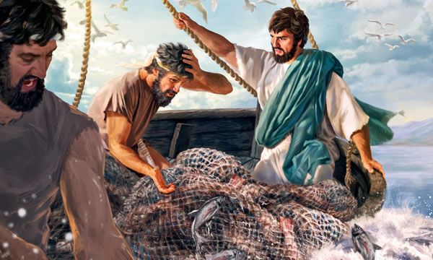
Mt 4:17 “Repent for the Kingdom (authority) of God is at hand.”
19 “Follow me, and I will make you fishers of men.”
²⁰ And they straightway left their nets,
and followed him.”
Andrew and Peter
Luke 5:8-11

Slide 7
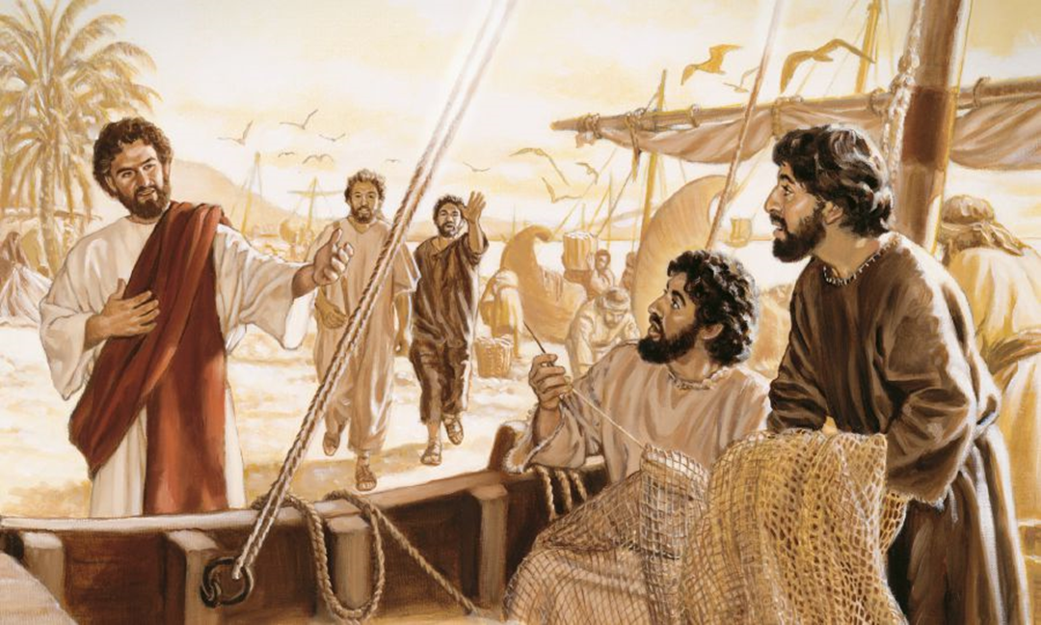
Mt 4:21 “He saw other two brethren, James the son of Zebedee, and John his brother, in a ship
with Zebedee their father, mending their nets;
and he called them.
John and James
22 And they immediately left the ship
^{and their father,}
^{and followed him.”}

Slide 8
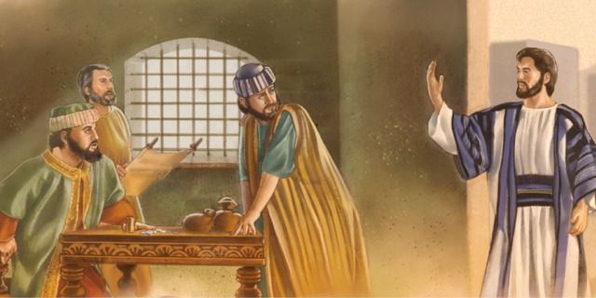
Lk 5:27-28 “after these things he went forth, and saw a publican, named Levi, sitting at the receipt of custom: and he said unto him, Follow me.
Levi (Matthew)
And he left all, rose up,
and followed him.”

Slide 9
Did you notice the pattern?
Recognizing/Reconsidering their {our}
Position with God (Repenting)
Must happen before we’re ready to
Realign their {our} Priorities!
“Follow me” (See Pr. 3:5-7; Ro 12:1b)
Is it “Me first” or Christ First? Lk 9:57-62 Ro 12:1a

Slide 10
Luke 5 gives more details to illustrate this:
1-7 Jesus teaching and directing them to the abundant fish:
vs 8 “When Peter saw it, he fell down at Jesus' knees, saying, Depart from me; for I am a sinful man,
For he was astonished, and all that were with him, at the draught of the fishes which they had taken:
9 And so was also James, and John, …and Jesus said
…, Fear not; from henceforth thou shalt catch men.
And when they had brought their ships to land,
they forsook all, and followed him.”
O Lord!

Slide 11
You can’t “Follow Jesus”
and stay where (and how) you are!
(See Mt. 4:19-22; Lk 5:27,28; Pr. 3:5-7,6; Ro 12:1b)

Slide 12
Jesus spent the first 24 verses of Lk 14 trying to help the self righteous pharisees “think differently” about their position with God.
Unless we truly “repent”, we’ll not be ready or able to Realign our Priorities and Follow Christ.
Notice the very next verses: Luke 14:25-27
25 “And there went great multitudes with him:
Why were they really “following” him?
Why are you?

Slide 13
25 “And there went great multitudes with him:
and he turned, and said unto them,
26 If any man come to me, and hate not his father, and mother, and wife, and children, and brethren, and sisters, yea, and his own life also,
he cannot be my disciple.
27 And whosoever doth not bear his cross,
and come after me,
cannot be my disciple.”

Slide 14
Is Jesus really demanding that we hate our families in order to follow him?
Eph. 5:22-33 “let every one of you in particular
so love his wife, even as himself; and the wife see that
she reverence her husband.
6:1,2 Children obey your parents…honor them…
4 Fathers, bring up your children in the nurture and admonition of the Lord.”
What then is he asking/expecting of us?
He gives two examples to help us understand.
(see vs 22 and 25!)
(also Mt. 22:39; Jn 13:34,35)

Slide 15
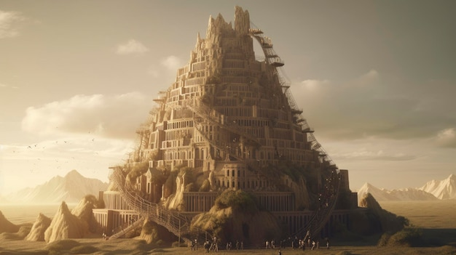
Examples of counting the cost
1. Building a tower. 28-30 “For which of you,
intending to build a tower, sitteth not down first,
and counteth (psēphiz’ō: to reckon, compute, to vote)
the cost, (dapan’ē: from dapto: to devour)
whether he have sufficient
to finish it?”

Slide 16
1. Building a tower. 28-30
A. The Consequence of miscalculation 29-30
“Lest, after he hath laid the foundation, and is not able to finish it, all that behold it begin to mock him, Saying,
This man began to build
and was not able to finish.”
1) Humiliation “mock him”
2) Frustration (Waste of time, money, effort)
Mt 7:13“broad is the way that leadeth to destruction”
(apoleia: waste)

Slide 17
2. Battling (an enemy) 31-32
“Or what king, going to make war against another king, sitteth not down first, and consulteth
whether he be able with ten thousand to meet him
that cometh against him with twenty thousand?
A. The Consequences of Miscalculation….
1) Being conquered (and possibly destroyed).
2) Being compromised (and probably spoiled).
32 “Or else, …he sendeth an ambassage,
and desireth conditions of peace.”

Slide 18
Why use Building as an example?
1) God designed us to build something eternal!
1 Cor 3:9 “We are laborers together with God,
ye are God’s building!”
2) Most prioritize their desire/design > God’s,
and so build with only time in mind. Vs 11-14
14 “If any work be burned (temporary materials)
they shall suffer loss…” (zēmio’ō: detriment)

Slide 19
“if any work be burned…they shall suffer loss”
3) What might we “lose” by building/focusing on the “wood, hay, and stubble” of this world?
Phil. 3:18-20 “For many walk, of whom I have told you often, and now tell you even weeping,
that they are the enemies of the cross of Christ:
Whose end is destruction, whose God is their belly, whose glory is in their shame, who mind earthly things.)
For our conversation (politeuma: citizenship) is in heaven!
From whence we look for the savior, the Lord…”

Slide 20
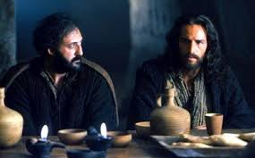
Why use Battling as an example?
1) The Christian life takes place on a battlefield,
against powerful enemies.
Luke 22:31,32 “Simon…Satan (Satanas’: adversary) hath desired to have you, that he may sift you as wheat:
But I have prayed for thee, that thy faith fail not:
and when thou art converted, strengthen thy brethren”

Slide 21
Why use Battling as an example?
1) The Christian life takes place on a battlefield,
against powerful enemies.
Jn 16:33 “These things I have spoken unto you
that in me ye might have peace.
In the world ye shall have tribulation:
(thlipsis: pressure, distress, affliction)
but be of good cheer;
I have overcome the world.”

Slide 22
a) God calls us to fight in this battle! 1 Pt 5:8
“Be sober, be vigilant; because your adversary the devil, …walketh about, seeking whom he may devour:
8 Whom resist (anthistēmi) steadfast in the faith…”
We’re not commanded to Run,
2 Tim. 2:1-4 “Be strong in the Grace that’s in Christ…
Thou therefore endure hardness, as a good soldier…..
No man that wars entangleth himself with the affairs of this life; that he may please him who hath chosen him
to be a soldier.”
but to Resist!

Slide 23
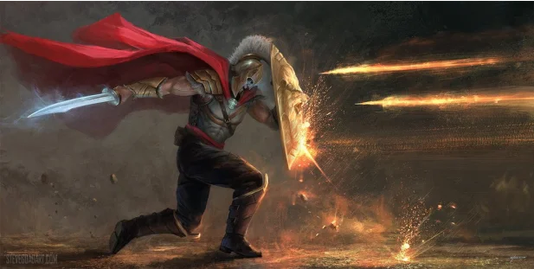
b) God equips us to overcome. Ro. 8:37; 1 Jn 4:4; 5:4
Eph 6:12 “for we wrestle against principalities, against powers, against the rulers of the darkness of this world, against spiritual wickedness in high places.
13 Wherefore take unto you the whole armor of God,
that ye may be able to withstand in the evil day,
and having done all, to stand.”

Slide 24
D. Why use Battling as an example?
1) The Christian life takes place on a battlefield.
2) The consequences of losing this battle involve:
a) Being conquered (and possibly Killed). 1Cor 11:30 “For this cause many are weak and sickly among you,
and many sleep.” (see Ro 6:16; 1 Jn 5:16)
b) Being compromised (and probably spoiled). Col 2:8
“Beware lest any man spoil you through philosophy
and vain deceit, after the tradition of men,
after the rudiments of the world, and not after Christ.”

Slide 25
What are the benefits of building and battling well?
2 Tim. 4:5 “watch (nepho: be sober, alert) in all things, endure afflictions, do the work of an evangelist,
make full proof of (plērophore’ō: accomplish fully)
thy ministry. (diakoneo: service, assignments)
6 For I am now ready to be offered,
and the time of my departure is at hand.
7 I have fought (agōnizomai) a good fight, (agon: contest)
I have finished (teleo: accomplished) my course, (dromos: race)
I have kept (tereo: guarded) faith: (pistis: conviction)

Slide 26
8 “Henceforth there is laid up for me a crown of righteousness, which the Lord, the righteous judge,
Shall give me in that day. (Remember 1 Cor 3:10-15)
and not to me only,
but unto all them also that love his appearing.”
Are you ready for
“That day”? Rev. 22:12

Slide 27
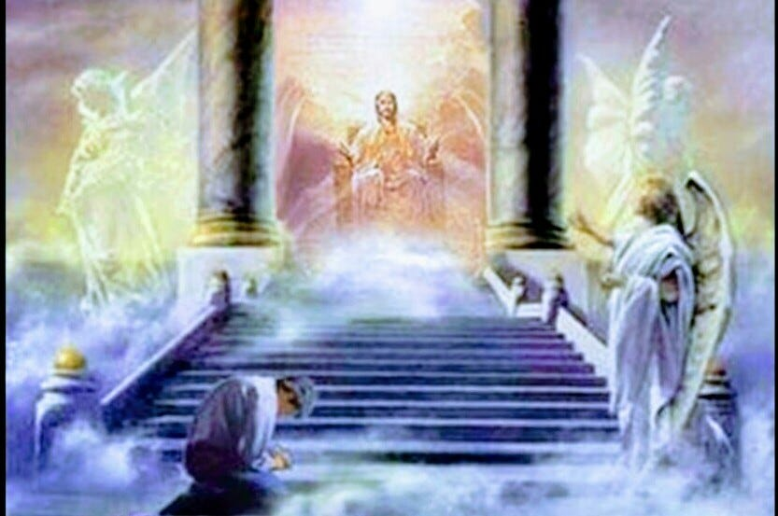
When you stand before God,
Will you have an “unfinished” life?

Slide 28
Will you have an “unfinished” life?
When I stand at the judgment seat of Christ
And He shows me His plan for me;
The plan of my life as it might have been
Had He had His way, and I see;
How I blocked him here,
and I checked Him there;
And I would not yield my will,
Shall I see grief in my Savior’s eyes;
Grief though He loves me still?

Slide 29
Will you have an “unfinished” life?
He’d have me rich, and I stand there poor,
Stripped of all but His grace,
While my memory runs like a hunted thing
Down the paths I can’t retrace.
Then my desolate heart will well-nigh break
With tears that I can no longer shed.
I’ll cover my face
my empty hands,
And bow my uncrowned head.

Slide 30
It’s not too late to have a “finished” one.
“Lord of the years that are left to me,
I yield them to Thy hand.
Take me, make me,
mold me
To the pattern
Thou hast planned.”
Alexander Maclaren,
1826-1910.

