Slide 1
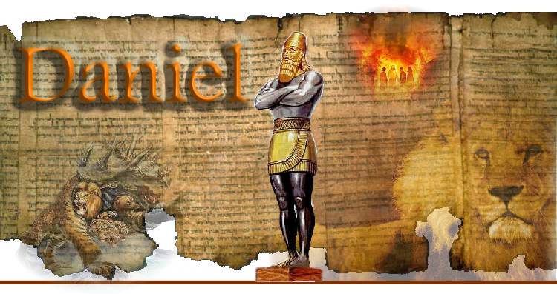
And the power of prayer!
And the last days!
Daniel is about both Prophecy and Prayer!

Slide 2
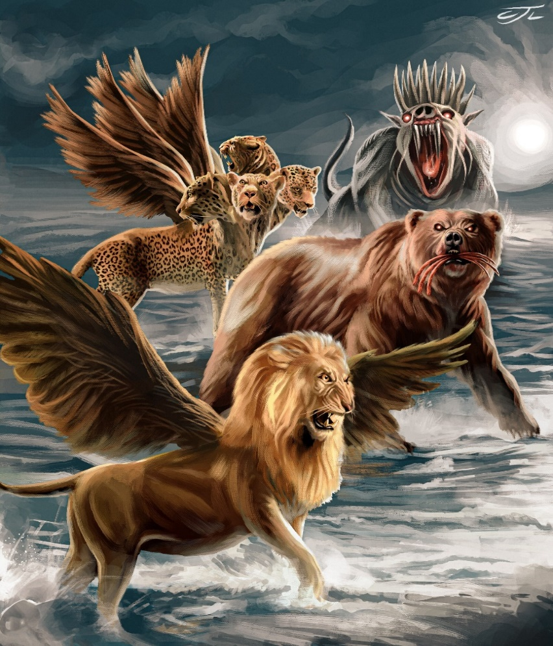
It was in answer to prayer that God revealed the future of the world’s major empires to Daniel.

Slide 3
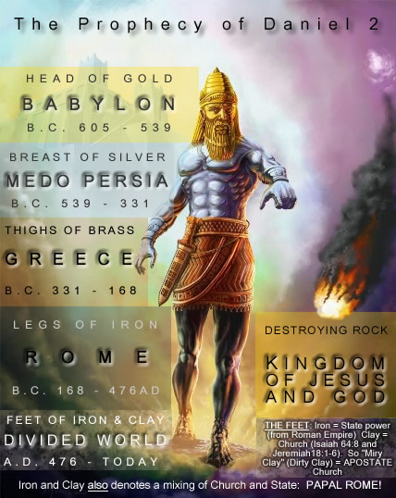
Dan 2:44 “in the days of
these (10) kings shall the God of heaven set up a kingdom,
which shall never be destroyed
… and it shall stand for ever.
45 …The great God hath made known to the king what shall come to pass hereafter:
and the dream is certain, and the interpretation thereof sure.”
Vs 37-38
39a
39b
40-41
Final world Kingdom

Slide 4
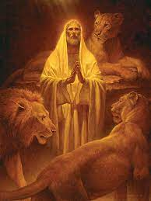
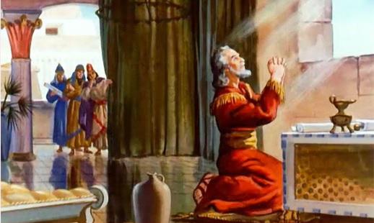
It was Daniel’s faithful and obedient praying that landed him in the lion’s den (Dan. 7)
And then protected him through it.

Slide 5
Daniel’s faithfulness led to more visions (Ch. 7)
5) Final “revived Roman” empire
vs 8, 21,21
4) Roman vs 7
2) Medo- Persian Vs 5
3) Grecian Vs 6
1) Babylonian Vs 4
¹⁷ These great beasts…are …kings, which shall arise..
18 But the saints of the most High shall take the kingdom, and possess the kingdom for ever …”

Slide 6
Daniel’s faithfulness led to more visions (Ch. 8)

Slide 7
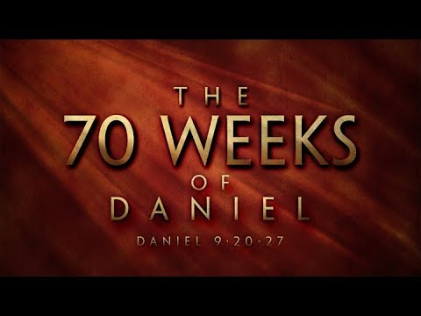

Slide 8
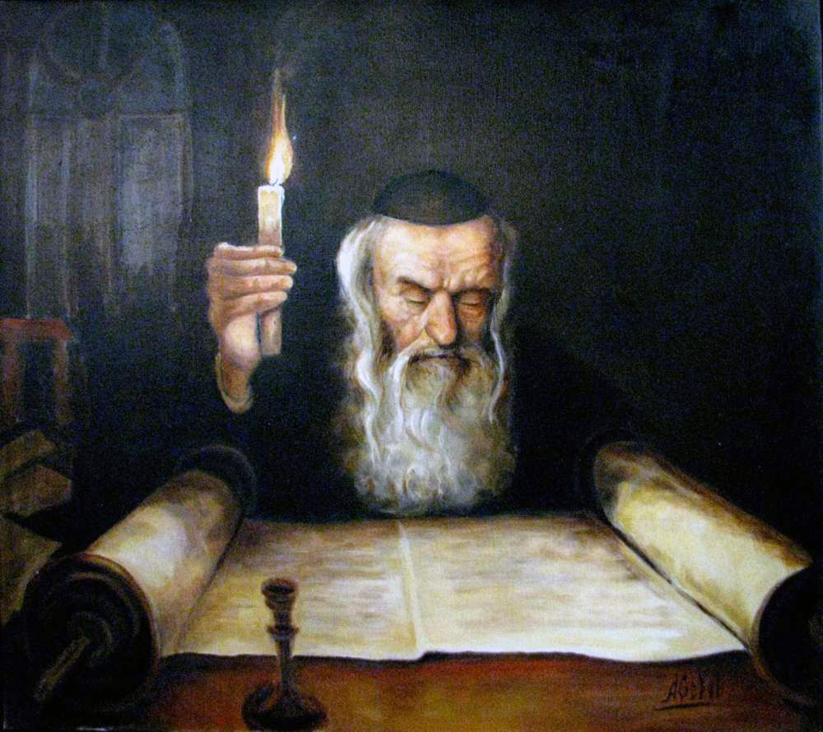
Daniel 9 opens with him studying scripture!
2 Tim. 2:15

Slide 9
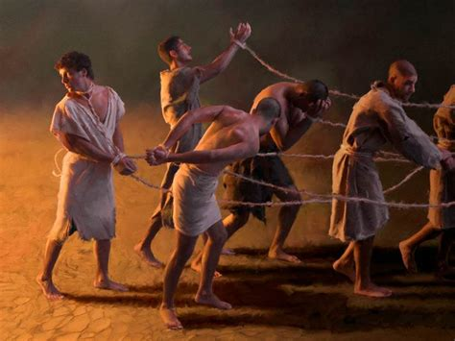
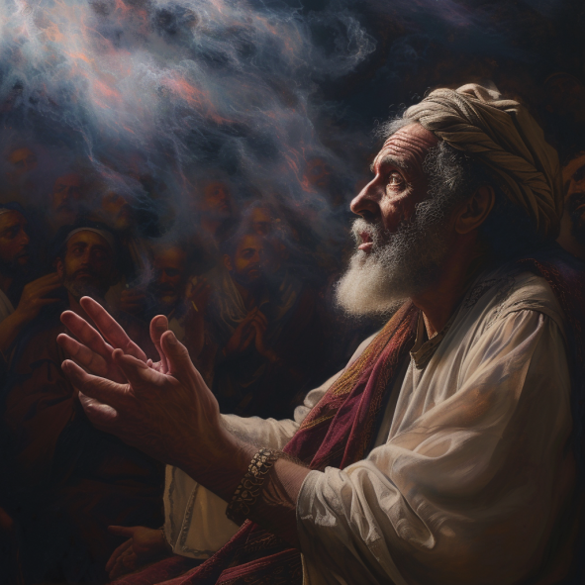
1. God revealed his plan to Jeremiah. 596 BC
Jer 29:10 “after 70 years be accomplished at Babylon
I will visit you,
and perform my good word toward you,
in causing you
to return to this place!”
Jews first taken to Babylon
in 605 BC. (Dan. 1:1)

Slide 10
Why 70 years of captivity?
1) Israel was commanded to allow its land to
remain idle every seventh year (Lev. 25:1-4, 18-22).
a) Obedience would bring great blessings. Lev 26:1-13
b) Disobedience would bring judgment. Lev. 26:14-46
2) For 490 (out of 1000 years) they disobeyed
(Lev. 26:33-35; Jer. 34:12-22; 2 Chr. 36:21)
building up a “land debt” of 70 years.
3) God warned them about the consequences of this 1000 years earlier! (Lev. 26)

Slide 11
God warned them of this. Leviticus 26:
30 “I will destroy your high places, and cut down your images, and cast your carcasses upon …your idols…
33 And I will scatter you among the heathen…
and your land shall be desolate, and your cities waste.
34 Then shall the land enjoy her sabbaths, as long as it lieth desolate, and ye be in your enemies' land; …
35 As long as it lieth desolate it shall rest;
because it did not rest in your sabbaths,
when ye dwelt upon it.”

Slide 12
1. God revealed his plan to Jeremiah. 596 BC
Jer 29:11 “For I know the thoughts (maḥashābâ: plans) that I think (ḥāshab: to weave)
toward you, saith the LORD,
thoughts of peace, and not of evil,
to give you an expected end.”
12 Then shall ye call upon me,
and ye shall go and pray unto me,
and I will hearken unto you.”

Slide 13
Jer 29:13 “And ye shall seek me, and find me,
when ye shall search for me with all your heart.
And I will be found of you, saith the LORD:
14 And I will turn away your captivity,
and I will gather you from all the nations, …whither I have driven you, saith the LORD;
and I will bring you again into the place
whence I caused you to be carried away captive.”

Slide 14
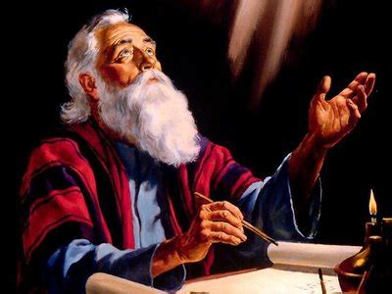
2. In 539 God revealed His Plan to Daniel
Vs 2 “In the first year of the reign (of Darius)
I Daniel understood by books the number of the years, whereof the word of the LORD came to Jeremiah …,
that he would accomplish seventy years
in the desolations of Jerusalem.”
66 years had already passed!

Slide 15
2. In 539 God revealed His Plan to Daniel
A. God wants to reveal himself and his plan!
1 Cor 10:11 “the things happened unto them for ensamples, and are written for our admonition…”
1) He does this most clearly through his word.
Amos 3:7; Jn 14:21
Ps 19:11 “Moreover by them is thy servant warned
and in keeping of them there is great reward!”
Ps. 119:105 “Thy word is a lamp unto my feet
and a light unto my path.”

Slide 16
3. God’s Revelations are His Invitations!
They’re not just about information, but:
1) Clarification (Recognition) vs 2 “I Daniel
understood …” (bin: discerned, recognized)
Ps 119:130 “The entrance of thy words giveth light;
it giveth understanding unto the simple.”
(2 Cor. 4:4-6; 2 Tim. 2:15)
Jn 8:32 “Ye shall know (ginōskō: understand, follow)
the truth (alētheia: illuminating, revealing)
and the truth shall make you free.”

Slide 17
1) Clarification vs 2 “I Daniel understood …”
Clarification/ Recognition is prerequisite to:
2) Transformation: vs 3 “I set (natan: gave) my
face (pānîm: focus, before) unto the Lord God”
a) Focus produces Force! (energy) 2 Cor. 3:18
“But we all with open face, beholding as
in a glass the glory of the Lord are changed
(metamorphoo: transfigured, transformed)
Into the same image, From glory to glory,
even by the Spirit of the Lord.”

Slide 18
Metamorphoo = metamorphosis
Romans 8:28,29

Slide 19
b) God’s Spirit uses God’s word (truth)
to transform us! Heb. 4:12; Ro. 12:2
“Be transformed (metamorpho’ō: transfigured)
by the renewing (anakai’nōsis: renovation)
of your mind (nous: understanding)
that ye may prove what is that good, acceptable,
and perfect, will of God.”
Jn 15:3 “Ye are clean through the word…”
Ps. 119:9-11 “wherewithal shall a man cleanse his ways?
By taking heed…according to thy word.”

Slide 20
b) God’s Spirit uses God’s word (truth) to change us!
2 Pt 1:2-4 ”Grace and peace be multiplied unto you through the knowledge of God, and of Jesus our Lord.
3 According as his divine power hath given unto us all things that pertain unto life and godliness,
through the knowledge of him
that hath called us to glory and virtue:
4 Whereby are given unto us exceeding great and precious promises: that by these
ye might be partakers of the divine nature...”

Slide 21
c) Distraction Fights Transformation! Mt 6:33
Phil 3:13 “I count not myself to have apprehended: but this one thing I do…,
14 I press toward the mark for the prize
of the high calling of God in Christ Jesus.
15 Let us therefore, as many as be perfect,
(teleios: mature, complete) be thus minded:…
19 (but) Many walk…whose end is destruction…
who mind earthly things.”
See Gal 5:17

Slide 22
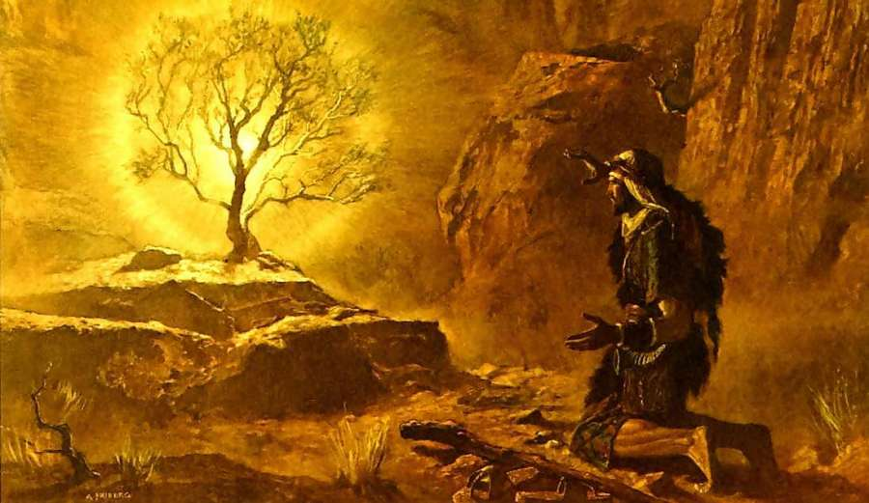
They are not just about information, but:
1) Clarification vs 2 ➔ 2) Transformation: vs 3
These motivate and enable:
3) Participation (Partnership) (1 Cor 3:9; Mt 11:28,29)
10 “I will send thee…, that thou mayest bring forth my people …out of Egypt…
11 Who am I…?
12 …I will be with thee“
Exodus 3

Slide 23
He partnered with God in Prayer! Vs 3-19
Effective Prayer involves:
a) An intentional shift of direction (focus) 3a
“And I set my face unto the Lord God,
to seek by prayer and supplications”
Phil 4:6,7 “be anxious (miramnao: distracted) for nothing but in everything by prayer (proseuchē: toward God/worship) and supplication, with thanksgiving,
let your requests be made known unto God.”

Slide 24
Effective Prayer involves:
a) An intentional shift of direction (focus) 3a
Phil 4:6,7 “be anxious for nothing but in everything
by prayer and supplication, with thanksgiving,
let your requests be made known unto God.
And the Peace of God which passeth
all understanding
Remember “peace” comes from eiro: “to join”
shall keep (phroureō: guard) your heart and mind
Through Christ Jesus”

Slide 25
Effective Partnering in Prayer involves:
a) An intentional shift of Direction Vs 3a
b) An intensity motivating the removal of
temporary Distractions. 3b
“with fasting, and sackcloth, and ashes:”
Mt 6:6 “when you pray…enter your closet”
James 5:16 “The Effectual, fervent prayer of a righteous man, availeth much.”

Slide 26
An intentional shift of Direction (toward God)
with an intense removal of distractions
reveals much about God and ourselves!
Ps 36:9 “in thy light shall we see light.”
Is. 6:5 “woe is me for I am undone! I am a man of unclean lips… for mine eyes have seen the King, the LORD of hosts”
1 Jn 1:5-10

Slide 27
a) An intentional re-Direction (Vs 3)
b) An intense removal of Distractions. (Jms 5:16)
Will facilitate (enable) an:
c) Honest Reflection leading to sincere confession. Vs 4-5 “I prayed unto the LORD my God,
and made my confession
and said, O Lord, the great and dreadful God, …
5 We have sinned, and have committed iniquity,
and have done wickedly, and have rebelled…”

Slide 28
Daniel’s reading led to God’s Revelation.
God’s Revelation was His Invitation.
Daniel recognized and responded to this
by faithful and fervent prayer.
Prayer is Participation
in Spiritual Warfare! Dan. 10
Eph. 6:10-18 “praying always
with all prayer and supplication,
In the Spirit”

Slide 29
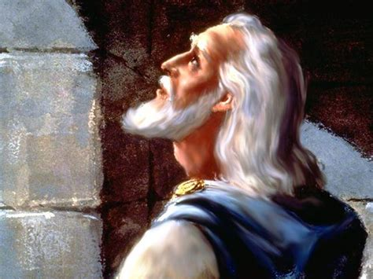
Vs 19 “O Lord, hear; O Lord, forgive; O Lord,
(ʾadōnāy: from adon: master, controller)
hearken and do;
What He’d promised to do in response to repentant prayer. (Lev. 26:40-46; 2 Ch. 7:14)
(1 Jn 5:14 “This is the confidence we have in Him”)
(Do what?)
defer not, for thine own sake O my God:
for thy city and thy people
are called by thy name.”

Slide 30
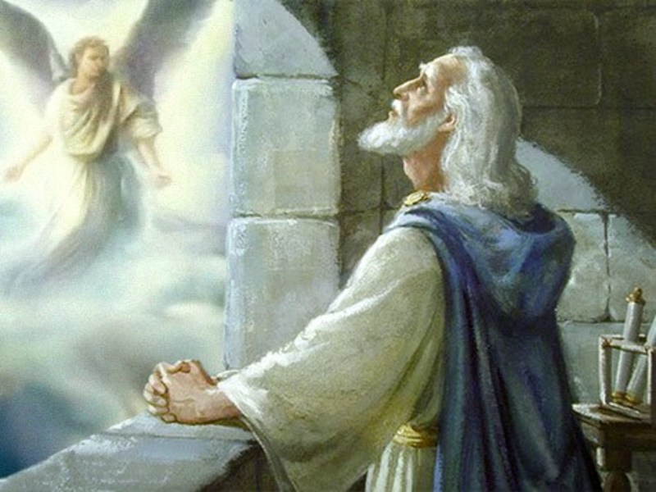
C. God sends an angelic answer!
Dan. 9:21-23 “while I was in prayer…Gabriel, … said,
O Daniel, I am now come forth to give thee skill and understanding.
At the beginning of thy supplications
the commandment came,
and I am come to shew thee;
for thou art greatly beloved!”

Slide 31
Conclusion: Light (truth) received (responded to)
brings more light.
Light (truth) rejected (ignored)
brings darkness.
God found in Daniel someone who valued His word and responded to it.
Because Daniel recognized and responded to God’s revelation about the 70 years of captivity;
God revealed much more to Him. 24-27

Slide 32
23 “therefore understand the matter…consider the vision.
24 Seventy weeks are determined upon thy people
and upon thy holy city,
to finish the transgression,
and to make an end of sins,
and to make reconciliation for iniquity,
and to bring in everlasting righteousness,
and to seal up the vision and prophecy,
and to anoint the most Holy.”
“Christ” (māšîaḥ/Christos) means “the anointed one”!

Slide 33
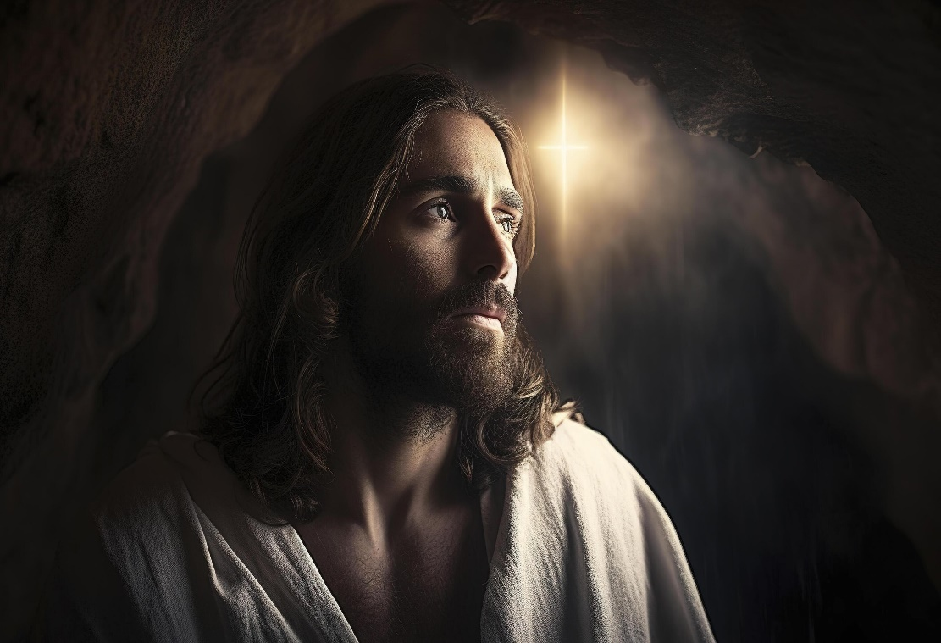
3x God tells Daniel he’s “Greatly beloved”
Daniel 9:23; 10:11, 19
Jn 14:21 “He that hath my commandments,
and keepeth them, he it is that loveth me:
he that loveth me shall be loved of my Father,
and I will love him,
and will manifest myself to him.”

Slide 34
What are you doing to better understand God’s word and will? (Ro. 12:1,2)
What are you doing about what you do understand? James 1:21,22
“Wherefore lay apart all filthiness and superfluity of naughtiness, and receive with meekness the engrafted word, which is able to save your souls.
But be ye doers of the word, and not hearers only, deceiving your own selves.” (Jms 4:17)

Slide 35
Eph. 6:11
“Put on the whole armor of God,
That ye may be able to stand against the wiles of the devil.”
For we wrestle not against flesh and blood,
but against principalities, against powers,
against the rulers of the darkness of this world,
against spiritual wickedness in high places…
18 Praying always with all prayer…”

