Slide 1
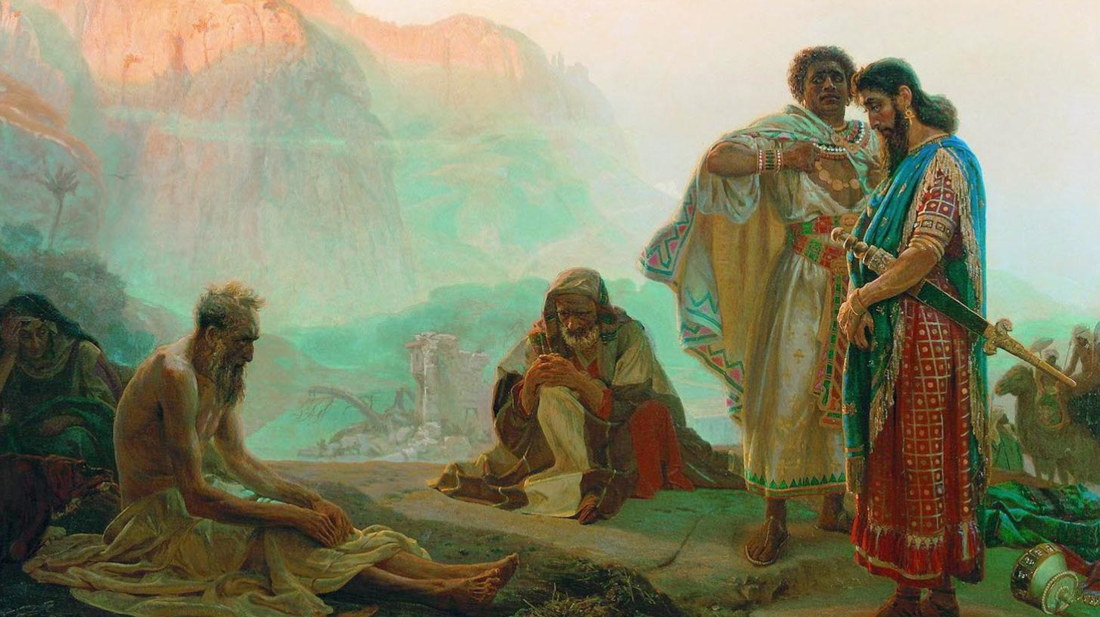
קְלָלָה וְאֵת בְּרָכָה
My Jewish Learning
By Joseph Peters

Slide 2
Objective
Anyone can obtain a blessing out of any situation
How?
By learning the proper response from these various examples,

Slide 3
Rationale:
Examples of God blessing through…
Discipline
Suffering
Testing

Slide 4
Blessings: Through Discipline
Hebrews
Judges

Slide 5
Discipline
A fair punishment that is intended for the benefit of the recipient by teaching them a valuable life lesson.

Slide 6
Hebrews 12:5-11 (NASB)
⁶ FOR THOSE WHOM THE LORD LOVES HE DISCIPLINES, AND HE SCOURGES EVERY SON WHOM HE RECEIVES.” (Proverbs 3:12 quote)
⁷ It is for discipline that you endure; God deals with you as with sons; for what son is there whom his father does not discipline?
⁸ But if you are without discipline, of which all have become partakers, then you are illegitimate children and not sons.

Slide 7
Hebrews 12:5-11 (NASB)
⁹ Furthermore, we had earthly fathers to discipline us, and we respected them; shall we not much rather be subject to the Father of spirits, and live?
¹⁰ For they disciplined us for a short time as seemed best to them, but He disciplines us for our good, so that we may share His holiness.
¹¹ All discipline for the moment seems not to be joyful, but sorrowful; yet to those who have been trained by it, afterwards it yields the peaceful fruit of righteousness.

Slide 8
Judges
Freedom
Sin
Captivity
Repentance
Deliverance

Slide 9
Judges 3:7-12 (KJV)
⁷ And the children of Israel did evil in the sight of the LORD, and forgat the LORD their God, and served Baalim and the groves.
⁸ Therefore the anger of the LORD was hot against Israel, and he sold them into the hand of Chushanrishathaim king of Mesopotamia: and the children of Israel served Chushanrishathaim eight years.
⁹ And when the children of Israel cried unto the LORD, the LORD raised up a deliverer to the children of Israel, who delivered them, even Othniel the son of Kenaz, Caleb's younger brother.

Slide 10
Judges 3:7-12 (KJV)
¹⁰ And the Spirit of the LORD came upon him, and he judged Israel, and went out to war: and the LORD delivered Chushanrishathaim king of Mesopotamia into his hand; and his hand prevailed against Chushanrishathaim.
¹¹ And the land had rest forty years. And Othniel the son of Kenaz died.
¹² And the children of Israel did evil again in the sight of the LORD: and the LORD strengthened Eglon the king of Moab against Israel, because they had done evil in the sight of the LORD.

Slide 11
Is Discipline Good?

Slide 12
Blessings: Through Suffering
Joseph
Daniel

Slide 13
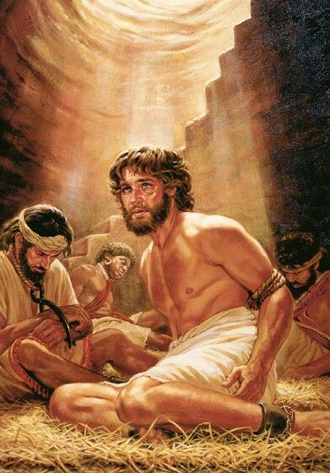
Joseph
Was sold into slavery by his brothers (Genesis 37)
His father thought he was dead
Falsely accused and thrown in Prison (Genesis 39)
Forgotten for several years (Genesis 40-41)

Slide 14
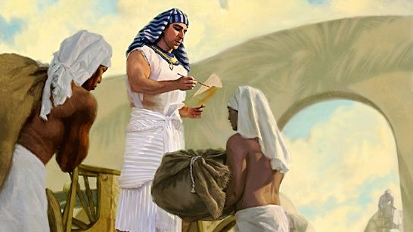
Joseph Blessed
Moses Egyptianised - WordPress.com

Slide 15
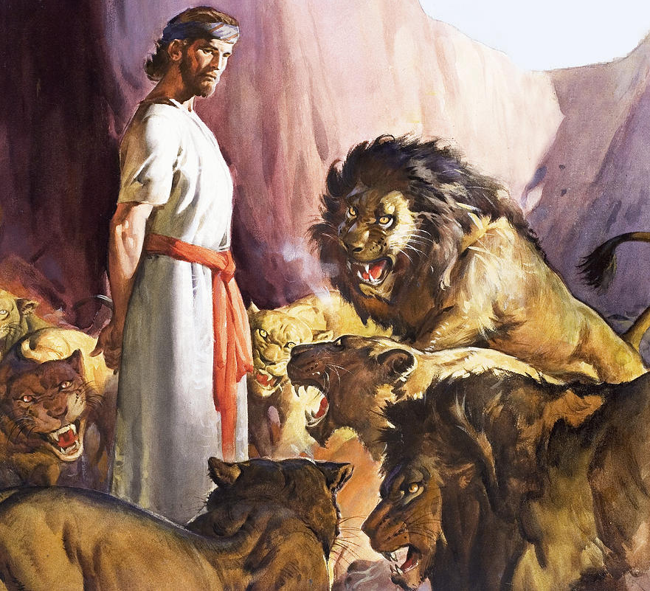
Daniel
Kidnapped by a foreign power (Daniel 1)
Survived a genocide of wise men (Daniel 2)
Was sentenced to death by lions (Daniel 6)

Slide 16
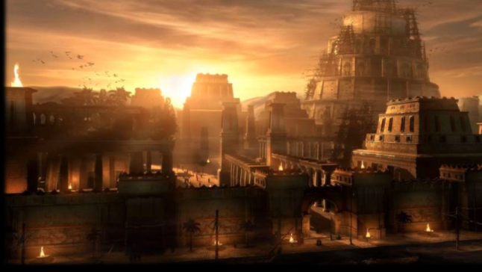
Daniel Blessed

Slide 17
Blessings: Through Testing
Abraham
Job

Slide 18
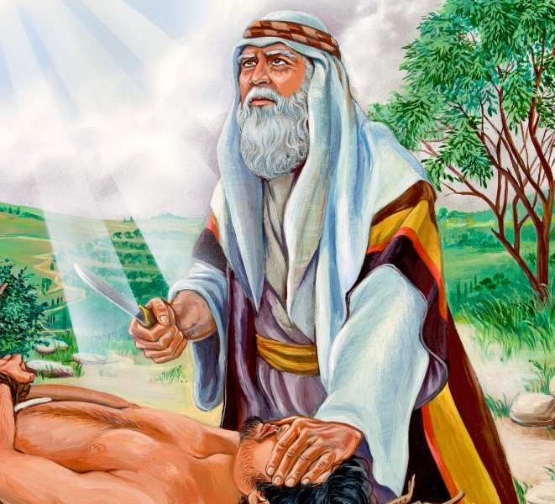
Abraham

Slide 19
Hebrews 11:17-19 (NASB)
¹⁷ By faith Abraham, when he was tested, offered up Isaac, and he who had received the promises was offering up his only begotten son;
¹⁸ it was he to whom it was said, "IN ISAAC YOUR DESCENDANTS SHALL BE CALLED.“
¹⁹ He considered that God is able to raise people even from the dead, from which he also received him back as a type.

Slide 20
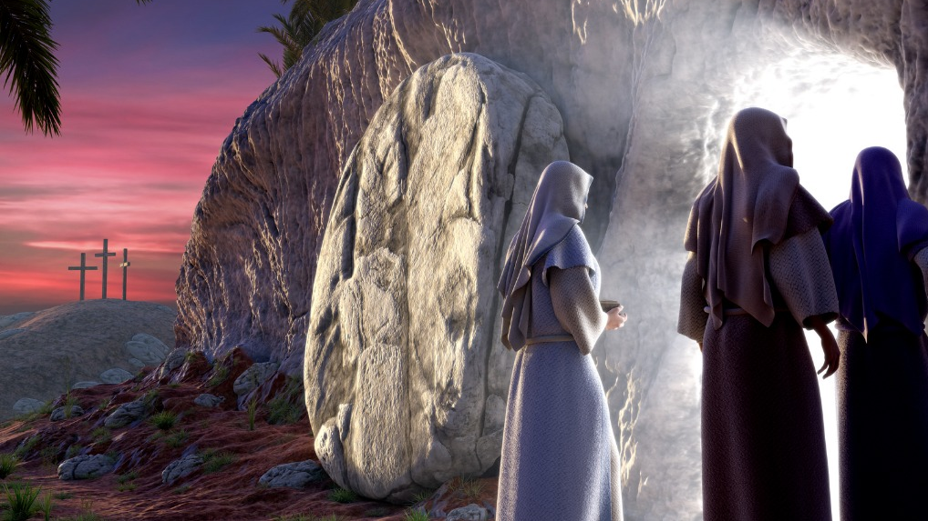
The World was Blessed
timgori.pw

Slide 21
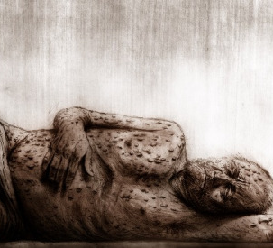
Job
A good man (Job 1:1,8)
His children and wealth were all taken away (Job 1:13-22)
He lost his health and became plagued with boils (Job 2:7)
His wife was bitter and pessimistic (Job 2:9)
His friends accused and mocked him (Job 4-36)
The Evangelical Calvinist - WordPress.com

Slide 22
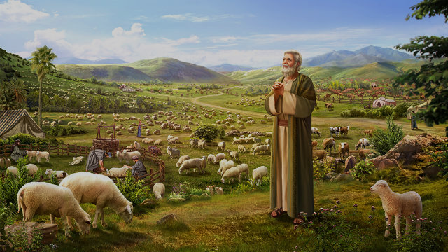
Job is Blessed

Slide 23
Conclusion
God does not want us to suffer, but He can use the pains of this life to help us.
Any situation can be either a blessing or a curse, it just depends on how we respond

