Slide 1
2 Cor 10:3-5; 1 Tim 4:1-2; 2 Tim. 2:1-4, 22-26
2 Cor 2:11 “Lest Satan should get an advantage of us:
for we are not ignorant of his devices.”

Slide 2
Satan’s devices include using:
Our Limited Perspective ➔ Complaining
Our Lustful Pleasures ➔ Compulsions
Our Propensity for Perversion ➔ Corruption
Jer 3:20,21 “they have perverted their way,
and they have forgotten the LORD their God.”
This corruption leads to eventual rebellion (Departing from God ➔ Drifting toward Satan)
and our ultimate Destruction. Jn10:10a
Pr 14:12; 16:25; Mt 7:13

Slide 3
In I Cor 10 God uses Ancient Israel
to illustrate this pernicious process:
Vs 1 “I would not have you ignorant how that all our fathers were under the cloud…baptized…
Vs 5 “but with many of them God was not pleased
for they were overthrown in the wilderness.”
Satan works his poison in individual lives
in order to distract, defile, and eventually destroy the entire culture.

Slide 4
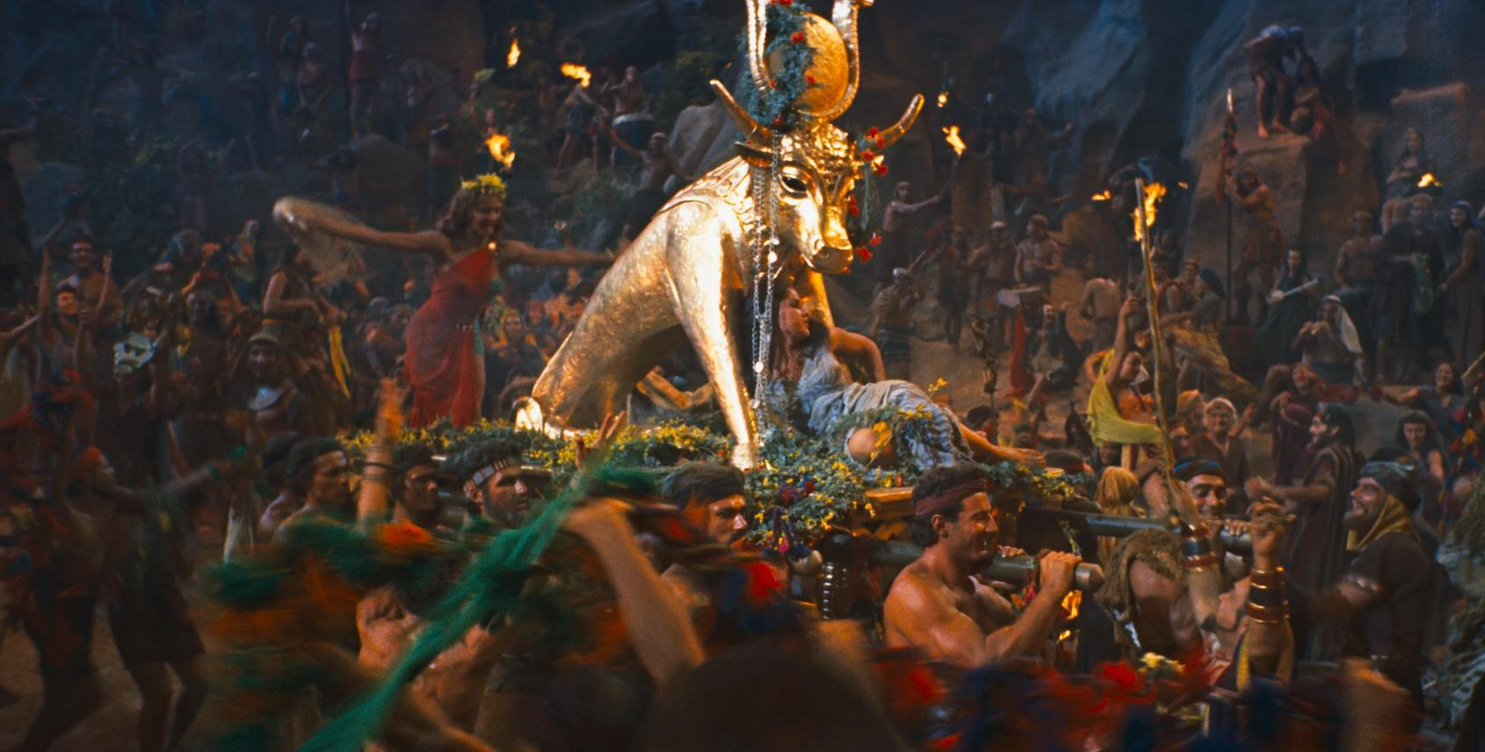
His vehicle of choice is some form of Idolatry!
Vs 5 “they were overthrown in the wilderness.
6 Now these things were our examples,
to the intent we should not lust after evil things,
as they also lusted.
7 Neither be ye idolaters…”

Slide 5
Defining Idolatry (Old Testament)
Lev 19:4 “Turn ye not unto idols…” (elîl: good for nothing)
Jer 8:19 “provoked me... with graven images…strange vanities?”
(heb’el: emptiness {from habal: to lead astray})
Lev. 26:30 “cast …upon your idols, (gillûl’îm: To wallow/trust)
and my soul shall abhor (gaal’: reject) you.”
1 Sam 15:23 “rebellion is as the sin of witchcraft,
and stubbornness is as iniquity and idolatry.” (terāpîm)
From rapha: promises to heal, repair
(from rapa: actually weakens and consumes.)

Slide 6
Review: Defining Idolatry (New Testament)
1 Cor 10:7 “Neither be ye idolaters” Eidōlolat’rēs: from eidolon (form) and latreu’o (to serve /worship)
by implication a heathen god!
20 …the things which the Gentiles sacrifice,
they sacrifice to devils, and not to God:
and I would not that ye should have
fellowship with devils.”
Idolatry opens us up to demonic influence.

Slide 7
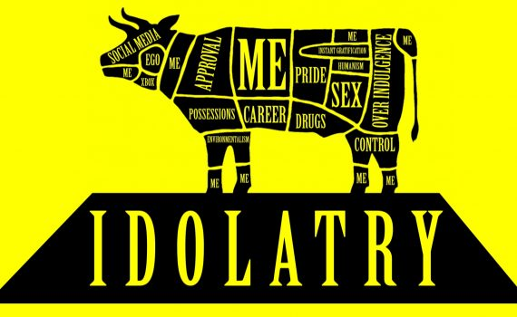
“Any thing which usurps the place of God
in the hearts of his rational creatures.”

Slide 8
We Delight in Idolatry because it (they)
Promise to our meet our desires without God.
➔ Pleasure (Isthar/Astoreth Num. 25)
➔ Provision (Baal/Isthar Jer. 44:15-27)
➔ Protection (Ahaz & Assyrian gods 2 Kings 16)
➔ Direction (Ahaziah to Baalzebub 2 Kings 1)
➔ Pride/Purpose (Jezebel 1 Kgs 16; Simon Acts 8:9-11)

Slide 9
Idolatry has no power to lastingly fulfil our needs
and ends up deceiving us (2 Cor. 11:1-3)
Until we become “diseased” by it.
2 Peter 2:19
“While they promise them liberty,
they themselves are the servants of corruption:
for of whom a man is overcome,
of the same is he brought in bondage.”
1 Jn 2:15-17; 5:19

Slide 10
Deliverance from Idolatry Mt 6:13
Jesus taught us to pray “deliver us from evil…”
Ponēros: evil {in effect or influence}, diseased.
1. Idolatry literally “delivers us to evil”
1 Cor 10:20 “that the things which the Gentiles sacrifice, they sacrifice to devils, and not to God:
and I would not that ye should have fellowship (koinōnos: partner, common) with devils.”
(daimonion: demons!)

Slide 11
Idolatry literally “delivers us to evil”
A. Satan uses the temptation of idolatry:
1) To get us to drift from God. Jms 1:14
“tempted when he is drawn away of his own lust”
2) Get us caught in the current (infection) of sin.
Vs 14 b “and enticed” (deleaz’ō: deluded/trapped)
from dolos: a decoy, bait!
15 Then when lust hath conceived, (syllamban’o: captures) it bringeth forth (apokye’o: breeds) sin:”

Slide 12
A. Satan uses the temptation of idolatry to get us:
1) To drift from God Jms 1:14a
2) Caught in the current (infection) of sin. 14b
3) Shipwrecked by sin. (1 Tim. 1:19) Jms 1:15
“Then when lust hath conceived,
it bringeth forth sin: (Hamartia: offence/trespass)
(from hamartano: to miss the mark {forfeit the prize})
and sin, when it is finished, (apotele’ō: consummated)
bringeth forth (apokye’ō: breeds) death.”

Slide 13
3) Shipwrecked by sin. (1 Tim. 1:19) Jms 1:15
a) Presumptuous sin (rebellion) Ps. 19:13;
moves us into Satan’s “current” (influence)
and it eventually overpowers us.
1 Cor 5:5 “To deliver (paradidōmi: surrender)
such an one unto Satan …”
b) This is usually a slow drift/infection. (Eccl. 8:11)
1 Cor 5:6 “Know ye not that a little leaven
leavens the whole lump?”
(1 Sam 15:23?)

Slide 14
2. Jesus wants to “deliver us from evil…” Mt 6:13
Deliver (rhy’omai) has the idea of choosing
(getting caught up in) a (different) current.
A. Christ’s sacrifice can deliver us from:
1) The Penalty of sin (Ro. 6:23; 2 Cor. 5:21)
Lk 19:10 “come to seek and to save that which was lost.”
sozo: deliver, protect, preserve, “make whole”
Jn 19:30 “It is finished” (teleo: paid in full,
the debt has been discharged!)

Slide 15
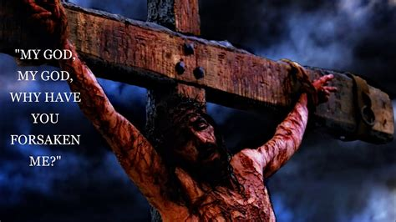
A. Christ’s sacrifice can deliver us from:
1) The Penalty of sin (Ro. 6:23; 2 Cor. 5:21)
Hebrews 9:26
“but now…hath he appeared to put away sin
(athe’tēsis: cancel, disannul)
by the sacrifice of himself.”
Mt 27:46
From Ps. 22:1

Slide 16
A. Christ’s sacrifice can deliver us from:
1) The Penalty of sin (Ro. 6:23; 2 Cor. 5:21)
a) We avail ourselves of this gift by Faith!
Jn 3:16; Gal. 2:8,9; Ro 5:1-2 “Therefore being justified (dikaio’ō: rendered innocent) by faith,
we have peace with God
through our Lord Jesus Christ:
By whom also we have access by faith
into this grace wherein we stand,
and rejoice in hope of the glory of God.”

Slide 17
A. Christ’s sacrifice can deliver us from:
1) The Penalty of sin (Ro. 6:23; 2 Cor. 5:21)
a) We avail ourselves of this gift by Faith!
b) This is known as Salvation!
Gabriel’s message to Joseph: Mt 1:21 “she shall bring forth a son, and thou shalt call his name JESUS:
for he shall save his people from their sins.”
Jesus (Iēsous’) from the Hebrew Yehôwshû’waʿ:
Jehovah Saves!

Slide 18
A. Christ’s sacrifice can deliver us from the:
1) The Penalty of Sin.
2) The Power of Sin! 1 Cor 5:7,8
“Purge out therefore the old leaven, (sin)
that ye may be a new lump, as ye are unleavened.
For even Christ our passover is sacrificed for us:
Therefore let us keep the feast, not with old leaven, neither with the leaven of malice and wickedness;
(Poneria: from poneros; evil influence/infection)
but with the unleavened bread of sincerity and truth.”

Slide 19
A. Christ’s sacrifice can deliver us from the:
2) The Power of Sin!
a) We also avail ourselves of this by faith. Ro 6:9-13
9 “Knowing that Christ being raised from the dead dieth no more; death hath no more dominion over him.
10 For in that he died, he died unto sin once:
but in that he liveth, he liveth unto God.
11 Likewise reckon (logiz’omai: take inventory)
ye also yourselves to be dead indeed unto sin,
but alive unto God through Jesus Christ our Lord.”

Slide 20
2) Christ delivers us from The Power of Sin!
a) We also avail ourselves of this by faith. Ro 6:12-13
12 “Let not sin therefore reign in your mortal body,
that ye should obey it in the lusts thereof.
13 Neither yield ye your members as instruments of unrighteousness unto sin:
but yield yourselves unto God,
as those that are alive from the dead,
and your members as instruments
of righteousness unto God”

Slide 21
2) Christ delivers us from The Power of Sin!
a) We also avail ourselves of this by faith. Ro 6:12-13
b) This is called Sanctification. 1 Th.2:13
“God hath …chosen you to salvation through sanctification of the Spirit and belief of the truth:
1 Th 5:23-24 “the very God of peace sanctify you wholly;
(Hagiazo: make holy, pure, sacred, consecrated)
and I pray God your whole spirit and soul and body
be preserved blameless unto the coming of our Lord.
24 Faithful is he that calleth you, who also will do it.”

Slide 22
Conclusion:
Idolatry (sin) delivers us to evil. Jms 1:13-15
Jesus wants to “deliver us from evil…” Mt 6:13
Deliver (rhy’omai) has the idea of choosing (getting caught up in) a (different) current/path.
We choose which path (current) we take.
Pr 4:23-27 “Keep thy heart with all diligence;
for out of it are the issues of life…
26 Ponder the path of thy feet, and let all thy ways be
established. …
27 remove thy foot from evil.”

Slide 23
“deliver us from evil” Mt 6:13
1 Cor 10:13-14 “There hath no temptation taken you but such as is common to man: but God is faithful, who will not suffer you to be tempted above that ye are able;
but will with the temptation also make a way to escape, that ye may be able to bear it.
14 Wherefore, my dearly beloved,
flee (pheu’gō: shun/run) from idolatry.”
Get/Stay out of the current of sin!

Slide 24
Application: How can we shift currents/paths?
1) Recognize Satan’s devices. (purpose/disposition)
Jms 1:14 “every man is tempted when he’s drawn away of his own lusts and enticed. (dolos: trapped)
a) Recognize where Satan’s path/current leads!
15 Then when lust hath conceived, it bringeth forth sin, and sin, when it is finished, bringeth forth death.”
(Jn 10:10a)
b) Recognize/Resist the temptation to drift from God.
16 “Do not err, (planao: drift from safety) my …brethren.

Slide 25
Application: How can we shift currents/paths?
2) Remember God’s purpose/plan. Jn 10:10b; Rev. 4:11
Jms 1:15 “Every good gift and every perfect gift is from above, and cometh down from the Father of lights,
16 With whom is no variableness, neither shadow …
17 Of his own will begat he us with the word of truth, that we should be a kind of firstfruits of his creatures.”
Lk 12:31-32 “But rather seek ye the kingdom of God; and all these things shall be added unto you.
³² Fear not, little flock; for it is your Father's good pleasure to give you the kingdom.”

Slide 26
Application: How can we shift currents/paths?
1) Recognize Satan’s devices. (Jms 1:13-16)
2) Respond to God’s purpose/plan. Jms 1:15-17
3) Realize (take inventory) of our own evil infection.
19 “Wherefore, my beloved brethren, let every man be swift to hear, slow to speak, slow to wrath:
20 For the wrath of man worketh not
the righteousness of God.”
(See Eph. 4:26; 1 Jn 1:6-8)

Slide 27
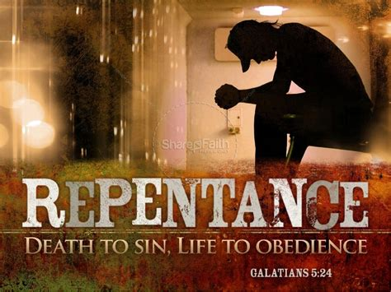
Application: How can we shift currents/paths?
4) Repent (metanoe’ō: think differently) of
(and about) our sin.
24a “Wherefore lay apart all filthiness and superfluity (abundance)
of naughtiness,
(kakia: malignity)
(1 Jn 1:9,10)

Slide 28
Application: How can we shift currents/paths?
5) Receive God’s Truth into your soul. 24b
“and receive with meekness the engrafted word,
(take God’s “prescription” {entole})
which is able to save your souls.”
6) Respond to what God is showing you! 22
“But be ye doers of the word, and not hearers only, deceiving your own selves.”

Slide 29
Life is short
(James 4:14)
Death is Sure
(Heb. 9:27)
Sin is the Cause
(Ro. 5:12)
Christ is the Cure.
(Ro. 6:23)
Jn 5:40; Mt 11:28-30
”It’s appointed unto man once to die,
After this the judgment”

