Slide 1
Lessons in the Deserts of Life.
“Neither murmur ye,
as some of them murmured,
and were destroyed of
the destroyer.”
John 10:10; Rev. 9:11
1 Cor 10:10,11
Now all these things happened unto them for ensamples:
and they are written for our admonition.”

Slide 2
That’s 7 deserts in the first 18 months!

Slide 3
All of God’s children will pass through desert seasons! Mt 7:15 “Strait is the gate and narrow is the way
that leads to life”
Satan meets us during these “troubled times” seeking to sidetrack us from God’s plan.
This is the essence of sin! (harmartano):
“To miss the mark and so not share in the prize.”
(Thli’bō: troubled, afflicted)

Slide 4
Our disappointments can affect our disposition,
producing a critical, complaining spirit;
that affects us and infects those around us.
(Numbers 11:1-7; 10-15)
Heb. 12:15 “Looking diligently lest any man fail of the grace of God; lest any root of bitterness
(pikria: poison) springing up trouble (annoy) you,
and thereby many be defiled.”
(miai’nō: contaminated)

Slide 5
God uses desert experiences to determine (reveal) as well as to develop our faith.
James 1:2-4 “count it all joy when ye fall into divers temptations; (peirasmos’: proof, trials)
Knowing that the trying of your faith worketh patience.
(hupomone’: cheerful, hopeful endurance)
But let patience have her perfect work, that ye may be perfect (telios: mature) and entire (complete)
wanting (lacking) nothing.”

Slide 6
Review:
Twice in Nu. 11 God had to deal with the infection of bitter complaining.
1) 1st time Brought God’s immediate punishment: 1-3
2) 2nd time Burdened God’s Prophet. Vs 4-15
a) God provided 70 Partners for Moses. Vs 16-17
b) God provided meat for the masses. Vs 31-34
³³ And while the flesh was yet between their teeth, ere it was chewed, the wrath of the LORD was kindled against the people, and the LORD smote the people.”

Slide 7
Last week we discussed how Satan uses the difficult disappointments of life to motivate us to bitterness & complaining.
His purpose is to push us away from God’s providence and toward his (Satan’s) purposes.
Today we’ll examine how Satan uses internal, unresolved issues (pride, envy, conflict, etc)
to accomplish the same goals.

Slide 8
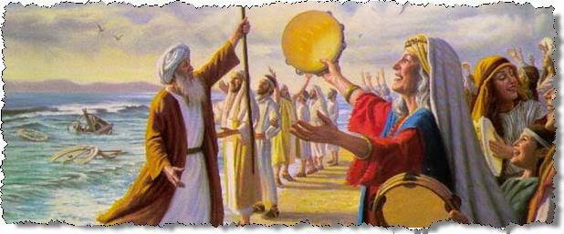
Miriam’s Madness Numbers 12
The last time we heard from Miriam,
She was supporting Moses’ leadership:
leading the chorus of the song of Moses.
(Ex. 15:20-21)
This time she’s subverting it! Vs 1

Slide 9
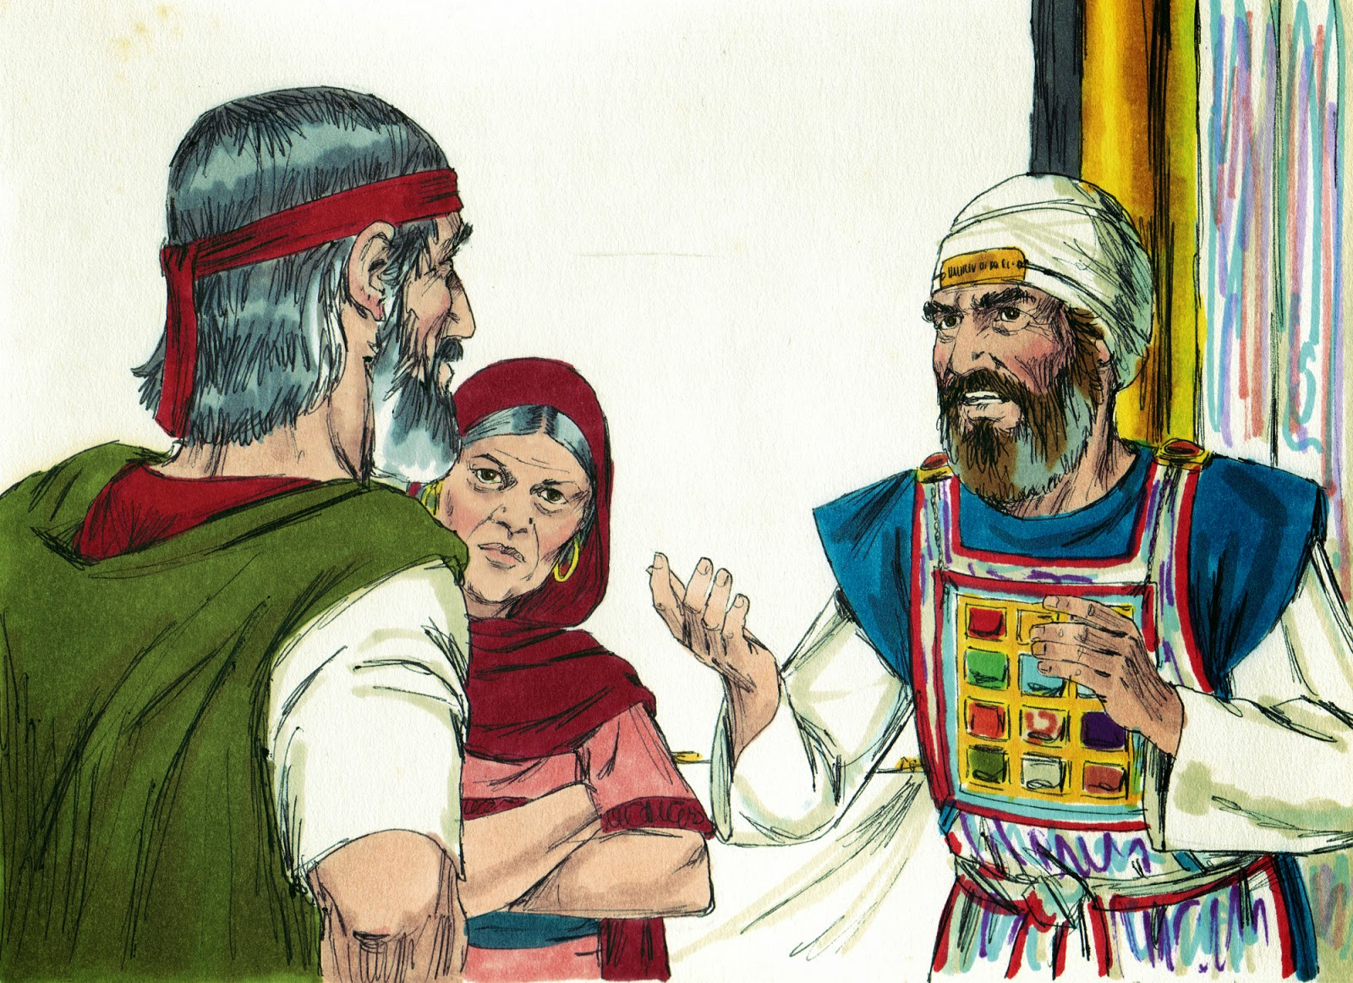
1. Vs 1 “Miriam and Aaron spake against Moses”
A. Their alleged (surface) problem/concern was
criticism over some of his past decisions.
“because of the Ethiopian woman whom he had married.”
1) They obviously disagreed with how he handled this situation.

Slide 10
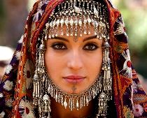
Vs 1 “Miriam and Aaron spake against Moses”
1) They criticized Moses’ past decisions.
a) Ex. 2:21 (18:2) tells us he married Zipporah,
who was clearly a Midianite (descendent of
Abraham from Arabia) Gen. 25; Gal. 4:25
So who was this
“Ethiopian Woman”?
Dt. 29:29 “The secret things….”
Pr. 25:2; Jn 21:25

Slide 11
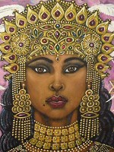
1. Miriam’s Madness Nu 12
b) Historical Background. Stephen revealed:
“Moses was Mighty in words and deeds” Acts 7:2
(1) Josephus records* that prince Moses
defeated the Ethiopian kingdom of Saba.
As was customary, he was given the Ethiopian princess "Tharbis" as his wife.
*Antiquities Chapter 10

Slide 12
1. Miriam’s Madness Nu 12
b) Historical Background
(2) When Moses fled Egypt in fear, He left Tharbis
behind, later marrying Zipporah.
(3) Tharbis apparently rejoined him (40 years later)
at the Exodus.
(Before the law)
Creating this conflict!
(with Miriam/Aaron?!?)

Slide 13
1. Miriam’s Madness Nu 12
Whether Josephus was correct about Tharbis or not,
this “issue” was complicated and 40 years old!
What could Moses have done about it now?
God didn’t appear to have a problem with it.
But Miriam (and Aaron) did!

Slide 14
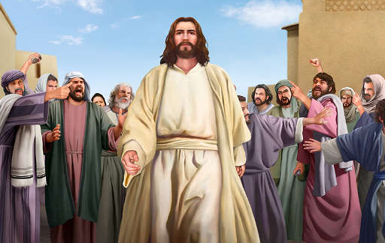
Vs 1 “Miriam and Aaron spake against Moses”
B. The Real issue:
2 “Hath the LORD indeed spoken only by Moses?
hath he not spoken also by us?”
Mt 13:57 “they were offended in him. But Jesus said…
Envy born of Pride!
A prophet is not without honor, save in his own country,
and in his own house.”
(also Luke 4:16-30)

Slide 15
1) The stated issue is seldom the real issue!
Pr 13:10 “Only by pride (zādôn: arrogance, presumption)
cometh contention” (maṣṣâ’: strife)
From nāṣâ’: to expel, lay waste or leave desolate.
2) Pride always leads to waste and desolation!
a) That’s Satan’s Nature! (Jn. 10:10; Rev. 9:11)
Satan (satanas’) means “the accuser!”
Rev. 12:10 “the accuser of the brethren”

Slide 16
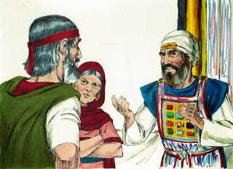
The stated issue is seldom the real issue!
3) They were projecting their sin on to Moses!
Ro 2:1 “Therefore thou art inexcusable… that judgest:
for wherein thou judgest another, thou condemnest thyself;
for thou that judgest
doest the same things!”
(see also Mt. 7:1-5)

Slide 17
Miriam’s Madness Num. 12
1. “Miriam and Aaron spake against Moses”
2. “And the LORD heard it.” 2b
Psalm 139:4 “there is not a word in my tongue,
(or heart according to Heb. 4:12)
but, lo, O LORD, thou knowest it altogether.”
Jer. 17:9,10 “The heart is deceitful…who can know it?
I the Lord search the hearts…”

Slide 18
2. “And the LORD heard it.” 2b
A. God’s Intervention: Nu. 12:3-8
1) Moses doesn’t defend himself. Vs 3
3 “Now …Moses was very meek, (ʿânâv: Humble) above all the men which were upon the …earth.”
Remember Numbers 11:25-29
29 “Enviest thou for my sake? would God that all the LORD'S people were prophets, and that the LORD would put his spirit upon them!”

Slide 19
Jms 3:13-16 “Who is a wise man and endued with knowledge? Let him shew out of a good conversation his works with meekness of wisdom.
But if ye have bitter envying and strife in your hearts,
glory not, and lie not against the truth.
This wisdom is …earthly, sensual, devilish.
For where envying and strife is there is confusion
Who’s the author of confusion? (1 Cor 14:33)
And every evil work.”

Slide 20
1) God defends Moses. Vs 3
a) It’s natural for our “flesh” to defend itself!
b) It takes “faith” to trust God to do so. Ro. 12:19
“avenge not yourselves, Give place unto wrath
…vengeance is mine, I will repay saith the Lord”
Jesus modeled this. 1 Peter 2:23
“Who, when he was reviled, reviled not again; when he suffered, he threatened not; but committed himself
to him that judgeth righteously:”

Slide 21
B. God Explanation. Numbers 12:4,5
“the LORD spake suddenly unto Moses, and unto Aaron, and unto Miriam, Come out ye three unto the tabernacle of the congregation….
5 And the LORD came down in the pillar of the cloud, and stood in the door of the tabernacle, and called Aaron and Miriam: and they both came forth.”
They wanted to hear from God!?!?!?!
So God spoke up!

Slide 22
Numbers 12:7-9 “My servant Moses is not so,
who is faithful in all mine house.
With him will I speak mouth to mouth…:
wherefore then were ye not afraid to speak against
my servant Moses?
And the anger of the LORD was kindled against them…”

Slide 23
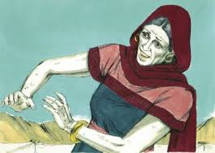
C. God’s Confrontation & Correction 10-14 “And the cloud departed from off the tabernacle;
and…Miriam became leprous…
1) Aaron repented. “Aaron said unto Moses, Alas, my lord, I beseech, lay not the sin upon us wherein we have done foolishly and wherein we have sinned.”
What about Miriam?

Slide 24
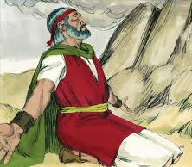
2) Moses Prayed. Nu 12:13
”Moses cried unto the LORD,
Heal her now, O God, I beseech thee.
3) God explained. 14 “the LORD said unto Moses,
…let her be shut from the camp seven days…
4) Israel watched and waited. Vs 15
“the people journeyed not until Miriam was brought in again.”

Slide 25
Questions to consider:
Why was Miriam (not Aaron) punished?
1 Kgs 21:25 “whom Jezebel his wife stirred up.”
2. Why such a public judgment (leprosy)?
Nu 32:23 “be sure your sin will find you out.”
3. Why wait 7 days before healing her?
Rev 2:21 “I gave her space to repent…” (Aaron did!)
4. Why require Israel to wait for/with her?
1 Tim 5:20 “rebuke before all that others may fear”

Slide 26
Principles to Ponder: 1 Cor 10:11
“all these things…are Written for our admonition”
God uses flawed people! 2 Cor 4:7
“we have this treasure in earthen vessels that the excellency …may be of God and not of us.”
2. Leaders are natural targets. Mt 26:31
“I will smite the shepherd,
and the sheep …shall be scattered abroad.”
Any decision can produce disagreements!

Slide 27
Principles to Consider:
3. The stated problem is seldom the real problem.
1 Cor 4:1-3,5 “Let a man so account of us, as of the ministers of Christ, and stewards of the mysteries of God.
it is required in stewards, that a man be found faithful.
But with me it is a very small thing that I should be judged of you, or of man's judgment:
Judge nothing before the time, until the Lord come, who both will bring to light the hidden things of darkness,
and will make manifest the counsels of the hearts”

Slide 28
Principles to Consider:
4. Pride poisons our perspectives! Mt 7:1-5
“Why beholdest thou the mote in thy brother’s eye…
But considerest not (katanoeō: fully perceive)
the beam …in thine own eye?”
Pr 14:30 “envy (is as) the rottenness of the bones.”
That’s why we need God’s perspective.
Jms 1:5 “If any of you lack wisdom, let him ask of God”
Sophia: from saphes meaning to make clear!

Slide 29
Application: James 4:5-8
“The spirit that dwelleth in us lusteth to envy…
But He giveth more grace. Wherefore he saith,
God resists the proud, but gives grace to the humble.
Submit yourselves therefore to God.
Resist the devil,
and he will flee from you.
Draw nigh to God,
and he will draw nigh to you.”

Slide 30
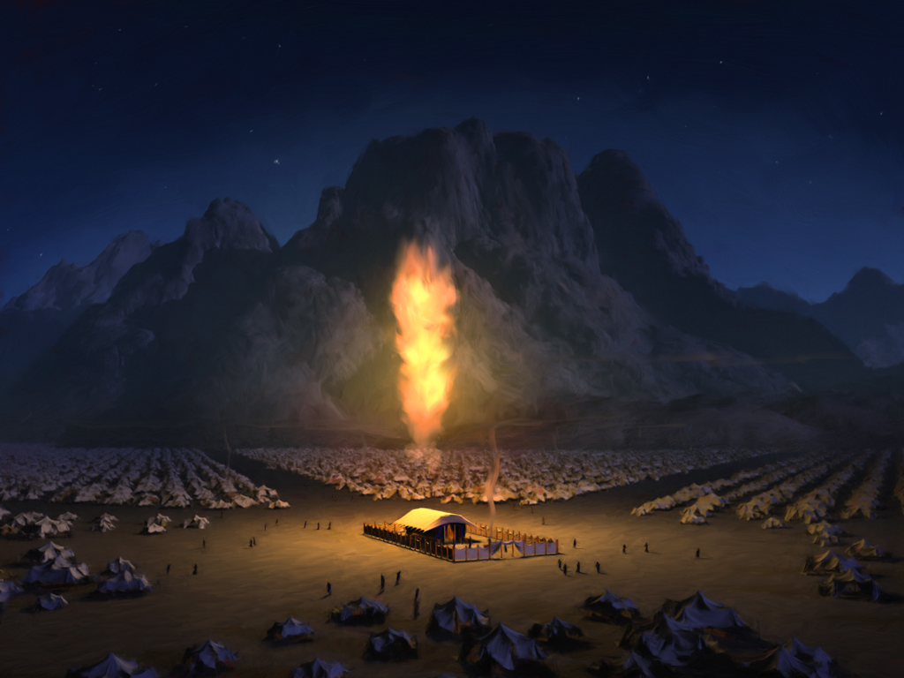
This Tab

