Slide 1
Last week we discussed how the disciples failed to grasp (understand) Jesus’
Purposes, Promises, and Priorities,
Because they were so focused on their own Priorities, Pride and Perspective.
(AKA: reticular activating system)
(See 2 Cor 4:4)

Slide 2
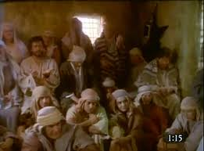
This left them disappointed, disillusioned and defeated! (Jn 10:10a)
“the disciples
were assembled
for fear of the Jews,
(then) came Jesus and stood in the midst,
and saith unto them, Peace be unto you.”
John 20:19

Slide 3
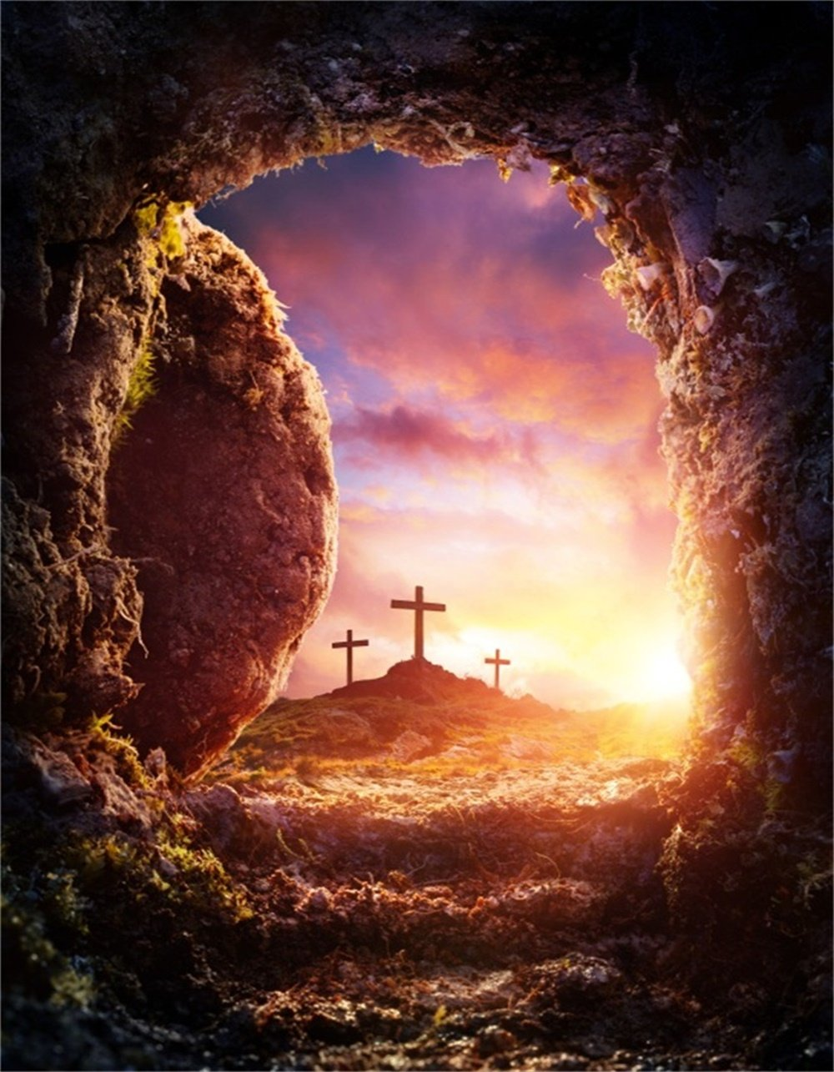
The Resurrection restored
(realigned) their Perspective, Purpose, and Peace.
Ps 23:3 “He restoreth my soul.
He leadeth me in paths of righteousness…”
Restoration comes before Direction! Jer. 29:10-13

Slide 4
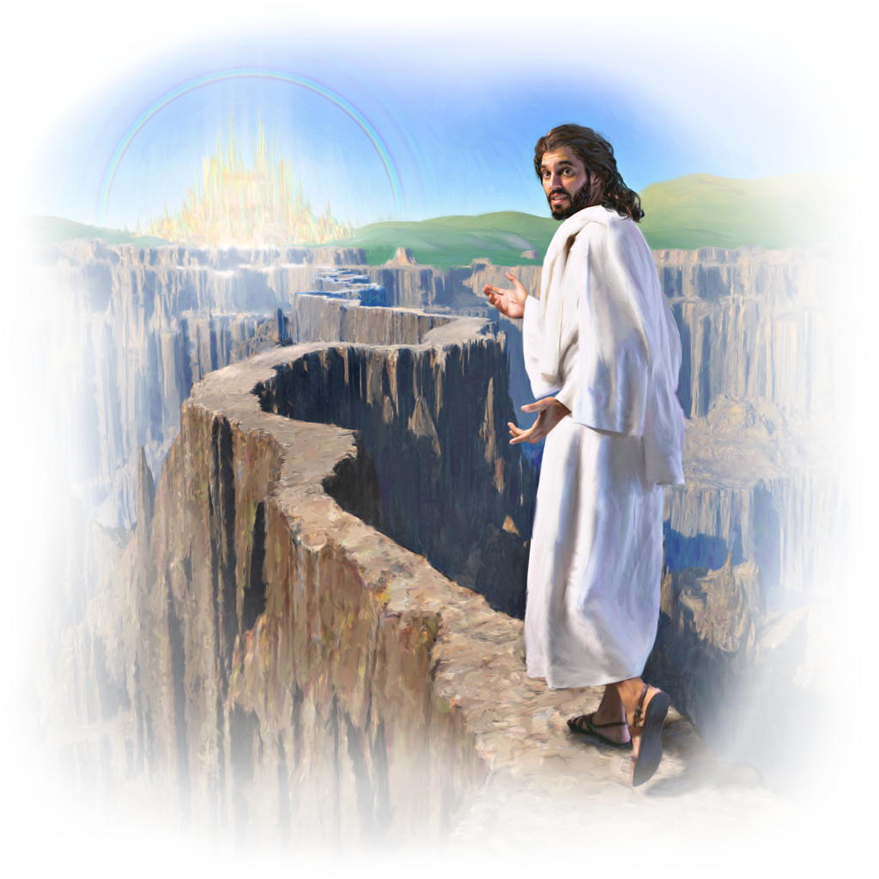
Restoration requires Repentance! Mt 4:17
Direction requires Faith.
Heb. 11:1,6; John 10:27
“My sheep hear my voice…
and they follow me.”
John 14:6

Slide 5
Following by Faith
2 Cor 4:18
“While we look (skopeo: regard) not at the things which are seen,
but at the things which are not seen:
for the things which are seen are temporal; (pros’kairos: seasonal)
but the things which are not seen are eternal.” (aiōn’ios: perpetual)
2 Cor 5:7 ”For we walk by faith, not by sight:”

Slide 6
Past failures/disappointments, makes such Faith
(literally a transfer of trust {from us to God})
particularly difficult.
This cycle of past failure and frustration leaves us distrustful of ourselves, others, and even our God!
The disciples had to learn to replace their distorted/disappointed dreams
with God’s divine direction.
(Jer. 29:11; Pr. 29:18)

Slide 7
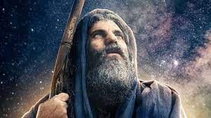
This morning we’re going to look at one such “disappointed dreamer”
and how he learned to trust the Dream Giver in spite of his disappointments.
In doing so, he paved the path of Faith,
leaving mile markers for others to follow.

Slide 8
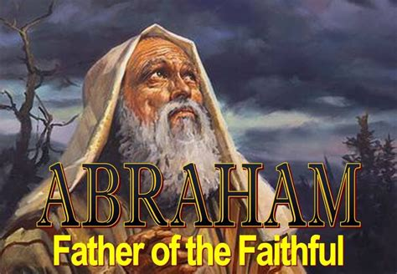
Is 51:1-2 “Hearken to me, ye that follow after righteousness, ye that seek the LORD:
look unto the rock whence ye are hewn,
and to the hole of the pit whence ye are digged.
Look unto Abraham your father, and unto Sarah …
for I called him alone, and blessed him,
and increased him.”

Slide 9
Abraham’s story is given more attention than any other in the book of Genesis;
As well as in the “heroes of faith” in Heb. 11.
His faith journey, and the “mile markers”
he left along the side of the Road,
serves to prepare us for our own.
400 years had passed since the flood and
already sin had corrupted creation (again)
turning God’s dream for us into a nightmare.”

Slide 10
The Dream-Giver finally found a Dreamer
Notice how God Gave and Grew that dream.
1. Abram’s Dream!
A. He dreamed of a Family of his own.
1) Abram means “lofty Father” Gen. 11:29
“Abram and Nahor took them wives:
…Abram's wife was Sarai; …Nahor's wife was Milcah
2) His Dream was initially denied!
30 “But Sarai was barren; she had no child.”

Slide 11
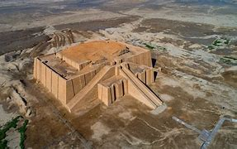
2. God’s Direction Gen. 12:1,2; Acts 7:2,3
God promised to fulfil that dream,
but gave him a 3-fold command to leave:
1) Familiar: “Get thee out of thy country.” 12:1
a) UR was the “capital” of the ancient world,
located in the fertile crescent.
b) It was dedicated to the
moon god “sin”. (Nanna).

Slide 12
God gave him a 3-fold command to leave:
1) Familiar: “Get thee out of thy country.” 12:1
2) Family/Friends “and from thy kindred”
a) God called Abram to leave his family and friends
and to follow Him. (see Lk 14:25-33)
b) God knew that these friends and family would
try to dissuade him from pursuing God’s Dream.
3) Father: “and from thy father’s house.”
God asked “Childless” Abram to leave his entire family and network in order to follow Him.

Slide 13
2. God’s Direction Gen. 12:1,2; Acts 7:2,3
B. God’s Dream was bigger than Abram’s! 12:2,3
“…and I will make of thee a great nation,
and I will bless thee, and make thy name great;
and thou shalt be a blessing:
And I will bless them that bless thee,
and curse him that curseth thee:
and in thee shall all families of the earth
be blessed.”

Slide 14
1. Abram’s Dream. (He was Childless)
2. God’s Directions: (Leave all that’s familiar)
3. Abram’s “Distractions”
A. Our faith isn’t really tested
until we cross the border of our “familiar.”
1) Staying/living in “Familiar” doesn’t
require a lot of faith.
(We already know how to
“do” familiar!)

Slide 15
B. The borders of our familiar are usually
patrolled by border bullies.
(People who try to delay or detour us from
following God’s Dreams.)
1) They usually know us
2) They’re close enough to us so that our
“Comfort zones” often intersect.
3) Breaking out of our comfort zones
threatens theirs!
Families of Ministers, Missionaries
and may even love us.

Slide 16
God called William Carey to serve in India (1793),
But his wife Dorothy initially refused to go.
At the last minute she was finally persuaded to go
(if she could take her sister).
The hardships of those early years embittered her.
She complained and despaired, eventually going insane;
spending most of the last 12 years
of her life in bitter isolation.

Slide 17
3. Abram’s Distractions:
C. Border bullies usually fall into one of the
following:
1) Alarmist: Motivated by fear of failure.
2) Traditionalist: Motivated by comfort/routine.
3) Defeatist: Motivated by fear of
embarrassment.
4) Antagonist: Motivated by control.

Slide 18
D. Notice How his border bullies delayed Abram.
1) God called Him to leave his father and family,
but they “came along” anyway.
2) They influence him to detour & delay in Haran, (800 miles North of Canaan.) Acts 7:2-4 “The God of glory appeared to Abram before he dwelt in Charran…
Get thee out of thy country, and from thy kindred,
and come into the land which I shall show thee.
Then came he out of the land of the Chaldaeans,
and dwelt in Charran:”

Slide 19
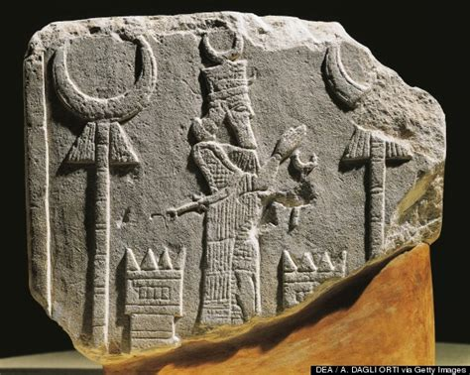
D. Notice How his border bullies delayed him.
2) They influence him to “Detour” to Haran.
a) They were Idol worshippers. (Joshua 24:2)
b) Both Ur and Haran worshiped “Sin” (Nanna)
the moon god (patron god of shepherds)
Sign: crescent moon
c) Sin was worshipped well into the third century AD.
https://www.ancient-origins.net/premium-preview/harran-0016824
Look familiar?

Slide 20
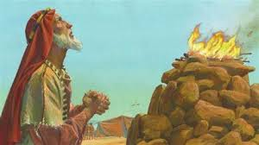
D. Notice How his border bullies delayed him.
3) Their influenced delayed his obedience for 5 years.
Acts 7:4 “and from thence, when his father was dead, he removed him into this land”
a) God didn’t meet/speak with him in Haran!
b) Only in Canaan did Abram build an altar and
worship/meet God!
(Gen. 12:7,8)

Slide 21
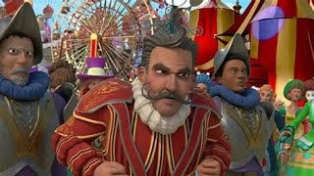
We’ll all pass through our own version of “Haran” on our faith journey.
John Bunyan portrayed this as
“Vanity Fair” in “Pilgrim’s Progress.”
Many get stuck there!

Slide 22
1. Abram’s Dream 2. God’s Direction 3. Distractions
4. Abram’s Disappointment (Gen. 12:10)
A. There’s usually a “wasteland” between
our familiar and God’s promise.
Satan uses this to try to sidetrack us in “Haran”.
a) It was “Familiar”
b) It was “Comfortable”

Slide 23
4. Abram’s Disappointment (Gen. 12:10)
B. Sometimes even the promised land can
become a wasteland of:
1) Discouragement Gen. 12:10
“there was famine in the land”
2) Doubt (About God and ourselves!)
a) Can god really take care of me? Ps 78:19
“can god furnish a table in the wilderness?”
b) Did I hear him correctly? Gen 3:1

Slide 24
4. Abram’s Disappointment (Gen. 12:10)
B. Sometimes even the promised land can
become a wasteland of:
3) Discovery (About God and ourselves)
Jn 6:67 “will ye also go away?”
4) Development of Faith.
(He learned to trust God.)
Faith is developed through disappointment!

Slide 25
Conclusion: Between where/what we are,
and where/what God desires for/with us,
we will go through:
1) A Process (To grow our relationship)
2) A Path (To guide our steps)
3) Some Painful Detours (To test our obedience)
4) Some Perplexing Disappointments
(To try our commitment and teach us faith)
(James 1:3-5)

Slide 26
Application:
Faith Always involves a Journey!
Heb 11:8-9 “By faith Abraham, when he was called to go out into a place which he should after receive for an inheritance, obeyed; and he went out,
not knowing whither he went.
By faith he sojourned in the land of promise,
as in a strange country, …:”
Abraham couldn’t stay where he was
and still follow (obey) God.

Slide 27
Neither can We!
Where are you in your faith journey?
Still stuck in your familiar Ur?
Hanging out in “Haran”? (Vanity Fair)
(2 Tim 2:4; 4:10)
“Dutiful”, but discouraged by delays & disappointments? (James 1:2-5)
Sidetracked in Egypt?

Slide 28
Experiencing God’s Dream involves a Process
➔ Path ➔ Detours ➔ Disappointments.
At every stage of this faith journey are critical Decisions that will:
1) Determine our Destination,
(where we’ll ultimately end up)
2) Shape our Destiny!
(who we’ll touch/influence along the way!)

Slide 29
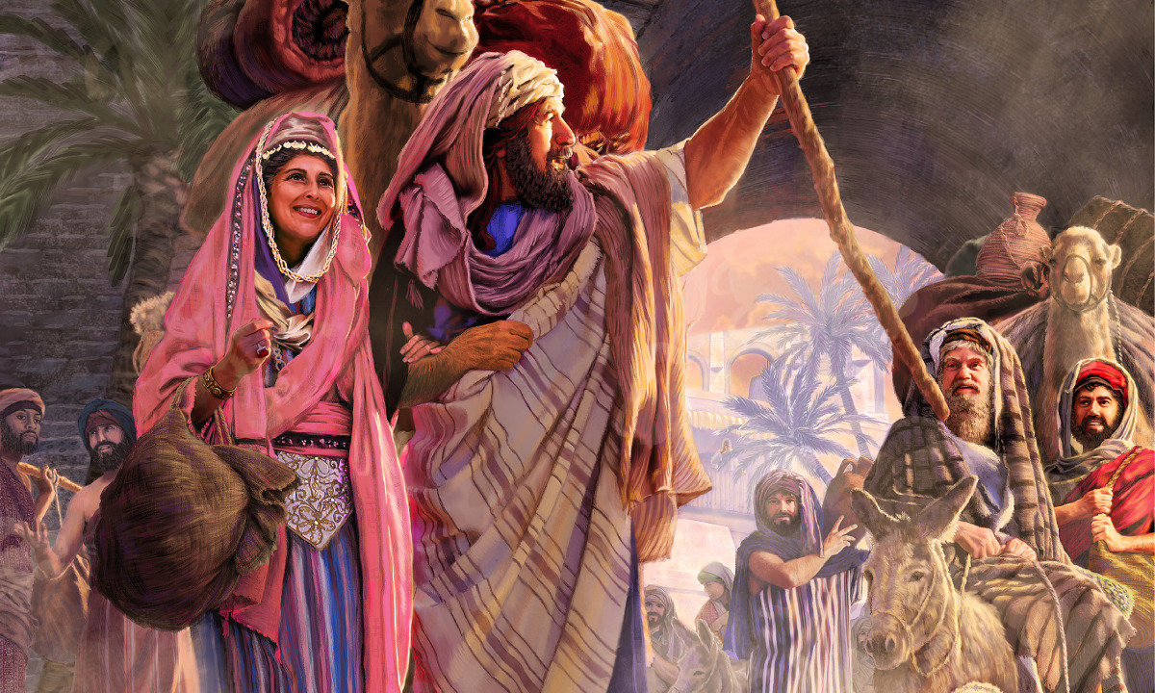
Next week we’ll focus on some of the decisions Abram made along his journey
and how they impacted his
Family,
Future,
and his Faith.

Slide 30
What’s God Dream for you? Jer 29:11
Are you willing to pursue it (Him)?

