Slide 1
Pr 29:18 “Where there is no vision (ḥāzôn: direction/dream)
the people perish” (pāraʿ: let go, expose, go/turn back)
God has a dream for you! Jer 29:11-13

Slide 2
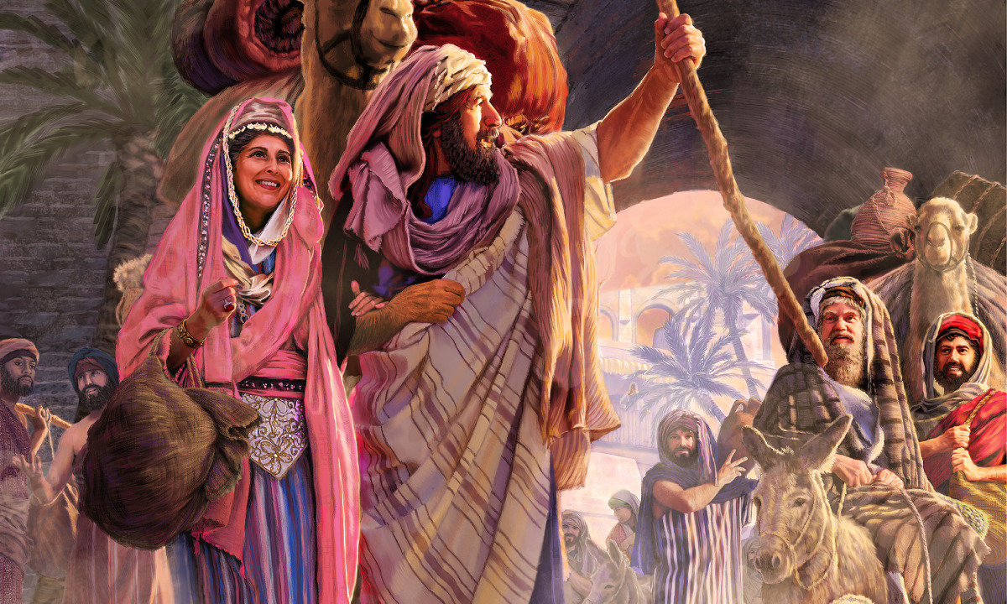
We find and focus on God’s Dreams when:
“we walk (Peripateō: conduct ourselves)
by faith, (pistis: reliance, trust)
not by sight” 2 Cor 5:7
(Ei’dos: appearance)
See 2 Cor 4:18; Heb. 11:27
But our “invisible” Faith
should have “visible” impact! James 2:17,18

Slide 3
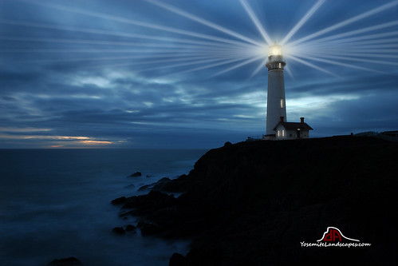
Matthew 5:14
“Ye are the light of the world.
A city that is set on a hill
cannot be hid...
Let your light so shine before men,
that they may see your good works,
and glorify your Father which is in heaven.”
Faith is Personal,
But not Private!

Slide 4
God calls us to be light to a world darkened with doubt and deceit. (2 Cor 4:4; Jn 10:10)
Col 1:12-14 “Giving thanks unto the Father, …,
Who hath delivered us from the power of darkness,
and translated us into the kingdom of his dear Son:
In whom we have redemption through his blood, even the forgiveness of sins:”
1 Jn 5:4 “This is the victory that overcomes the world
Even our Faith”

Slide 5
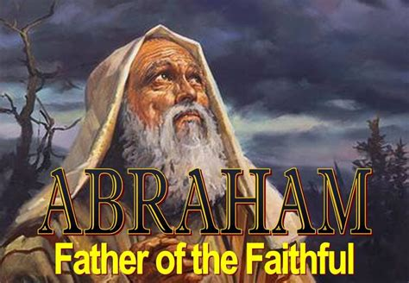
God calls us to walk by faith and gives us examples to help guide and grow us.
Is 51:1-2 “Hearken to me, ye that follow after righteousness, ye that seek the LORD…:
Look unto Abraham your father, and unto Sarah …
for I called him alone, and blessed him,
and increased him.”
1 Cor 10:11

Slide 6
Reflection: Last week we discussed
1. Abram’s Dream!
Abram means “lofty Father” Gen. 11:29
Gen. 11:30 “But Sarai was barren….”
God had a much bigger dream for Abram!
12:2-3 “Thou shalt be a blessing…
in thee shall all families be blessed!”

Slide 7
2. God’s Direction Gen. 12:1,2; Acts 7:2,3
God promised to fulfil that dream,
but gave him a 3-fold command to leave:
Familiar: “Get thee out of thy country.” 12:1
Family/Friends “and from thy kindred”
Father: “and from thy father’s house.”
God knew they’d become “Border Bullies”!

Slide 8
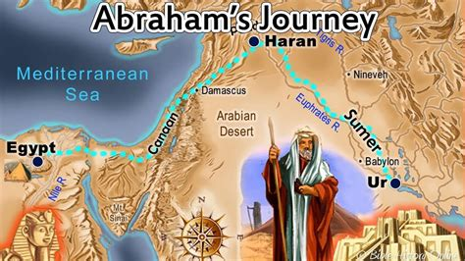
3. Abram’s “Distractions” (Disobedience)
In spite of God’s direction, his family came along with him, sabotaging his obedience,
and delaying him
for 5 more years.
(Acts 7:3,4)
His brother
(Nahor) decided
to stay in Haran.

Slide 9
Haran was “halfway” there!
There’s a lot of halfway obedience.
Rev. 3:16

Slide 10
Abram’s (God’s) Dream➔ God’s Direction
Abram’s Disobedience (Distractions) ➔
4. Abram’s Disappointment (Gen. 12:10)
Even when he finally obeyed,
he was immediately confronted with:
Discouragement Gen. 12:10
“there was famine in the land”
Doubt (about God and himself!)
Can god really take care of me? Ps 78:19

Slide 11
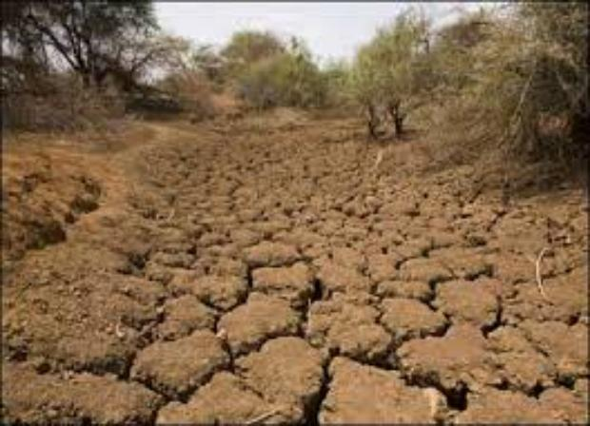
Direction: Disappointment ➔ Decisions.
1. Abram’s decisions were distressed.
A. Distressed decisions are often dangerous
(Painful/Pressured) Gen 12:10
“the famine was grievous”
(kābēd’: heavy, severe,
stupid!)

Slide 12
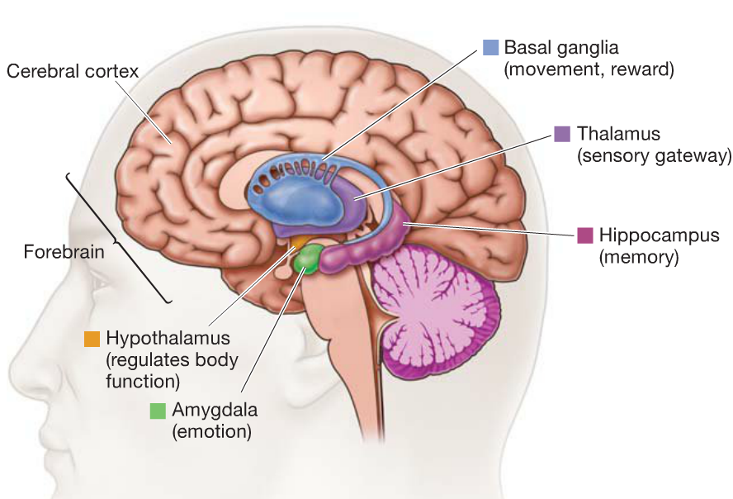
1) Distress/fear dulls our perception.
Frontal Lobe:
Proactive Processing, consequences.
Amygdala:
Reactive Protection, emotion!
Sends signal to Hypothalamus
to release adrenaline.
➔fight/flight.
Adrenaline

Slide 13
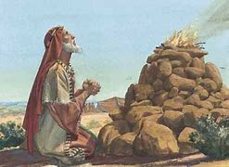
2) Distress/Fear shifts our focus.
a) He was initially focused on Family.
(Leading/leaving him in “halfway” Haran)
b) He rededicated himself and focused on Faith,
Building altars to worship God:
➔ At Sichem (6)
(Where God reconfirmed
His promise! Vs 7 )
➔ At Bethel “The House
of God” (vs 8)
(Phil. 4:6-8)

Slide 14
2) Distress/Fear shifts our focus. (Phil. 4:6-8)
c) As the famine continued, he focus shifted
from Faith to Fear.
(1) Physically: Drifting from Bethel (house of God)
toward Egypt. (House of the pagan gods)
(2) Spiritually: Drifting from trusting God,
Toward trusting his own instincts. (Pr 3:5,6)
(3) Instead of praying (Jms 1:3-5; 3:15-17)
he chose the popular (reasonable) path. 12:10

Slide 15
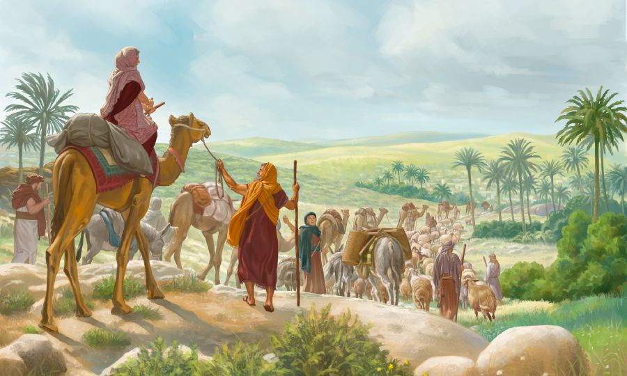
His drifting left him closer to Egypt than to Bethel! “Abram went down into Egypt to Sojourn there”
(gûr: to turn aside,
shrink in fear)
Remember AMYgdala?
2 Tim 1:7 “God hath not given us the spirit of fear,
but of power, and of love
and of a sound mind”

Slide 16
His decisions were “Directional”
(Progressive)
A. Notice the Subtle Inertia! 12:9-10
That which is set in motion tends to stay in motion until acted upon by an equal/opposite force.
9 “Abram journeyed, going on still toward the south.
1) What was he looking for?
10 And there was a famine in the land: and Abram went down into Egypt to sojourn there”.
(another “Haran?”)

Slide 17
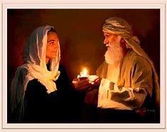
2. His decisions were directional (Progressive)
A. Subtle Inertia. 12:9,10 usually leads to:
B. Selfish Interests. 11-13 “he said unto Sarai Behold, I know that thou art a fair woman to look upon:
Therefore it shall come to pass, when the Egyptians shall see thee, that they shall say,
This is his wife: and they will kill me, …
Say, I pray thee, thou art my sister:
that it may be well with me ..”
Jeremiah 17:9

Slide 18
His Decisions were Distressed. (Pressured)
His Decisions were Directional! (Progressive)
3. His decisions seemed Reasonable (Practical)
at the time, but even reasonable choices
have lasting repercussions.
A. Sarai was taken by Pharaoh. 12:14-15
1) Pharaoh rewarded Abram with cattle and
male/female servants. Vs 16
2) God punished Pharaoh
3) Pharaoh sent them away. 18-20
and protected Sarai. 17

Slide 19
3. “Reasonable” choices have repercussions.
B. Lot became “infected” (taken) by Egypt. Gen 13
1) He got used to the “big life”!
2) Their prosperity produced:
a) Contention. 7 “There was strife between
the herdsmen…”
b) Separation 9 …they separated …
c) Seduction: 12 …Lot pitched his tent
toward Sodom.”
The big (Lie!)

Slide 20
b) Their prosperity produced:
Contention ➔ Separation ➔ Seduction
d) Infection! 13 “But the men of Sodom were
wicked and sinners before the LORD exceedingly.”
e) Deterioration. 2 Pt 2:7-8 “delivered Lot,
vexed (kataponeō: worn down) with the filthy
conversation of the wicked:…vexed his righteous
soul from day to day with their unlawful deeds;”

Slide 21
f) Eventual Destruction! Gen. 19

Slide 22
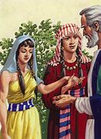
3. “Reasonable” choices have repercussions.14-16
A. Sarai was taken by Pharaoh. 12:14-15
B. Lot became taken by Egypt/Sodom. 13
C. Sarai became “taken” with impatience,
pressuring Abram to take
Hagar! (Gen 16) producing:
Rebellion vs 4
Resentment vs 5
Bitterness vs 6

Slide 23
Dreams ➔ Direction ➔ Distractions ➔ Disappointment ➔ Decisions.
Our decisions will have lasting ramifications.
That’s why God warns us to:
Pr 4:23 “Keep thy heart with all diligence;
for out of it are the issues of life.
26 Ponder the path of thy feet,
and let all thy ways be established.”
(kûn: prepared)

Slide 24
Abram failed to diligently “keep his heart”
Because he failed to honestly
“ponder the path of his feet”.
Rather than allowing God to “Establish his ways” He followed the slow drift toward Egypt,
sliding into self preservation,
deception and compromise;
Endangering his wife, life, family, and ultimately God’s Dream for him (and us!)

Slide 25
But he didn’t stay in Egypt!
Gen. 13:1-3 “And Abram went up out of Egypt, he, and his wife, and all that he had, and Lot with him…
And he went …even to Bethel,
the place where his tent had been at the beginning..
Unto the place of the altar,
which he had made there at the first:
and there Abram called
on the name of the LORD.”

Slide 26
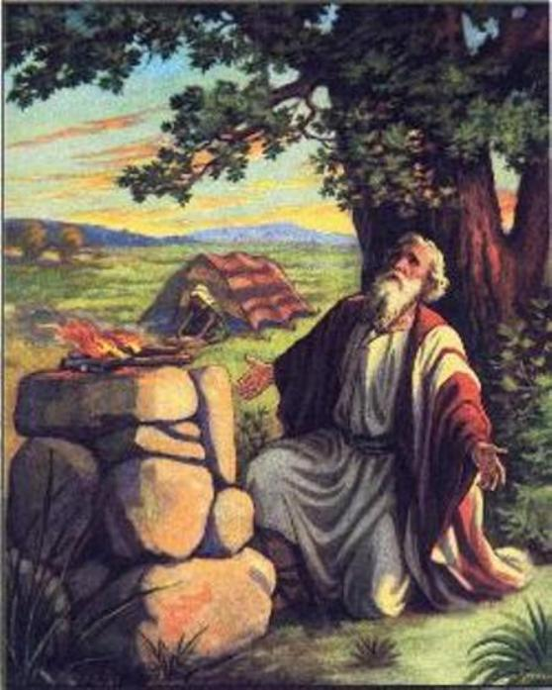
Application: (1 Cor 10:11)
What do we do when we’re faced with life’s distresses, disappointments, or disasters?
Do/will we go back to the altar at “Bethel”
allowing God to
“cleanse/keep our hearts”
and “establish our paths” ?
(Pr 3:5,6)

Slide 27
Application: (1 Cor 10:11)
What do we do when we’re faced with life’s distresses, disappointments, or disasters?
Do/will we drift/lean toward “our own
understanding”, making “reasonable” choices for our own protection and self preservation;
Deceiving ourselves into thinking
all will eventually turn out well?
1 Cor 10:12-14

Slide 28
What’s God Dream for you? Jer 29:11
Are you willing to pursue it (Him)?

