Slide 1
DESTINY

Slide 2
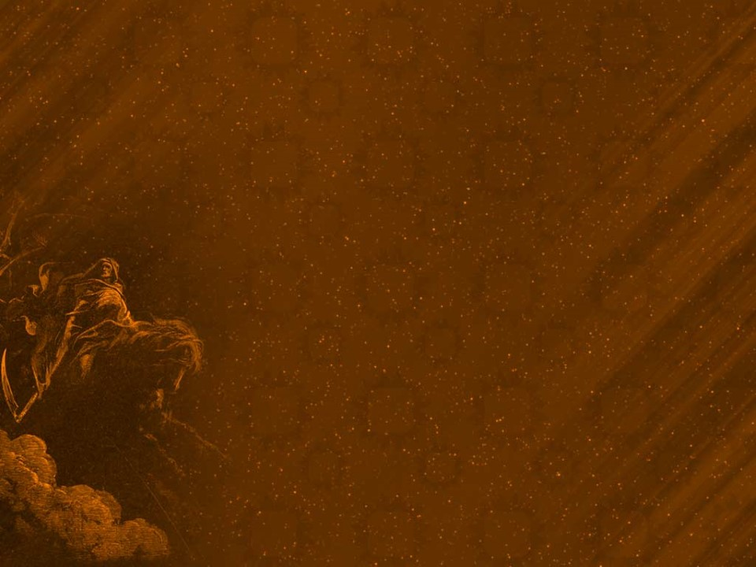
Eternity
Our Mortal lives are represented by the small “dot” on this “eternal” timeline.
Our “afterlife” is represented by the “ray”.
What we do during the small “dot” affects everything that happens on the “Ray.”
James 4:14 “(mortal) life is …a vapor that appeareth
for a little time, then vanisheth away.”
Ps 90:12 “So teach us to number our days,
that we may apply our hearts unto wisdom.”

Slide 3
Most tombstones sum up our mortal lives with a small dash.
What you do with Jesus during your “dash”;
determines your Destination after the dash.
”It is appointed unto men once to die,
but after this the judgment:” Hebrews 9:27
Κρίσις (Kri’sis) Decision (for or against);
justice (especially divine law)

Slide 4
What you do For Jesus during your “dash”;
determines your Destiny after your dash.
2 Cor 5:9-10 “Wherefore we labor, that, whether present or absent, we may be accepted of him…
we must all appear before the judgment seat of Christ;
(βῆμα {bēma} Platform, throne, tribunal
that every one may receive the things done in his body, according to that he hath done,
whether it be good (agathos: beneficial)
or bad.” (kakos: worthless)

Slide 5
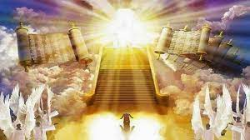
2 Cor 5:11 “Knowing therefore the terror of the Lord we persuade men…
20 “we are ambassadors for Christ, …
we pray you in Christ's stead,
be reconciled
to God”

Slide 6
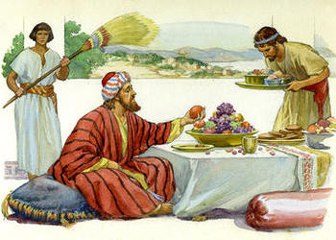
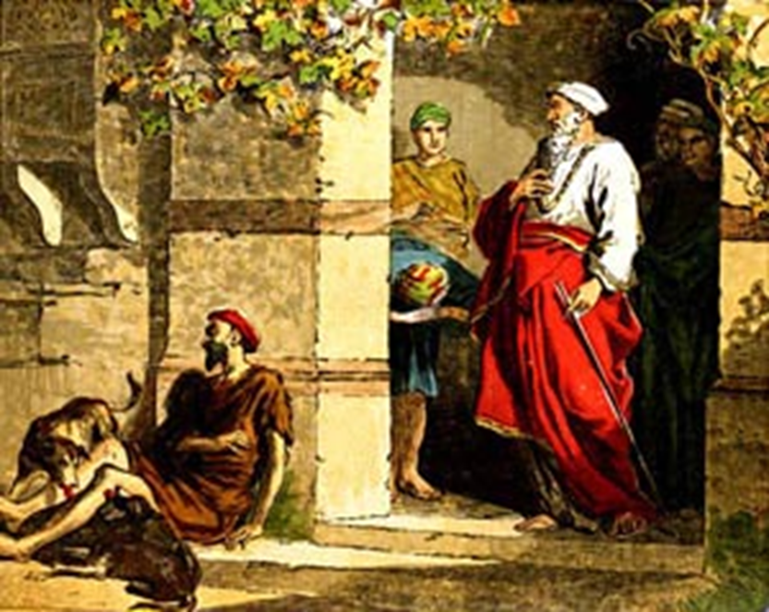
Jesus closes Luke 16 by using two very different men to reveal what happens immediately after death.
Vs 19-31
Vs 19: “There was a certain rich man…
20-21 “And there was a certain beggar named Lazarus, which was laid at his gate, full of sores”

Slide 7
In Luke 16 Jesus revealed death is:
Inevitable! Vs 22 “the beggar died, …
the rich man also died”
Transitional! Not a “conclusion”,
but the Introduction into Eternity! Vs. 22,23
Eccl 12:7 “Then shall the dust return to the earth as it was: and the spirit shall return unto God who gave it.”
Destinational. 22,23

Slide 8
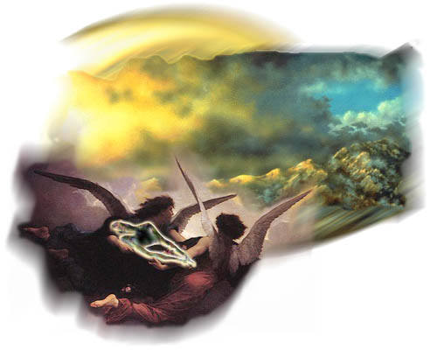
Death is “Destinational” 22,23
There’s only two destinations after death.
1. Paradise vs 22 “Lazarus died and was
carried to Abraham’s bosom.” (Paradise)
Lk 23:43 “Today shalt thou be with me in paradise.” {para’deisos}
An Eden, a park)

Slide 9
1. Paradise (and Heaven) is a place of:
A. Comfort. Vs 25 “now he is comforted”
B. Clarity. 1Cor. 13:12 “Now we see through a glass,
darkly, but then face to face.”
C. Companionship. “Abraham’s bosom” Heb. 12:22-23
“ye are come unto …the city of the living God…
and to an innumerable company of angels,
To the …church of the firstborn, …, and to God the Judge of all, and to Jesus the mediator…”

Slide 10
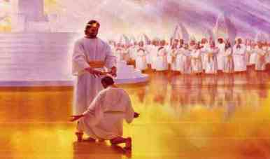
1. Paradise (and Heaven) is a place of:
A. Comfort. B. Clarity. C. Companionship.
D. Compensation. 1 Cor. 3:10-15
“If any man’s work abide,
He shall receive a reward…”
Mt. 6:20; 2 Cor. 5:10-21; 2 Tim. 4:7,8; 2 Pt 1:5-11

Slide 11
Mt 25:21 “Well done, thou good and faithful servant:
thou hast been faithful over a few things,
I will make thee ruler over many things:
enter thou into the joy of thy lord.”

Slide 12
Rev 2:7 “To him that overcometh (nikao
will I give to eat of the tree of life,
which is in the midst of the paradise of God.”
Described in detail in Rev. 21,22
Ro. 8:37-39
“we are more than conquerors (hupernikao)
through him
that loved us!”

Slide 13
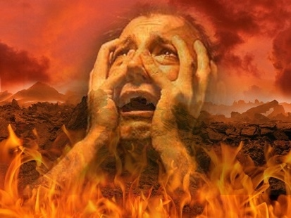
There’s only two destinations after death.
Heaven (paradise)
Hell (54 x in the Bible)
Lk 16:23-24 “The rich man died also,
and in hell
(ᾅδης {hades})
he lifted up his eyes
being in torments.”

Slide 14
2. Hell Lk 16:23-24 “rich man died…and in hell..”
A. Hades is a type of “jail” to hold unrepentant
humanity until the final judgment.
Ezek. 18:20 “The soul that sinneth, it shall die.”
Ro. 6:23 “The wages of sin is death.”
Jn 8:24 “if ye believe not that I am he,
ye shall die in your sins.”
Jn 3:18, 36

Slide 15
2. Hell Lk 16:23-24 “rich man died…and in hell..”
B. Hell is a place of:
1) Clarity. Vs 25 “Son, Remember…”
Hades comes from οἶδα (Eidō):
to know, be aware!
a) He recognized Abraham, Lazarus!
b) He remembered his life & family!

Slide 16
2. Hell Lk 16:23-24 “rich man died…and in hell..”
B. Hell is a place of
2) Corruption. Jesus described Hell (Mark 9:44)
“Where their worm dieth not,
and the fire is not quenched.”
Mt 10:28 “fear him which is able to
destroy both soul and body in hell. “

Slide 17
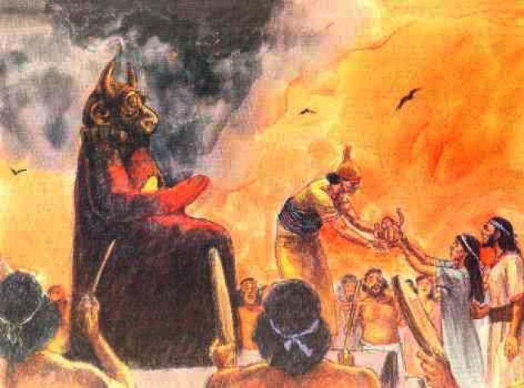
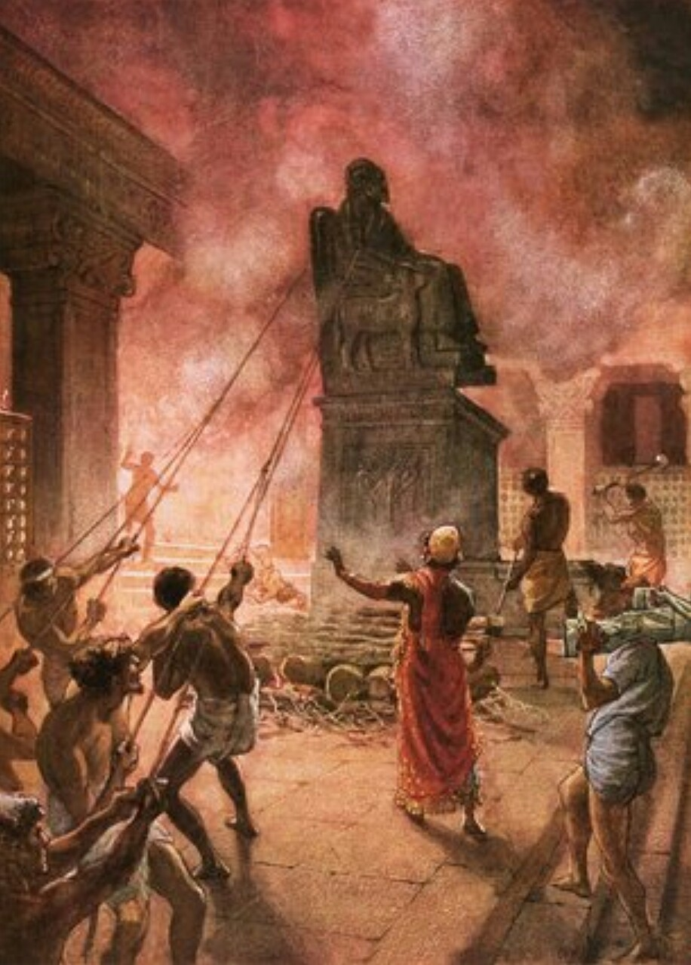
2) It’s a place of Corruption. Mt 10:28 “fear him
which is able to destroy both soul and body in hell. “
a) Hell here is Ge’enna (hell fire) Valley of Hinnom
This is where they sacrificed their babies to Molech.
King Josiah “defiled Tophet” by turning it into the city
dump where garbage was constantly burned.
2 Kings 23:10

Slide 18
2. Hell Lk 16:23-24 “rich man died…and in hell..”
3) A place of Covetousness. (unsatisfied desires)
vs 24 “Send Lazarus that he may dip his finger
in a glass of water and cool my tongue”
a) He Felt, saw, experienced.
Desired (what was forever
out of his reach!)
Rev. 22:11 “let him be filthy still…”

Slide 19
2. Hell Lk 16:23-24 “rich man died…and in hell..”
B. It’s a place of
4) Cruciation (excruciating torment)
vs 24 “I am tormented in this flame
(odyna’ō: grieved, anguished)
28 …this place of torment”
(basinos: grief, torture)

Slide 20
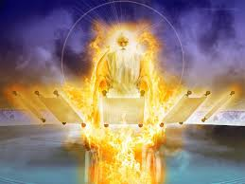
If Hades is the temporary Jail,
What, Where, & When is the Prison?
At the final (White Throne) judgment,
the souls in hades will reunite with their (immortal) bodies for final (and eternal) sentencing.

Slide 21
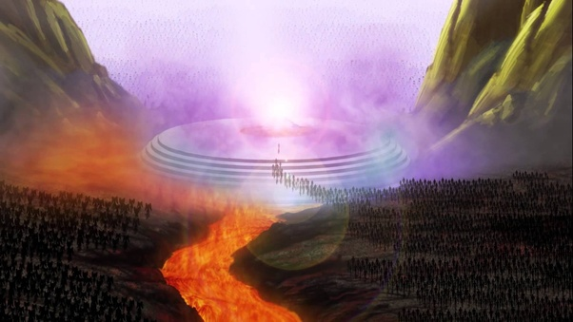
Rev 20:11 “I saw a great white throne, and him that sat on it, from whose face the earth and the heaven fled away; and there was found no place for them.
I saw the dead, small and great, stand before God;
and the books were opened:
and another book was opened,
which is the book of life:

Slide 22
“and the dead were judged out of those things which were written in the books,
according to their works.”

Slide 23
the sea gave up the dead which were in it;
and death (the grave {vs 5}) and hell (Hades)
delivered up the dead which were in them:
and they were judged (krino: distinguished, condemned)
according to their works.”

Slide 24
14 “death and hell were cast into the lake of fire.
This is the second death.
15 And whosoever was not found written in the book of life
was cast into the lake of fire.”

Slide 25
Matthew 7:22-23
“Many will say to me in that day, Lord, Lord, have we not prophesied in thy name?
and in thy name have cast out devils?
and in thy name done many wonderful works?
Then will I profess unto them, I never knew you:
depart from me, ye that work iniquity.
Then closed with the parable of the Wise and Foolish man. 24-27

Slide 26
Right after the Parable of the Faithful servants Jesus told the parable of the Sheep and Goats. Matthew 25:41
“Then shall he say also unto them on his left…,
Depart from me, ye cursed, into everlasting fire, prepared for the devil and his angels:…
46 And these shall go away into everlasting punishment:
but the righteous into life eternal.”

Slide 27
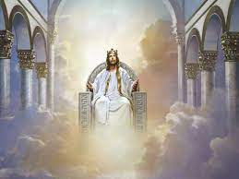
Revelation 21:5-6 “And he that sat upon the throne said, Behold, I make all things new.
And he said unto me, Write:
for these words are true and faithful.
6 I am Alpha and Omega,
the beginning and the end.
I will give unto him that is athirst of the fountain of the water of life freely.

Slide 28
7 He that overcometh (Ro. 8:37-39; 1 Jn 5:4)
shall inherit all things; and I will be his God,
and he shall be my son.
8 But the fearful, and unbelieving, and the abominable, and murderers, and whoremongers, and sorcerers, and idolaters, and all liars,
shall have their part in the lake which burneth with fire and brimstone:
which is the second death.”

Slide 29
Romans 6:23 “The wages of sin is death,
but the gift of God is eternal life,
through Jesus Christ our Lord”
2 Cor 5:19 “God was in Christ,
reconciling the world unto himself,
not imputing their trespasses unto them;
and hath committed unto us
the word of reconciliation.”
katallagē’: exchange through atonement

Slide 30
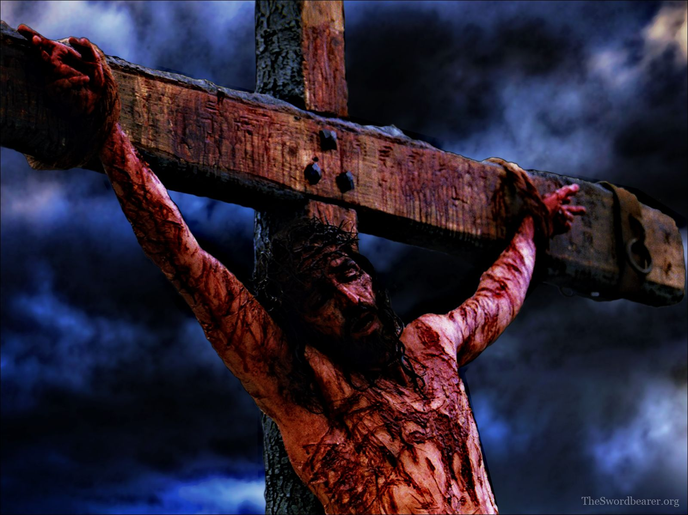
2 Cor 5:21 “for God made him to be sin for us,
Who knew no sin,
That we might be made the righteousness Of God,
In Him!”
Have you been Reconciled to God?

Slide 31
Are you a faithful ambassador seeking to “reconcile” others to God? Pr. 24:11-12
“If thou forbear to deliver them that are drawn unto death, and those that are ready to be slain;
If thou sayest, Behold, we knew it not;
doth not he that pondereth the heart consider it? and he that keepeth thy soul, doth not he know it?
and shall not he render to every man
according to his works? “

Slide 32
Hebrews 9: 27
“it is appointed…once to die,
But after this, the Judgment”
(Kri’sis: Decision)

Slide 33
God’s Judgment (decision) then
will depend on your decision now!
Which Destiny will be yours?
The Great White Throne
Rev. 20:11-15
2 Cor 5:10

