Slide 1
Communion (Fellowship) with God
(or anyone else)
Requires clear communication!

Slide 2
Satan seeks to Confuse/Contaminate this.
“The thief cometh not, but for to steal, and to kill, and to destroy:
I am come that they might have life, and that they might have it more abundantly.
I am the good shepherd:
the good shepherd giveth his
life for the sheep.”
John 10:10,11

Slide 3
Some still doubted this truth (Jn 10)
And were deceived by and actually following this “thief” and therefore rejecting the “Good Shepherd”.
26 But ye believe not, because ye are not of my sheep, as I said unto you.
27 My sheep hear my voice,
and I know them,
and they follow me:“

Slide 4
Have you ever been Deceived?
Have you ever been misunderstood?
Have your words, actions, or intentions ever been misjudged, misrepresented or misinterpreted
In such a way as to misrepresent you?
Do you think God ever feels that way?

Slide 5
One of the greatest needs of the human heart is to need to be “understood”!
Where do you think this need comes from?
There have never been more ways to share information and so little “Communication”!
Whether we use text, snap chat, twitter, tweet, email, voice mail, snail mail, phone calls, or “Face to Face”,
the goal is to share enough information
so that we can be understood!

Slide 6
In much the same way, God “in sundry times and divers manners” (Heb. 1:3) speaks to us, seeking to be “understood’”.
Since we’re “Laborers together with God” (1 Cor. 3:9)
God has the responsibility to communicate
what He expects from us.
We have the responsibility to:
Recognize and Respond to Him.
It’s in these 2 areas that Satan works hardest.

Slide 7
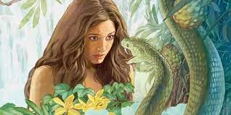
How Does He keep us from Recognizing & Responding to God?
Satan manipulates/distorts truth.
1. He’s the “Father of lies” (Jn 8:44)
A. He’s a master of manipulation & misinformation.
Gen. 3:1 “The serpent was more subtle than any…
Ārûm: cunning, crafty, prudent!
And he said to the woman
Yea, Hath God said…?”

Slide 8
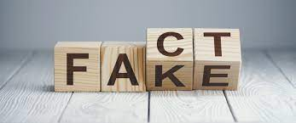
2. Since He’s “subtle” he knows that
Lies must be disguised to be believed.
Oxford Dictionary defines Disinformation as:
“false information which is intended to mislead,
especially propaganda issued by a government organization to a rival power or the media.”

Slide 9
2. Lies must be disguised to be believed!
A. How do you “disguise” lies?
1) Mingle (dress them up) with some truth!
2 Cor 11:13-15 “such are false apostles, deceitful workers, transforming themselves into the apostles of Christ.
14 And no marvel; for Satan himself is transformed into an angel of light.
15 Therefore it is no great thing if his ministers also be transformed as the ministers of righteousness…”

Slide 10
Satan manipulates/distorts truth.
1. The Devil is the “Father of lies” (Jn 8:44)
2. Lies must be disguised to be believed.
B. This means we must learn to Discern.
1 Jn 4:1 “Beloved, believe not every spirit,
but try the spirits whether they are of God:
Dokimazo: Prove 10x; try 4x; discern 2x
because many false prophets are gone out into the world.”

Slide 11
B. This means we need to become discerning.
1 John 4:4-6 “Ye are of God… and have overcome them:
because greater is he that is in you,
than he that is in the world.
They are of the world: therefore speak they of the world…
We are of God: he that knoweth God heareth us;
he that is not of God heareth not us.
Hereby know we the spirit of truth,
and the spirit of error.”
(plan’e: to deceive, delude, and drift) James 1:16

Slide 12
“Hereby know we the spirit of truth, & the spirit of error.”
Recognizing “Mis-(Dis) Information.
False Connection: Headlines, pictures, captions don’t support the actual content.
Acts 21:28-29 “Men of Israel, help: This is the man, that teacheth all men every where against the people, and the law, and this place:
and further brought Greeks also into the temple,
and hath polluted this holy place.
(For they had seen before with him in the city Trophimus an Ephesian,
whom they supposed Paul brought into the temple.)

Slide 13
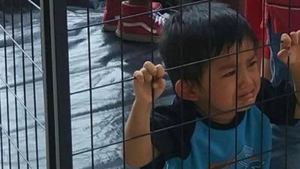
Recognizing “Mis-(Dis) Information.
False Connection Headlines, pictures, captions don’t support the actual content.
Journalist and filmmaker Jose Antonio Vargas posted the photo on Twitter,
"This is what happens when a government believes people are 'illegal'. Kids in cages.“
Actually taken at a Dallas rally where this child was temporarily isolated from his mom (For 30 seconds)

Slide 14
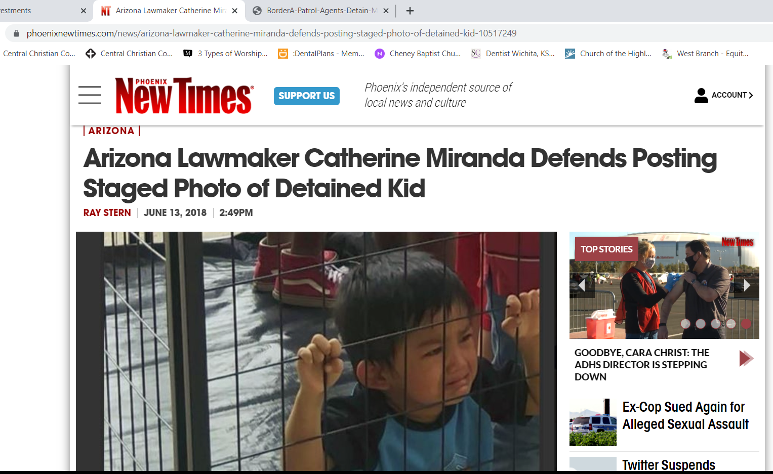

Slide 15
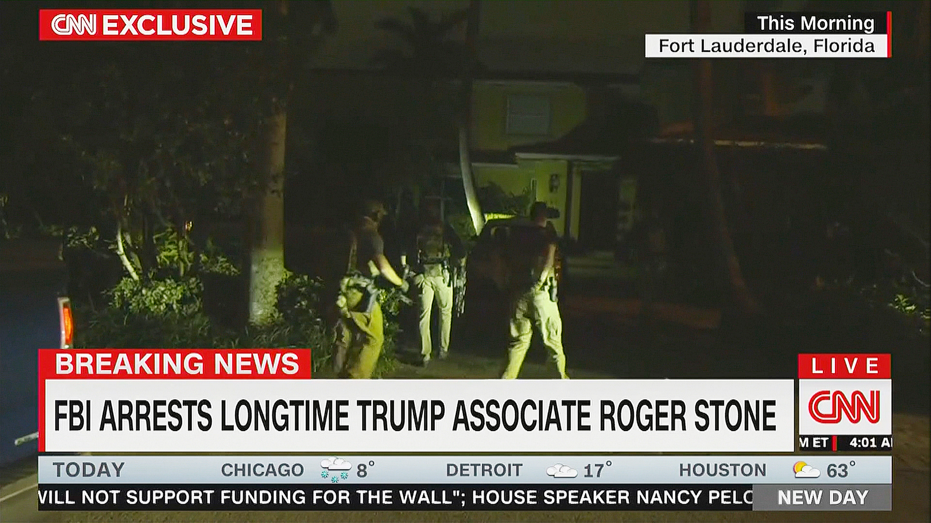
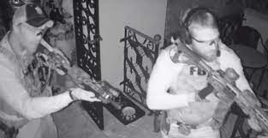
6:00 AM 29 armed agents raid on Roger Stone’s home

Slide 16
“Hereby know we the spirit of truth, & the spirit of error.”
2) False Content When genuine content (Truth) is
shared with “False contextual information” (Lies)
Cherry picking (taking statements out of context)
and turning them into talking points.
Mt 26:59-61 “the chief priests, …, sought false witness against Jesus, to put him to death; … At the last came two false witnesses, And said, This fellow said, I am able to destroy the temple of God, and to build it in three days.”
Jn 2:21 “But he spake of the temple of his body.”

Slide 17
Recognizing “Mis-(Dis) Information.”
3) Manipulated Content. When genuine imagery is
used to manipulate or deceive.
Viral pictures blaming President Trump’s border control policies.
Many of the Pictures were actually taken in 2014
when Obama enforced the same immigration laws.

Slide 18
3) Manipulated Content.
Where’s the current outcry today?
Where’s the Covid Concerns?
March 30, 2021
(In a facility built for 250!)
https://www.nytimes.com/2021/03/30/us/texas-border-facility-migrants.html

Slide 19
Recognizing “Mis-(Dis) Information.”
4) Satire or Parody. “Fooling” in fun.
NBC: “The Late Show with Stephen Colbert”
CBC: “The Tonight Show with Jimmy Fallon” on CBS.
During Joe Biden’s first 100 days in office,
Mr. Colbert and Mr. Fallon together featured
more than twice as many jokes about Trump (349)
than they did about Biden (158)
Mr. Colbert’s monologues, zinged the ex-president nearly four times as often as the incumbent (228 to 60).
https://www.baltimoresun.com/opinion/op-ed/bs-ed-op-0704-late-night-trump-20210702-bygx3t6wynftdipwdcdg35fzte-story.html

Slide 20
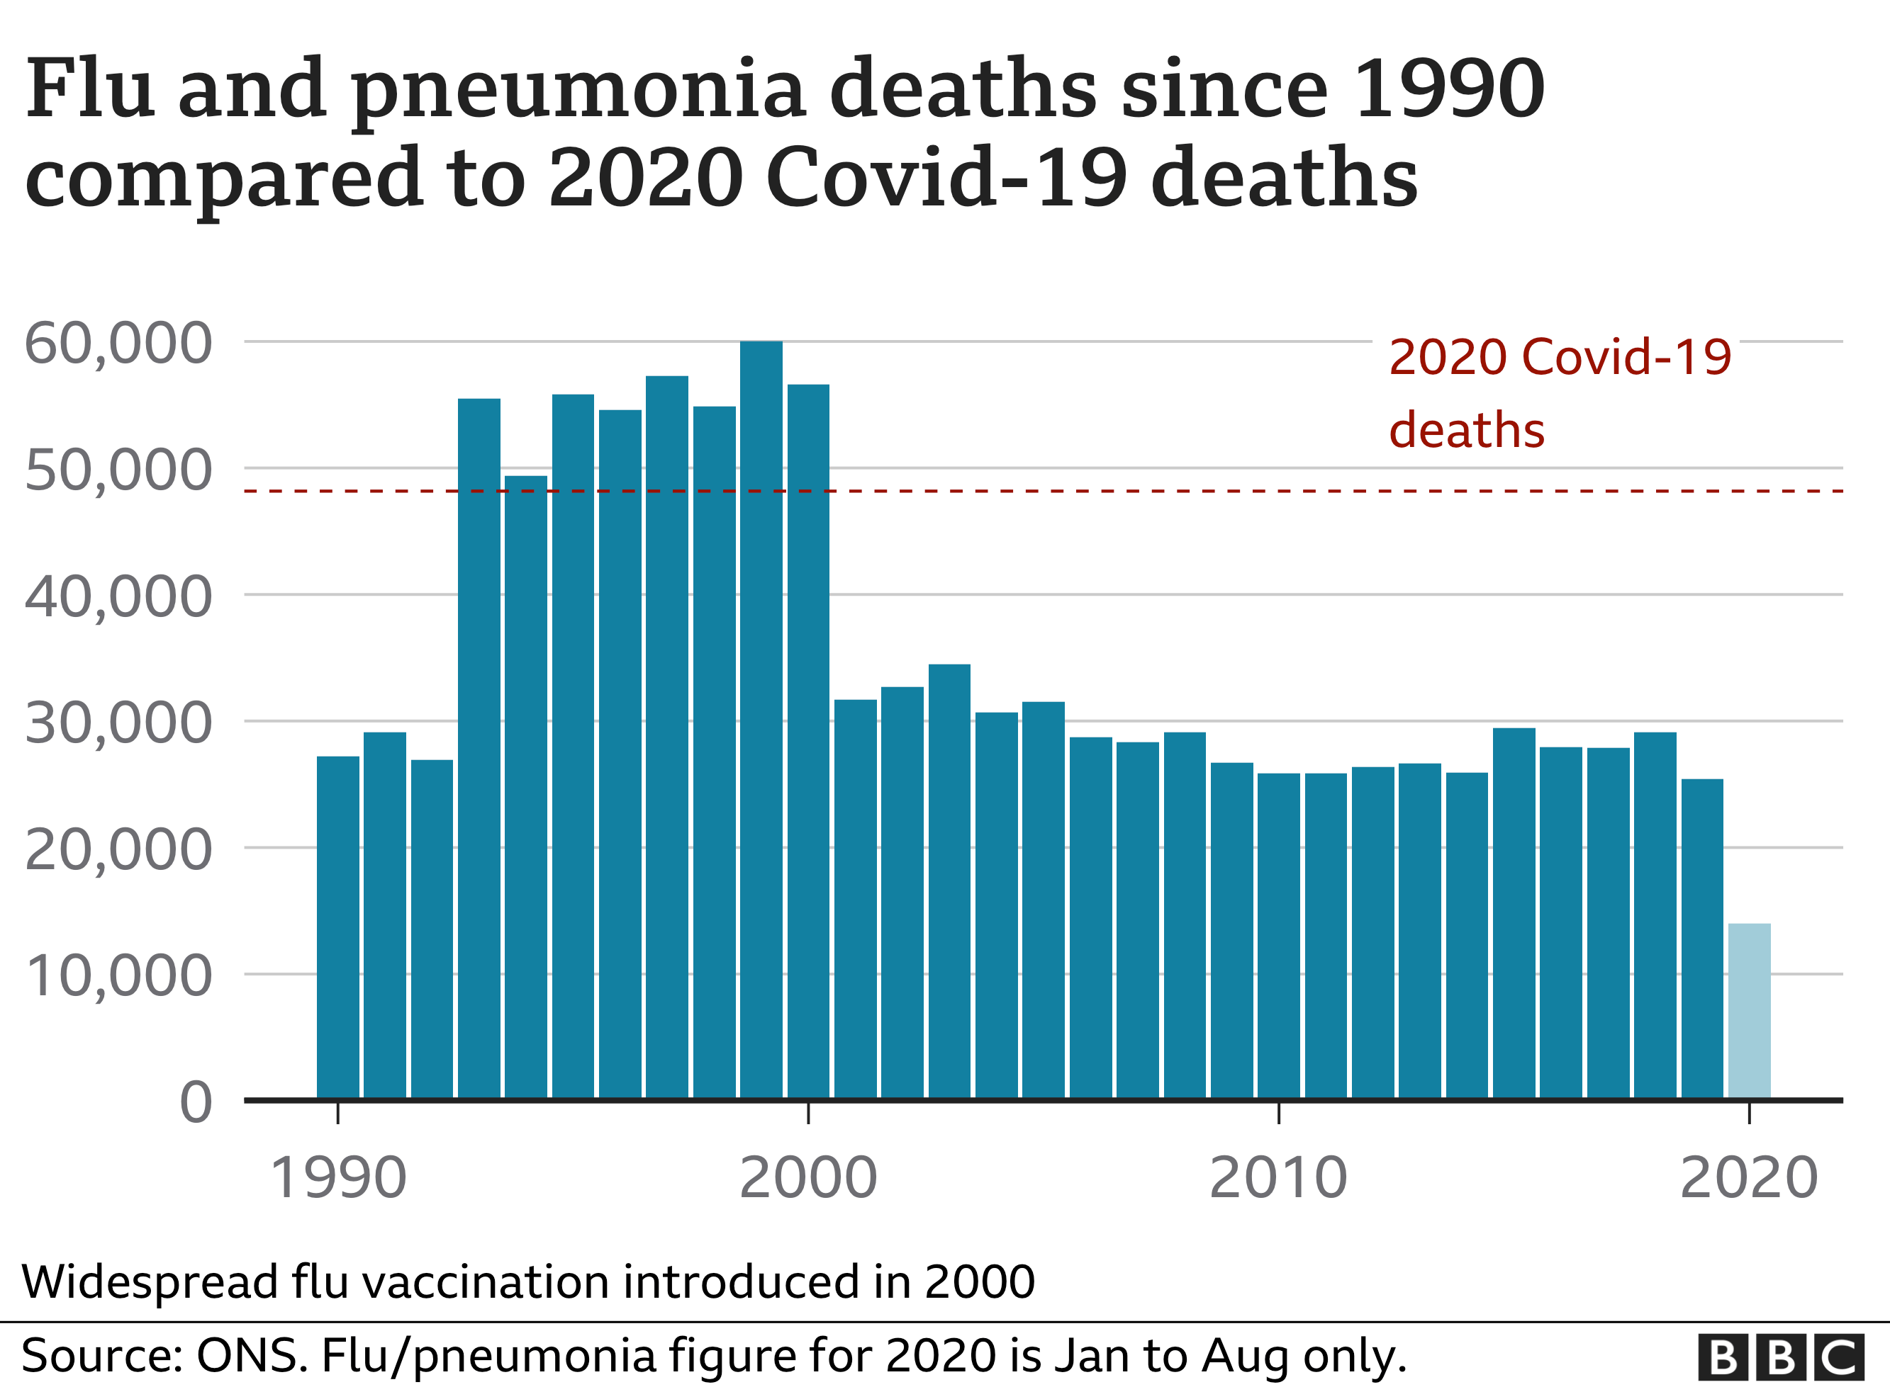
Recognizing “Mis-(Dis) Information.”
5) Misleading Content. Twisting information to frame an issue or individual in a certain light.
Covid Statistics!
Covid
Reported
Deaths!

Slide 21
Recognizing “Mis-(Dis) Information.”
6) Imposter Content.
When the author of the content portends to be someone else or impartial!
Who funds the “fact checkers?”
Who “fact Checks” them?

Slide 22
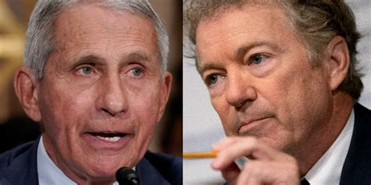
6) Imposter Content. When the author of the content portends to be someone else or impartial!
Fauci as the National Covid spokesman
when his organization (NHI) funded the research ($600,000) at the Wuhan lab!?!?
https://www.dailymail.co.uk/news/article-9823791/Fauci-defends-U-S-funding-research-Wuhan-lab-says-negligent-not-so.html

Slide 23
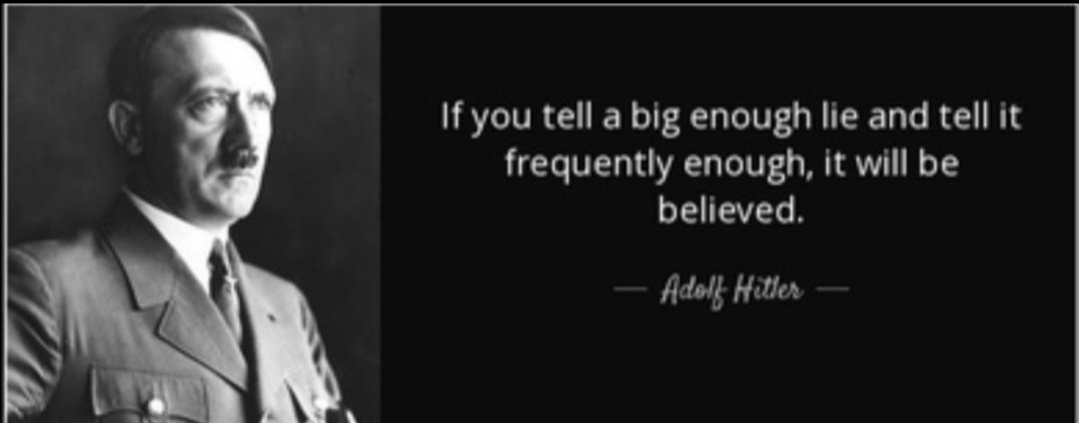
7) Fabricated Content.
Completely false and designed to deceive.
Gen. 3:4,5 “Ye shall not die… ye shall be as gods”

Slide 24
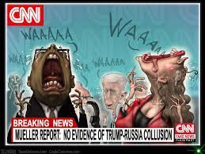
7) Fabricated Content.
Completely false and designed to deceive.
“Russian Collusion” was the national narrative for 4 years!

Slide 25
8) Propaganda. Content is used to create or
manage values, attitudes, or ideas.
“If you tell a lie big enough and keep repeating it, people will eventually come to believe it.
The lie can be maintained only for such time as the State can shield the people from the political, economic and/or military consequences of the lie.
It thus becomes vitally important for the State to use all of its powers to repress dissent, for the truth is the mortal enemy of the lie, and thus by extension,
the truth is the greatest enemy of the State.”
Joseph Goebbels

Slide 26
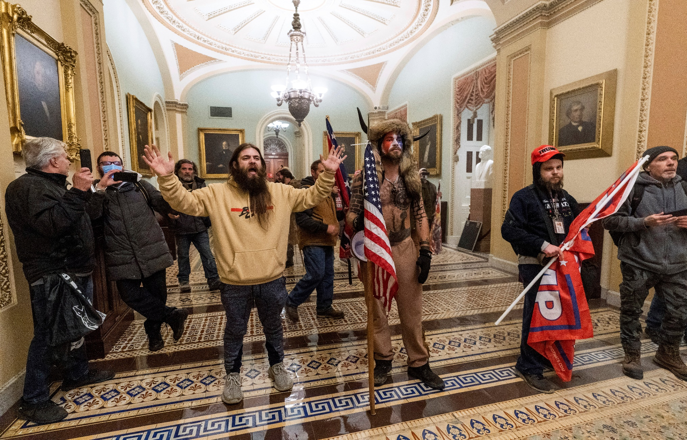
8) Propaganda. Content used to create or
manage values and/or ideas & information.
These are Armed Insurrectionists

Slide 27
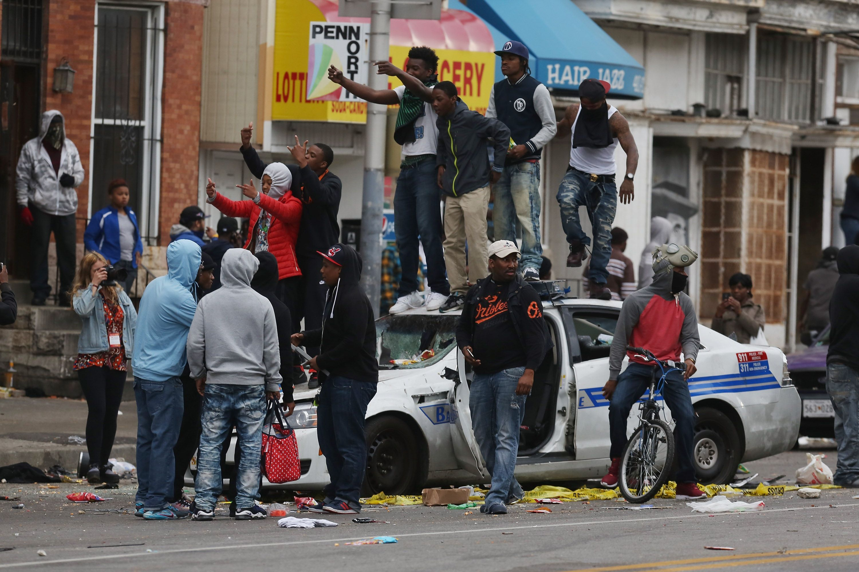
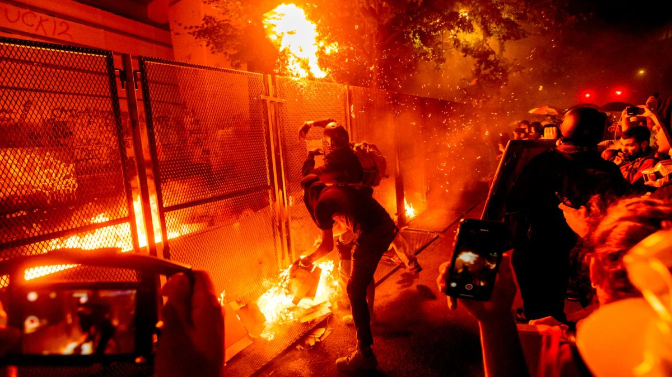
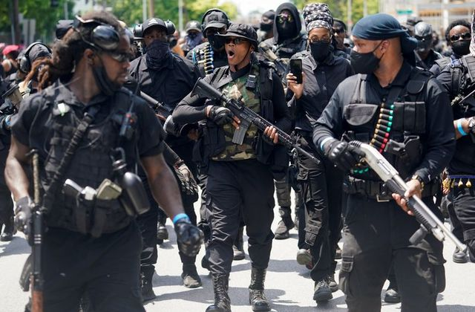
8) Propaganda. Content used to create, manage values
These are Peaceful Protestors

Slide 28
8) Propaganda.

Slide 29
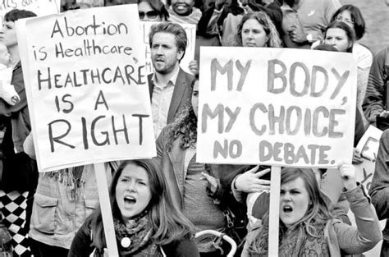
Why doesn’t this apply to experimental “gene therapy” vaccines?

Slide 30
9) Sponsored Content. Advertising or PR. Disguised as editorial Content.
“The WHO Director-General (DG) has been an outspoken advocate for the Chinese government’s COVID-19 response….
Tedros commended China …and praised the country’s top leadership for its
“openness to sharing information”.
Yet in Wuhan, the epicenter of the Covid outbreak, Chinese officials were busy arresting and punishing citizens for “spreading rumors”
https://www.cfr.org/blog/who-and-china-dereliction-duty

Slide 31
10) Error: When Established news
organizations make mistakes.
“But the rest of the video—nearly two hours of additional footage showing what happened before and after the encounter—adds important context that strongly contradicts the media's narrative.”

Slide 32
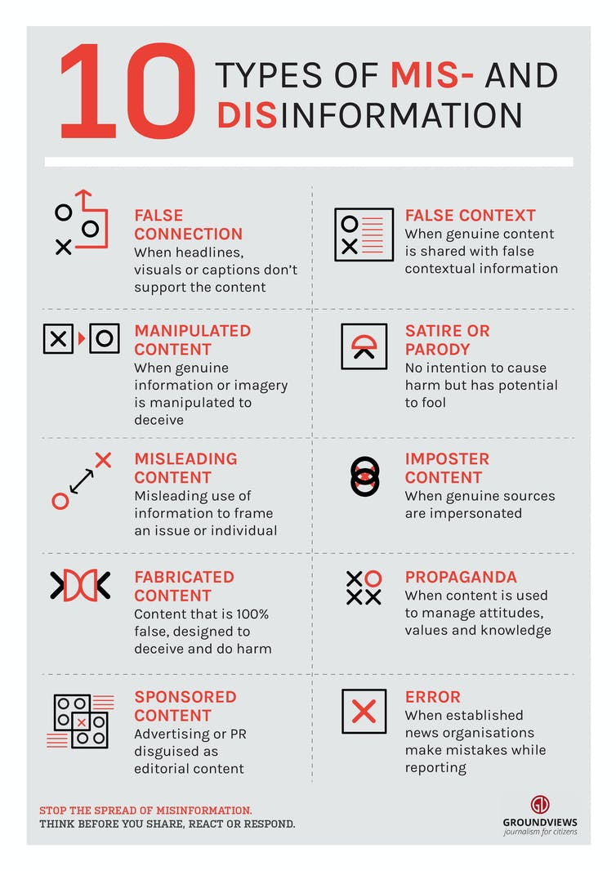
This list comes from Groundviews
A citizens journalism website based in Sri Lanka.
“Stop the Spread of Misinformation.
Think before you share, react or respond.

Slide 33
Disinformation leads us to distrust
And therefore, reject truth.
John 8:44-45 “Ye are of your father the devil,
and the lusts of your father ye will do.
He was a murderer from the beginning, and abode not in the truth, because there is no truth in him.
When he speaketh a lie, he speaketh of his own:
for he is a liar, and the father of it.
45 And because I tell you the truth,
ye believe me not.”

Slide 34
Since Satan as “The god of this world”
(2 Cor. 4:4; 1 Jn. 2:16-18)
has contaminated our society with deception.
1 Jn 5:19 “the whole world lieth in wickedness”
Ponēros’: evil, diseased, hurtful
(in effect and influence)
Since our world is so diseased with deceit;
What can we “Know” for sure?

Slide 35
So what can we “Know” for sure?
1 Jn 5:19 “And we know that we are of God,
and the whole world lieth in wickedness.
20 And we know that the Son of God is come,
and hath given us an understanding,
that we may know him that is true,
and we are in him that is true”

Slide 36
1 Jn 5:4 “whatsoever is born of
God overcometh the world:
Have you been born again?
and this is the victory that overcometh the world,
even our faith.”
(pistis: conviction, confidence)

Slide 37
Where will you place your faith (confidence)?
“The thief cometh not, but for to steal, and to kill, and to destroy:
I am come that they might have life, and that they might have it more abundantly.
I am the good shepherd:
the good shepherd giveth his
life for the sheep.”
John 10:10,11

