Slide 2
Ekklesia: a called out assembly
belonging to the Lord. Mt 16:18

Slide 3
Pictures of God’s People
“I will build my church;
and the gates of hell shall not prevail against it.”
Mt 16:7

Slide 4
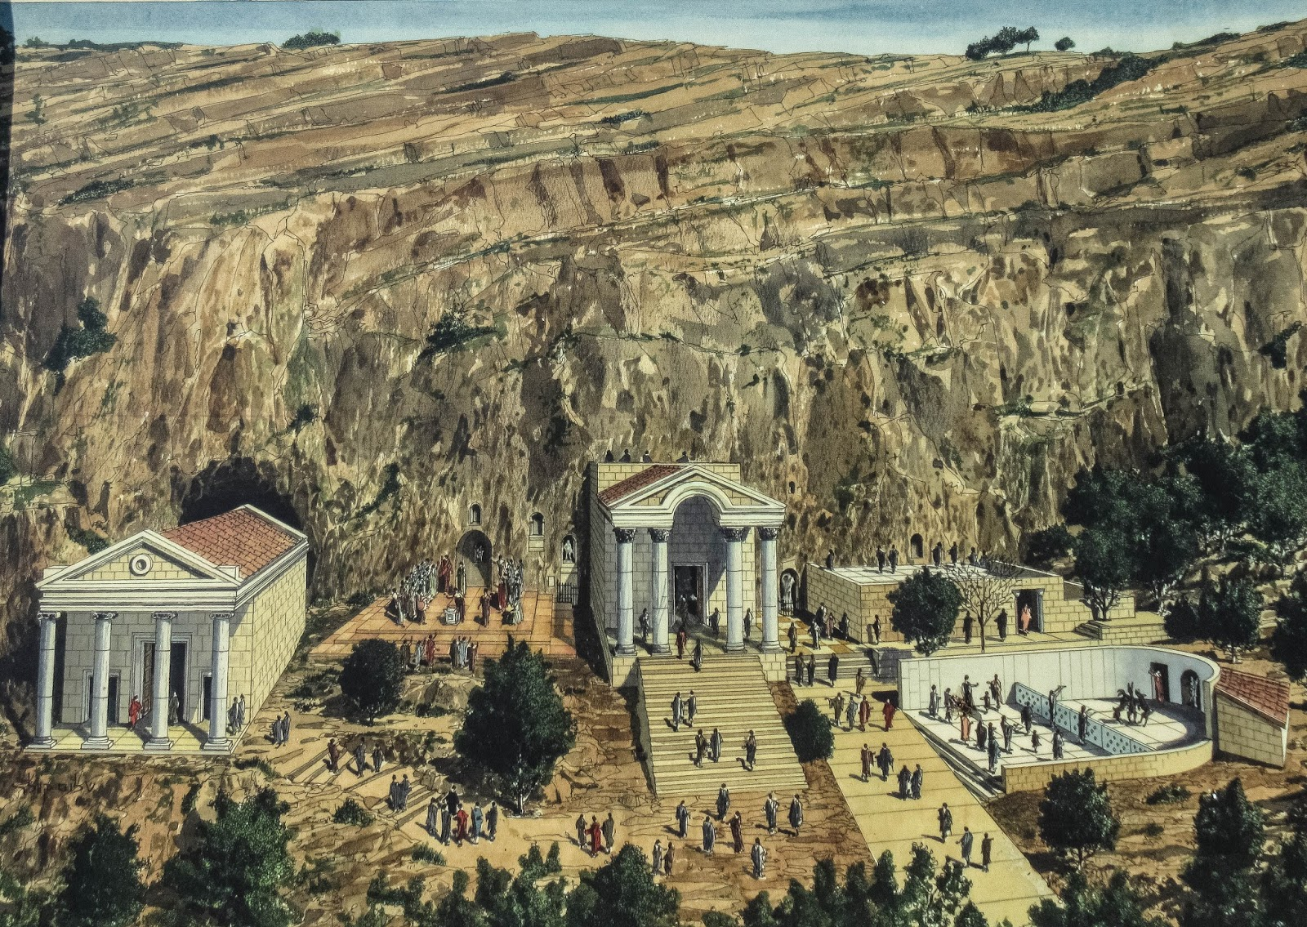
The “Gates of Hell” at Caesarea Philippi
Mt 16:7

Slide 5
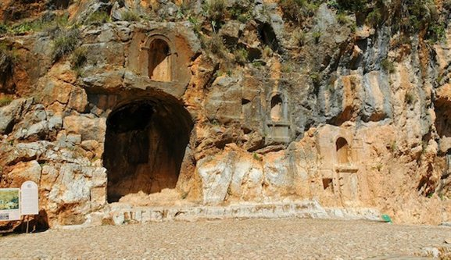
“the gates of hell shall not prevail against it.”
Mt 16:7

Slide 6
Pictures of the People of God
Seeing ourselves through God’s Eyes.

Slide 7
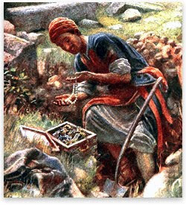
God describes us as: A Hidden Treasure! Mt 13:44
“The kingdom of heaven is like unto treasure hid in a field;
the which when a man hath found, he hideth,
and for joy thereof goeth
and selleth all that he hath,
and buyeth that field.”

Slide 8
God describes us as Pearls of Great Price!
Mt 13:45,46
Mt 13:45,46 “The kingdom of heaven is like unto a merchant man, seeking goodly pearls:
Who, when he had found one pearl of great price,
(Poly’timos: extraordinary value)
went and sold all that he had, and bought it.”

Slide 9
God describes us as clay in the hands of a Master Potter. Isaiah 64:8
“Lord, thou art our father; we are the clay,
and thou our potter;
We are the work of thy hand.”
Eph. 2:10 “We are his
workmanship…”

Slide 10
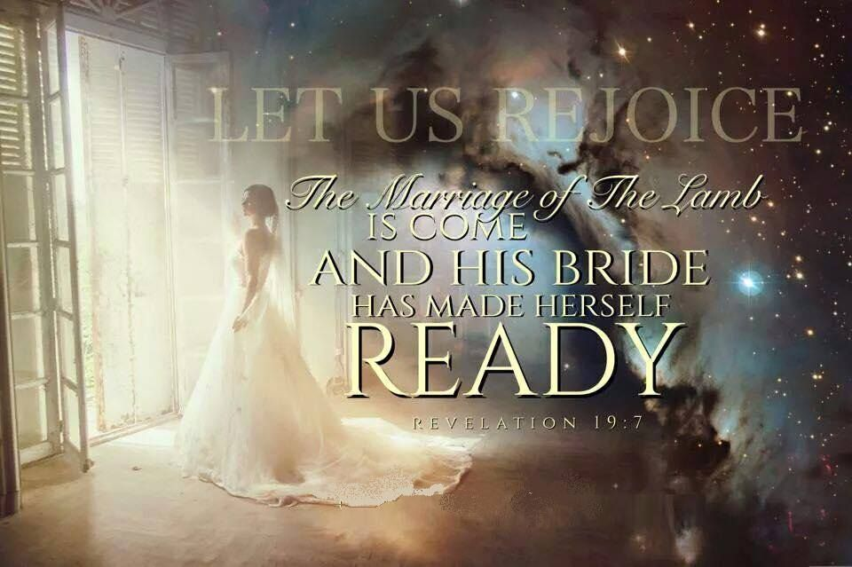
God describes us as the Bride of Christ!
(Eph 5:22-33; 2 Cor 11:2; Rev 19, 21)

Slide 11
We’re the “Sheep of His Pasture”
Ps. 100:3; John 10

Slide 12
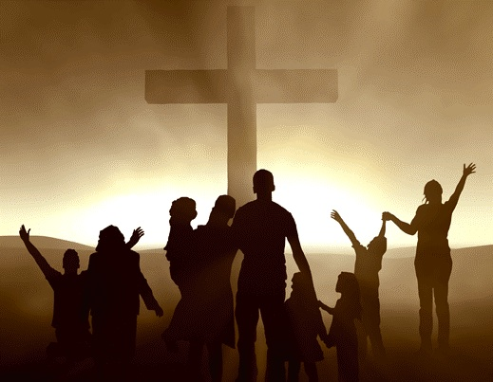
We’re part of God’s Family!
2 Cor 6:18 “I will be a Father unto you,
ye shall be my sons and daughters,
saith the Lord Almighty.”
(2 Cor. 6:18; Ro. 8:14-16; Eph. 2:19; Gal 4:4-6)

Slide 13
These pictures reveal the Precious and Personal ways in which God sees us.
The next one focuses on the Practical!

Slide 14
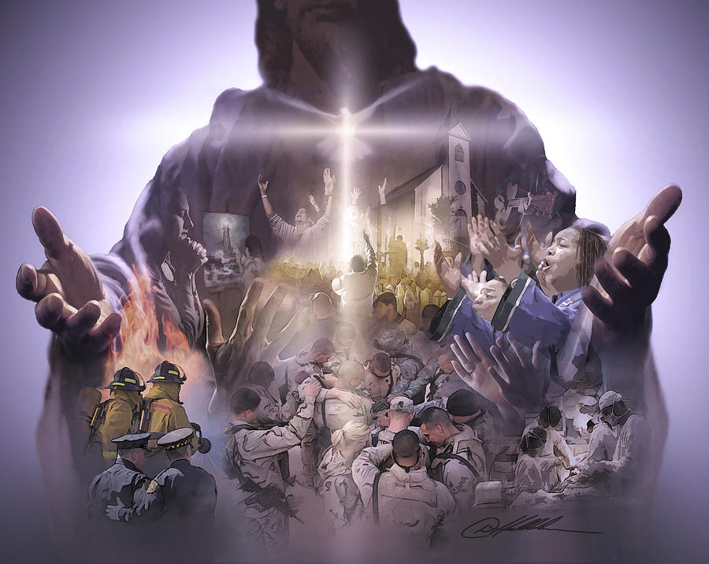
“Ye are the body of Christ,
and members in particular”
1 Cor 12:27

Slide 15
The Distinction of the body.
1. Churches, like Bodies, are different!
(Jerusalem vs. Antioch)
A. Cultural Differences.
(Who are we trying to minister to?)
1) Urban vs. Rural.
2) Ethnic Diversity.
(Church in Belgium
; Manila)

Slide 16
The Distinction of the body.
1. Churches, like Bodies, are different!
B. Traditional Differences.
How do we “do” church?
(What is the church background/ History?)
1) Music
2) Small groups
3) Preaching style, etc.

Slide 17
C. Organizational Differences.
(How are they governed / guided?)
1) Episcopalian (Catholic, Methodist, Lutheran)
Outside the church by Bishops, etc.
2) Presbyterian/Reformed
Inside church by Elders
3) Congregational (Baptist, Some Bible, AG)
Inside by church members

Slide 18
D. Philosophical Differences.
(What’s our Primary mission/goal?)
1) Relational (Feel good, me focused)
2 Tim. 4:1-4
“heap to themselves teachers,
having itching ears”

Slide 19
D. Philosophical Differences.
(What’s our Primary mission/goal?)
2) Traditional (Rule, tradition focused)
Amish, Jews {Ro. 10:3; Mt 15:6})
“Thus have ye made the commandment of God of none effect by your tradition.”

Slide 20
D. Philosophical Differences.
(What’s our Primary mission/goal?)
3) Evangelical (Lost people focused)
(Reach the lost @ any cost)
The church is designed to appeal to the tastes and interests of the spiritually lost.
Focus on evangelism but not discipleship.
Heb 6:1; 2 Pt. 1:5-11; 3:18

Slide 21
D. (What’s our Primary mission/goal?)
While Relationships, Traditions, and Evangelism are all important,
The focus of Christ’s church should be:
4) Biblically (Christ) focused! 1 Tim. 3:14,15)
“Equip the saints for the … ministry” Eph. 4:12
➔The Great Commission {Mt 28:18-20}
➔ The Great Commandment {Mt 22:36-40}

Slide 22
2. Individual church “members” are
also different by Design!
1 Cor 12:12 “For as the body is one, and hath many members, and all the members of that one body, being many, are one body:
so also is Christ.” (His Church body)
the body is not one member, but many.
If the foot shall say, Because I am not the hand, I am not of the body; is it … not?”

Slide 23
A. Different By Function: (Calling) Vs. 14-26
1) Form (How) Follows Function (What)!
1 Cor 12:5-7 “there are differences of administrations, but the same Lord.
There are diversities of operations,
but it’s the same God which worketh all in all.
But the manifestation of the Spirit is given to every man to profit withal.”

Slide 24
2. We’re different by Design!
A. By Function: (Calling) Vs. 14-26
1) Form (How) Follows Function (What)!
Vs. 29 “Are all apostles? are all prophets?
are all teachers?“
I can “walk on my hands”,
but not very naturally or easily.
An “eye” makes a pretty poor “ear”.
NO!

Slide 25
2) Both Peter and Paul were Apostles,
but they were designed differently
Because they were “assigned” differently!
Gal 2:7-8 “when they saw that the gospel of the uncircumcision was committed unto me, as the gospel of the circumcision was unto Peter;
(For he that wrought effectually in Peter to the apostleship of the circumcision,
the same was mighty in me toward the Gentiles:)

Slide 26
They were designed / assigned differently
Gal 2:9 “And when James, Cephas, and John, who seemed to be pillars, perceived the grace that was given unto me,
they gave to me and Barnabas the right hands of fellowship;
that we should go unto the heathen,
and they unto the circumcision.”

Slide 27
2. We’re different by Design!
B. By our unique Form (or SHAPE) Vs. 27-31; Ro. 12:4-6 “as we have many members in one body, and all members have not the same office:
So we, being many, are one body in Christ,
and every one members one of another.”

Slide 28
By our unique SHAPE Vs. 27-31;
1) S: Spiritual Gift Ro. 12:6
“Having then gifts differing according to the grace that is given to us…“
Eph 4:7 “For unto every one of us is given grace according to the measure
of the gift of Christ.”

Slide 29
By our unique SHAPE Vs. 27-31;
Spiritual Gift 1Peter 4:10
“ As every man hath received the gift,
even so minister the same one to another,
as good stewards
of the manifold grace of God.”

Slide 30
By our unique SHAPE Vs. 27-31;
2) H: Heart (Passion) Ex. 35:35
Bezallel: God “hath put in his heart that he may teach…”
Col 4:12-13 “Epaphras…labouring fervently for you in prayers, that ye may stand perfect and complete in all the will of God.
For I bear him record, that he hath a great zeal for you, and them that are in Laodicea…”

Slide 31
C. By SHAPE:
3) A: Ability Ex 18:21 “thou shalt provide …able men, such as fear God, men of truth, hating covetousness;
and place such over them, to be rulers…”
Mt 25:15 “to one he gave five…two…one; to every man according to his several ability”
Idios: Distinct dynamis: power, force

Slide 32
C. By SHAPE:
4) P: Personality/Temperament 1 Cor 4:7 “For who maketh thee to differ from another? and what hast thou that thou didst not receive?
Now if thou didst receive it, why dost thou glory, as if thou hadst not received it?”

Slide 33
C. By SHAPE:
5) E: Experience Ro 5:3-5
“we glory in tribulations also: knowing that tribulation worketh patience; 4 And patience,
experience;
and experience, hope:
5 And hope maketh not ashamed; because the love of God is shed abroad in our hearts by the Holy Ghost which is given unto us.”
(dokime’: test, proof, trustiness)

Slide 34
C. By SHAPE:
5) E: Experience Ro 5:3-5
“we glory in tribulations also: knowing that tribulation worketh patience; 4 And patience,
experience;
and experience, hope:
5 And hope maketh not ashamed; because the love of God is shed abroad in our hearts by the Holy Ghost which is given unto us.”
(dokime’: test, proof, trustiness)

Slide 35
5) E: Experience 2 Cor 1:3-4
3 “Blessed be God, …the Father of mercies, and the God of all comfort;
Who comforts us in all our tribulation,
that we may be able to comfort them which are in any trouble,
by the comfort wherewith we ourselves are comforted of God.”

Slide 36
Mt 16:18 “I will build my church”
Ekklesia: a called out assembly
belonging to the Lord
1 Cor. 12:18 ”God set the members every one of them in the body, as it pleased him.
25 That there should be no schism in the body,
but that the members should have the same care one for another.”

Slide 37
1 Cor. 12:27 “Now ye are the body of Christ,
and members (melos: limb or part)
in particular!” (ek meros: to share a part)
Are you an active part of Christ’s body?
What part are you “shaped” to share
in God’s “Church” body?

Slide 38
“Christ has no hands but our hands
to do His work today
He has no feet but our feet
to lead men in the way
He has no tongue but our tongue
to tell men how He died
He has no help but our help
to bring them to His side.

Slide 39
We’re the only Bible
this careless world will read,
We are the sinner’s gospel;
we are the scoffer’s creed;
We are the Lord’s last message, given in word and deed;
What if the type is crooked?
What if the print is blurred?

Slide 40
What if our hands are busy
with other work than His?
What if our feet are walking
where sin’s allurement is?
What if our tongue is speaking
of things His lips would spurn?
How can we hope to help Him
or welcome His return?”
Annie Johnston Flint

