Slide 1
Easter Resurrections

Slide 2
The Resurrection is Central to our Faith and Hope! 1 Cor 15:17-19
“If Christ be not raised, your faith is vain; ye are yet in your sins,
then they also which are fallen asleep in Christ are perished.
If in this life only we have hope in Christ, we are of all men
most miserable.”

Slide 3
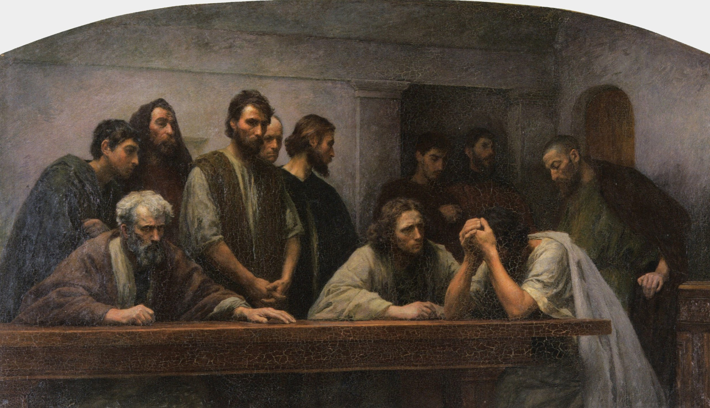
“Most miserable” certainly seems to describe the disciples during those 3 days.
They spent them in crippling fear and confusion,
wrestling with the reality of Christ’s death
and the inevitability
of their own.
Artist: Eugene Burnand

Slide 4
They had to go through a painful process
(The death of their dreams)
before they could comprehend
and experience
the power of the resurrection.
Paul spoke of this is Phil 3:10
“That I may know him,
and the power of his resurrection,
and the fellowship of his sufferings,
being made conformable
unto his death”

Slide 5
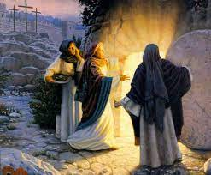
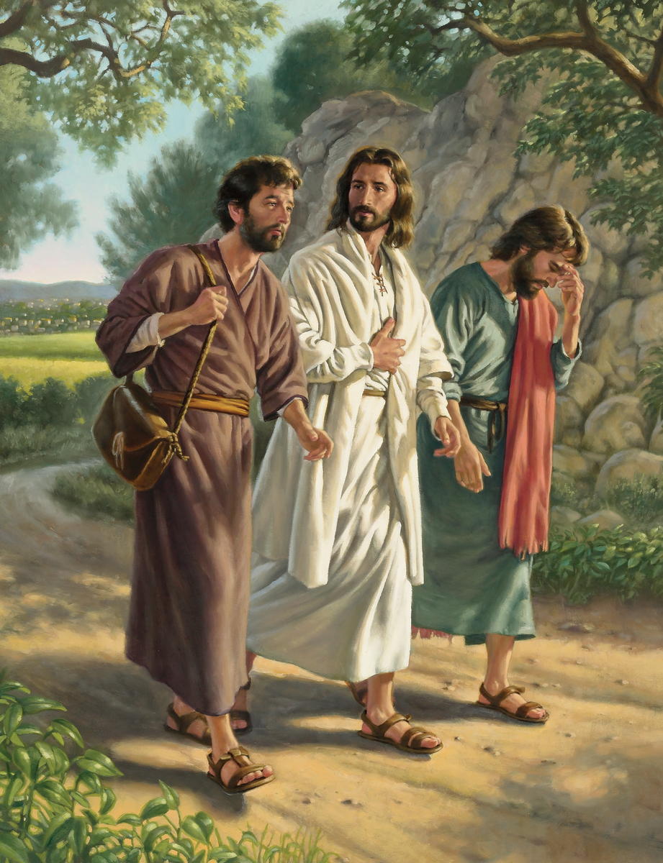
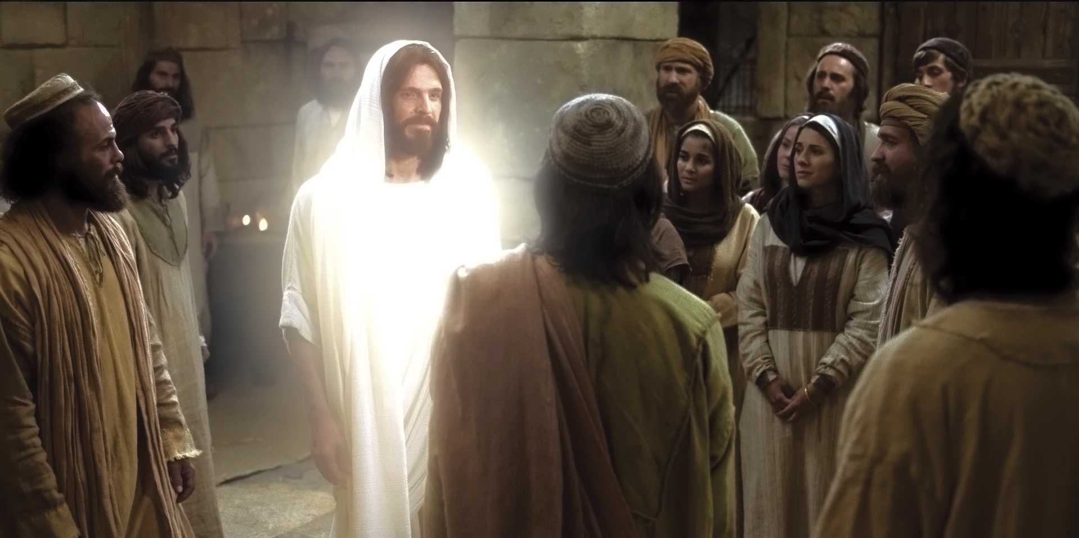
Luke 24 records that God brought the news of Jesus’ resurrection to 3 groups of people
in 3 distinctly different ways.

Slide 6
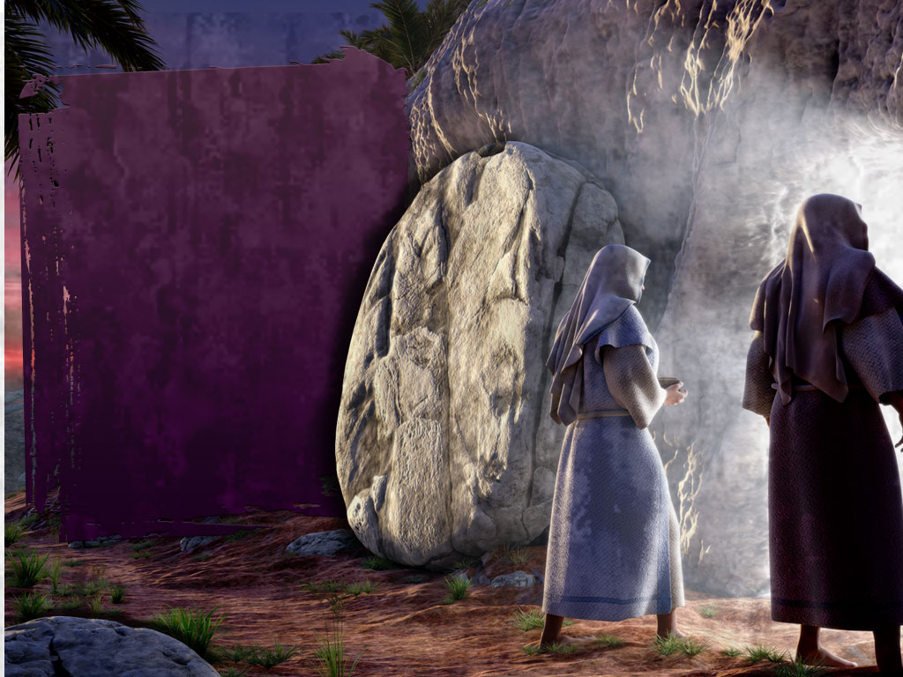
To the Faithful:
A Resurrection of Peace! Lk. 24:1-11
A. Those who “seek” are the first to “Find”.
The ladies sought in order to “Serve”
Vs 1 “bringing spices”

Slide 7
To those seeking to serve.
A Resurrection of Peace! Lk. 24:1-11
Jesus Promises
Peace to those who
truly seek him. (Jer 29:13, 14; Mt 7:7)
Jn 14:27 “my peace
I give unto you.”

Slide 8
To those seeking to serve.
A Resurrection of Peace! Lk. 24:1-11
3) God greeted them with angelic messengers.

Slide 9
⁵ Why seek ye the living among the dead?
⁶ He’s not here, but is risen:
remember how he spake unto you when he was yet in Galilee ⁷ Saying, The Son of man must be delivered into the hands of sinful men,
be crucified, and the third day rise again.”
Luke 24:5-7

Slide 10
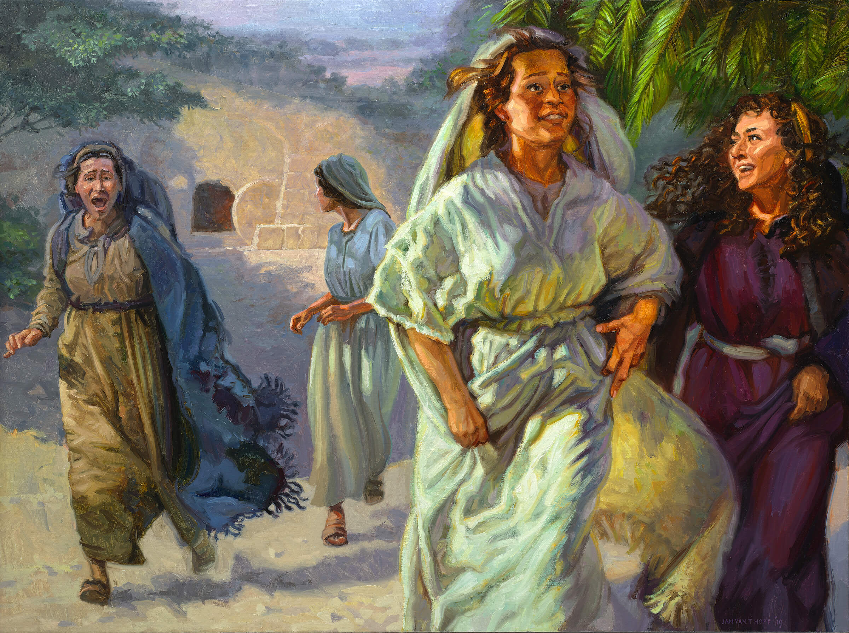
To those seeking to serve.
A Resurrection of Peace! Lk. 24:1-11
4) Since “Peace” (eiro) comes
from partnering with God,
God gave them a more
productive “service”. Vs 9
Mt 28:7 “go quickly and tell his disciples that he is risen from the dead.”

Slide 11
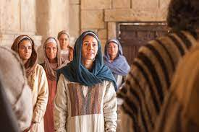
They quickly and joyfully obeyed!
vs 9 They "returned …and told all these things unto the eleven and to all the rest.
It was Mary Magdalene,
and Joanna, and Mary the mother of James, and other women that were with them,
which told these things unto the apostles.

Slide 12
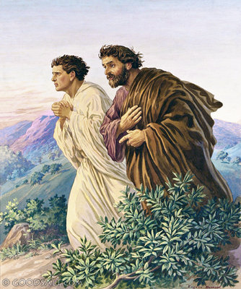
B. The Apostles were slow to believe
(and receive Peace!)
vs 11 " their words seemed to them as idle tales,
and they believed them not."
Peter and John investigated
but saw no angels or Jesus.
Vs 11-12 (Jn 20:2-10)
2) They sought, not to serve,
but to satisfy their minds.

Slide 13
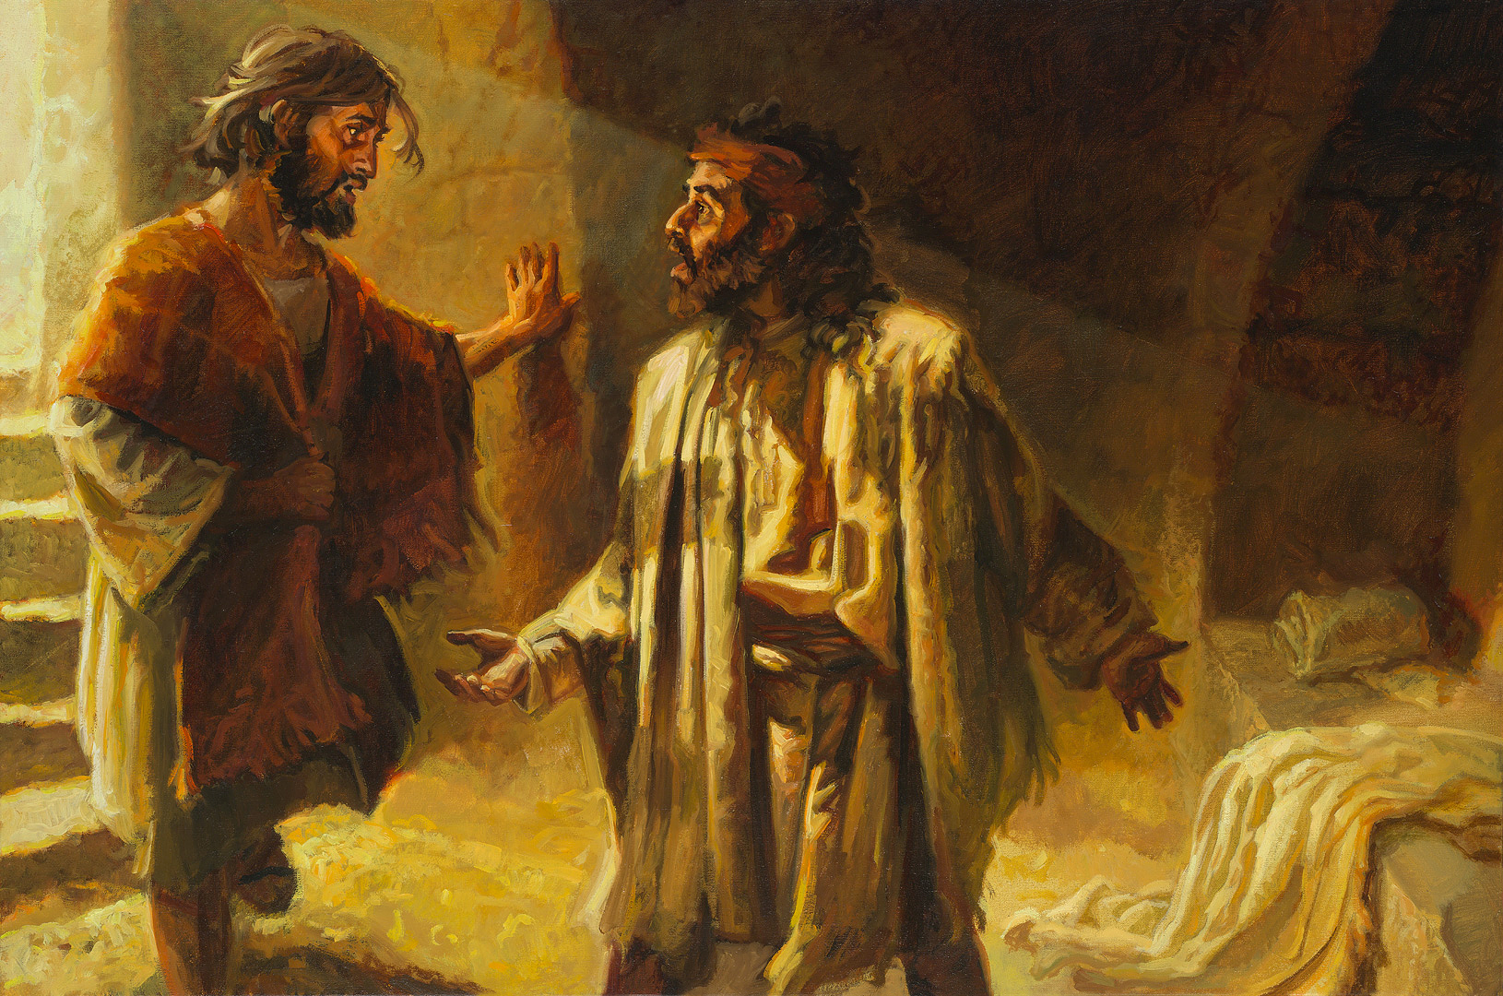
B. The others were slow to believe (and receive Peace!)
vs 11 " their words seemed to them as idle tales,
and they believed them not."
3) Instead of finding
Peace,
they left Perplexed!
vs 12 “departed
wondering”

Slide 14
2. To the Confused: The Resurrection Of Perspective. 13-35
A. Their Confusion Caused Them To Lose Their Clarity (and Confidence)!
1) We tend to see what we’re looking for
(and miss what we’re not!)
15 “while they …reasoned, Jesus drew near, and went with them.
16 But their eyes were holden …
(Krateō: seized, retained/focused)

Slide 15
The Resurrection Of Perspective. 13-35
A. Their Confusion Caused Them To Lose Their Clarity (and Confidence.)
2) Our focus can affect our feelings!
“he said unto them, What manner of communications are these that ye have,
as ye walk,
and are sad? “
Skythrōpos’: from skuthros {sullen}
And aptanomai: to gaze (or focus)
at appearances

Slide 16
3) Our feelings can affect our faith!
a) They heard the report of the resurrection, (22-24)
22 “certain women made us astonished, …
which said that he was alive”
But failed to investigate it for themselves!
b) They were so preoccupied with their own agenda (what they wanted)
that they couldn’t recognize God’s!
(See verse 19-21)

Slide 17
3) Our feelings can affect our faith!
c) This emotional preoccupation
(with their own disappointment and agenda)
blinded them to the presence of Jesus!
16 “But their eyes were holden …”
Do we ever fail to recognize Jesus’ will, word or work in, on, & through us
for the same reason?

Slide 18
The Resurrection Of Perspective. 13-35
B. Jesus’ solution for their emotional confusion is Biblical Clarity! Vs 25-27
“O fools, and slow of heart to believe all that
the prophets have spoken:
Ought not Christ to have suffered these things,
and to enter into his glory?
And beginning at Moses and all the prophets,
he expounded unto them in all the scriptures the things concerning himself.”

Slide 19
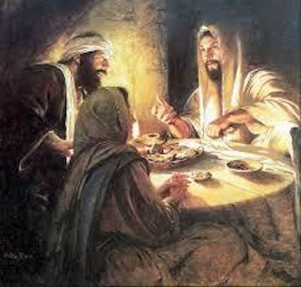
B. Jesus’ solution for their emotional confusion is Biblical Clarity! Vs 25-27
When God’s facts conflict with our feelings,
it often produces “heart burn”! vs 32
“Did not our heart burn within us,
while he talked with us by the way,
and while he opened to us
the scriptures?”
2) Their Hearts had to be opened
before their eyes could be!

Slide 20
C. Biblical Repentance (thinking differently)
produces Biblical Obedience! Vs 33-35
“they rose up the same hour, and returned to Jerusalem,
(6.5 miles away)
and found the eleven gathered together, and them that were with them, Saying,
The Lord is risen indeed,
and hath appeared to Simon.
And they told what things were done in the way,
and how he was known of them in breaking of bread.”

Slide 21
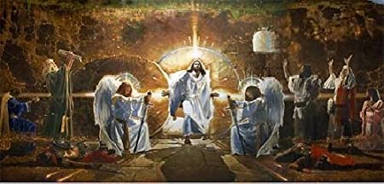
Resurrection of: 1. Peace! 2. Perspective.
3. To the Aimless:
The disciples must have wondered: “what now”!
A Resurrection of Purpose! 36-53
Ron DiCanni

Slide 22
Luke 24:36-39
“Jesus himself stood in the midst of them…,
And said: Peace be unto you.
³⁷ But they were terrified and affrighted,
and supposed that they had seen a spirit.
And he said unto them, Why are ye troubled? … Behold my hands and my feet, that it is I myself:
handle me, and see; for a spirit hath not flesh and bones,
as ye see me have.”

Slide 23
3. A Resurrection of Purpose! 36-53
Jesus’ Purpose. Vs 44-46 “these are the words
which I spake unto you while I was yet with you,
That all things must be fulfilled, which were written in the Law…Prophets…Psalms, concerning me.
Then opened he their understanding,
that they might understand the scriptures,
And said unto them, Thus it is written,
and thus it behoved Christ to suffer,
and to rise from the dead the third day:”

Slide 24
3. A Resurrection of Purpose! 36-53
B. Their Purpose. Vs 47-48
“And that repentance and remission of sins should be preached in his name among all nations, beginning at Jerusalem.
And ye are witnesses of these things.”
1) His Peace (vs 36) is related to
His Purposes (vs 48)! Mt 11:28-30

Slide 25
A Resurrection of Purpose! 36-53
C. God’s Promise vs 49 “And, behold,
I send the promise of my Father upon you:
but tarry ye in the city of Jerusalem,
until ye be endued with power from on high.”
1) His Power is related to His Purposes
(See Acts 1:8)
2) The job was bigger than they were.
Only God’s Spirit can produce life in a dead heart.

Slide 26
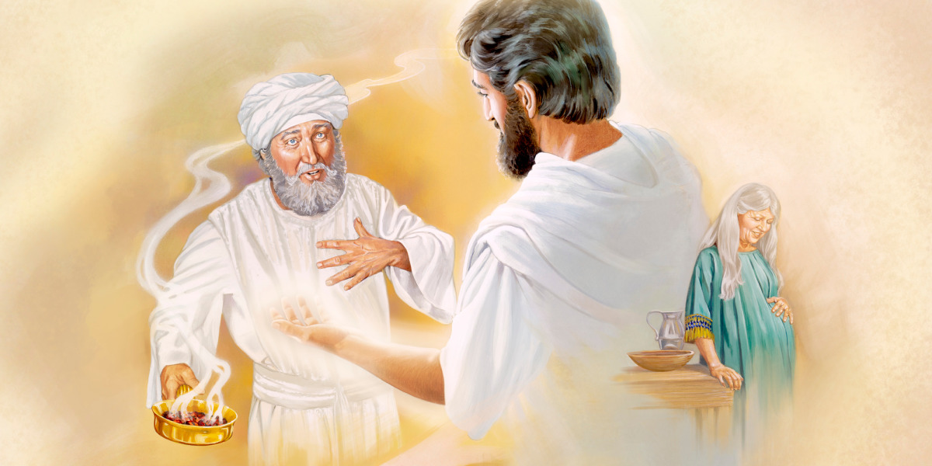
Luke opens in the Temple with Gabriel bringing God’s message of hope and purpose to a doubting Zecharias.
Luke 1:5-35

Slide 27
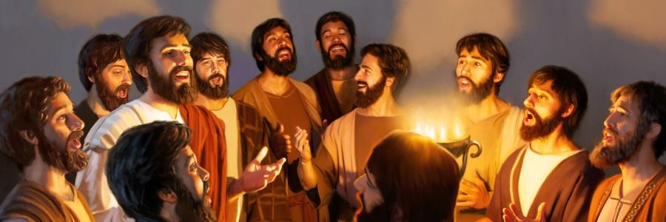
It closes with: “And they worshipped him,
and returned to Jerusalem with great joy:
And were continually in the temple,
praising and blessing God. Amen. “
Lk 24:52-53

Slide 28
The difference was the resurrection of Jesus Christ which brought a resurrection of
Peace, Perspective, and Purpose.

Slide 29
Jesus’ Resurrection is God’s Exclamation mark on the Gospel message! 1 Cor. 15:3,4
Our Sin carries a death penalty. Ro. 6:23
Jesus died in our place. Ro. 5:8; Jn 19:30
“It is finished” (teleo) Fulfilled, the debt is discharged
God accepted His sacrifice. 2 Cor 5:21
Since our Debt has been paid,
God offers us Pardon and Peace. (Ro. 5:1; Ro. 6:23)

Slide 30
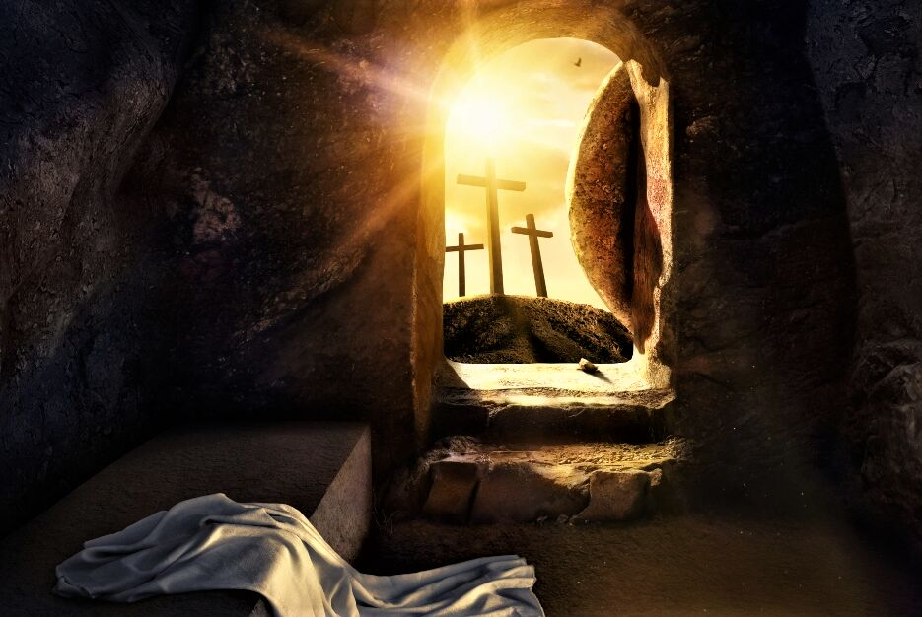
“God so loved the world that He gave his only begotten Son,
that whosoever believeth
in him should not perish,
but have everlasting life.”
Do you Believe?

Slide 31
Easter divides the world in two groups! Jn 3:36
1) “He that believeth (pisteuo: entrust, credit)
on the Son
hath everlasting life:
2) he that believeth not the Son
shall not see life;
but the wrath of God
abideth on him.”
Which Group are you in?

