Slide 1
It’s easy to get caught up in the
“Tyranny of the temporary”:
To feel stuck
in a particularly challenging season.
Eccl. 3:1-10

Slide 2
In such seasons it’s easy to jump to conclusions and judge prematurely.
We tend to judge the man by the moment;
the day by the disaster;
the week by the worry;
the month by the moment;
and the life by the loss!
The Scriptures are filled with examples of people passing through painful seasons.

Slide 3
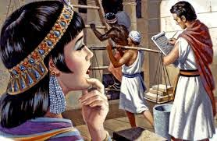
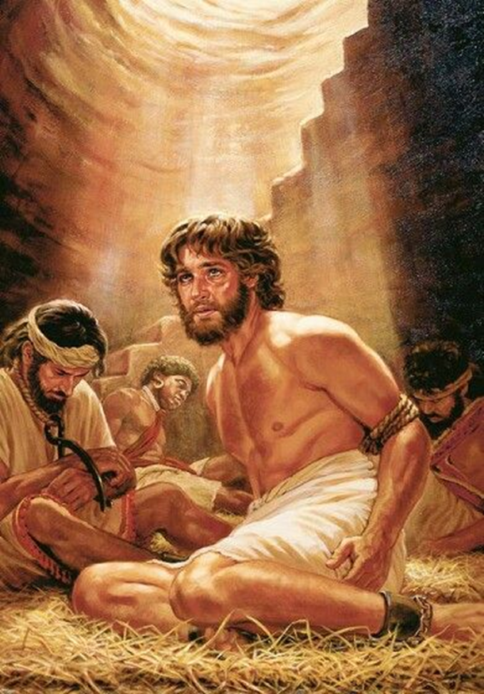
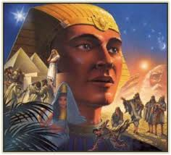
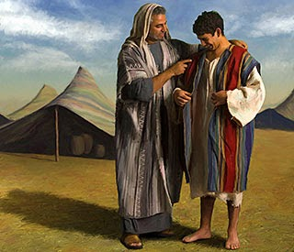
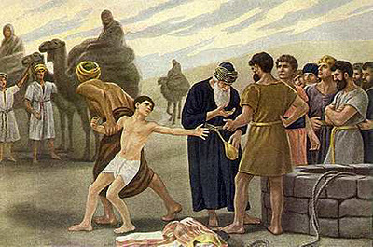
Joseph’s journey had several “seasons” before he could be in a position to nourish the people of Israel through the years of famine (Gen. 37-50)
and fulfil the prophecy God gave to his Great Grandfather Abraham in Gen. 15.

Slide 4
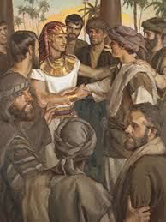
It was years later that he was able to see & honestly say to the brothers that betrayed him:
“Fear not: for am I in the place of God?
ye thought evil against me;
but God meant it unto good,
to bring to pass, as it is this day, to save much people alive.”
Gen 50:19-20

Slide 5
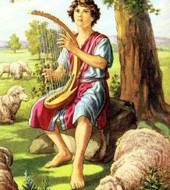
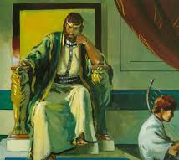
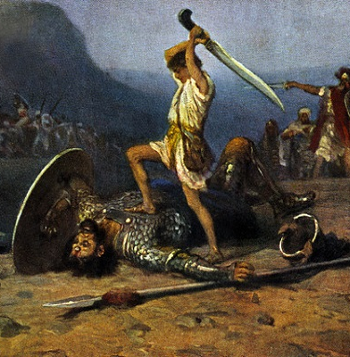
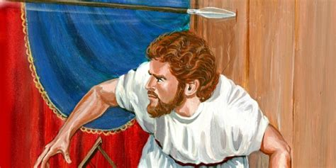
David’s path also took many disappointing detours that moved him from sheepfolds to Saul’s palace;
Then battlefields ➔ years of running for his life.
In frustration he chooses Exile with the Philistines and settles in Ziklag.

Slide 6
Where he becomes a murderous marauder (1Sam. 27)
& Joins the enemy to fight against Israel! (1 Sam 29)
After ignoring God and common sense, David returned to find Ziklag destroyed and their families gone.
1 Sam. 30:6 “And David was greatly distressed;
for the people spake of stoning him,
because the soul of all the people was grieved, (Mārar’: embittered)
every man for his sons
and for his daughters:”

Slide 7
6 “but David encouraged (ḥāzaq’: to seize, repair, strengthen) himself in the LORD his God.
8 …So David enquired at the Lord…”
He got a hold of himself and His God
and shifted from pouting to:
Praying (vs 8)
Purpose (vs 8)
Power! (16-20)
1 Samuel 30

Slide 8
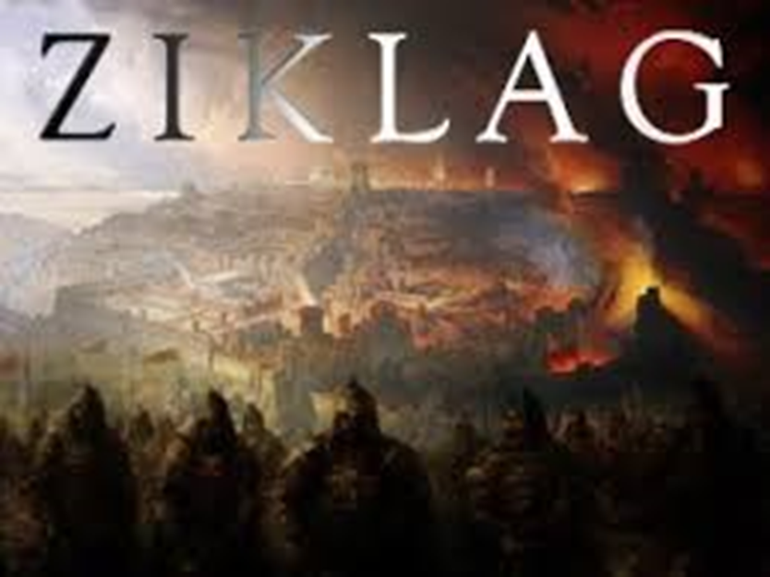
What might have been the sad conclusion of a
promising life
became a turning point.
It was at Ziklag that the armies of Israel came to support David and make him their King!
(1 Chron 12)
(1 Samuel 30)

Slide 9
The truth is that each of us will pass through several seasons before God’s purposes can be clearly understood and completely accomplished.
That’s why 1 Cor 4:5 tells us to:
“judge nothing before the time, until the Lord come,
who both will bring to light the hidden things…,
and will make manifest the counsels of the hearts…”
Forgetting this truth was at the heart of much of the misery the disciples faced 2000 years ago.

Slide 10
By changing the disciples.

Slide 11
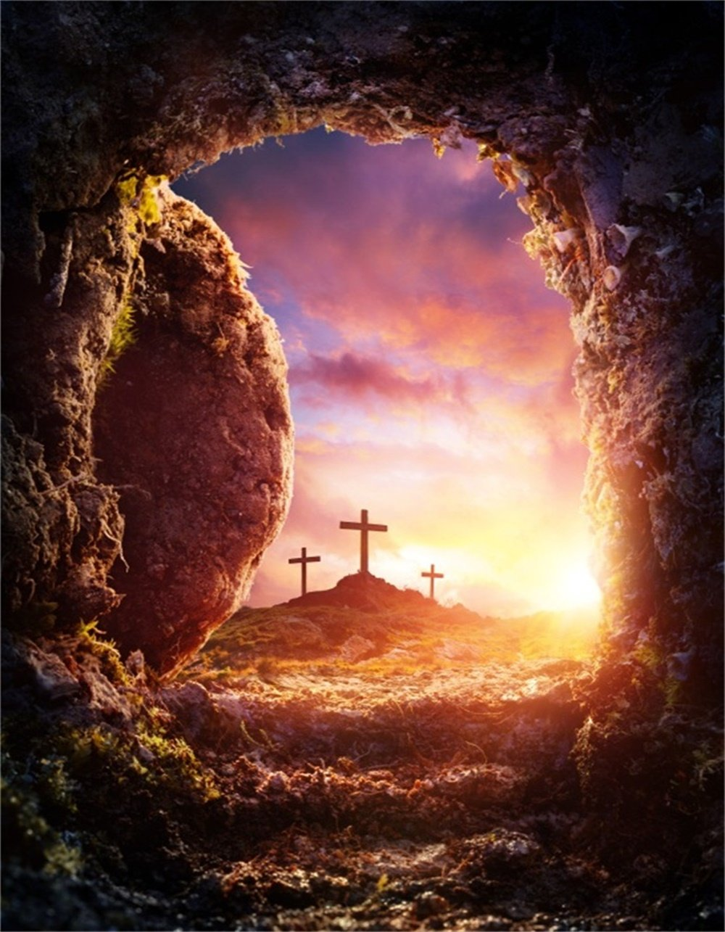
The Resurrection is Central to our Faith and Hope!
“If Christ be not raised,
your faith is vain;
ye are yet in your sins
If in this life only we have hope in Christ, we are of all men
most miserable.”
1 Cor 15:17-19

Slide 12
“Most miserable” certainly seems to describe the disciples during those
3 days.
They had to go through a process before they could experience the power
of the resurrection.

Slide 13
That first Easter was a beautiful illustration of how Christ uses this process to bring
“beauty out of ashes….
Joy out of mourning…
Praise out of heaviness.
Isaiah 61:1-3
That they might be called trees of righteousness,
the planting of the Lord , that He might be glorified.”
God is trying to Grow us!

Slide 14
Trees of righteousness grow over many seasons!
The Disciples should have realized that they were simply passing through territory that’s filled with Satan’s snares and familiar to all who must learn to
“walk by faith, not by sight.”
2 Corinthians 5:7
Satan understands this process and seeks to trap us in the “Tyranny of the Temporary”.

Slide 15
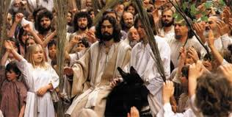
Satan’s snares are masked by:
1. Preoccupation with Personal Priorities (Agendas)
A. Our Perspective is tainted by our personal agendas
1) Palm Sunday Crowd revealed this. Mt 21:9
“Hosanna” from yāshaʿ
(deliver, rescue, free us)
and nāʾ:
(NOW!)

Slide 16
A. Our Perspective is tainted by our agendas.
2) This is why the Apostles couldn’t “grasp”
Jesus’ words and warnings.
Luke 9:44-46 “Let these sayings sink down into your ears:
for the Son of man shall be delivered into the hands of men.
But they understood not…, and it was hid from them, that they perceived it not: and they feared to ask him.
46 Then there arose a reasoning among them,
which of them should be greatest.”

Slide 17
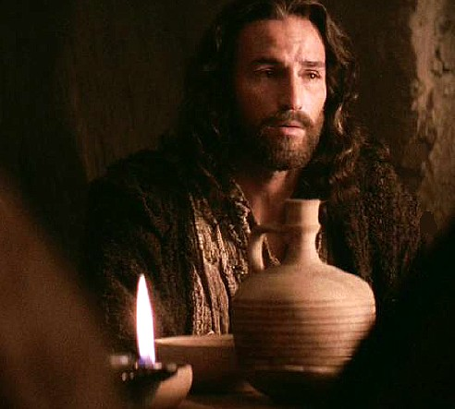
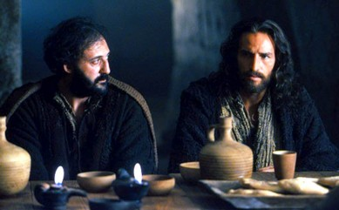
2. A Personal and Powerful Pride. Mt 26:31-32
“All ye shall be offended because of me: for it is written, I will smite the shepherd, and the sheep of the flock shall be scattered abroad. (Zech. 13:7)
But after I am risen again,
I will go before you…
33 Peter answered, Though all men shall be offended because of thee,
yet will I never be offended.”

Slide 18
A. Pride binds us to our own agenda!
Mt 20:21 “Then came to him the mother of Zebedee's children with her sons, worshipping him, and desiring a certain thing of him.
22 Jesus saith unto her, What wilt thou?
…Grant that these my two sons may sit, the one on thy right hand, and the other on the left, in thy kingdom….
24 And when the ten heard it, they were moved with indignation against the two brethren.”

Slide 19
B. Pride Blinds us to Satan’s snares!
Notice the Pride Mt 26:34,35
“Verily I say unto thee, this night, before the cock crow,
thou shalt deny me thrice.
Peter said,
Though I should die with thee, yet will I not deny thee.
Likewise also said all the disciples.”

Slide 20
B. Pride Blinds us to Satan’s Snares.
2) Notice the “Permission”. Lk 22:31-33
“Satan hath desired (exaiteō: demanded) to have you,
that he may sift you as wheat:
But I have prayed for thee, that thy faith fail not:
and when thou art converted, strengthen thy brethren.
33 Lord, I am ready to go with thee,
both into prison, and to death.”
“Pride goeth before destruction…“
Pr 16:18

Slide 21
Satan’s snares are masked by:
1. Personal Priorities 2. Powerful Pride
3. Short term (Temporary) Perspective.
A. We often fail to Connect Today’s choices
with Tomorrows Consequences.
1) Satan seeks to preoccupy us with our
immediate agenda,
Leaving little thought (time/energy) for eternity
or the “long look”. Hebrews 11:13-16

Slide 22
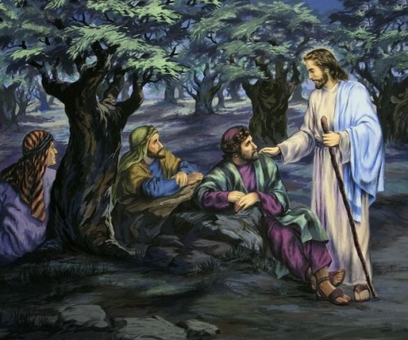
a) In Gethsemane: Mt 26:36-37
“Then cometh Jesus with them unto Gethsemane, and saith unto the disciples, Sit ye here, while I go and pray yonder.
And he took with him Peter and the two sons of Zebedee, and began to be sorrowful and very heavy.”

Slide 23
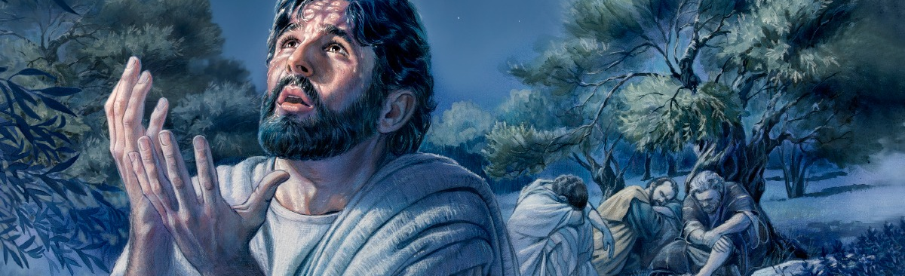
Mt 26:38-39
“My soul is exceeding sorrowful, even unto death:
tarry ye here, and watch with me.
And he went a little further, and fell on his face, and prayed,
O my Father, if it be possible, let this cup pass from me:
nevertheless not as I will, but as thou wilt.“

Slide 24
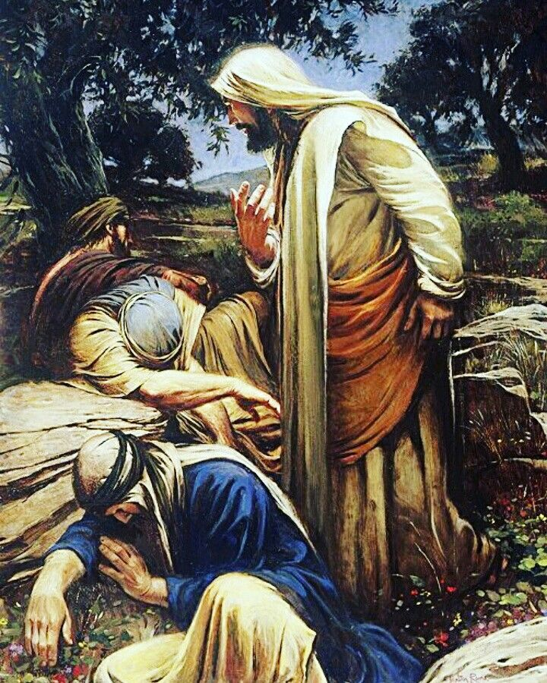
Matthew 26:40-41
“he comes unto the disciples, and finds them asleep,
and saith unto Peter,
could ye not watch with me 1 hour?
Watch and pray, that ye enter not into temptation:
the spirit indeed is willing,
but the flesh is weak.”
See 1 Peter 1:8

Slide 25
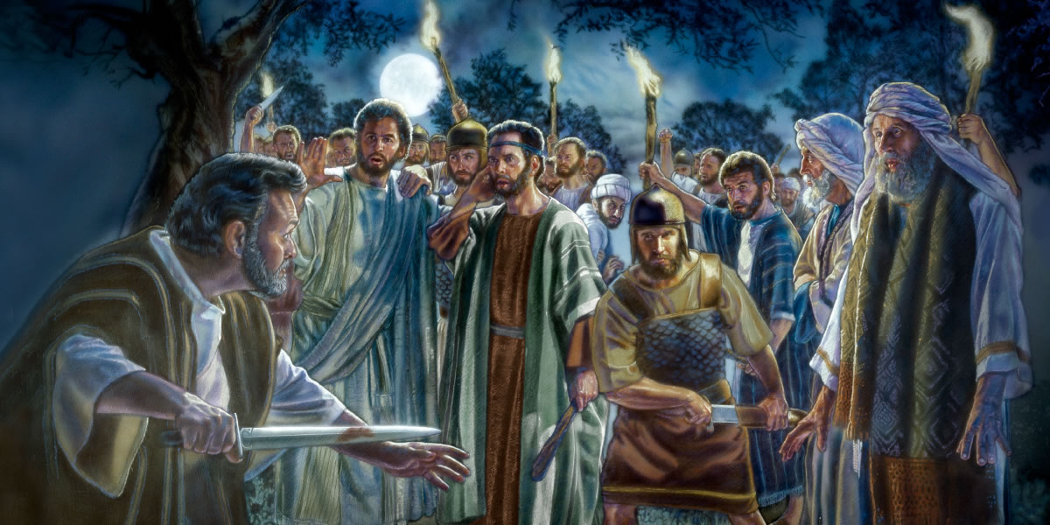
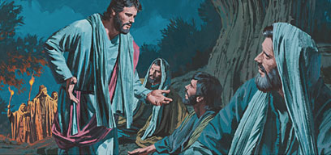
b) The satisfaction of their temporary rest caused them to drift off again (2 more times).
When the soldiers came,
Peter reacted and Jesus corrected Him by saying:
“Thinkest thou that I cannot pray to my Father, and he shall presently give me more than 12 legions of angels?
But how then shall the scriptures be fulfilled,
that thus it must be? “ Mt. 26:52-54

Slide 26
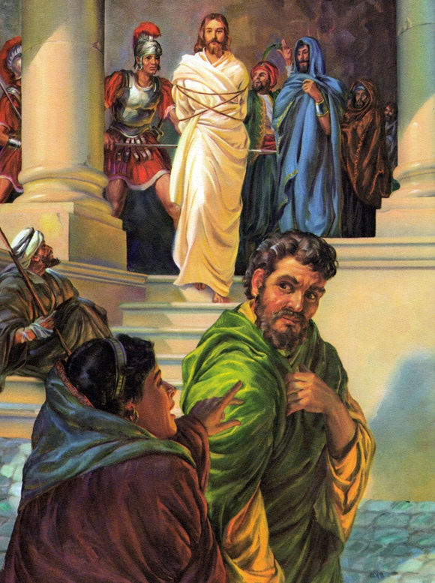
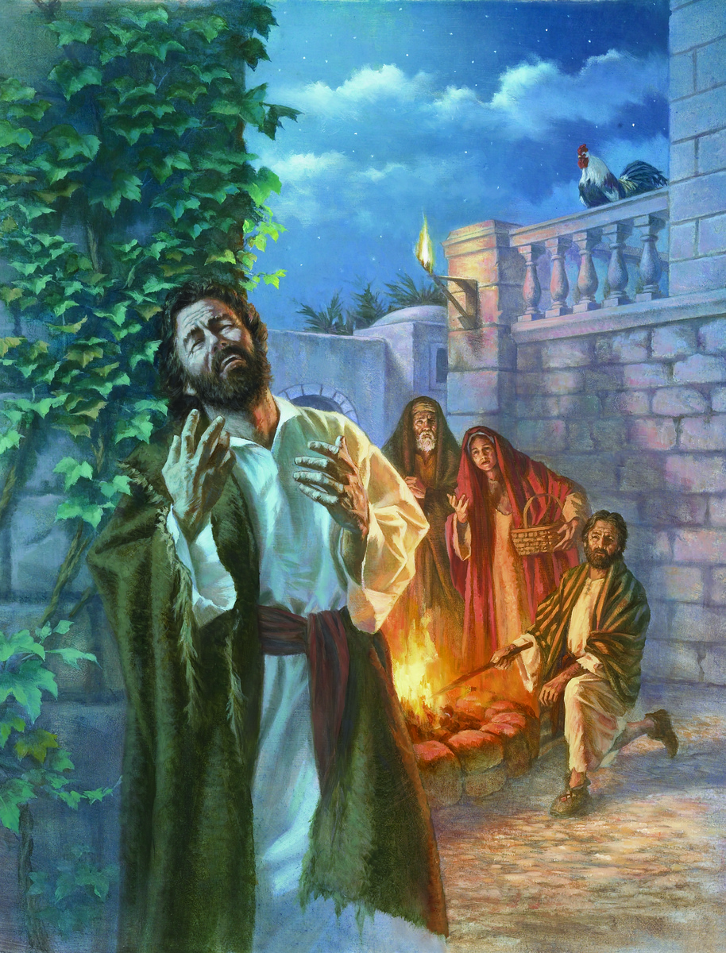
c) Peter followed Jesus “afar off” and warmed himself by the fire.
When confronted he denied knowing Jesus (3x) .
Lk 22:61-62 “the Lord turned,
and looked upon Peter.
And Peter remembered
the word of the Lord,…
And Peter went out,
and wept bitterly.”

Slide 27
Satan had managed to snare Peter with his own:
1. Personal Priorities
2. Powerful Pride
3. Temporary Perspective
Thankfully Jesus came
“to set the captives free!”
Isaiah 61:1-3; Luke 4:18

Slide 28
Through all this God’s Grace was at work
and on Easter Sunday He said:
“go tell his disciples
(and Peter)
that He is risen from the dead,
and goeth before you.”
Mt. 28:7; Mk 16:7

Slide 29
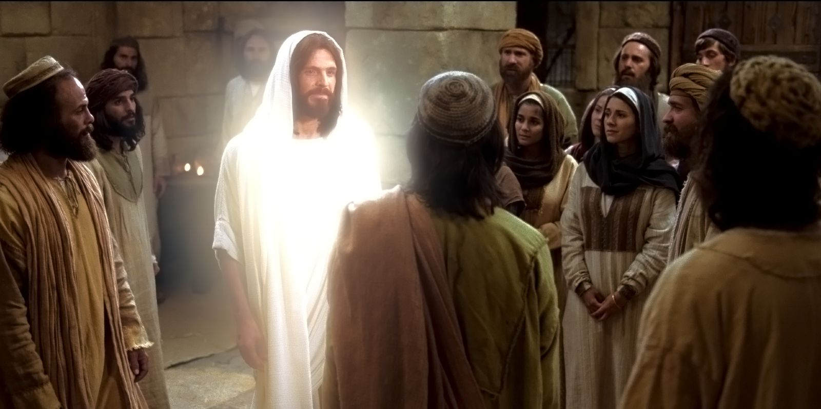
When Jesus presented himself to the Apostles on Easter…
“Jesus stood in the midst of them, and saith unto them,
Peace be unto you. …
These are the words which I spake unto you, while I was yet with you,
that all things must be fulfilled, which were written in the law of Moses, and in the prophets, and in the psalms, concerning me.
Luke 24:36-46

Slide 30
Jesus finally presented himself to the Apostles on Easter
46 “Thus it is written, and thus it behoved Christ to suffer, and to rise from the dead the third day:
47 And that repentance and remission of sins should be preached in his name
among all nations...
48 And ye are witnesses
of these things.”
Luke 24:46-48

Slide 31
Satan sought to permanently sidetrack Peter with the Tyranny of the Temporary.
God sought to Powerfully sanctify Peter
Through His Grace,
To His Service!
Lk 24:48 “ye are witnesses of these things”

Slide 32
Through Repentance and Rededication (See Jn. 21:15-19)
Peter became an instrument of Grace to others. 1 Pt 1:
2 “Grace be unto you and peace be multiplied. Blessed be the God and Father of our Lord Jesus Christ,
3 which according to his abundant mercy
hath begotten us again unto a lively hope
by the resurrection of Jesus Christ from the dead,
4 To an inheritance incorruptible, and undefiled, and that fadeth not away,
reserved in heaven for you,

Slide 33
5 “Who are kept by the power of God through faith unto salvation ready to be revealed in the last time.
6 Wherein ye greatly rejoice, though now for a season, if need be, ye are in heaviness through manifold temptations:
7 That the trial of your faith, being much more precious than of gold that perishes, though it be tried with fire,
might be found unto praise and honor and glory
at the appearing of Jesus Christ:

Slide 34
1 Peter 1:8-9 “Whom having not seen, ye love;
in whom, though now ye see him not, yet believing,
ye rejoice with joy Unspeakable and full of glory:
Such Joy: (chara’: calm delight) is a biproduct of
God’s Grace (charis). (1 Pt 1:2, 10)
Receiving the end of your faith,
even the salvation of your souls.”

Slide 35
Are you trapped in the Tyranny of your:
Personal Priorities (Agenda)
Powerful Pride
Limited Perspective
(fear, anxiety, etc)
God’s Grace and Peace are just as available to you
as they were to Peter!

Slide 36
Jn 14:27 “Peace I leave with you, my peace I give unto you…:
Let not your heart be troubled, neither let it be afraid.”
God’s Peace is a biproduct of pursuing God’s Priorities
and seeking
God’s Perspective.
Will you join Him?
Lk 24:48 “ye are witnesses of these things.”

Slide 37
Easter reminds us that “Faith” involves a Journey that includes a “Cross”….
But leads to a Crown! 2 Tim. 4:6-8
Ron DiCianni

