Slide 1
Failing
Forward!
Mt 26:31-56

Slide 2
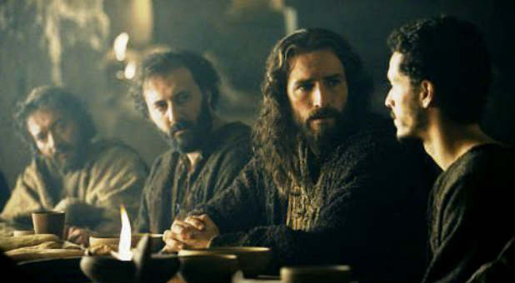
Mt 26:31 “All ye shall be offended because of me…”

Slide 3
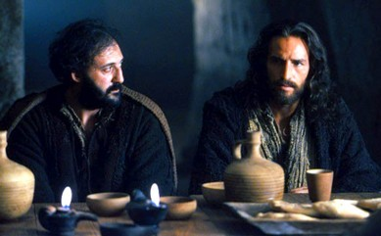
33 “Peter said,
Though all men shall be offended
because of thee,
yet will I never be offended.
35 Though I should die with thee,
yet will I not deny thee.
Likewise also said all the disciples.”

Slide 4
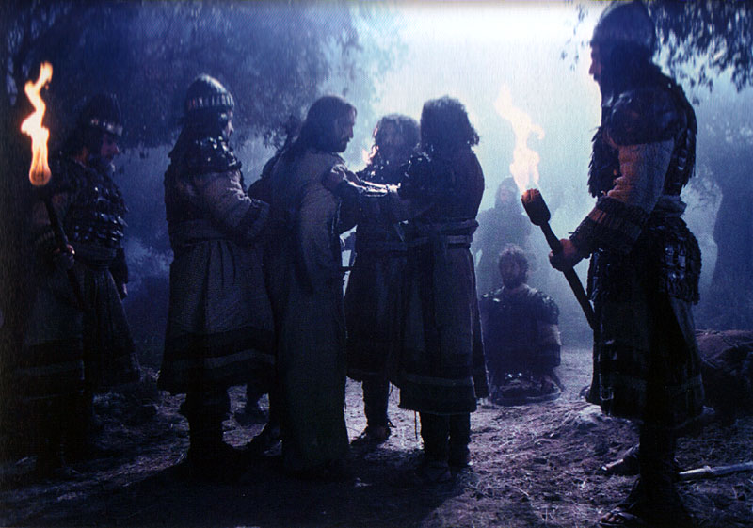
“Then all the disciples forsook him, and fled.”
Mt 26:56

Slide 5
Reflection: Understanding Failure
Failure Is Universal Ro. 3:23
“all have sinned and come short…”
Failure Is An Indicator.
It reveals deeper issues. Mt 26:40-41
“could ye not watch with me one hour?
Watch and pray, that ye enter not into temptation:”

Slide 6
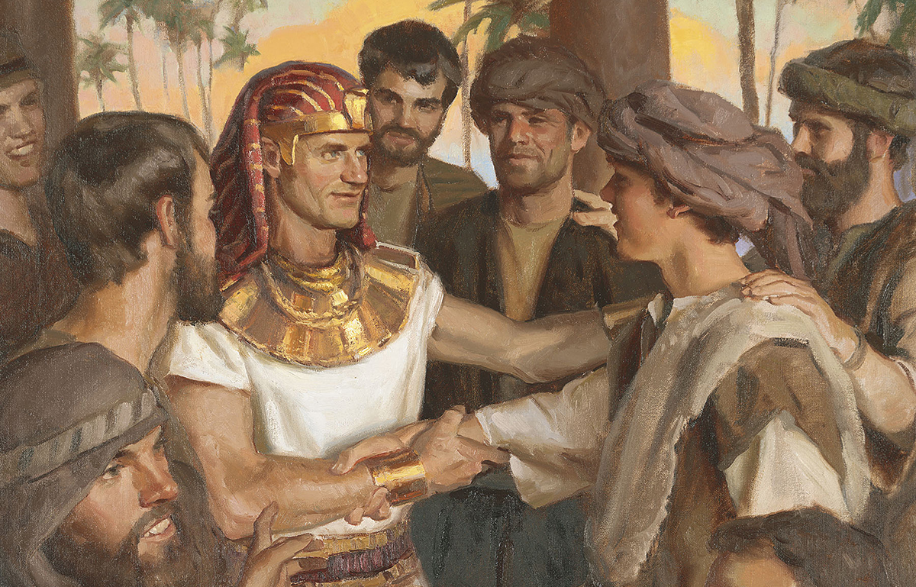
Failure Is Subjective. Isaiah 55:8,9
“The Life of Jesus seemed like an absolute failure from every standpoint,
Except God’s!” Oswald Chambers
“ye thought evil against me; but God meant it unto good,
Genesis 50:20

Slide 7
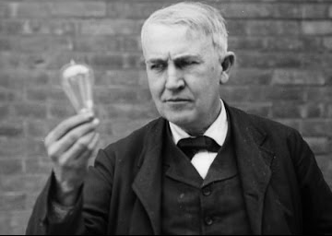
Failure Is Subjective.
Thomas Edison who tried 10,000 times to perfect the light bulb stated:
“I haven’t Failed!
I’ve just discovered 10,000 ways
that won’t work.”

Slide 8
“No amount of falls will really undo us if we keep picking ourselves up each time.
We shall of course be very muddy and tattered children by the time we reach home....
It’s when we notice the dirt that God is most present in us;
it is the very sign of his presence.”
C. S. Lewis

Slide 9
Direction: Failing Forward involves
Using the pain and disappointment of our failures to draw us closer to God.
(Mt 11:29,30; James 4:6-10)
“Beauty out of Ashes”. (Is. 61:1-3)
Cultivating a teachable spirit enabling
us to learn from our failures.

Slide 10
To truly learn from our failures we must determine:
1. What Caused The Failure?
Unless / until you learn this,
you’re bound to repeat the failure.
“Insanity is doing the same thing over and over and expecting different results.”
Albert Einstein

Slide 11
1. What Caused The Failure?
Spiritual / Moral Failure is caused by:
A. Satan: “Satan hath desired to have you,
that he may sift you as wheat…” Lk 22:31
1 Pt 5:8 “your adversary the devil,
as a roaring lion, walketh about,
seeking whom he may devour.”

Slide 12
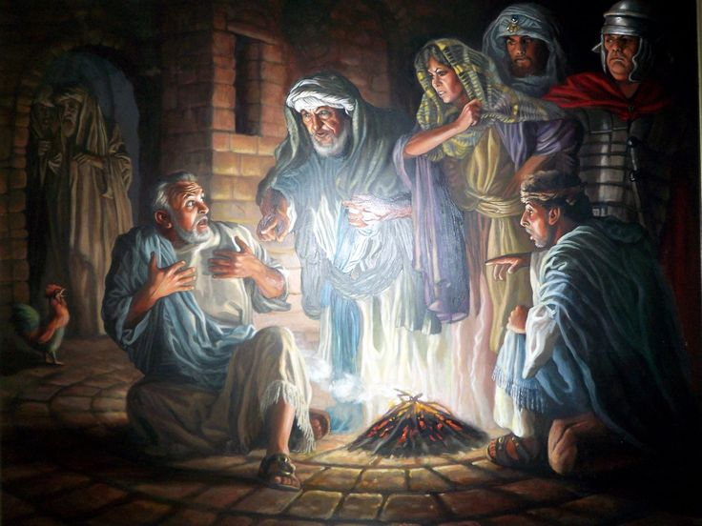
1. What Caused The Failure?
B. Society: (Culture) 1Jn 5:19 “the whole world lieth in wickedness” (poneros: disease)
Where was Peter when he denied Christ?
Lk 22:54-62

Slide 13
1. What causes spiritual failure?
B. Society: (Culture) 1 Cor 15:33
“Be not deceived: evil communications (homilia: companions)
corrupt good manners.” (ethos: habits)
2 Tim. 4:10 “Demas hath forsaken me, having loved this present world”
Phil. 3:17-20; 1 Jn 2:15,16

Slide 14
1. What causes spiritual failure?
C. Self: “the spirit indeed is willing,
but the flesh is weak.” Mt 26:41
Ro 7:18 “For I know that in me (that is, in my flesh,) dwelleth no good thing:
for to will is present with me; but how to perform that which is good I find not.”

Slide 15
2. How Can I Learn From The Failure?
A. Some are so distracted (or disgusted),
that they can’t (or won’t) look for the lesson.
1) God doesn’t want to waste a hurt.
2 Cor 1:3-4 “the God of all comfort;
Who comforteth us in all our tribulation,
that we may be able to comfort them which are in any trouble, by the comfort wherewith we ourselves are comforted of God.”

Slide 16
2. How Can I Learn From The Failure?
B. God can use “all things” to grow us.
Ro. 8:28,29 “all things work together
for good to them that love God…”
Ps 119:71 “It is good for me that I have been afflicted; that I might learn thy statutes.”
James 1:2-5

Slide 17
3. Who Can Help Me With This issue?
Peter went back to the Apostles.
A. Who can help me “live” through
the mistake? (Comfort)
B. Who can help me “Learn” through
the mistake? (Counsel)
Those who’ve survived failure make
the best comforters and counselors.

Slide 18
Ps 51:12-13 “Restore unto me the joy of thy salvation; and uphold me with thy free spirit.
Then will I teach transgressors thy ways;
and sinners shall be converted unto thee.”
Ro 5:3-5 “…tribulation worketh patience;
And patience, experience; and experience, hope:
And hope maketh not ashamed; because the love of God is shed abroad in our hearts by the Holy Ghost”
Psalm 40:1-3; Gal. 6:1,2

Slide 19
3. Who Can Help Me With This Problem. Admiral Hyman Rickover: “We all need to learn from others' mistakes. We’ll not live long enough to make them all ourselves.“
"A winner knows how much he still has to learn, even when he is considered an expert by others.
A loser wants to be considered an expert by others
before he has learned enough to know
how little he really knows."

Slide 20
4. Where Do I Go From Here?
A. Too many move away from God
after their failures!
1) In their book “Everyone’s a Coach”
Don Shula & Ken Blanchard observe that:
“Learning involves a change in behavior.
You haven’t really learned a thing
until you can take action and use it."

Slide 21
4. Where Do I Go From Here?
B. John 21 illustrates this principle.
1) “I go a fishing…we all go with thee” Vs 3
2) After a fruitless night Jesus calls (vs 5)
and directs them (vs 6)
thereby repeating Jesus repeated the
miracle he first used to reach them.
(Compare Jn 21:1-6 to Lk 5:1-11)

Slide 22
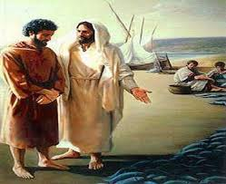
B. John 21 illustrates this principle.
3) Peter swims to Jesus. (Vs 7)
4) After lunch Jesus asked 3 times:
“Lovest thou me
more than these?
…Feed my lambs…
feed my sheep”
Jn 21:15, 16, 17

Slide 23
Conclusion:
Without some conscious changes,
we won’t be able to Fail Forward!
Lasting Change usually requires that we:
1) Hurt enough we’re motivated to change.
2) Learn enough we’re able to change.
3) Love enough we’re willing to change.
“Lovest thou me more than these?” Jn 21:15

Slide 24
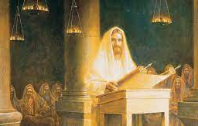
Jesus came to redeem our failures!
Is 61:1-3 “the LORD hath anointed me to preach good tidings unto the meek;
he hath sent me to bind up the brokenhearted, to proclaim liberty to the captives, and the opening of the prison to them that are bound;
To proclaim the acceptable year of the LORD, …
to comfort all that mourn”;

Slide 25
3 “to give unto them beauty for ashes,
the oil of joy for mourning, the garment of praise for the spirit of heaviness;
that they might be called trees of righteousness,
the planting of the LORD,
that he might be glorified.”
(See Luke 4:14-22)

Slide 26
God can redeem our failures if we’re willing to partner with him (Mt 11:28,29)
and humbly and honestly:
Seek to understand what caused them.
(James 1:2-5)
Be willing to learn from them.
(Ro. 8:28,29)

Slide 27
God can redeem our failures if we’re willing to partner with him (Mt 11:28,29) &
Learn to lean on (and learn from)
others. (Gal. 6:1-2)
Listen to God’s voice and direction
for the next steps in your faith journey.
(Pr. 3:5,6)

Slide 28
What Satan did to Peter (& the Apostles),
Lk. 22:31,32 “Satan hath desired to have you, that he may sift you as wheat:
he will seek to do to us!
But I’ve prayed for thee,
that thy faith fail not:
and when thou art converted,
strengthen thy brethren.”

Slide 29
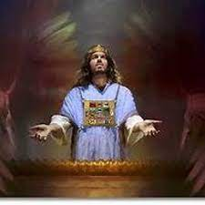
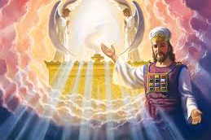
Thankfully, what Jesus did for them,
He does for us! Heb. 4:14-16

Slide 30
Will you partner with God
And Fail Forward?
Mt 26:31-56

