Slide 1
Faith Defined
And Refined.

Slide 2
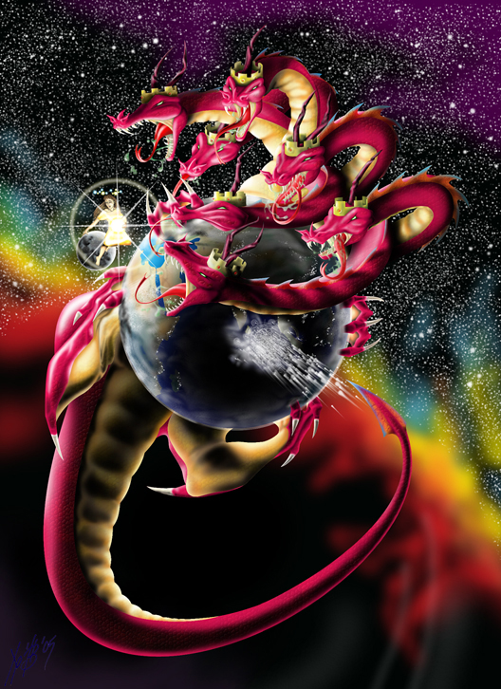
Over the past few months we’ve been discussing the “devices of the Devil” (2 Cor 2:11) and his plan for our lives and world.
“The thief cometh not, but for to steal, and to kill, and to destroy:
Thankfully Jesus reveals:
I’m come that they might have life,
and that they might have it more abundantly.” John 10:10
Revelation 12

Slide 3
While Satan’s power / plans are formidable,
God invites us to partner with Him, promising His Presence, Principles,
and Power to guard, guide, and grow us
into becoming:
“more than conquerors
through him that loved us”. (Ro.8:37)
See also 2 Peter 1:4; 1 Jn 2:14-17; 4:4)

Slide 4
The vehicle of this Victory is revealed in 1 Jn 5:4:
“This is the victory that overcomes the world,
(and the “god of this world” {2 Cor 4:4})
even our faith!”
Since faith is so essential to a victorious life:
What is Faith?
Where (in Who) should my Faith be placed?
How do I do this and grow my Faith?

Slide 5
The What of victorious Faith.
A. The Reality of Faith. Heb 11:1,2
“Now faith is the substance of things hoped for, the evidence of things not seen.
For by it the elders obtained a good report.”
1) “Faith” (pistis) = Conviction, reliance, trust.
From peitho = convinced, persuaded, conciliated

Slide 6
A. The Reality of Victorious Faith.
1) “Faith” (pistis) Conviction, reliance, trust.
2) “Substance” (hypost’asis) substructure, footing.
from hypo: under and/or with
and his’tēmi: to stand, set.
3) “Hoped for” (elpiz’ō) to expect, trust
from elpis’: to anticipate
Jeremiah 17:7 “Blessed is the man that trusteth in the LORD, and whose hope the LORD is.”

Slide 7
A. The Reality of Victorious Faith.
“Faith is the substance of things hoped for…
4) “The evidence” (elegchos’) Proof, conviction.
5) “Not seen” (ou blepō) Not (physically) visible
Not just wishful thinking based on selfish desire,
but assurance/anticipation/conviction
based on the character and promises of God!
“For by it (Faith) the elders received a good report”
(martyreo: testify, witness)

Slide 8
The What of victorious Faith.
A. The Reality of Victorious Faith.
B. The Relationship of Victorious Faith
1) Faith is synonymous with, and essential to,
Trust! (Jn 3:16; Eph. 2:8,9; Heb. 11:1,6)
a) The Bible word for “believe” is the verb Pisteuō,
meaning to trust or commit to something or someone.
➔ It comes from Pistis (translated “Faith” 239x)
and literally means “conviction”.

Slide 9
Faith is synonymous with Trust!
b) The depth (growth) of our relationships are
related to the faith we place in those involved.
This makes Faith/Trust the indispensable ingredient to every healthy relationship!
Jn 3:16 “that whosever believeth in him…”
Eph. 2:8 “By grace are ye saved, through faith!”
Ro. 5:1 “Therefore being justified by faith,
we have peace with God through our Lord Jesus.”

Slide 10
2. The Where of victorious faith.
While many have a misunderstanding of faith,
A. Most have a Misplaced Faith!
1) (Misplaced) Faith in themselves! Ro. 10:1-2
“my heart's desire and prayer to God for Israel is,
that they might be saved. (sōtēri’a: rescued)
For I bear them record that they have a zeal of God,
but not according to knowledge.”
(epignōsis: recognition)
(Hosea 4:6; Jn 8:32)

Slide 11
1) Faith in themselves! Ro. 10:3,4
“For they being ignorant of God's righteousness,
(agnoeō: a {not} & noeo {consider} ➔ to ignore)
and going about to establish (histemi: stand on)
their own righteousness,
have not submitted themselves (hypotasso)
unto the righteousness of God.
For Christ is the end (telos: goal) of the law
for righteousness (dikaiosy’nē: justification)
to every one that believeth.” (pisteuō: commits)

Slide 12
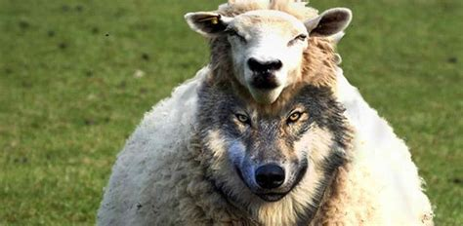
2) (Misplaced) Faith in Others.
Mt 7:15“Beware of false prophets,
which come to you in sheep's clothing,
but inwardly they are ravening wolves.
16 Ye shall know them by their fruits.”
a) False faith give a false hope! Mt 7:22-27
“Many will say unto me in that day, Lord, Lord, have we not…23 Then will I profess unto them,
depart from me, I never knew you…”
Notice how he closes his message! Vs 24-27

Slide 13
a) Misplaced Faith➔ False Hope. Mt 23:15,16
“Woe unto you, scribes and Pharisees, hypocrites!
for ye compass sea and land to make one proselyte,
and when he is made, ye make him twofold more the child of hell than yourselves.
Woe unto you, ye blind guides…”
Mt 15:14 “…they be blind leaders of the blind.
And if the blind lead the blind,
both shall fall into the ditch.”

Slide 14
a) Misplaced Faith ➔ False Hope. Mt 23:15,16
b) Misplaced Faith results in Division. Ro 16:17-18
“mark them which cause divisions…contrary to the doctrine which ye have learned; and avoid them.
For they that are such serve not our Lord Jesus Christ, but their own belly;
and by good words and fair speeches
deceive the hearts of the simple.”
(akakos: unsuspecting)

Slide 15
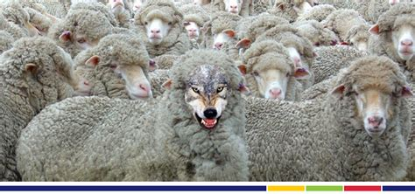
c) Misplaced faith brings destruction!
2 Pt 2:1 “But there were false prophets among them,
even as there shall be false teachers among you,
who privily shall bring in damnable heresies,
(hairesis: disunion, division)
And many shall follow their pernicious ways..”
Apōleia: destructive

Slide 16
Satan, Self, and Others offer us a misplaced faith:
B. God offers us a Miraculous Faith. Eph 2:8
“For by grace are ye saved (sozo: delivered, protected, preserved) through faith;
and that not of yourselves:
it is the gift (Dōron: offering, sacrifice) of God:”
Gal. 5:22 “The fruit of the Spirit is …faith…”

Slide 17
1 Jn 5:4 “This is the victory that overcomes the world, even our faith!”
1) Definition: What is “victorious” Faith?
It’s a reality (conviction, confidence)
That produces a Relationship.
➔Have you recognized God’s gift of Grace?
➔Have you responded to it by faith?
Romans 5:1; 2 Cor 4:4,6; Eph. 2:8,9

Slide 18
2) Destination: Where (in Who) should my Faith be placed for Victorious living?
In the only truly reliable source
based on the Character and Nature of God.
Titus 1:1,2 “…according to the faith of God's elect, and the acknowledging of the truth
which is after godliness;
In hope of eternal life, which God, that cannot lie,
promised before the world began”

Slide 19
Faith, like seed, must be rightly planted in order to rightly produce!
Mt 17:19 “Why could not we cast him out?
20 Jesus said unto them,
Because of your unbelief:”
(apistia) Their “faith” was in their ability
instead of God’s!
vs 17 “O faithless and perverse generation”

Slide 20
1 John 5:4 “this is the victory that overcometh the world, even our faith.”
1) The Definition: What is your faith?
2) The Destination: Where is your faith?
3) The Demonstration/ Application:
How are you developing your faith?
Heb. 10:37 “Now the just shall live by faith…”
Heb. 11:1-2

Slide 21
Lk 17:5-10 “Lord, increase our faith.
His answered focused on
The Power of Faith: vs 6: “if ye had faith as a grain of mustard seed, ye might say unto this sycamine tree, Be plucked up by the root, and … planted in the sea;
and it should obey you.”

Slide 22
His answered focused on
The Process of Faith involved:
(1) Obedient actions: 7-9 “Doth he thank
that servant because he did the things that were
commanded him? I trow (think) not”
Humble attitudes. Vs 10: “So likewise ye, when ye shall have done all those things
which are commanded you, say,
We … have done that which was our duty to do.”

Slide 23
Heb 11:6 “without faith it’s impossible to please him.”
What do your actions and attitudes say about your faith?

Slide 24
Where are you planting your faith?
What are you doing to nurture it?
John 15:1-16; 2 Peter 1; Pr. 3:1-10

