Slide 1
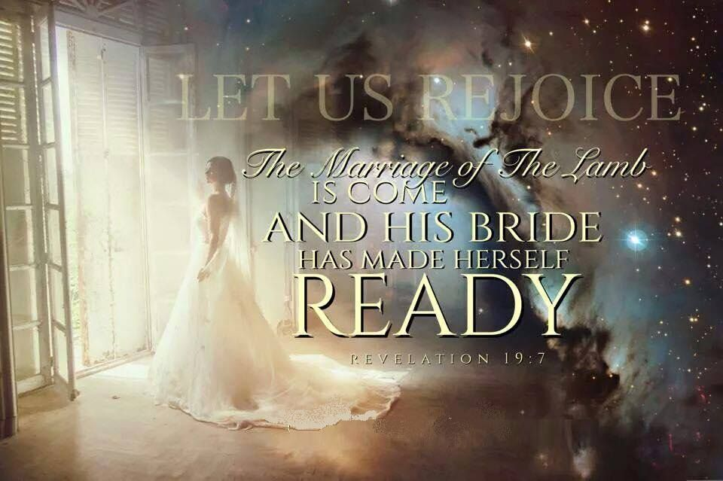
Last week we discussed the rapture of the church and the importance of being “ready” for Christ’s return.
Revelation. 19:7
1 Jn 2:28-3:3

Slide 2
We do this by “abiding in him”. (1 Jn 2:28-3:3)
This was on Jesus’ heart as he walked toward Gethsemane! (Jn 15)
To the degree that we “abide in him” we will become fruitful, (Jn 15:1-5; Gal. 5:22-24)
and fulfil the purpose for our lives. (Jn 15:16; Ro. 8:29)
2 Cor 5:7 “For we walk by faith, not by sight:…
9 Wherefore we labor, that, whether present or absent,
we may be accepted of him.
10 For we must all appear before the judgement seat of Christ…“

Slide 3
Jesus’ final promise reiterated this!
Rev 22:12 “Behold, I come quickly; (tachu: suddenly)
and my reward (misthos: pay for service) is with me,
to give every man according as his work shall be.”
(1 Cor 3:9-15; 2 Tim. 4:1-8)
Mt 6:19-22 reveals that what we do with our treasures (giving) reveals our heart (priorities).
“lay not up treasures on earth…but lay up for yourselves treasures in heaven,… For where your treasure is,
there will your heart be also.”

Slide 4
2Cor. 8:8 tells that our giving is not an obligation,
But an opportunity to
“prove the sincerity of our love.”
2 Cor. 8,9 is about a special offering for a special need that presented a special opportunity.
(See Acts 11:27-30; Ro. 15:25-28)
The Corinthian Church initially promised to help meet this need, but failed to follow through. (8:10,11)

Slide 5
Paul used the example of the Macedonian Churches to inspire them to partner with God
and invest in God’s Plan.
Grace is related to giving.
“Grace” is used 7 times in these two chapters and literally means: “The divine influence on our heart,
and its reflection in the life;
including gratitude!”
It (charis) comes from chai’rō meaning Cheerful, Joyful, Blessed!

Slide 6
Phil. 2:13 “It is God which worketh in you both to will, and to do of His good pleasure”.
Grace involves both recognizing and responding to God’s promptings such that
His will is accomplished in & through us,
resulting in His pleasure (Rev. 4:11)
and our Joy. (2 Cor 9:7)

Slide 7
Understanding Faith Promise Giving:
1. Faith begins with God’s Grace and involves:
A. Recognizing God’s Will (purposes)
1) What does God want to accomplish? Jn 5:17; 1 Cor. 3:9
a) Satan seeks to deceive/ blind us to this. (2 Cor. 4:4)
b) The world seeks to distract us. (Mark 4:19; Ro. 12:1,2)
c) Our own selfishness blinds/binds us.
(Jer. 17:9; Is. 55:7,8; Ph 3:17-20)
Pr 5:22 “His own iniquities shall take the wicked himself,
and he shall be holden with the cords of his sins.”

Slide 8
1. Faith begins with God’s Grace and involves:
A. Recognizing God’s Will (purposes)
1) How can we recognize God’s purposes?
a) Relinquish control Ro. 12:1
“present your bodies a living sacrifice”
2 Cor 8:5 “they first gave themselves to the Lord”
b) Resist rationalization. Ro 12:2
“be not conformed to this world”

Slide 9
1. Faith begins with God’s Grace and involves:
A. Recognizing God’s Will (purposes)
1) How can we recognize God’s purposes? Ro. 12:1,2
a) Relinquish control 12:1
b) Resist rationalization. 12:2
c) Renew your mind. 12:2 “but be ye
transformed by the renewing of your mind,
that ye may prove what is that good,
and acceptable and perfect will of God”

Slide 10
1. Faith begins with God’s Grace and involves:
A. Recognizing God’s Will (purposes)
B. Responding in obedience to God.
1) God works around us, and within us,
so that He can work through us! (Ph. 2:12-14)
2) Faith, Grace, and peace involves a
partnership. (Mt. 11:29; 1 Cor 3:9; 2 Cor 8:1-4)
Heb. 11:6 “without faith it is impossible to please him…”
Rev. 4:11 “…for thy pleasure they are and were created”

Slide 11
Understanding Faith Promise Giving:
1. Faith (Recognizing & responding to God)
2. Promise (Commitment): 2 Cor 8:10-12
A. This is the process (partnership) of faith!
1. With God. 5 “first gave their own selves to the Lord,”
2. With God’s people. Vs. 5 “and unto us by the will of God.
6 Insomuch that we desired Titus, that as he had begun,
so he would also finish in you the same grace also. “
1 Cor 3:9 “We are laborers together with God!”

Slide 12
Understanding Faith Promise Giving:
1. Faith (Recognizing & responding to God)
2. Promise (Commitment): 2 Cor 8:
3. Giving (obedient action)
“faith without works is dead” James 2:17, 20
A. This demonstrates the “Proof” (evidence) of our faith.
2 Cor. 8:8 “I speak not by commandment,
but by occasion of the forwardness of others,
and to prove the sincerity of your love.”

Slide 13
In fact, the Bible mentions giving more than any other topic. It mentions love 522x, prayer 544x, heaven 582x,
and giving 1547x!
I believe it emphasizes our giving because it’s a spiritual barometer.
That’s why almost half of Jesus’ parables involved money!

Slide 14
3. Giving (obedient action)
A. This demonstrates the “Proof” (evidence) of our
faith. (and Priorities!)
1) You can give without loving,
but you can’t really love, without giving!
B. Notice how God “proved” his love:
Jn 3:16 “God so loved…that he gave…”
Ro 5:8 “God commendeth his love toward us…”
2 Cor 8:9 “For ye know the grace of our Lord Jesus Christ, that, though he was rich, yet for your sakes he became poor,
that ye through his poverty might be rich.”

Slide 15
2) God’s love (giving) should motivate our own!
2 Cor. 5:14,15 “For the love of Christ constraineth us; because we thus judge, that if one died for all, then were all dead:
And that he died for all,
that they which live should not henceforth live unto themselves, but unto him which died for them”
Jn 14:15 “if you love me, keep my commandments…
21 “He that hath my commandment and keepeth thim.. Loveth me”
Gal 2:20 “I am crucified with Christ: nevertheless I live; yet not I,
but Christ liveth in me: and the life which I now live in the flesh
I live by the faith of the Son of God, who loved me,
and gave himself for me.”

Slide 16
1. Faith 2. Promise 3. Giving
God’s love (giving) should motivate our own!
2 Cor 8:11 “Now therefore perform the doing of it;
that as there was a readiness to will,
so there may be a performance also out of that which ye have.”
12 For if there be first a willing mind, it is accepted according to that a man hath, and not according to that he hath not.
Vs 24 Wherefore shew ye to them, and before the churches,
the proof of your love….”
Aka: Just do it! (James 1:22-24)

Slide 17
1. Faith 2. Promise 3. Giving
Before there can be a harvest, someone has to prepare the soil and plant the seeds. (Gal. 6:7,8)
Our gratitude is demonstrated by our giving (sharing).
That’s why we call it “Thanks-Giving”!
God uses this same “planting” principle to describe our “faith promise giving.” 2 Cor 9:6-15
6 “He which soweth sparingly shall reap also sparingly;
and he which soweth bountifully shall reap bountifully.

Slide 18
7 “Every man according as he purposeth in his heart, so let him give; not grudgingly, or of necessity:
For God loveth a cheerful giver.
8 And God is able to make all grace abound toward you; that ye, always having all sufficiency in all things,
may abound to every good work:
9 He hath dispersed abroad; he hath given to the poor:
his righteousness remaineth for ever.
10 Now he that ministers (furnishes/supplies) seed to the sower both minister bread for your food, and multiply your seed sown, and increase the fruits of your righteousness;

Slide 19
11 Being enriched in every thing to all bountifulness,
which causes through us thanksgiving to God.
13 Whiles by the experiment of this ministration they glorify God for your professed subjection unto the gospel of Christ, and for your liberal distribution unto them…;
14 And by their prayer for you, which long after you for the exceeding grace of God in you.
15 Thanks be unto God for his unspeakable gift.”
(The Privilege of partnering with Him!)

Slide 20
Faith Promise Giving involves:
1) Faith: Recognizing/Responding to God’s Prompting
Will you prayerfully seek what God wants to do through you to fulfil the Great Commission?
2) Promise: Purposing to pursue the process of Partnership.
Will you promise God that you will partner with Him and others (Missionaries) to this end?
3) Giving: Demonstrating the Proof of our Love.
If God is faithful to provide,
will you be faithful to honor your promise to Him?

Slide 21
Isaiah 6:8 “I heard the voice of the Lord, saying,
Whom shall I send, and who will go for us?
send me!”
Then said I, Here am I;

Slide 22
John 20:21
“Then said Jesus to them,
Peace be unto you:
as my Father hath sent me,
even so send I you.”
Mt. 28:18-20

Slide 23
Missionary: “One Sent”
God calls all of His people to “follow Him”
and to be willing to make any adjustments
that may be necessary in order to do so.
(Ro. 12:1,2; Heb. 12:1,2)
“Count the cost” Luke 14:25-35
33 “So likewise, whosoever he be of you that forsaketh not all that he hath, he cannot be my disciple.”
Apotassō: arrange in proper order!

Slide 24
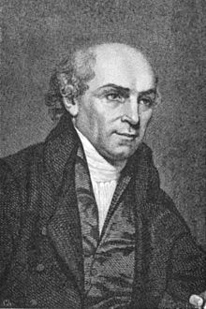
“I was once young and now I am old, but not once have I been witness to God’s failure to supply my need when first I had given for the furtherance of His Work!
He has never failed in His promise,
so I cannot fail in my service to Him.”

Slide 25
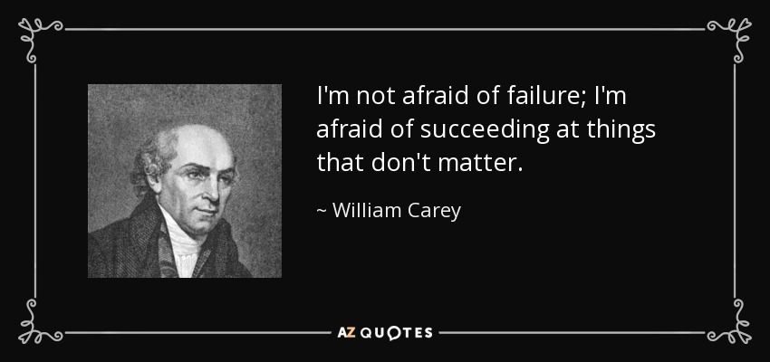
I’m not afraid of failure;
I’m afraid of
Succeeding at things
that don’t matter!”
William Carey
(1761-1834)

